Slide 1
Using Regression Analysis to Determine Consumer Demand for Supply Chain Efficiency: Testing the effect of mediators and moderators using SAS
By Dr. Jeanette Shutay
January 20, 2009

Slide 2
Purpose of the Presentation
To provide real-life examples, using SAS, of how to test the effect of mediators and moderators in forecasting for supply chain efficiency.

Slide 3
Acronyms
Independent variable (I.V.)
Dependent variable (D.V.)
Moderator variable (Mod. V.)
Mediator variable (Med. V.)

Slide 4
What is a Moderator Variable?
A moderator variable is a variable that influences the relationship between two other variables, therefore resulting in an interaction effect.
A moderator variable is often thought of as a confounding variable if it is not statistically accounted for during the data analysis process or if it is not controlled for in the data sampling process (e.g., held constant).
For example, the effect of a food promotion (I.V.) on large drink sales (D.V.) depends on the type of promotion (Mod.V.). Or, the effect of a price promotion (I.V.) on large drink sales (D.V) depends on whether or not the medium drink is also featured in the promotion (Mod. V.).

Slide 5
How Do I Determine if a Variable is a Moderator Variable?
In most cases, the analyst will determine which variables may be possible moderators based on theory, business experience, and or common sense. If a particular variable is expected to be a moderator, then that variable is statistically tested for moderation effects. This can be done in the following steps:
  Center or standardize all of the scaled predictor variables to be included in the model. This helps deal with multicollinearity, which is often present when interaction terms are created in models with moderators.
  If the moderator is qualitative, then code the moderator using either dummy coding (i.e. 1 and 0) or contrast coding (i.e. 1 and -1).
  Create the interaction terms by multiplying each independent variable by the transformed (e.g. centered, coded, etc.) moderator variable(s).
  Run the regression analysis by entering the interaction term(s) with the independent variables into the prediction model.

Slide 6
Real-Life Example Using SAS:
Testing for Moderation Effects
Let’s see if the ability of fry sales to predict large drinks sales depends on the restaurant type (Restaurant A versus Restaurant B). The independent variable is fry sales, the moderator is restaurant type and the dependent variable is large drink sales. The SAS code is provided below:
/*calculating the mean for the scaled variable*/
proc means data=perm.moderator;
var unit_fry; run;
/*subtracting the mean from each observation to center the variable*/
data centered;
set perm.moderator;
cen_fry = unit_fry - 96.01; run;
/*creating the interaction term*/
data centered;
set centered;
interact = rest_typ * cen_fry; run;
/* running the regression analyses*/
proc reg data=centered;
model unit_cuplarge = interact rest_typ cen_fry; run;
quit;

Slide 7
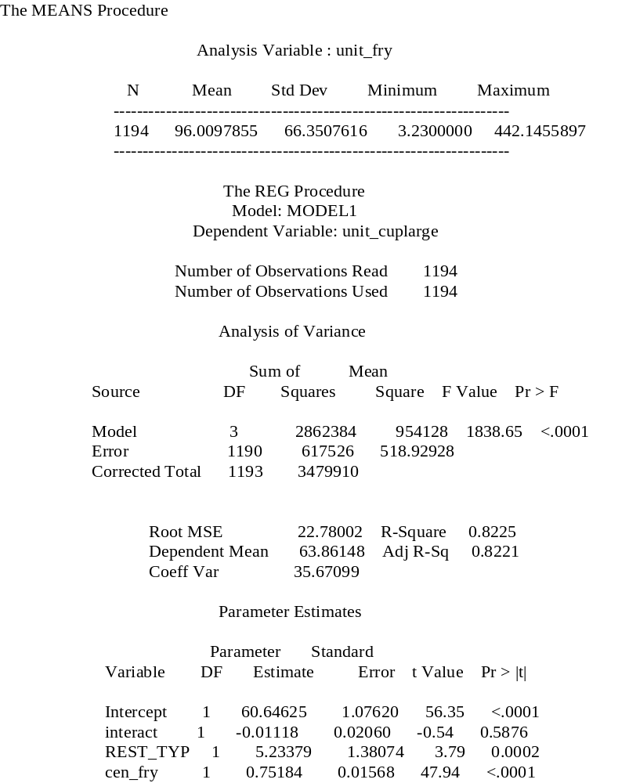
SAS Output: Moderator Results
The moderator (interact) is not statistically significant (p = .5876) and is therefore not a moderator variable. Therefore the ability of fry sales to predict large drink sales does not depend on the restaurant type (Restaurant A versus Restaurant B).

Slide 8
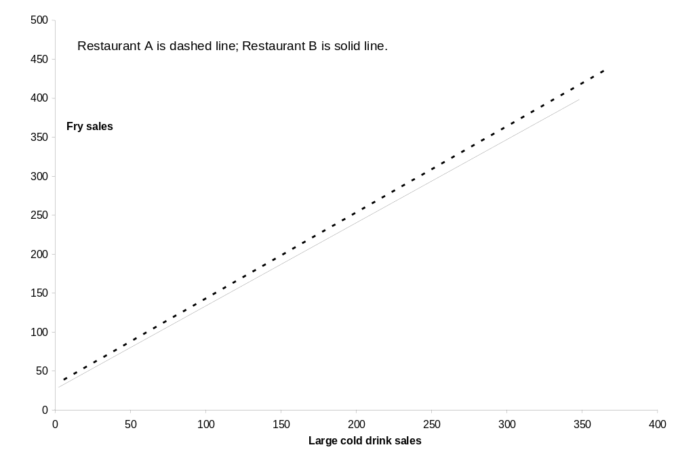
Visual Display of Regression Slopes by Restaurant Type

Slide 9
What is a Mediator Variable?
A mediator variable is a variable that accounts for the relationship between a predictor (e.g., I.V.) and a predicted variable (e.g., D.V.). In other words, it partially or fully explains the relationship between two variables.
A potential mediator variable must be measured and included as a predictor in the analysis so that the analyst can determine its influence, if any. Once this is done, the “true” relationship between the independent variable and the dependent variable can be determined.
For example, the effect of a price promotion (I.V.) on large drinks sales (D.V.) is mediated by the price point of medium drinks (Med. V.). In other words, in order to get the true effect of a price promotion on large drinks sales, one must take into account the pricing of competing items in order to determine if the change in large drink sales is due completely to the price promotion of the large drink or if it is also due to price changes in competing items (e.g. cannibalization).

Slide 10
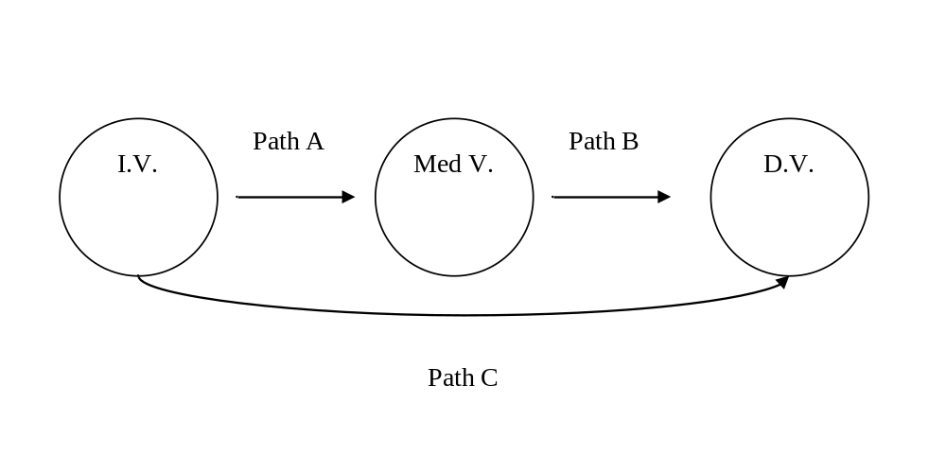
How Do I Determine if a Variable is a Mediator Variable?
As with moderators, one typically has a certain expectation based on theory, business experience or common sense. Two requirements must be met in order for a variable to be considered a potential mediator: (1) it has to be significantly related to the predictors and (2) it has to be significantly related to the outcome, or dependent variable. See the diagram below for a map of the relationships between the variables.

Slide 11
Steps for Testing Mediation
Once the mediators have been selected, the following steps need to be taken:
  Step 1: Test to see if the predictor variables are actually related to the dependent variable by running a regression analysis (Path C). If not, it does not make sense to talk about whether or not the effect of the predictors is mediated by another variable because there is no effect to be mediated. If the predictor variables are related to the dependent variable, then move to Step 2.
  Step 2: Determine if the predictor variables are related to the mediator variable(s). If they are not, then we know that the variable is not a mediator (Path A). If there is a significant relationship, the move to Step 3.
  Step 3: Determine if the mediator is related to the dependent variable by entering the mediator as a predictor into a regression model (Path B). If the mediator significantly predicts the dependent variable, then the second requirement for mediation has been met. Move to Step 4.
  Step 4: Enter the predictors with the mediator(s). If the effect of the predictors has changed from Step 1 (Path C), then we know that the mediator has had an impact on the relationship between the predictors and the outcome. However, we still don’t know if the mediation effect was significant or specifically how much variance was mediated.

Slide 12
Computations
In order to test whether or not the mediator(s) significantly mediates the relationship between each of the independent variables and the dependent variable, then the following calculation needs to be made:
  Multiply the unstandardized regression coefficient from path A and path B and divide that product by the square root of b²sa² + a²sb² + sa²sb² where a and b are unstandardized regression weights and sa and sb are their standard errors.
In order to determine the amount of variance accounted for by the mediator, one can use the following formula:
  ab/c where the unstandardized regression coefficient for path A is multiplied by the unstandardized regression coefficient for path B and divided by the unstandardized regression coefficient for path C.

Slide 13
Real-Life Example Using SAS:
Testing for Mediation Effects
Suppose we wanted to determine whether or not the effect of fry sales on large drinks sales is mediated by the price of medium drinks. For example, if the fry is promoted and therefore its sales rates are higher, one would expect the large drinks sales to also increase assuming that the price of medium drinks remains constant. However, this isn’t always the case. Therefore we want to see if the relationship between fry sales and large drinks sales is independent of medium drink price. If not, what is the effect? The SAS code is provided below.
/* Step 1 and Path C */
proc reg data=perm.mediator;
title 'Step 1 and Path C';
model unit_cuplarge=unit_fry; run;
/* Step 2 and Path A */
proc reg data=perm.mediator;
title 'Step 2 and Path A';
model cupmed_price=unit_fry; run;
/* Step 3 and Path B */
proc reg data=perm.mediator;
title 'Step 3 and Path B';
model unit_cuplarge=cupmed_price; run;
/* Step 4 */
proc reg data=perm.mediator;
title 'Step 4';
model unit_cuplarge=cupmed_price unit_fry; run;
quit;
Path A
Path B
Fry sales
Medium
drink sales
Large
drink sales
Path C

Slide 14
SAS Output: Mediator Results for Step 1
Step 1 and Path C
The REG Procedure
Model: MODEL1
Step 1 (Path C) is statistically significant (p < .0001) and therefore the predictor variable (fry sales) is related to the dependent variable (large drink sales).
Dependent Varia
ble: unit_cup
large
Number of Observations Read 999
Number of Observations Used
978
Number of Observations with Missing Values 21
Analysis of Variance
Sum of Me
an
Source DF Squares Square F Value Pr > F
Model 1 206503 206503 5104.64 <.0001
Error 976
39483 40.45393
Corrected Total 977 245986
Root MSE 6.36034 R
-
Square 0.8395
Dependent Mean 73.29008 Adj R
Coeff Var 8.67831
-
Sq
0.8393
Parameter Estimates
Variable
Parameter Standard
DF Estimate Error t Value Pr > |t|
Intercept 1
-
0.43589 1.05175
-
0.41 0.6786
unit_fry
1 0.66939 0.00937 71.45 <.0001

Slide 15
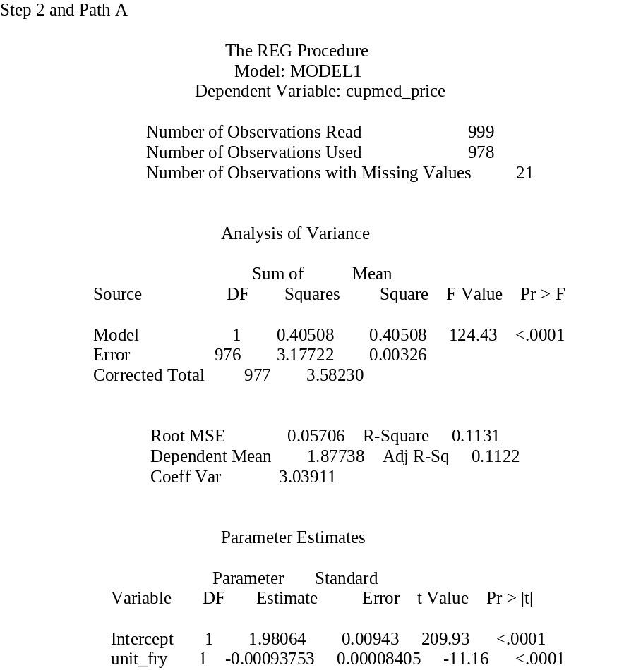
SAS Output: Mediator Results for Step 2
Step 2 (Path A) is statistically significant (p < .0001) and therefore the predictor variable (fry sales) is related to the mediator variable (medium drink price).

Slide 16
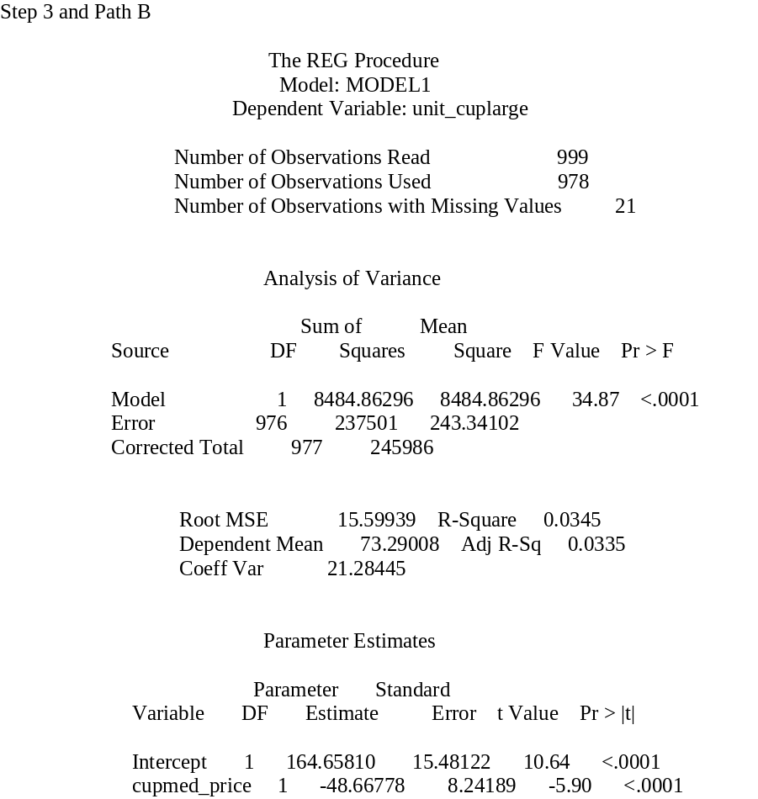
SAS Output: Mediator Results for Step 3
Step 3 (Path B) is statistically significant (p < .0001) and therefore the mediator variable (medium drink price) is related to the dependent variable (large drink sales).

Slide 17
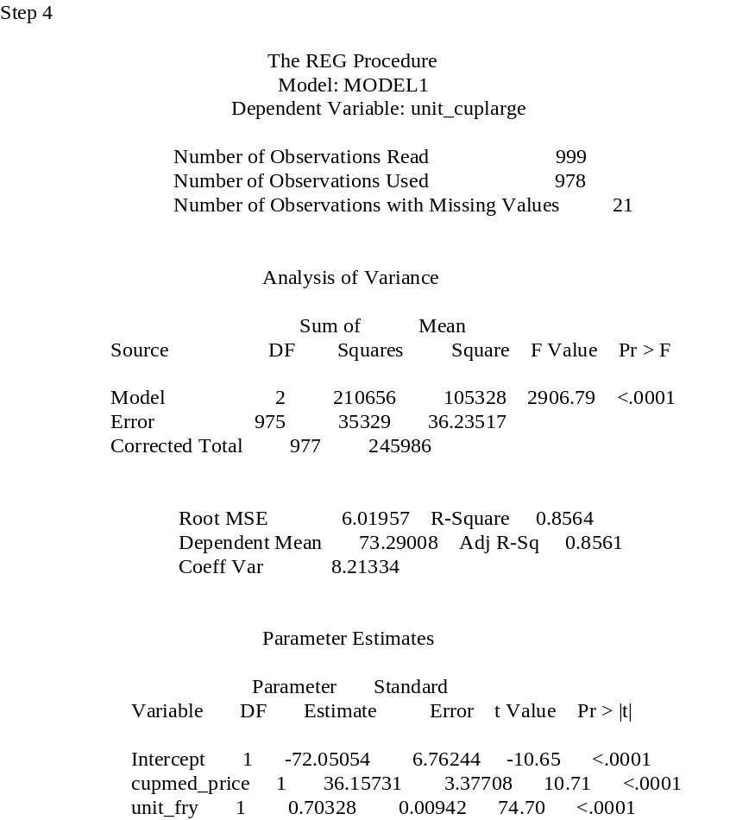
SAS Output: Mediator Results for Step 4
Step 4 – If the effect of the predictor changed from Step 1 (Path C) to Step 4, then we know that the mediator has had an impact on the relationship between the predictors and the outcome. The parameter estimate changed from 0.669 to 0.703.
However, we don’t necessarily know if the mediation effect was significant or specifically how much variance was mediated.

Slide 18
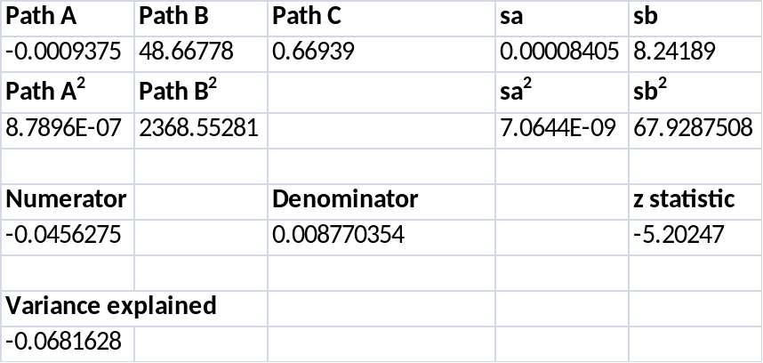
Interpretation of Mediator Results
Using the formulas presented on Slide 12, the z-score for the mediator is -5.20 (p < .01) and the amount of variance that the mediator explained (medium drink price) with regard to the relationship between fry sales and large drink sales was 6.8%.

Slide 19

Questions?

