Slide 1
0xFFFFFFFF
0xF80000000
PAGE_OFFSET + 896MB
High
Memory
0xc0000000
PAGE_OFFSET
User Stack
%esp
Memory Mapped region for shared libraries
0x40000000
Low
Memory
brk
Runtime heap(via malloc)
copy
Uninitialized data(.bss)
Initialized data(.data)
swapper_pd_dir (1kb)
Program binary code(.text)
0x00101000
Forbidden
0x00100000
initialization
1MB for BIOS
Process Virtual Address
Physical Address

Slide 2
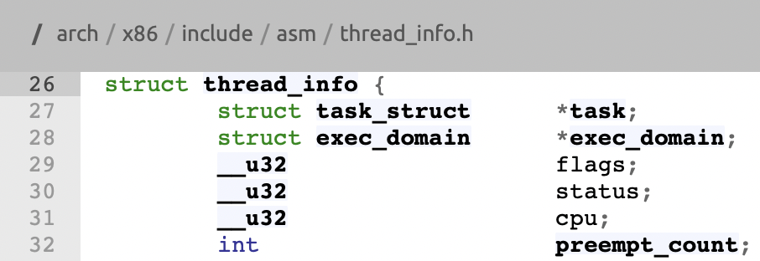
. . .
Kernel Stack
(8kb = 4kb page *2)
%esp
(%esp) & ~(THREAD_SIZE-1)
address of task_struct of current task
. . .

Slide 3
GDTR or LDTR
47
15
0
base
limit
15
3
2
0
Index
TI
RPL
Segment Selector

