Slide 1
IoT Enterprise Architecture
Layer 4
UI/UX Design – Web / Mobile User Interface
Layer 3
Database
Layer 2
Data Processing
Layer 1
Sensor Data Ingestion

Slide 2
KOSMOS - IoT Enterprise Architecture
Layer 4
Web / Mobile User
Dashboard Live Data
Dashboard Historical Data <30 days
Apache Spark – Analytic Query >=30days
User-Config/ Device Config / Alerts / Audit log
Request Report
Request Report
Request Response
Write/Update Read
Layer 3
Database Storage
(cloud/server)
Database In-memory(RAM)
Apache IoT DB – Hot
Raw/Processed Data
ClickHouse - Warm
PostgreSQL
Redis Cluster
Cloud bucket - Cold
Layer 2
Data Processing
Data Streaming
Apache flink
Apache kafka
NATS JetStream
Layer 1
Data Ingestion
Modbus TCP
MQTT
OPC-UA
(client/server)
OPC-UA Pub/Sub
Ethernet/IP
Profinet (IRT)

Slide 3
KOSMOS - IoT Enterprise Architecture
Layer 4
Web / Mobile User
Dashboard Live Data
Dashboard Historical Data <30 days
Apache Spark – Analytic Query >=30days
User-Config/ Device Config / Alerts / Audit log
Request Report
Request Report
Request Response
Write/Update Read
Layer 3
Database Storage
(cloud/server)
Database In-memory(RAM)
Apache IoT DB – Hot
Raw/Processed Data
ClickHouse - Warm
PostgreSQL
Redis Cluster
Cloud bucket - Cold
Layer 2
Data Processing
Data Streaming
Apache flink
Apache kafka
NATS JetStream
Layer 1
Data Ingestion
Modbus TCP
MQTT
OPC-UA
(client/server)
OPC-UA Pub/Sub
Ethernet/IP
Profinet (IRT)
Layer 0
Data Aggregator / Gateway Device

Slide 4
Layer 1
Data Ingestion – Protocol Comparision
Protocol | Usecase | Security | Datamodel | Data Freq | Max Data Rate | Max Data Size/Register | Round Trip Time | Latency
Modbus TCP | Sensors/Meters | No | Simple registers | 1-100Hz | 100 Mbps | 125 registers (250 bytes) | 2-10ms | 1-5ms
MQTT | IoT Cloud | Yes | Topic-based | 1-100Hz | Network dependent (100Mbps) | Upto 256MB | 10-50ms | 5-30ms
OPC-UA (client/server) | Industrial Integration | Yes | Structured-Object oriented | 1-200Hz | 10-100 Mbps | 64 KB | 5-20ms | 3-10ms
OPC-UA (pub/sub) |  |  |  | Upto 1kHz | 100 Mbps – 1Gbps | Upto 1MB | <2ms | <1ms
Ethernet IP | PLC Control | Limited | CIP Model – object oriented | 100-1000Hz | 100 Mbps | 1500 bytes/frame | 1-10ms | 1-5ms
Profinet | Factory Automation | Limited | Device Model | 1-4kHz | 100 Mbps | 1440 bytes/frame | <1ms | 250us-1ms

Slide 5
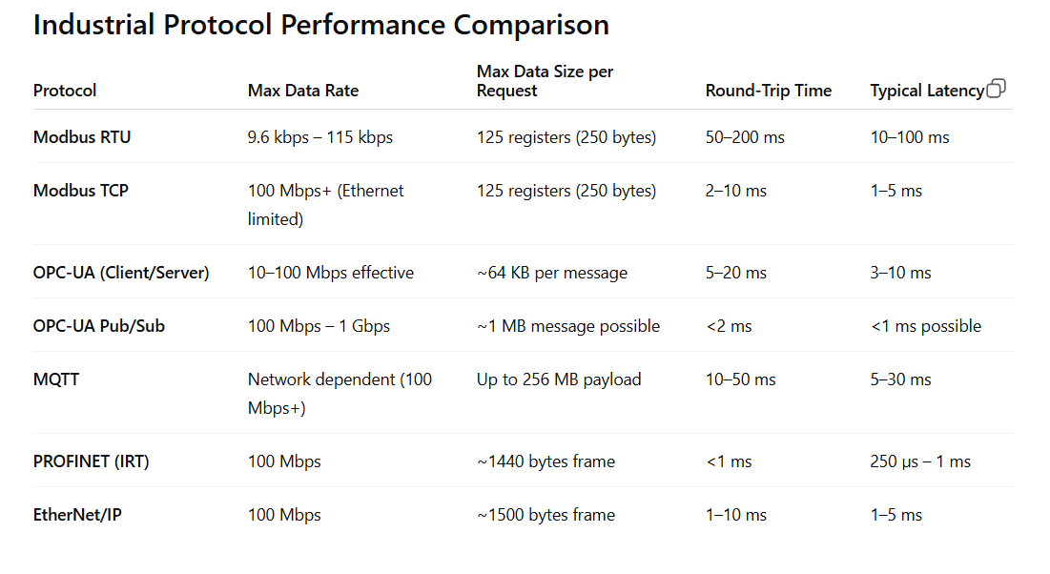
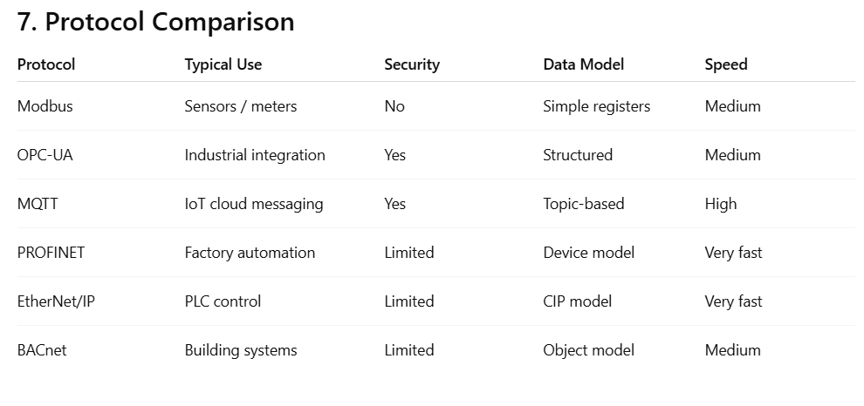

Slide 6
