Slide 1
200427_project_curry
File created on: 02.05.20 12:28:15 GMT+02:00

Slide 2
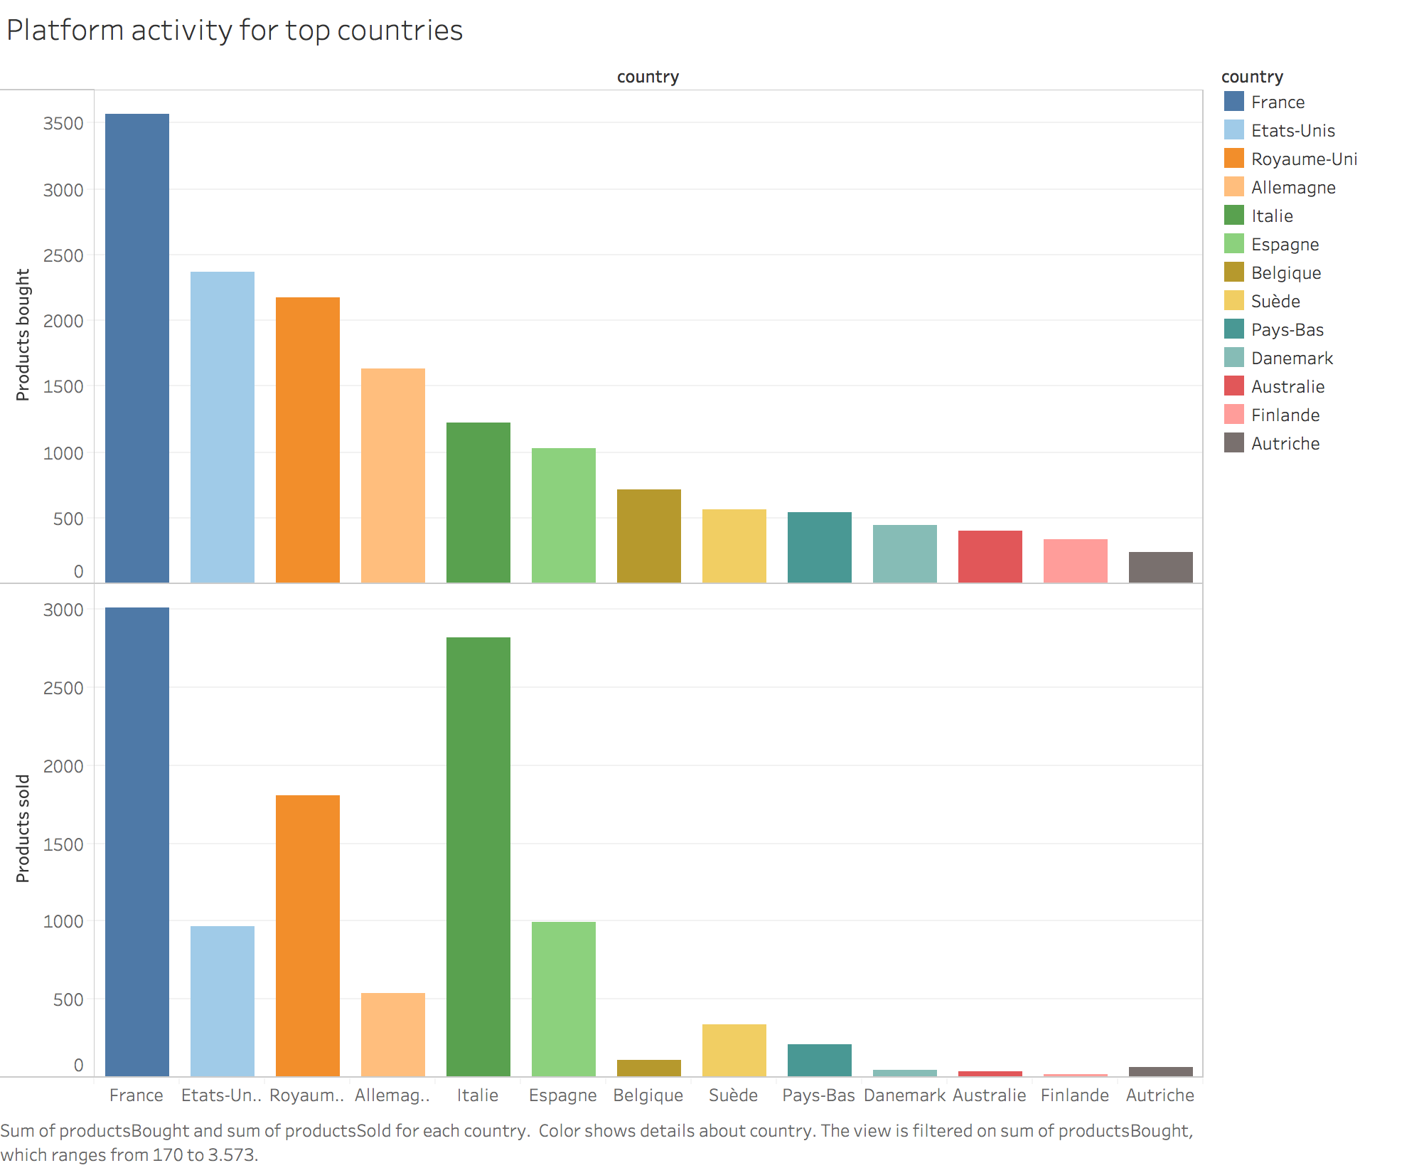

Slide 3
