Slide 1



The Challenge
Provide reporting and diagnostic tools to help gain insights and understanding from multiple data sources.
Provide an extendible architecture to allow for new reports and visualizations

Slide 2
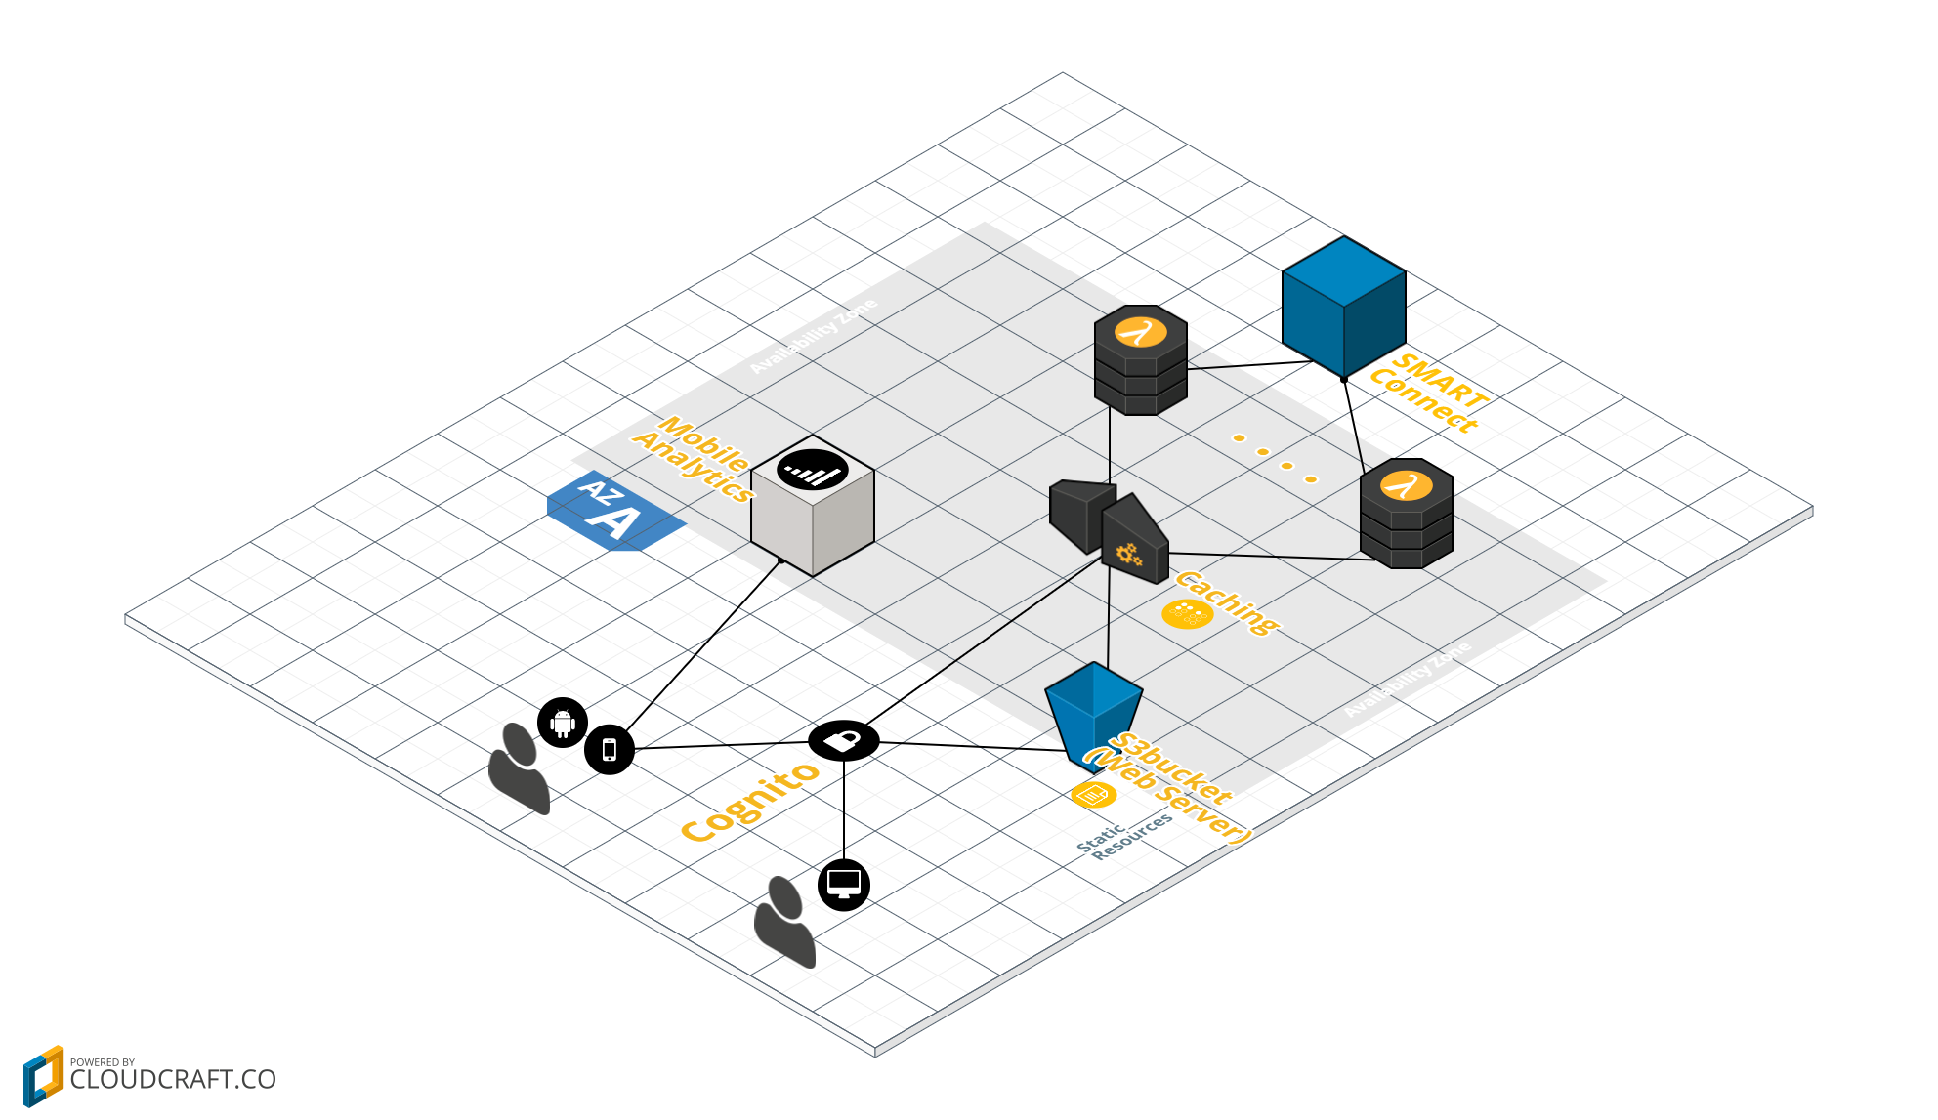
Current Solution

Slide 3
Further Opportunities
Quickly add additional data views via new endpoints
Provide additional drill-down capabilities into data sets
Add predictive capabilities through specialized microservices

