Slide 1

Hearthstone Arena Deck Builder
By Jordan Silver

Slide 2
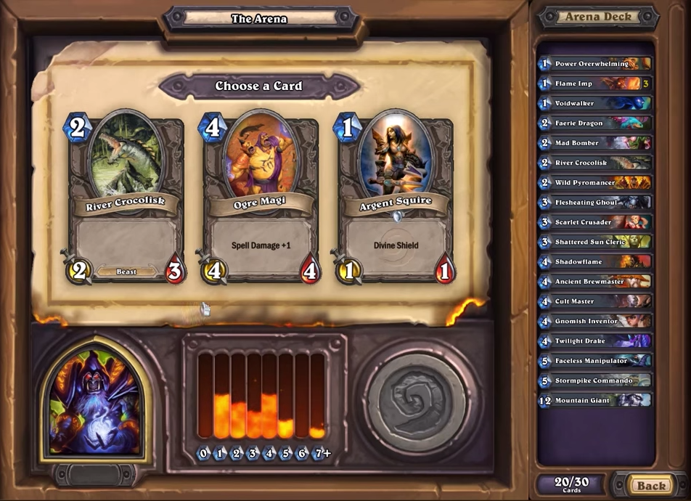

Slide 3
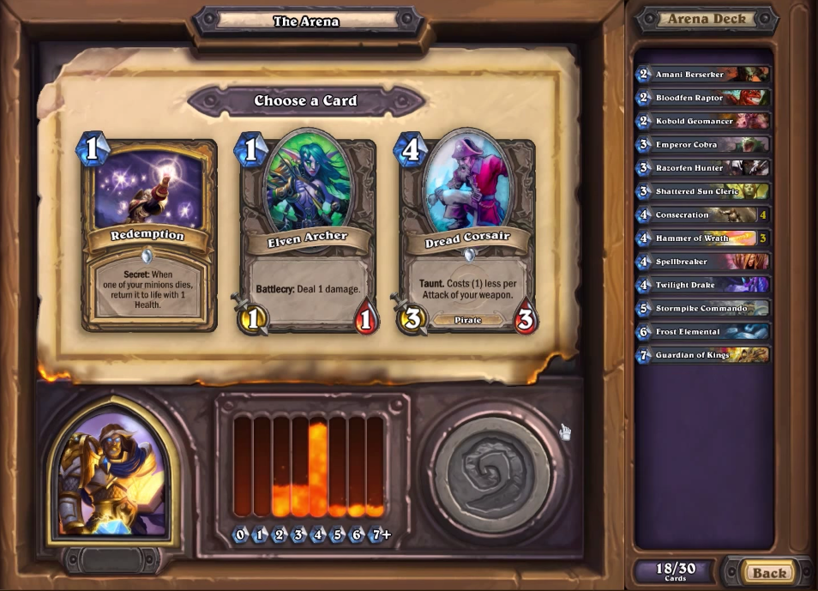
Mana Curve
Deck View

