Slide 1

U.S. DEPARTMENT OF COMMERCE
INTERNATIONAL TRADE ADMINISTRATION
G20 Digital & Trade Ministers
GDP and U.S. Bilateral Trade Profiles
Internal Reference | Trade data: 2025 full year (goods basis) | July 16, 2026
U.S. Department of Commerce | International Trade Administration
trade.gov

Slide 2
Summary — GDP & U.S. Bilateral Goods Trade
USD billions · GDP 2025 · trade 2025 (goods) · part 1 of 2
Country
GDP (2025)
U.S. exports to
U.S. imports from
U.S. bilateral balance
Argentina
$681.5B
$9.9B
$8.3B
+$1.6B
Australia
$1,840.0B
$33.7B
$29.1B
+$4.6B
Brazil
$2,280.0B
$54.4B
$39.9B
+$14.5B
Canada
$2,284.0B
$336.5B
$383.0B
−$46.5B
China
$19,399.0B
$106.3B
$308.4B
−$202.1B
France
$3,362.0B
$44.4B
$61.1B
−$16.7B
Germany
$5,014.0B
$82.7B
$159.0B
−$76.3B
India
$4,125.0B
$45.6B
$103.8B
−$58.2B
Indonesia
$1,443.0B
$11.0B
$34.7B
−$23.7B
Italy
$2,544.0B
$43.7B
$78.7B
−$35.0B
Negative U.S. bilateral balance = U.S. goods deficit; positive = U.S. surplus. Bilateral columns measure trade with the United States, so the U.S. row shows N/A — the U.S. country page reports world totals.
U.S. Department of Commerce | International Trade Administration
trade.gov
GDP: IMF WEO 2025 · U.S. goods trade: U.S. Census 2025 · officeholders verified 2026-07-16

Slide 3
Summary — GDP & U.S. Bilateral Goods Trade
USD billions · GDP 2025 · trade 2025 (goods) · part 2 of 2
Country
GDP (2025)
U.S. exports to
U.S. imports from
U.S. bilateral balance
Japan
$4,280.0B
$82.1B
$146.0B
−$63.9B
Mexico
$1,830.0B
$338.0B
$534.9B
−$196.9B
Poland
$1,040.0B
$14.1B
$14.5B
−$0.4B
Russia
$2,541.0B
$0.6B
$3.8B
−$3.2B
Saudi Arabia
$1,277.0B
$14.1B
$10.5B
+$3.6B
South Korea
$1,859.0B
$68.8B
$125.2B
−$56.4B
Türkiye
$1,565.0B
$20.4B
$16.4B
+$4.0B
United Kingdom
$3,959.0B
$97.0B
$64.8B
+$32.2B
United States
$30,620.0B
N/A
N/A
N/A
Negative U.S. bilateral balance = U.S. goods deficit; positive = U.S. surplus. Bilateral columns measure trade with the United States, so the U.S. row shows N/A — the U.S. country page reports world totals.
U.S. Department of Commerce | International Trade Administration
trade.gov
GDP: IMF WEO 2025 · U.S. goods trade: U.S. Census 2025 · officeholders verified 2026-07-16

Slide 4

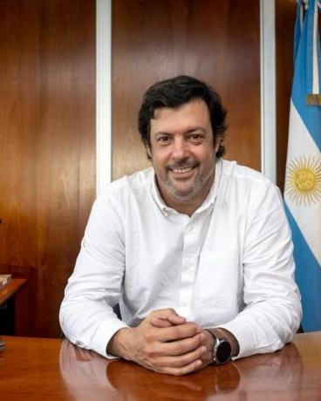
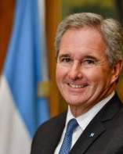
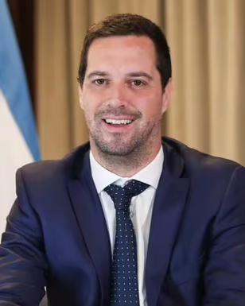
Argentina
DIGITAL / TECHNOLOGY
TRADE & ECONOMY
Darío Leandro Genua
NOMINAL GDP (2025)
$681.5B
Secretary of Innovation, Science and Technology
Jefatura de Gabinete de Ministros (Chief of Cabinet's Office) · Assumed office: Jun 2024
Darío Leandro Genua, a business-administration graduate of the Universidad Catolica Argentina with a postgraduate degree in information systems and administrative processes, became Secretary of Innovation, Science and Technology in June 2024, succeeding Alejandro Cosentino. He previously served as executive coordinator of the intervention of ENACOM, Argentina's telecommunications regulator, working on the repeal of DNU 690 and satellite-internet opening.
Digital and tech policy is led from the Chief of Cabinet's Office via the Secretariat of Innovation, Science and Technology (Darío Genua) — there is no standalone digital ministry.
OVERALL TRADE BALANCE (2025)
+$11.3B surplus · goods
U.S. GOODS EXPORTS TO (2025)
$9.9B
TRADE / COMMERCE · SPLIT PORTFOLIO
FOREIGN AFFAIRS & INTERNATIONAL TRADE
Pablo Quirno
Minister of Foreign Affairs, International Trade and Worship (Canciller)
DOMESTIC COMMERCE & INDUSTRY
Pablo Lavigne · acting
Secretary of Production Coordination (also exercising Industry & Commerce functions, acting)
U.S. GOODS IMPORTS FROM (2025)
$8.3B
Ministerio de Relaciones Exteriores, Comercio Internacional y Culto · Oct 27, 2025
Ministerio de Economía · Dec 11, 2024
Minister of Foreign Affairs, International Trade and Worship since October 27, 2025, succeeding Gerardo Werthein. Economist (born August 24, 1966) and former longtime JPMorgan executive; served as Secretary of Finance under Economy Minister Luis Caputo from December 2023, leading Argentina's debt operations.
Pablo Lavigne has been Secretary of Production Coordination in Argentina's Economy Ministry since December 2024. He led the Secretariat of Industry and Commerce; a March 2026 decree merged those functions into his secretariat, and he exercises them on an acting basis.
U.S. BILATERAL BALANCE (2025)
+$1.6B surplus
U.S. Department of Commerce | International Trade Administration
trade.gov 1 / 19
GDP: IMF WEO 2025 · U.S. goods trade: U.S. Census 2025 · officeholders verified 2026-07-16

Slide 5


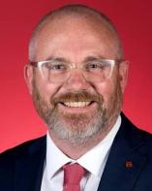
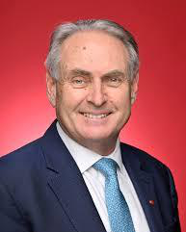
Australia
DIGITAL / TECHNOLOGY · SPLIT PORTFOLIO
TRADE & ECONOMY
SCIENCE, TECH & THE DIGITAL ECONOMY
Andrew Charlton
Cabinet Secretary; Assistant Minister for Science, Technology and the Digital Economy
INDUSTRY, INNOVATION & SCIENCE
Tim Ayres
Minister for Industry and Innovation; Minister for Science
NOMINAL GDP (2025)
$1,840.0B
Department of Industry, Science and Resources (also Department of the Prime Minister and Cabinet as Cabinet Secretary) · May 13, 2025
Department of Industry, Science and Resources · May 13, 2025
OVERALL TRADE BALANCE (2025)
+$4.5B surplus · g+s
Cabinet Secretary and Assistant Minister for Science, Technology and the Digital Economy since 13 May 2025; Labor MP for Parramatta since 2022.
Minister for Industry and Innovation and Minister for Science since 13 May 2025; Labor Senator for New South Wales since 2019.
U.S. GOODS EXPORTS TO (2025)
$33.7B
TRADE / COMMERCE
Don Farrell
Minister for Trade and Tourism; Special Minister of State
U.S. GOODS IMPORTS FROM (2025)
$29.1B
Department of Foreign Affairs and Trade · Assumed office: Jun 1, 2022
Senator Donald Edward Farrell (born 1954) is a Labor Senator for South Australia and a former trade unionist who was state secretary of the Shop, Distributive and Allied Employees Association (SDA) from 1993 to 2008.
Farrell is the sole senior minister for trade and tourism within the Department of Foreign Affairs and Trade; Ayres, formerly his Assistant Minister for Trade, moved up to the industry portfolio in May 2025.
U.S. BILATERAL BALANCE (2025)
+$4.6B surplus
U.S. Department of Commerce | International Trade Administration
trade.gov 2 / 19
GDP: IMF WEO 2025 · U.S. goods trade: U.S. Census 2025 · officeholders verified 2026-07-16

Slide 6

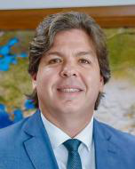
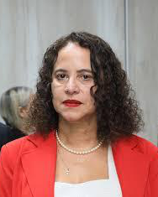
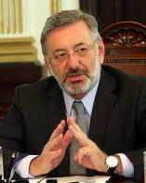
Brazil
DIGITAL / TECHNOLOGY · SPLIT PORTFOLIO
TRADE & ECONOMY
COMMUNICATIONS & TELECOM
Frederico de Siqueira Filho
Minister of Communications
SCIENCE, TECHNOLOGY & INNOVATION
Luciana Santos
Minister of Science, Technology and Innovation
NOMINAL GDP (2025)
$2,280.0B
Ministry of Communications (Ministério das Comunicações) · May 2025
Ministry of Science, Technology and Innovation (Ministério da Ciência, Tecnologia e Inovação, MCTI) · Jan 1, 2023
OVERALL TRADE BALANCE (2025)
+$68.3B surplus · goods
Frederico de Siqueira Filho, a Brazilian engineer with over 26 years in telecommunications, including some 21 years at operator Oi, led state-owned Telebras from 2023 to 2025. President Lula appointed him Minister of Communications in April 2025, succeeding Juscelino Filho.
Luciana Santos, an electrical engineer and national president of the Communist Party of Brazil, has been Minister of Science, Technology and Innovation since 1 January 2023. She previously served as mayor of Olinda, federal deputy and vice-governor of Pernambuco.
U.S. GOODS EXPORTS TO (2025)
$54.4B
TRADE / COMMERCE
Márcio Fernando Elias Rosa
Minister of Development, Industry, Trade and Services
U.S. GOODS IMPORTS FROM (2025)
$39.9B
Ministry of Development, Industry, Trade and Services (Ministério do Desenvolvimento, Indústria, Comércio e Serviços, MDIC) · Assumed office: Apr 6, 2026
Retired public prosecutor, lawyer and law professor, born in Ibiúna, São Paulo, in 1962. He spent his career in the São Paulo Public Prosecutor's Office, serving twice as Attorney General of Justice (2012-2016) and as São Paulo State Secretary of Justice. He joined MDIC as Executive Secretary in January 2023, and was sworn in as Minister on 6 April 2026, succeeding Vice President Geraldo Alckmin, who left the post to run for re-election as Lula's running mate.
U.S. BILATERAL BALANCE (2025)
+$14.5B surplus
U.S. Department of Commerce | International Trade Administration
trade.gov 3 / 19
GDP: IMF WEO 2025 · U.S. goods trade: U.S. Census 2025 · officeholders verified 2026-07-16

Slide 7


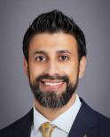
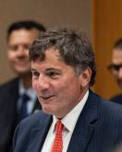
Canada
DIGITAL / TECHNOLOGY
TRADE & ECONOMY
Evan Solomon
NOMINAL GDP (2025)
$2,284.0B
Minister of Artificial Intelligence and Digital Innovation
Innovation, Science and Economic Development Canada (ISED) · Assumed office: May 13, 2025
Solomon, a longtime Canadian broadcaster and author, was elected Liberal MP for Toronto Centre in April 2025 and sworn in May 13, 2025 as Canada's first Minister of Artificial Intelligence and Digital Innovation, a portfolio created by PM Mark Carney. Before politics he hosted CTV's Power Play and Question Period and a CFRB talk-radio show, wrote for Maclean's, and co-founded Shift magazine. He studied at McGill University and now leads federal AI, quantum and digital policy within ISED.
OVERALL TRADE BALANCE (2025)
−$22.4B deficit · goods
U.S. GOODS EXPORTS TO (2025)
$336.5B
TRADE / COMMERCE · SPLIT PORTFOLIO
INTERNATIONAL TRADE
Maninder Sidhu
Minister of International Trade
CANADA–U.S. TRADE
Dominic LeBlanc
President of the King's Privy Council for Canada and Minister responsible for Canada-U.S. Trade, Intergovernmental Affairs, Internal Trade and One Canadian Economy
U.S. GOODS IMPORTS FROM (2025)
$383.0B
Global Affairs Canada · May 13, 2025
Privy Council Office / Global Affairs Canada (Canada-U.S. trade file) · May 13, 2025
Maninder Sidhu, a businessman and Liberal MP for Brampton East since 2019, was sworn into Mark Carney's cabinet on May 13, 2025, as Minister of International Trade. He was previously Parliamentary Secretary to the Ministers of Foreign Affairs and International Development.
Dominic LeBlanc, a lawyer and Liberal MP for Beausejour since 2000, is a veteran minister who has held Fisheries, Intergovernmental Affairs, Public Safety and Finance. Since May 13, 2025 he has led the Canada-U.S. trade file as Privy Council President.
U.S. BILATERAL BALANCE (2025)
−$46.5B deficit
U.S. Department of Commerce | International Trade Administration
trade.gov 4 / 19
GDP: IMF WEO 2025 · U.S. goods trade: U.S. Census 2025 · officeholders verified 2026-07-16

Slide 8

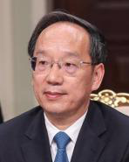
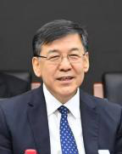
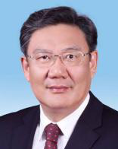

China
DIGITAL / TECHNOLOGY · SPLIT PORTFOLIO
TRADE & ECONOMY
INDUSTRY & INFORMATION TECHNOLOGY (MIIT)
Li Lecheng
Minister of Industry and Information Technology
SCIENCE & TECHNOLOGY (MOST)
Yin Hejun
Minister of Science and Technology
NOMINAL GDP (2025)
$19,399.0B
Ministry of Industry and Information Technology (MIIT) · Apr 30, 2025
Ministry of Science and Technology (MOST) · Oct 24, 2023
OVERALL TRADE BALANCE (2025)
+$1,190.0B surplus · goods
Li Lecheng was appointed China's Minister of Industry and Information Technology on 30 April 2025, replacing Jin Zhuanglong, after becoming MIIT party secretary in February 2025. He previously served as Governor of Liaoning (2021-2025) and executive vice governor of Hubei.
Minister of Science and Technology since October 24, 2023, and MOST Party Secretary since October 7, 2023.
U.S. GOODS EXPORTS TO (2025)
$106.3B
TRADE / COMMERCE · SPLIT PORTFOLIO
COMMERCE MINISTER (MOFCOM)
Wang Wentao
Minister of Commerce
CHIEF TRADE NEGOTIATOR
Li Chenggang
China International Trade Representative (full ministerial rank) and Vice Minister of Commerce
U.S. GOODS IMPORTS FROM (2025)
$308.4B
Ministry of Commerce (MOFCOM) · Dec 2020
Ministry of Commerce (MOFCOM) · Apr 16, 2025
Wang Wentao has served as China's Minister of Commerce since December 2020, leading trade, investment and market-access policy. He was previously mayor of Nanchang and Governor of Heilongjiang (2018-2020). In 2026 he co-chaired the first China-EU Trade and Investment Consultations.
Li Chenggang, a career MOFCOM official who served as China's Ambassador to the WTO from February 2021, was appointed China International Trade Representative and Vice Minister of Commerce on 16 April 2025, replacing Wang Shouwen as Beijing's chief trade negotiator.
U.S. BILATERAL BALANCE (2025)
−$202.1B deficit
U.S. Department of Commerce | International Trade Administration
trade.gov 5 / 19
GDP: IMF WEO 2025 · U.S. goods trade: U.S. Census 2025 · officeholders verified 2026-07-16

Slide 9

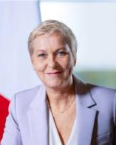
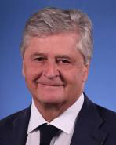
France
DIGITAL / TECHNOLOGY
TRADE & ECONOMY
Anne Le Hénanff
NOMINAL GDP (2025)
$3,362.0B
Minister Delegate for Artificial Intelligence and Digital Affairs
Ministry for the Economy, Finance and Industrial, Energy and Digital Sovereignty (attached to Minister Roland Lescure) · Assumed office: Feb 26, 2026
Anne Le Hénanff (born 22 July 1969 in Vannes) is a Horizons-party politician and, since the Lecornu II government, France's Minister Delegate for Artificial Intelligence and Digital Affairs, attached to the Economy ministry. With a background in cybersecurity (she held a cyber chair at Université Bretagne-Sud), she was a deputy mayor of Vannes for digital affairs and was elected deputy for Morbihan's 1st constituency in 2022, re-elected in 2024, sitting on the Defence Committee.
OVERALL TRADE BALANCE (2025)
−$76.1B deficit · goods
U.S. GOODS EXPORTS TO (2024)
$44.4B
TRADE / COMMERCE
Nicolas Forissier
Minister Delegate for Foreign Trade and Attractiveness
U.S. GOODS IMPORTS FROM (2024)
$61.1B
Ministry for Europe and Foreign Affairs (Minister Delegate attached to the Minister for Europe and Foreign Affairs) · Assumed office: Oct 12, 2025
Nicolas Forissier (born 17 February 1961) is a Les Républicains politician and, since October 2025 (retained in the Lecornu II government), France's Minister Delegate for Foreign Trade and Attractiveness, attached to the Minister for Europe and Foreign Affairs. A Sciences Po Paris graduate with a Sorbonne history degree, he was mayor of La Châtre (1995-2017) and has represented Indre's 2nd constituency in the National Assembly across several terms since 1993. He earlier served as Secretary of State for Agriculture (2004-2005).
U.S. BILATERAL BALANCE (2024)
−$16.7B deficit
U.S. Department of Commerce | International Trade Administration
trade.gov 6 / 19
GDP: IMF WEO 2025 · U.S. goods trade: U.S. Census 2025 · officeholders verified 2026-07-16

Slide 10



Germany
DIGITAL / TECHNOLOGY
TRADE & ECONOMY
Karsten Wildberger
NOMINAL GDP (2025)
$5,014.0B
Federal Minister for Digital Transformation and Government Modernisation
Federal Ministry for Digital Transformation and Government Modernisation (BMDS) · Assumed office: May 6, 2025
Karsten Wildberger (born 5 September 1969, Gießen) holds a doctorate in solid-state physics from RWTH Aachen and an INSEAD MBA. After Boston Consulting Group he held senior roles at T-Mobile, Vodafone and Telstra, sat on E.ON's management board (2016-2021), then led Ceconomy AG (parent of MediaMarktSaturn) from 2021 to 2025. On 6 May 2025 he became Germany's first federal digital minister under Chancellor Friedrich Merz, heading a new ministry consolidating digital responsibilities previously spread across several ministries.
OVERALL TRADE BALANCE (2025)
+$226.0B surplus · goods
U.S. GOODS EXPORTS TO (2025)
$82.7B
TRADE / COMMERCE
Katherina Reiche
Federal Minister for Economic Affairs and Energy
U.S. GOODS IMPORTS FROM (2025)
$159.0B
Federal Ministry for Economic Affairs and Energy (BMWE) · Assumed office: May 6, 2025
Katherina Reiche (born 16 July 1973, Luckenwalde) is a CDU politician and former energy executive, a trained chemist. She was a Bundestag member 1998-2015, including deputy chair of the CDU/CSU parliamentary group and parliamentary state secretary roles. She then led the municipal-utilities association VKU (2015-2019) and chaired the board of E.ON subsidiary Westenergie AG (2020-2025).
Also: Maroš Šefčovič (European Commissioner for Trade and Economic Security)
U.S. BILATERAL BALANCE (2025)
−$76.3B deficit
U.S. Department of Commerce | International Trade Administration
trade.gov 7 / 19
GDP: IMF WEO 2025 · U.S. goods trade: U.S. Census 2025 · officeholders verified 2026-07-16

Slide 11

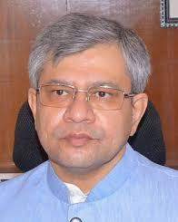
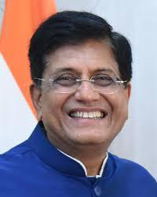
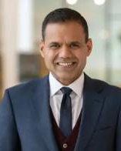
India
DIGITAL / TECHNOLOGY
TRADE & ECONOMY
Ashwini Vaishnaw
NOMINAL GDP (2025)
$4,125.0B
Union Minister of Electronics and Information Technology (concurrently Minister of Railways and Minister of Information & Broadcasting)
Ministry of Electronics and Information Technology (MeitY) · Assumed office: Jun 10, 2024
Ashwini Vaishnaw (born 18 July 1970), a 1994-batch former IAS officer of the Odisha cadre, holds engineering degrees from MBM Jodhpur and IIT Kanpur and an MBA from Wharton. After district-collector postings and corporate roles at GE Transportation and Siemens, he entered the Rajya Sabha from Odisha in 2019.
Also: Jitin Prasada (Union Minister of State for Electronics and Information Technology (also Minister of State for Commerce and Industry))
OVERALL TRADE BALANCE (FY 2025-26)
−$333.2B deficit · goods
U.S. GOODS EXPORTS TO (2025)
$45.6B
TRADE / COMMERCE · SPLIT PORTFOLIO
CABINET MINISTER
Piyush Goyal
Union Minister of Commerce and Industry
COMMERCE SECRETARY · CHIEF US NEGOTIATOR
Rajesh Agrawal
Commerce Secretary (Secretary, Department of Commerce) and India's Chief Negotiator for the India-US Bilateral Trade Agreement
U.S. GOODS IMPORTS FROM (2025)
$103.8B
Ministry of Commerce and Industry · May 31, 2019
Ministry of Commerce and Industry, Department of Commerce · Oct 1, 2025
Piyush Goyal, a chartered accountant, lawyer and BJP parliamentarian, has served as India's Union Minister of Commerce and Industry since 2019, leading trade policy and free-trade-agreement strategy including India-US talks. He previously held the Railways, Power and Textiles portfolios.
Rajesh Agrawal, a senior IAS officer, became India's Commerce Secretary on 1 October 2025 after serving as Special Secretary and Additional Secretary in the Department of Commerce. He is chief negotiator for major trade deals, including the India-US Bilateral Trade Agreement.
U.S. BILATERAL BALANCE (2025)
−$58.2B deficit
U.S. Department of Commerce | International Trade Administration
trade.gov 8 / 19
GDP: IMF WEO 2025 · U.S. goods trade: U.S. Census 2025 · officeholders verified 2026-07-16

Slide 12


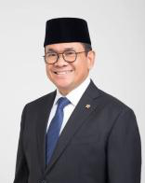
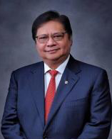
Indonesia
DIGITAL / TECHNOLOGY
TRADE & ECONOMY
Meutya Viada Hafid
NOMINAL GDP (2025)
$1,443.0B
Minister of Communication and Digital Affairs
Ministry of Communication and Digital Affairs (Kementerian Komunikasi dan Digital, 'Komdigi') · Assumed office: Oct 21, 2024
Meutya Viada Hafid (born 3 May 1978, Bandung) is an Indonesian former television journalist and Golkar politician who became Minister of Communication and Digital Affairs on 21 October 2024 in President Prabowo Subianto's Red and White Cabinet, the first woman to lead the ministry. A former Metro TV newscaster, she previously served multiple terms in the House of Representatives (DPR), chairing Commission I on defense, foreign affairs and information.
OVERALL TRADE BALANCE (2025)
+$41.0B surplus · goods
U.S. GOODS EXPORTS TO (2025)
$11.0B
TRADE / COMMERCE · SPLIT PORTFOLIO
TRADE MINISTER
Budi Santoso
Minister of Trade
ECONOMIC COORDINATION & NEGOTIATIONS
Airlangga Hartarto
Coordinating Minister for Economic Affairs
U.S. GOODS IMPORTS FROM (2025)
$34.7B
Ministry of Trade (Kementerian Perdagangan) · Oct 21, 2024
Coordinating Ministry for Economic Affairs (Kementerian Koordinator Bidang Perekonomian) · Oct 23, 2019
Budi Santoso, a career Ministry of Trade civil servant, has served as Indonesia's Minister of Trade since October 2024 in President Prabowo Subianto's cabinet. He was Director General of Foreign Trade (2022-2024) and emphasizes expanding exports through trade agreements.
Airlangga Hartarto has served as Indonesia's Coordinating Minister for Economic Affairs since 2019, retained under President Prabowo Subianto, and acts as chief negotiator in trade talks with the United States. He was Minister of Industry (2016-2019) and Golkar Party chairman (2017-2024).
U.S. BILATERAL BALANCE (2025)
−$23.7B deficit
U.S. Department of Commerce | International Trade Administration
trade.gov 9 / 19
GDP: IMF WEO 2025 · U.S. goods trade: U.S. Census 2025 · officeholders verified 2026-07-16

Slide 13

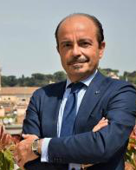
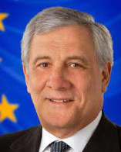

Italy
DIGITAL / TECHNOLOGY
TRADE & ECONOMY
Alessio Butti
NOMINAL GDP (2025)
$2,544.0B
Undersecretary of State to the Presidency of the Council of Ministers with responsibility for Technological Innovation
Presidency of the Council of Ministers (Presidenza del Consiglio dei Ministri) - Department for Digital Transformation · Assumed office: Nov 2, 2022
Alessio Butti (born 1959) is an Italian politician of Fratelli d'Italia and a longtime senator and deputy who served as the party's head of media and telecommunications. In the Meloni government he holds the digital portfolio as Undersecretary of State to the Presidency of the Council with responsibility for Technological Innovation, inheriting functions of the former standalone Ministry for Technological Innovation and Digital Transition (held under Draghi by Vittorio Colao) that Meloni abolished.
OVERALL TRADE BALANCE (2025)
+$56.8B surplus · goods
U.S. GOODS EXPORTS TO (2025)
$43.7B
TRADE / COMMERCE · SPLIT PORTFOLIO
FOREIGN TRADE & EXPORT PROMOTION
Antonio Tajani
Deputy Prime Minister (Vice President of the Council of Ministers) and Minister of Foreign Affairs and International Cooperation
ENTERPRISES & DOMESTIC INDUSTRY
Adolfo Urso
Minister of Enterprises and Made in Italy
U.S. GOODS IMPORTS FROM (2025)
$78.7B
Ministry of Foreign Affairs and International Cooperation (Ministero degli Affari Esteri e della Cooperazione Internazionale - MAECI / 'Farnesina') · Oct 22, 2022
Ministry of Enterprises and Made in Italy (Ministero delle Imprese e del Made in Italy - MIMIT) · Oct 22, 2022
Antonio Tajani, a Forza Italia founder, former European Commissioner and President of the European Parliament (2017-2019), has been Italy's Deputy Prime Minister and Foreign Minister since October 2022. His ministry holds Italy's foreign-trade and export-promotion competency, coordinating ITA/ICE, SACE and SIMEST.
Adolfo Urso, a politician and journalist of the Italian right and former Deputy Minister of Economic Development responsible for Foreign Trade under Berlusconi, has led the Ministry of Enterprises and Made in Italy since 22 October 2022, covering industrial policy.
U.S. BILATERAL BALANCE (2025)
−$35.0B deficit
U.S. Department of Commerce | International Trade Administration
trade.gov 10 / 19
GDP: IMF WEO 2025 · U.S. goods trade: U.S. Census 2025 · officeholders verified 2026-07-16

Slide 14

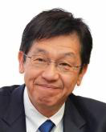
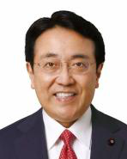
Japan
DIGITAL / TECHNOLOGY
TRADE & ECONOMY
Matsumoto Hisashi
NOMINAL GDP (2025)
$4,280.0B
Minister for Digital Transformation
Digital Agency (Cabinet) · Assumed office: Oct 21, 2025
Matsumoto Hisashi (born June 13, 1962) is a Liberal Democratic Party member of the House of Representatives for Chiba's 13th district, elected in 2021. A former emergency and trauma surgeon and specially appointed professor at Nippon Medical School, he was named Minister for Digital Transformation by Prime Minister Takaichi Sanae on October 21, 2025, and reappointed in the Second Takaichi cabinet on February 18, 2026.
OVERALL TRADE BALANCE (2025)
−$17.0B deficit · goods
U.S. GOODS EXPORTS TO (2025)
$82.1B
TRADE / COMMERCE
Akazawa Ryosei
Minister of Economy, Trade and Industry
U.S. GOODS IMPORTS FROM (2025)
$146.0B
Ministry of Economy, Trade and Industry (METI) · Assumed office: Oct 21, 2025
Akazawa Ryosei is a Liberal Democratic Party member of the House of Representatives for Tottori's 2nd district, first elected in 2005. A University of Tokyo Law graduate with a Cornell MBA, he spent about two decades as an MLIT-lineage bureaucrat.
Also: Motegi Toshimitsu (Minister for Foreign Affairs)
U.S. BILATERAL BALANCE (2025)
−$63.9B deficit
U.S. Department of Commerce | International Trade Administration
trade.gov 11 / 19
GDP: IMF WEO 2025 · U.S. goods trade: U.S. Census 2025 · officeholders verified 2026-07-16

Slide 15


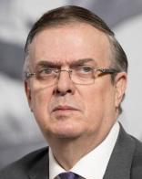
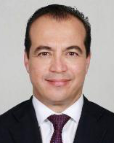
Mexico
DIGITAL / TECHNOLOGY
TRADE & ECONOMY
José Antonio Peña Merino
NOMINAL GDP (2025)
$1,830.0B
Head of the Agency for Digital Transformation and Telecommunications
Agencia de Transformación Digital y Telecomunicaciones (ATDT) - Office of the President (State-Secretariat rank) · Assumed office: Oct 1, 2024
José Antonio 'Pepe' Peña Merino is a political scientist and data specialist. He studied Political Science and International Relations at CIDE and earned a PhD in Political Science from New York University, specializing in political economy and quantitative methods. He co-founded Data Cívica and led Mexico City's Agencia Digital de Innovación Pública (ADIP) under then-Mayor Claudia Sheinbaum.
OVERALL TRADE BALANCE (2025)
+$0.8B surplus · goods
U.S. GOODS EXPORTS TO (2025)
$338.0B
TRADE / COMMERCE · SPLIT PORTFOLIO
SECRETARY OF ECONOMY
Marcelo Luis Ebrard Casaubón
Secretary of Economy
FOREIGN TRADE UNDERSECRETARY
Luis Rosendo Gutiérrez Romano
Undersecretary for Foreign Trade
U.S. GOODS IMPORTS FROM (2025)
$534.9B
Secretaría de Economía · Oct 1, 2024
Secretaría de Economía · Oct 1, 2024
Marcelo Ebrard Casaubón, former Head of Government of Mexico City (2006-2012) and Secretary of Foreign Affairs (2018-2023), took office as Mexico's Secretary of Economy on 1 October 2024. He leads trade policy, including the 2026 USMCA review and US tariff negotiations.
Luis Rosendo Gutiérrez Romano is Mexico's Undersecretary for Foreign Trade and lead trade negotiator, appointed to the Secretaría de Economía in October 2024. Holding a PhD from the University of Essex, he leads tariff and trade-treaty negotiations, including the USMCA review.
U.S. BILATERAL BALANCE (2025)
−$196.9B deficit
U.S. Department of Commerce | International Trade Administration
trade.gov 12 / 19
GDP: IMF WEO 2025 · U.S. goods trade: U.S. Census 2025 · officeholders verified 2026-07-16

Slide 16


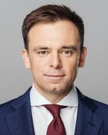

Poland
DIGITAL / TECHNOLOGY
TRADE & ECONOMY
Krzysztof Gawkowski
NOMINAL GDP (2025)
$1,040.0B
Deputy Prime Minister and Minister of Digital Affairs
Ministry of Digital Affairs (Ministerstwo Cyfryzacji) · Assumed office: Dec 13, 2023
Krzysztof Gawkowski (b. 1980) is a Polish political scientist and New Left (Nowa Lewica) politician, serving as the party's deputy chairman.
Digital portfolio unchanged by the July 2025 reshuffle: the Ministry of Digital Affairs (Ministerstwo Cyfryzacji) is led by Krzysztof Gawkowski (Nowa Lewica), who is simultaneously Deputy Prime Minister and Government Plenipotentiary for Cybersecurity — Poland's counterpart for digital economy, AI, and cyber issues.
OVERALL TRADE BALANCE (2025)
−$8.7B deficit · goods
U.S. GOODS EXPORTS TO (2025)
$14.1B
TRADE / COMMERCE · SPLIT PORTFOLIO
FINANCE & ECONOMY MINISTER
Andrzej Domański
Minister of Finance and Economy
TRADE & ECONOMIC SECURITY
Michał Baranowski
Undersecretary of State (deputy minister) responsible for trade
U.S. GOODS IMPORTS FROM (2025)
$14.5B
Ministry of Finance and Economy (Ministerstwo Finansów i Gospodarki) · Jul 24, 2025
Ministry of Finance and Economy (Ministerstwo Finansów i Gospodarki) · Dec 30, 2024
Andrzej Domański, a Polish economist and Civic Coalition politician, became Minister of Finance on 13 December 2023. Since a July 2025 reshuffle merged that ministry with the Ministry of Development and Technology, he has served as Minister of Finance and Economy.
Michał Baranowski spent nearly two decades at the German Marshall Fund, founding its Warsaw office in 2011. Appointed Poland's Undersecretary of State responsible for trade on 30 December 2024, he represents Poland at the EU Foreign Affairs Council (Trade).
U.S. BILATERAL BALANCE (2025)
−$0.4B deficit
U.S. Department of Commerce | International Trade Administration
trade.gov 13 / 19
GDP: IMF WEO 2025 · U.S. goods trade: U.S. Census 2025 · officeholders verified 2026-07-16

Slide 17




Russia
DIGITAL / TECHNOLOGY
TRADE & ECONOMY
Maksut Shadayev
NOMINAL GDP (2025)
$2,541.0B
Minister of Digital Development, Communications and Mass Media
Ministry of Digital Development, Communications and Mass Media of the Russian Federation (Mintsifry) · Assumed office: Jan 21, 2020
Maksut Igorevich Shadayev (born 11 November 1979) has led Russia's digital ministry since 21 January 2020 and was reappointed on 14 May 2024. Trained at the Russian State Social University, he built his career in ICT and public administration: department director at the communications ministry, aide to Sergey Naryshkin, IT minister of Moscow Oblast (2014-2018), then Rostelecom vice-president.
Digital government, telecommunications, IT-sector policy, and internet/media regulation are consolidated under the Ministry of Digital Development, Communications and Mass Media (Shadayev).
OVERALL TRADE BALANCE (2025)
+$139.3B surplus · goods
U.S. GOODS EXPORTS TO (2025)
$0.6B
TRADE / COMMERCE · SPLIT PORTFOLIO
INDUSTRY & TRADE MINISTER
Anton Alikhanov
Minister of Industry and Trade
TRADE POLICY & NEGOTIATIONS
Maxim Reshetnikov
Minister of Economic Development
U.S. GOODS IMPORTS FROM (2025)
$3.8B
Ministry of Industry and Trade of the Russian Federation (Minpromtorg) · May 14, 2024
Ministry of Economic Development of the Russian Federation (Minekonomrazvitiya) · Jan 21, 2020
Anton Alikhanov has been Russia's Minister of Industry and Trade since 14 May 2024, overseeing industrial policy, trade in goods, export support and import substitution. Previously governor of Kaliningrad Oblast (2016-2024), he holds degrees in finance and law.
Maxim Reshetnikov has served as Russia's Minister of Economic Development since 21 January 2020 and was reappointed in May 2024. He previously headed Moscow's economic-policy department (2012-2017) and governed Perm Krai (2017-2020). His ministry directs macroeconomic policy and international trade negotiations.
U.S. BILATERAL BALANCE (2025)
−$3.2B deficit
U.S. Department of Commerce | International Trade Administration
trade.gov 14 / 19
GDP: IMF WEO 2025 · U.S. goods trade: U.S. Census 2025 · officeholders verified 2026-07-16

Slide 18


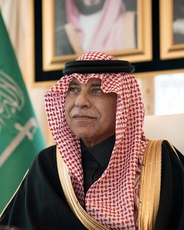

Saudi Arabia
DIGITAL / TECHNOLOGY
TRADE & ECONOMY
Abdullah bin Amer Alswaha
NOMINAL GDP (2025)
$1,277.0B
Minister of Communications and Information Technology
Ministry of Communications and Information Technology (MCIT) · Assumed office: Apr 24, 2017
Abdullah bin Amer Alswaha, a Saudi engineer, has been Minister of Communications and Information Technology since 24 April 2017 and remains in office in 2026 (the ministry publicly welcomed the 2026 budget under his name). He holds electrical-engineering and computer-science degrees from KFUPM and the University of Washington plus Harvard executive education. Before government he led Cisco Saudi Arabia as managing director, then served as the Kingdom's Chief Digital Officer.
OVERALL TRADE BALANCE (2025)
+$59.9B surplus · goods
U.S. GOODS EXPORTS TO (2025)
$14.1B
TRADE / COMMERCE · SPLIT PORTFOLIO
COMMERCE MINISTER
Majid bin Abdullah Al-Qasabi
Minister of Commerce
FOREIGN TRADE AUTHORITY (GAFT)
Mohammed bin Abdulaziz Al-Abduljabbar · acting
Acting Governor, General Authority for Foreign Trade (GAFT)
U.S. GOODS IMPORTS FROM (2025)
$10.5B
Ministry of Commerce · May 7, 2016
General Authority for Foreign Trade (GAFT)
Majid bin Abdullah Al-Qasabi has been Saudi Arabia's Minister of Commerce since May 2016 and chairs the board of the General Authority for Foreign Trade, which handles WTO representation and trade negotiations. He previously served as acting Minister of Media (2020-2023).
Mohammed bin Abdulaziz Al-Abduljabbar serves as Acting Governor of Saudi Arabia's General Authority for Foreign Trade (GAFT), which represents the Kingdom at the WTO, supervises the negotiating team and leads free-trade-agreement negotiations. GAFT's 2025-2026 communications list him in an acting capacity.
U.S. BILATERAL BALANCE (2025)
+$3.6B surplus
U.S. Department of Commerce | International Trade Administration
trade.gov 15 / 19
GDP: IMF WEO 2025 · U.S. goods trade: U.S. Census 2025 · officeholders verified 2026-07-16

Slide 19




South Korea
DIGITAL / TECHNOLOGY
TRADE & ECONOMY
Bae Kyung-hoon
NOMINAL GDP (2025)
$1,859.0B
Deputy Prime Minister and Minister of Science and ICT
Ministry of Science and ICT (MSIT) · Assumed office: Jul 16, 2025
Bae Kyung-hoon is an AI specialist who holds a PhD in computer vision (Kwangwoon University, 2006) and led LG AI Research, where he developed the Exaone large language model. President Lee Jae-myung appointed him Minister of Science and ICT on 16 July 2025; the post was later elevated to Deputy Prime Minister rank.
OVERALL TRADE BALANCE (2025)
+$78.0B surplus · goods
U.S. GOODS EXPORTS TO (2025)
$68.8B
TRADE / COMMERCE · SPLIT PORTFOLIO
TRADE, INDUSTRY & RESOURCES
Kim Jung-kwan
Minister of Trade, Industry and Resources
TRADE NEGOTIATIONS
Yeo Han-koo
Minister for Trade (Head of the Office of Trade Negotiations)
U.S. GOODS IMPORTS FROM (2025)
$125.2B
Ministry of Trade, Industry and Resources (MOTIR) · Jul 2025
Ministry of Trade, Industry and Resources (MOTIR) · Jun 2025
Kim Jung-kwan, a finance technocrat who served at Korea's Ministry of Economy and Finance, the Bank of Korea and the World Bank and led Doosan Enerbility, was nominated by President Lee and took office in July 2025 heading the renamed MOTIR.
Yeo Han-koo, with nearly three decades of public service, was appointed South Korea's Minister for Trade in mid-2025 under President Lee. Previously chief trade negotiator in 2021-2022 and a Peterson Institute senior fellow, he leads tariff talks with the United States.
U.S. BILATERAL BALANCE (2025)
−$56.4B deficit
U.S. Department of Commerce | International Trade Administration
trade.gov 16 / 19
GDP: IMF WEO 2025 · U.S. goods trade: U.S. Census 2025 · officeholders verified 2026-07-16

Slide 20



Türkiye
DIGITAL / TECHNOLOGY
TRADE & ECONOMY
Mehmet Fatih Kacır
NOMINAL GDP (2025)
$1,565.0B
Minister of Industry and Technology
Ministry of Industry and Technology (Sanayi ve Teknoloji Bakanlığı) · Assumed office: Jun 3, 2023
Mehmet Fatih Kacır (born 16 October 1984) became Minister of Industry and Technology on 3 June 2023, having previously served as a deputy minister in the same ministry. An industrial engineering graduate of Boğaziçi University (2008), he co-founded and chaired the T3 Foundation until 2018 and helped launch TEKNOFEST and the DENEYAP technology workshops.
No standalone digital ministry: cybersecurity (Önal, Cybersecurity Presidency) and telecom/digital infrastructure (Uraloğlu, Transport & Infrastructure) sit outside the Industry & Technology Ministry.
OVERALL TRADE BALANCE (2025)
−$92.0B deficit · goods
U.S. GOODS EXPORTS TO (2025)
$20.4B
TRADE / COMMERCE
Ömer Bolat
Minister of Trade
U.S. GOODS IMPORTS FROM (2025)
$16.4B
Ministry of Trade (Ticaret Bakanlığı) · Assumed office: Jun 3, 2023
Prof. Dr. Ömer Bolat (born 30 August 1963, Istanbul) has been Minister of Trade since the cabinet formed after Türkiye's May 2023 elections. He graduated from Marmara University's Faculty of Economics and Administrative Sciences in international economic relations, becoming associate professor in 2014 and professor in 2019. Before politics he was General Coordinator/CEO of the Albayrak Group for about 23 years and chaired the MÜSİAD business association.
U.S. BILATERAL BALANCE (2025)
+$4.0B surplus
U.S. Department of Commerce | International Trade Administration
trade.gov 17 / 19
GDP: IMF WEO 2025 · U.S. goods trade: U.S. Census 2025 · officeholders verified 2026-07-16

Slide 21




United Kingdom
DIGITAL / TECHNOLOGY
TRADE & ECONOMY
Liz Kendall
NOMINAL GDP (2025)
$3,959.0B
Secretary of State for Science, Innovation and Technology
Department for Science, Innovation and Technology (DSIT) · Assumed office: Sep 5, 2025
Liz Kendall is the Labour MP for Leicester West, first elected in 2010. She contested the 2015 Labour leadership election and held several shadow ministerial roles. After Labour's 2024 general election win she served as Secretary of State for Work and Pensions (July 2024 to September 2025).
Also: Ian Murray (Minister of State (Minister for Digital Government and Data)); Kanishka Narayan (Parliamentary Under-Secretary of State (Minister for AI and Online Safety))
OVERALL TRADE BALANCE (2025)
−$319.2B deficit · goods
U.S. GOODS EXPORTS TO (2025)
$97.0B
TRADE / COMMERCE · SPLIT PORTFOLIO
SECRETARY OF STATE · BOARD OF TRADE
Peter Kyle
Secretary of State for Business and Trade, and President of the Board of Trade
TRADE POLICY & ECONOMIC SECURITY
Chris Bryant
Minister of State (Minister for Trade Policy and Economic Security)
U.S. GOODS IMPORTS FROM (2025)
$64.8B
Department for Business and Trade (DBT) · Sep 5, 2025
Department for Business and Trade (DBT) · Sep 6, 2025
Peter Kyle, Labour MP for Hove and Portslade since 2015, became Secretary of State for Business and Trade and President of the Board of Trade in the September 2025 reshuffle. He was previously Science, Innovation and Technology Secretary (2024-2025).
Sir Chris Bryant, a former Anglican priest and Labour MP since 2001, now for Rhondda and Ogmore, was appointed Minister of State for Trade Policy and Economic Security at DBT on 6 September 2025, succeeding Douglas Alexander.
U.S. BILATERAL BALANCE (2025)
+$32.2B surplus
U.S. Department of Commerce | International Trade Administration
trade.gov 18 / 19
GDP: IMF WEO 2025 · U.S. goods trade: U.S. Census 2025 · officeholders verified 2026-07-16

Slide 22





United States
DIGITAL / TECHNOLOGY · SPLIT PORTFOLIO
TRADE & ECONOMY
WHITE HOUSE OSTP · S&T POLICY
Michael Kratsios
Director of the Office of Science and Technology Policy (OSTP) and Assistant to the President for Science and Technology
NTIA · TELECOM & BROADBAND
Arielle Roth
Assistant Secretary of Commerce for Communications and Information and Administrator, National Telecommunications and Information Administration (NTIA)
NOMINAL GDP (2025)
$30,620.0B
Executive Office of the President / White House Office of Science and Technology Policy · Mar 25, 2025
U.S. Department of Commerce (NTIA) · Jul 30, 2025
OVERALL TRADE BALANCE (2025)
−$1,240.9B deficit · goods
Michael Kratsios, confirmed March 25, 2025, is the 13th Director of the White House Office of Science and Technology Policy. Previously U.S. Chief Technology Officer and Under Secretary of Defense for Research and Engineering, he leads the administration's AI Action Plan.
Arielle Roth is Assistant Secretary of Commerce for Communications and Information and NTIA Administrator, confirmed July 23, 2025. Formerly telecommunications policy director for the Senate Commerce Committee's Republican staff, she oversees federal spectrum management and broadband programs including BEAD.
GOODS EXPORTS — WORLD (2025)
$2,197.5B
TRADE / COMMERCE · SPLIT PORTFOLIO
SECRETARY OF COMMERCE
Howard Lutnick
United States Secretary of Commerce
U.S. TRADE REPRESENTATIVE
Jamieson Greer
United States Trade Representative (USTR), with rank of Ambassador
GOODS IMPORTS — WORLD (2025)
$3,438.4B
U.S. Department of Commerce · Feb 21, 2025
Office of the United States Trade Representative (Executive Office of the President) · Feb 27, 2025
Howard Lutnick, the 41st U.S. Secretary of Commerce, was confirmed February 18, 2025. Longtime chairman and CEO of Cantor Fitzgerald, which he rebuilt after 9/11, he oversees trade policy, tariffs and export controls, and co-chaired Trump's 2024-25 transition.
Jamieson Greer is the 20th U.S. Trade Representative, confirmed February 27, 2025. A trade attorney and former Air Force JAG officer, he was chief of staff to USTR Robert Lighthizer and leads U.S. trade negotiations, tariff strategy and enforcement.
GOODS BALANCE — WORLD (2025)
−$1,240.9B deficit
U.S. Department of Commerce | International Trade Administration
trade.gov 19 / 19
GDP: IMF WEO 2025 · U.S. goods trade: U.S. Census 2025 · officeholders verified 2026-07-16

Slide 23


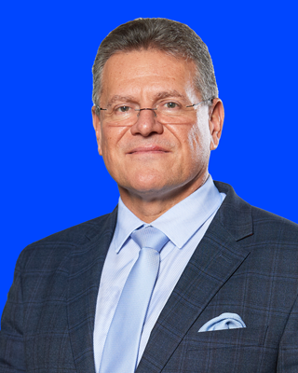
European Union · G20 BLOC MEMBER
Members: 27 · G20: Founding member since 1999 · HQ: Brussels · Commission President: Ursula von der Leyen
DIGITAL / TECHNOLOGY
TRADE & ECONOMY
Henna Virkkunen
NOMINAL GDP (2025)
$21,230.0B
Executive Vice-President for Tech Sovereignty, Security and Democracy
European Commission — Tech Sovereignty, Security and Democracy (Digital and Frontier Technologies portfolio) · Assumed office: Dec 1, 2024
Finnish politician of the National Coalition Party (EPP), born 1972 in Joutsa. A former journalist, she sat in Finland's Parliament from 2007 to 2014, serving as Minister of Education (2008-2011), of Public Administration and Local Government (2011-2014), and of Transport and Local Government (2014). An MEP from 2014 to 2024, she became Executive Vice-President on 1 December 2024, leading EU digital, AI, cybersecurity, platform-regulation and democracy policy.
OVERALL TRADE BALANCE (2025)
+$144.7B surplus · goods
U.S. GOODS EXPORTS TO (2025)
$414.4B
TRADE / COMMERCE
Maroš Šefčovič
Commissioner for Trade and Economic Security; Interinstitutional Relations and Transparency
U.S. GOODS IMPORTS FROM (2025)
$633.2B
European Commission — Trade and Economic Security · Assumed office: Dec 1, 2024
Slovak diplomat and politician, born 1966. A career diplomat and Slovakia's Permanent Representative to the EU (2004-2009), he has served in every European Commission since 2009, including as Vice-President for the Energy Union and Executive Vice-President for the European Green Deal. A veteran Brexit negotiator, he took the trade portfolio on 1 December 2024 and led the EU side of the 2025 U.S.-EU tariff framework agreed at Turnberry.
U.S. BILATERAL BALANCE (2025)
−$218.8B deficit
U.S. Department of Commerce | International Trade Administration
trade.gov Bloc annex
GDP: IMF WEO 2025 · U.S. goods trade: U.S. Census 2025 · officeholders verified 2026-07-16

Slide 24

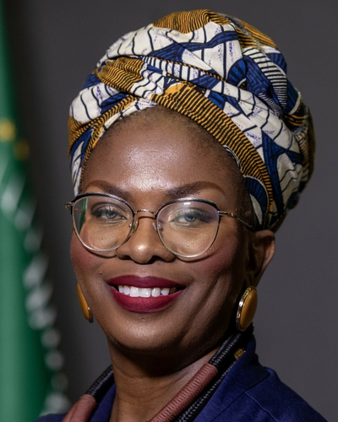
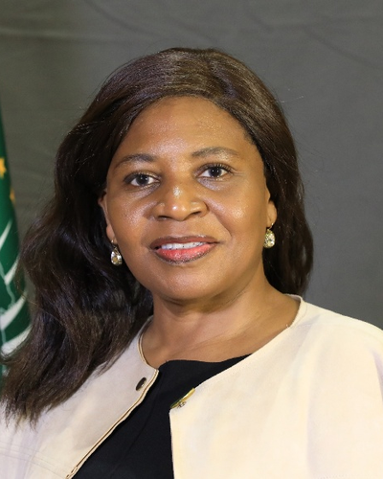
African Union · G20 BLOC MEMBER
Members: 55 · G20: Permanent member since Sept 2023 · HQ: Addis Ababa · AUC Chair: Mahmoud Ali Youssouf
DIGITAL / TECHNOLOGY
TRADE & ECONOMY
Lerato Dorothy Mataboge
NOMINAL GDP (2025 (IMF projection))
$2,810.0B
Commissioner for Infrastructure and Energy (portfolio covers transport, energy and ICT/digital transformation)
African Union Commission — Department of Infrastructure and Energy · Assumed office: Mar 13, 2025
A South African trade-and-investment specialist with over 23 years' experience, Mataboge leads the AU portfolio spanning transport, energy and ICT/digital transformation. She was previously Deputy Director-General at South Africa's Department of Trade, Industry and Competition, founded and led Trade Invest Africa, and served as South Africa's chief trade and investment representative in Washington, D.C. Elected in the February 2025 AUC elections, she was sworn in with the new Commission on 13 March 2025.
OVERALL TRADE BALANCE (2024)
N/A
U.S. GOODS EXPORTS TO (2025)
$40.4B
TRADE / COMMERCE
Francisca Tatchouop Belobe
Commissioner for Economic Development, Trade, Tourism, Industry and Minerals (ETTIM)
U.S. GOODS IMPORTS FROM (2025)
$43.0B
African Union Commission — Department of Economic Development, Trade, Tourism, Industry and Minerals · Assumed office: Sep 2025
An Equatoguinean economist and politician, Tatchouop Belobe heads the AU's economic integration, trade, industry and minerals portfolio. She previously served as Vice-President of the ECCAS Commission (Economic Community of Central African States), Second Vice-President of Equatorial Guinea's National Assembly, and Minister and Deputy Minister of Economy, Trade and SME Promotion.
Also: Wamkele Mene (Secretary-General, African Continental Free Trade Area (AfCFTA) Secretariat)
U.S. BILATERAL BALANCE (2025)
−$2.6B deficit
* U.S. trade figures are U.S.–Africa goods totals (proxy for the AU).
U.S. Department of Commerce | International Trade Administration
trade.gov Bloc annex
GDP: IMF WEO 2025 · U.S. goods trade: U.S. Census 2025 · officeholders verified 2026-07-16

Slide 25
Methodology, Sources & Notes
scope · datasets · caveats · compiled 2026-07-16
SCOPE & METHODOLOGY
DATASETS & VINTAGES
DATA CAVEATS
• 19 members: Argentina, Australia, Brazil, Canada, China, France, Germany, India, Indonesia, Italy, Japan, Mexico, Poland, Russia, Saudi Arabia, South Korea, Türkiye, United Kingdom, United States.
• Substitution: Poland is covered in place of South Africa — a deliberate substitution, not an omission.
• Bloc members: The European Union and African Union hold G20 seats as supranational blocs; both are profiled in the annex.
• Ministers: Each officeholder confirmed current on 2026-07-16 by live search plus an independent verification pass; split portfolios show every responsible official.
• Figures: USD billions throughout, one decimal. Positive balance = surplus (green); negative = deficit (orange).
• GDP: IMF World Economic Outlook, Oct 2025 (2025 estimates, nominal USD), single vintage across all members.
• U.S. bilateral goods trade: U.S. Census Bureau, full-year 2025, via USTR fact sheets and Census-derived series.
• U.S. world totals: Census/BEA FT-900, December & Annual 2025 release.
• Overall balances: national statistics offices / IMF, latest full year, goods basis unless noted.
• EU & AU annex: IMF WEO, Eurostat, USTR, and official EU/AU sources.
• Officeholders: official government sources and 2026-dated press, dual-verified 2026-07-16.
• Australia's balance is goods+services; India's is fiscal year 2025-26. All others goods-only, calendar 2025.
• Several balances are converted from local currency at ~2025 average rates; USD values carry exchange-rate uncertainty.
• census.gov and imf.org were not directly reachable at build time; figures come from official-data-derived channels.
• African Union: U.S. figures are U.S.–Africa goods totals (proxy); no continental goods balance is published (N/A).
• Acting officials: Argentina's domestic commerce portfolio and Saudi Arabia's GAFT governorship.
• Full uncertainty register: output/GAPS.md.
U.S. Department of Commerce | International Trade Administration
trade.gov
GDP: IMF WEO 2025 · U.S. goods trade: U.S. Census 2025 · officeholders verified 2026-07-16

