Slide 1


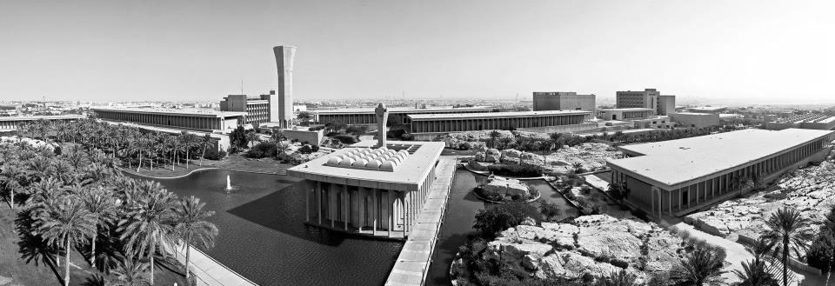
kfupm.edu.sa
COURSE SPECIFICATIONS PROJECT
CRF2. Course Specifications

Slide 2
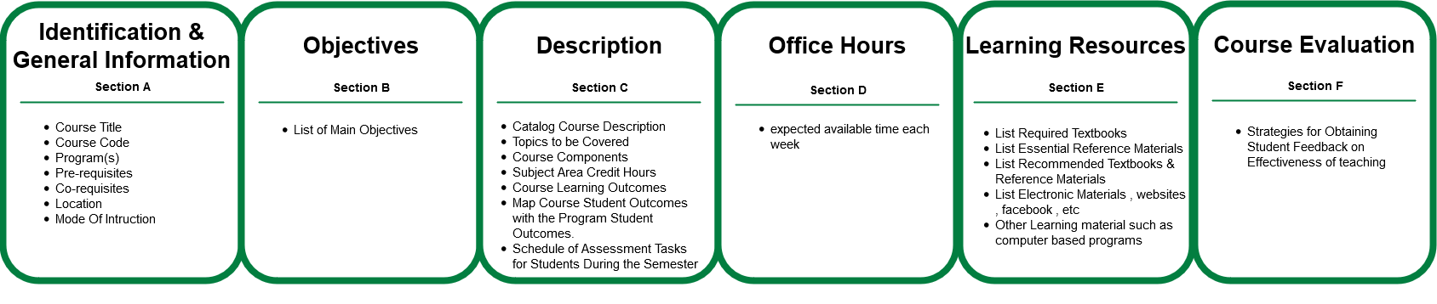
Course Specification Check List

Slide 3
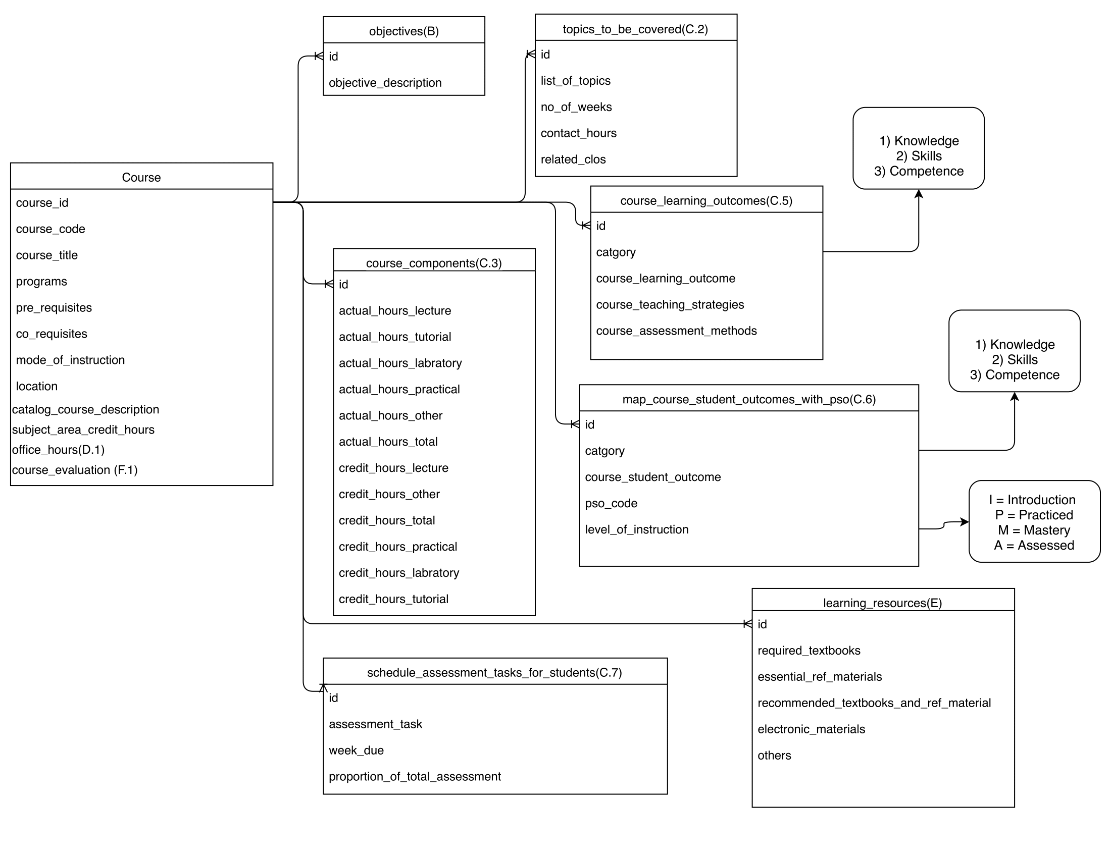
Course Specification Data Model (Draft)

Slide 4
Thank you!
King Fahd University of Petroleum & Minerals kfupm.edu.sa

