Slide 1
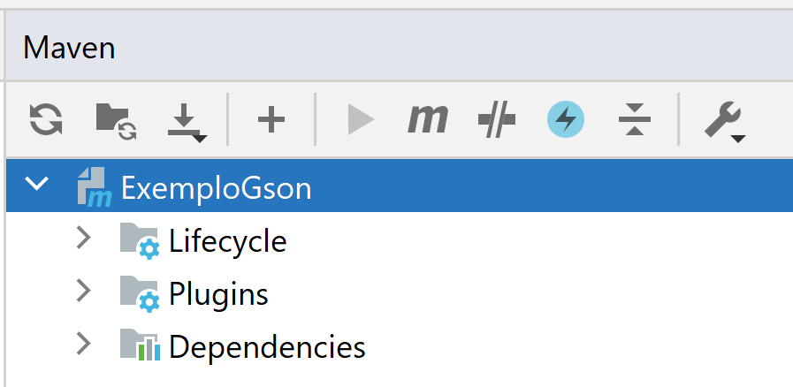
Instalar biblioteca Java do Spread no repositório local
mvn install:install-file -Dfile=spread-4.4.0.jar -DgroupId=org.spread -DartifactId=spread -Dversion=4.4.0 -Dpackaging=jar
A partir do IntelliJ.

