Slide 1







Pyomo.GDP:
Disjunctive Models in Python
Qi Chen^{a,c}, Emma S. Johnson^{b,c}, John D. Siirola^{c}, Ignacio E. Grossmannª
ªCenter for Adv. Process Decision-making, Carnegie Mellon University
^{b}H. Milton Stewart School of Ind. & Systems Engineering, Georgia Institute of Technology
^{c}Center for Computing Research, Sandia National Laboratories
2 June 2018
Sandia National Laboratories is a multimission laboratory managed and operated by National Technology and Engineering Solutions of Sandia, LLC, a wholly owned subsidiary of Honeywell International, Inc., for the U.S. Department of Energy’s National Nuclear Security Administration under contract DE-NA0003525.

Slide 2







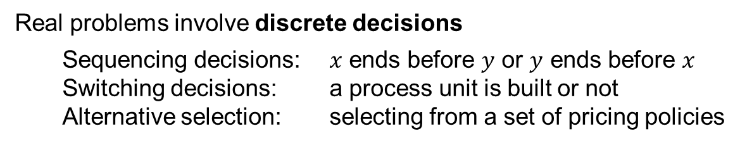
Optimization software – what do we want?
Why optimize?
To solve real problems
To make strategic decisions
Solve optimization problems
Understand intuition behind solution
Process synthesis
Supply chain
Scheduling
Inventory planning
Facility location
Real problems involve discrete decisions
Sequencing decisions: $x$ ends before $y$ or $y$ ends before $x$
Switching decisions: a process unit is built or not
Alternative selection: selecting from a set of pricing policies

Slide 3
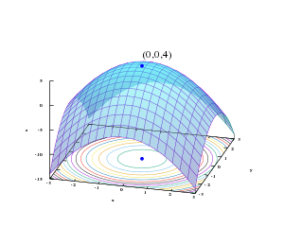






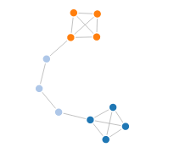

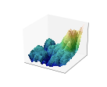
How do we want to solve problems?
“Where should I site my power plant?”
Natural language processing
Model formulation
Model solution
Solution interpretation
Python
Mature high-level programming language
Large, skilled user base – common in undergrad curriculum
Rich set of libraries:
Pandas – data management (csv, Excel, databases, etc.)
Matplotlib – visualization
Numpy – linear algebra
Networkx – Network graph analysis
PyQt – graphical interfaces

Slide 4
How do we want to solve problems?
“Where should I site my power plant?”
Natural language processing
Model formulation
Model solution
Solution interpretation
Python
Pyomo
Programmatic access to modeling components
Free to use, open source, open modeling environment
Model once, try many different solution approaches
Access to wide range of solvers
Interfaces to free, open-source solvers
Interface to AMPL-licensed solvers
Interface to GAMS-licensed solvers

Slide 5
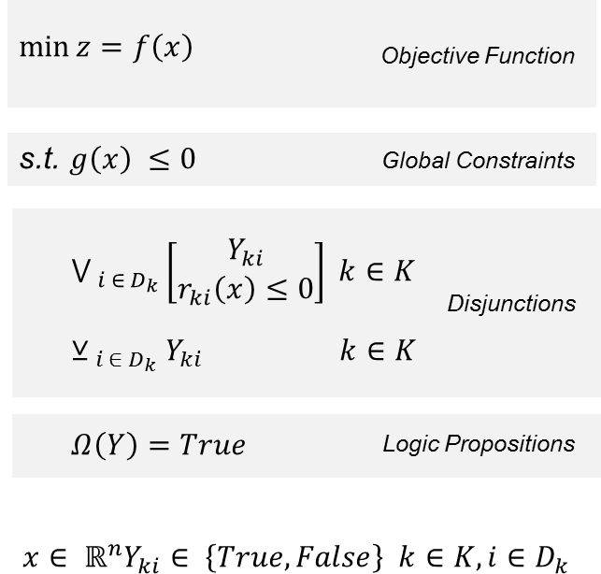
How do we want to solve problems?
“Where should I site my power plant?”
Natural language processing
Model formulation
Model solution
Solution interpretation
Python
Pyomo
Pyomo.GDP
Generalized Disjunctive Programming
Ability to natively express disjunctive either-or logic
Less human pre-processing, less prone to modeling errors
High-level description of engineering problem

Slide 6
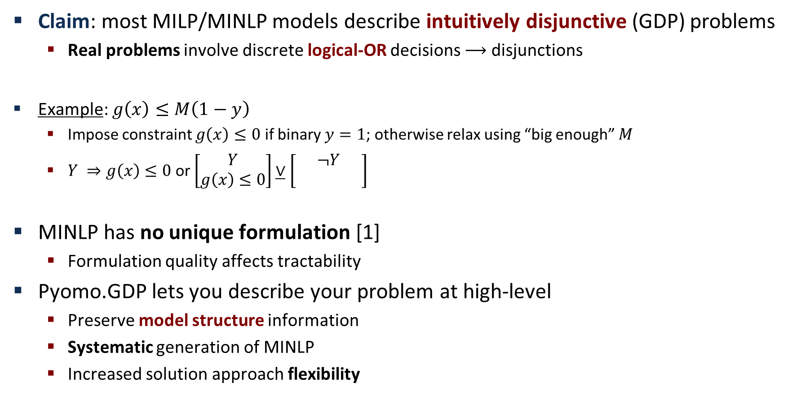
GDP vs. MINLP
Claim: most MILP/MINLP models describe intuitively disjunctive (GDP) problems
Real problems involve discrete logical-OR decisions $⟶$ disjunctions
Example: $g\left(x\right)≤M\left(1−y\right)$
Impose constraint $g\left(x\right)≤0$ if binary $y=1$; otherwise relax using “big enough” $M$
$Y ⇒g\left(x\right)≤0$ or $\left[\begin{matrix}Y \\ g\left(x\right)≤0\end{matrix}\right]\underline{∨}\left[\begin{matrix}¬Y \\ g\left(x\right)≤0\end{matrix}\right]$
MINLP has no unique formulation [1]
Formulation quality affects tractability
Pyomo.GDP lets you describe your problem at high-level
Preserve model structure information
Systematic generation of MINLP
Increased solution approach flexibility
[1] Trespalacios & Grossmann, 2014

Slide 7
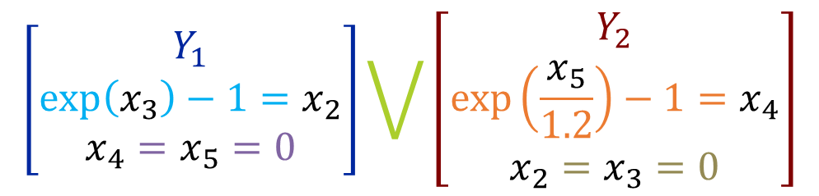
Pyomo.GDP modeling
$$\left[\begin{matrix}Y_{1} \\ \exp\left(x_{3}\right)−1=x_{2} \\ x_{4}=x_{5}=0\end{matrix}\right]\bigvee{\left[\begin{matrix}Y_{2} \\ \exp\left(\frac{x_{5}}{1.2}\right)−1=x_{4} \\ x_{2}=x_{3}=0\end{matrix}\right]}$$
Expanded syntax: more descriptive
m.use_unit1 = Disjunct()
m.use_unit1.inout1 = Constraint(expr=exp(m.x[3])–1 == m.x[2])
m.use_unit1.no_unit2_flow1 = Constraint(expr=m.x[4] == 0)
m.use_unit1.no_unit2_flow2 = Constraint(expr=m.x[5] == 0)
m.use_unit2 = Disjunct()
m.use_unit2.inout2 = Constraint(expr=exp(m.x[5]/1.2)–1 == m.x[4])
m.use_unit2.no_unit1_flow1 = Constraint(expr=m.x[2] == 0)
m.use_unit2.no_unit1_flow2 = Constraint(expr=m.x[3] == 0)
m.use1or2 = Disjunction(expr=[m.use_unit1, m.use_unit2])

Slide 8
Pyomo.GDP modeling
$$\left[\begin{matrix}Y_{1} \\ \exp\left(x_{3}\right)−1=x_{2} \\ x_{4}=x_{5}=0\end{matrix}\right]\bigvee{\left[\begin{matrix}Y_{2} \\ \exp\left(\frac{x_{5}}{1.2}\right)−1=x_{4} \\ x_{2}=x_{3}=0\end{matrix}\right]}$$
Compact syntax: more concise
m.use1or2 = Disjunction(expr=[
# First disjunct
[exp(m.x[3])-1 == m.x[2],
m.x[4] == 0, m.x[5] == 0],
# Second disjunct
[exp(m.x[5]/1.2)–1 == m.x[4],
m.x[2] == 0, m.x[3] == 0]])

Slide 9
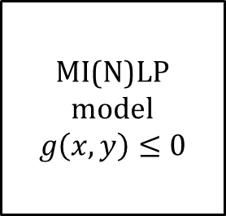
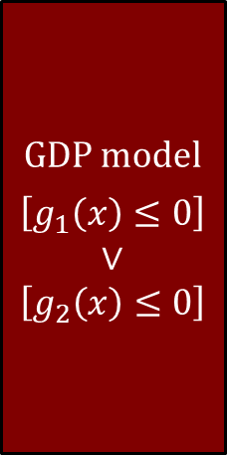
Pyomo.GDP – Flexible solution strategies
GDP model
$$\left[g_{1}\left(x\right)≤0\right] \\ ∨ \\ \left[g_{2}\left(x\right)≤0\right]$$
MI(N)LP model
$$g\left(x,y\right)≤0$$
Model
Big-M
Reformulation
HR
Solver
Hybrid BM/HR
GDP to MI(N)LP reformulations
Basic Step
MINLP solvers
GDPopt solver
Model Solution
Pyomo gives diverse solution options for GDP models

Slide 10
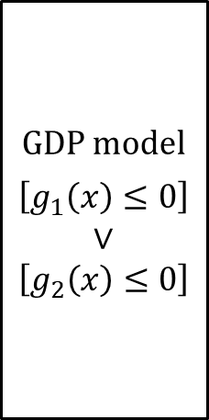
Pyomo.GDP – Flexible solution strategies
GDP model
$$\left[g_{1}\left(x\right)≤0\right] \\ ∨ \\ \left[g_{2}\left(x\right)≤0\right]$$
MI(N)LP model
$$g\left(x,y\right)≤0$$
Model
Big-M
Reformulation
HR
Solver
Hybrid BM/HR
GDP to MI(N)LP reformulations
Basic Step
MINLP solvers
GDPopt solver
Model Solution
Pyomo gives diverse solution options for GDP models
Standard reformulations to MINLP: Big-M (BM) and Hull Reformulation (HR)

Slide 11
Pyomo.GDP – Flexible solution strategies
GDP model
$$\left[g_{1}\left(x\right)≤0\right] \\ ∨ \\ \left[g_{2}\left(x\right)≤0\right]$$
MI(N)LP model
$$g\left(x,y\right)≤0$$
Model
Big-M
Reformulation
HR
Solver
Hybrid BM/HR
GDP to MI(N)LP reformulations
Basic Step
MINLP solvers
GDPopt solver
Model Solution
Pyomo gives diverse solution options for GDP models
Standard reformulations to MINLP: Big-M (BM) and Hull Reformulation (HR)
Cutting-plane based hybrid BM/HR reformulation to MINLP

Slide 12
Pyomo.GDP – Flexible solution strategies
GDP model
$$\left[g_{1}\left(x\right)≤0\right] \\ ∨ \\ \left[g_{2}\left(x\right)≤0\right]$$
MI(N)LP model
$$g\left(x,y\right)≤0$$
Model
Big-M
Reformulation
HR
Solver
Hybrid BM/HR
GDP to MI(N)LP reformulations
Basic Step
MINLP solvers
GDPopt solver
Model Solution
Pyomo gives diverse solution options for GDP models
Standard reformulations to MINLP: Big-M (BM) and Hull Reformulation (HR)
Cutting-plane based hybrid BM/HR reformulation to MINLP
Basic step reformulation GDP to tighter GDP

Slide 13
Pyomo.GDP – Flexible solution strategies
GDP model
$$\left[g_{1}\left(x\right)≤0\right] \\ ∨ \\ \left[g_{2}\left(x\right)≤0\right]$$
MI(N)LP model
$$g\left(x,y\right)≤0$$
Model
Big-M
Reformulation
HR
Solver
Hybrid BM/HR
GDP to MI(N)LP reformulations
Basic Step
MINLP solvers
GDPopt solver
Model Solution
Pyomo gives diverse solution options for GDP models
Standard reformulations to MINLP: Big-M (BM) and Hull Reformulation (HR)
Cutting-plane based hybrid BM/HR reformulation to MINLP
Basic step reformulation GDP to tighter GDP
Direct logic-based solution algorithms

Slide 14
Pyomo.GDP – Flexible solution strategies
GDP model
$$\left[g_{1}\left(x\right)≤0\right] \\ ∨ \\ \left[g_{2}\left(x\right)≤0\right]$$
MI(N)LP model
$$g\left(x,y\right)≤0$$
Model
Big-M
Reformulation
HR
Solver
Hybrid BM/HR
GDP to MI(N)LP reformulations
Basic Step
MINLP solvers
GDPopt solver
Model Solution
Pyomo gives diverse solution options for GDP models
Standard reformulations to MINLP: Big-M (BM) and Hull Reformulation (HR)
Cutting-plane based hybrid BM/HR reformulation to MINLP
Basic step reformulation GDP to tighter GDP
Direct logic-based solution algorithms

Slide 15
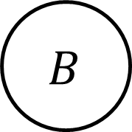

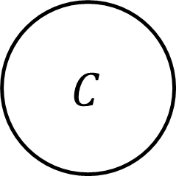


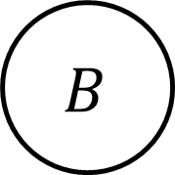
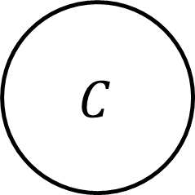
Classical GDP Reformulations: Big-M (BM) and Hull (HR)
$$A∨B∨C$$
$$C$$
$$C$$
$$A$$
$$A$$
$$B$$
$$B$$
Big-M reformulation
Looser relaxation
Smaller problem size
TransformationFactory( ‘gdp.bigm’).apply_to(model)
Hull reformulation
Tighter relaxation
Larger problem size
TransformationFactory( ‘gdp.chull’).apply_to(model)

Slide 16

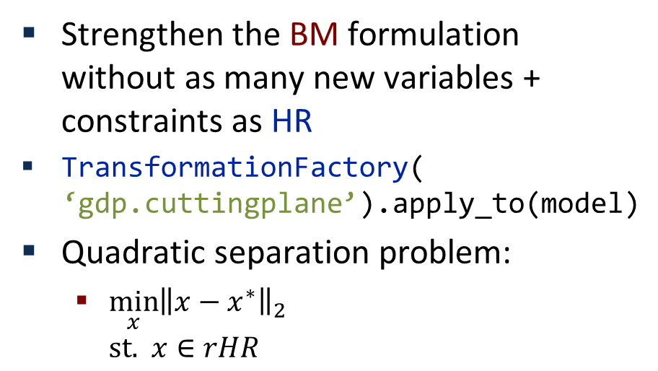



Advanced GDP Reformulations: Hybrid BM/HR
(1) HR
(3) relax integrality
(6) separation objective
GDP model
MIP-HR
rHR
SEP
(5) rBM solution
Model transformation
(7) new cut
Information transfer
(2) BM
(4) relax integrality
MIP-BM
rBM
Strengthen the BM formulation without as many new variables + constraints as HR
TransformationFactory( ‘gdp.cuttingplane’).apply_to(model)
Quadratic separation problem:
$\min_{x}{{\left\|x−x^{∗}\right\|}_{2}}$ $\text{st}\text{. } x∈rHR$
BM
$$C$$
HR
$$A$$
$$B$$
$$x^{∗}$$

Slide 17
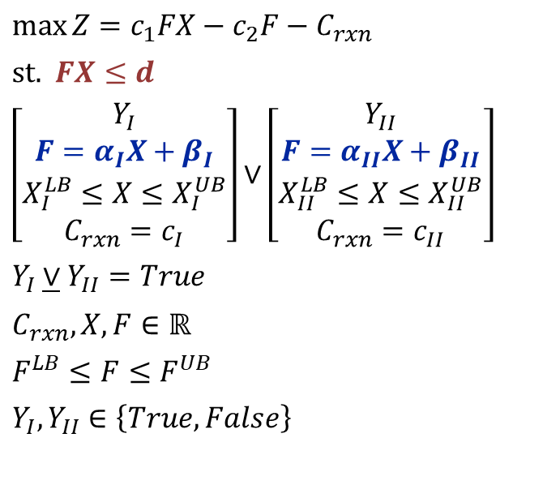
Advanced GDP Reformulations: Basic Steps
I
Basic step: intersection of disjunctions towards Disjunctive Normal Form
Tightens continuous relaxation of GDP
Optimal reactor selection example [1]
II
$$\max{Z}=c_{1}FX−c_{2}F−C_{rxn}$$
$$\text{st}\text{. } FX≤d$$
$$\left[\begin{aligned}Y_{I} \\ F=α_{I}X+β_{I} \\ X_{I}^{LB}≤X≤X_{I}^{UB} \\ C_{rxn}=c_{I}\end{aligned}\right]∨\left[\begin{aligned}Y_{II} \\ F=α_{II}X+β_{II} \\ X_{II}^{LB}≤X≤X_{II}^{UB} \\ C_{rxn}=c_{II}\end{aligned}\right]$$
$$Y_{I}\underline{∨}Y_{II}=True$$
$$C_{rxn},X,F∈ℝ$$
$$F^{LB}≤F≤F^{UB}$$
$$Y_{I},Y_{II}∈\left\{True, False\right\}$$
F
8
II
Feed flowrate
I
Global optimum=1.01
0
0
1
X
Conversion
[1] Ruiz & Grossmann, 2010

Slide 18
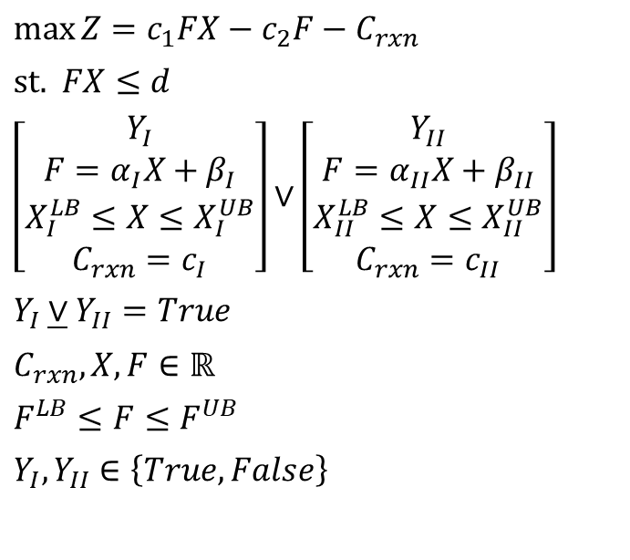
Advanced GDP Reformulations: Basic Steps
I
m = ConcreteModel()
m.F = Var(bounds=(0, 8), doc="Flow into reactor")
m.X = Var(bounds=(0, 1), doc="Reactor conversion")
m.C_rxn = Var(bounds=(1.5, 2.5), doc="Cost of reactor")
m.max_demand = Constraint(expr=m.F * m.X <= m.d, doc="product demand")
m.reactor_choice = Disjunction(expr=[
# Disjunct 1: Choose reactor I
[m.F == m.alpha['I'] * m.X + m.beta['I'],
m.X_LB['I'] <= m.X, m.X <= m.X_UB['I'],
m.C_rxn == m.c['I']],
# Disjunct 2: Choose reactor II
[m.F == m.alpha['II'] * m.X + m.beta['II'],
m.X_LB['II'] <= m.X, m.X <= m.X_UB['II'],
m.C_rxn == m.c['II']]
], xor=True) # xor=True is optional. Here for clarity.
m.profit = Objective(
expr=m.c[1] * m.F * m.X - m.c[2] * m.F - m.C_rxn, sense=maximize)
II
$$\max{Z}=c_{1}FX−c_{2}F−C_{rxn}$$
$$\text{st}\text{. } FX≤d$$
$$\left[\begin{aligned}Y_{I} \\ F=α_{I}X+β_{I} \\ X_{I}^{LB}≤X≤X_{I}^{UB} \\ C_{rxn}=c_{I}\end{aligned}\right]∨\left[\begin{aligned}Y_{II} \\ F=α_{II}X+β_{II} \\ X_{II}^{LB}≤X≤X_{II}^{UB} \\ C_{rxn}=c_{II}\end{aligned}\right]$$
$$Y_{I}\underline{∨}Y_{II}=True$$
$$C_{rxn},X,F∈ℝ$$
$$F^{LB}≤F≤F^{UB}$$
$$Y_{I},Y_{II}∈\left\{True, False\right\}$$
Full code for example can be found in pyomo.examples.gdp on Github
[1] Ruiz & Grossmann, 2010

Slide 19
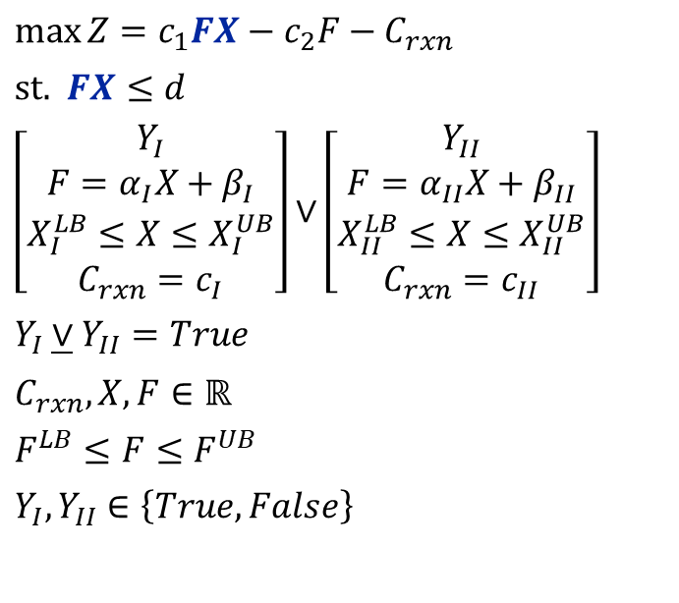
Advanced GDP Reformulations: Basic Steps
I
Basic step: intersection of disjunctions towards Disjunctive Normal Form
Tightens continuous relaxation of GDP
Optimal reactor selection example [1]
II
$$\max{Z}=c_{1}FX−c_{2}F−C_{rxn}$$
$$\text{st}\text{. } FX≤d$$
$$\left[\begin{aligned}Y_{I} \\ F=α_{I}X+β_{I} \\ X_{I}^{LB}≤X≤X_{I}^{UB} \\ C_{rxn}=c_{I}\end{aligned}\right]∨\left[\begin{aligned}Y_{II} \\ F=α_{II}X+β_{II} \\ X_{II}^{LB}≤X≤X_{II}^{UB} \\ C_{rxn}=c_{II}\end{aligned}\right]$$
$$Y_{I}\underline{∨}Y_{II}=True$$
$$C_{rxn},X,F∈ℝ$$
$$F^{LB}≤F≤F^{UB}$$
$$Y_{I},Y_{II}∈\left\{True, False\right\}$$
F
Bilinear
TransformationFactory(‘contrib.mccormick_bilinear’).apply_to(m)*
8
II
I
0
0
1
X
*Transformation not yet generalized
[1] Ruiz & Grossmann, 2010

Slide 20
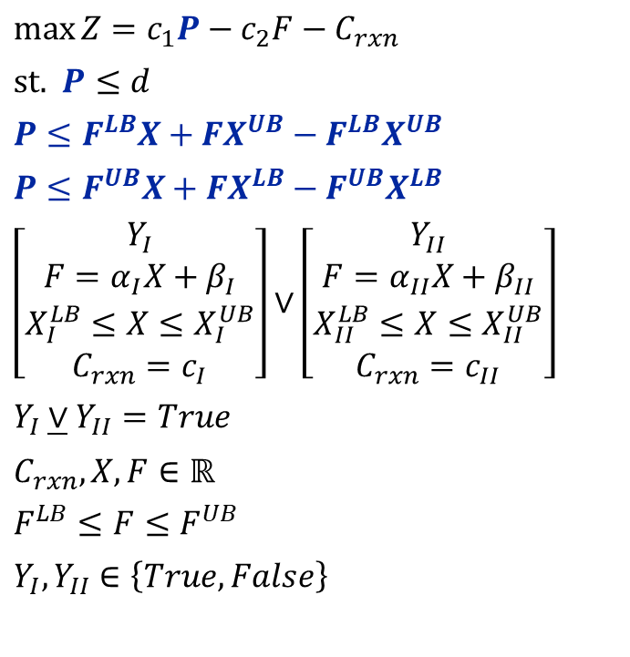
Advanced GDP Reformulations: Basic Steps
I
Basic step: intersection of disjunctions towards Disjunctive Normal Form
Tightens continuous relaxation of GDP
Optimal reactor selection example [1]
II
$$\max{Z}=c_{1}P−c_{2}F−C_{rxn}$$
$$\text{st}\text{. } P≤d$$
$$P≤F^{LB}X+FX^{UB}−F^{LB}X^{UB}$$
$$P≤F^{UB}X+FX^{LB}−F^{UB}X^{LB}$$
$$\left[\begin{aligned}Y_{I} \\ F=α_{I}X+β_{I} \\ X_{I}^{LB}≤X≤X_{I}^{UB} \\ C_{rxn}=c_{I}\end{aligned}\right]∨\left[\begin{aligned}Y_{II} \\ F=α_{II}X+β_{II} \\ X_{II}^{LB}≤X≤X_{II}^{UB} \\ C_{rxn}=c_{II}\end{aligned}\right]$$
$$Y_{I}\underline{∨}Y_{II}=True$$
$$C_{rxn},X,F∈ℝ$$
$$F^{LB}≤F≤F^{UB}$$
$$Y_{I},Y_{II}∈\left\{True, False\right\}$$
F
8
II
I
0
0
1
X
*Transformation not yet generalized
[1] Ruiz & Grossmann, 2010

Slide 21
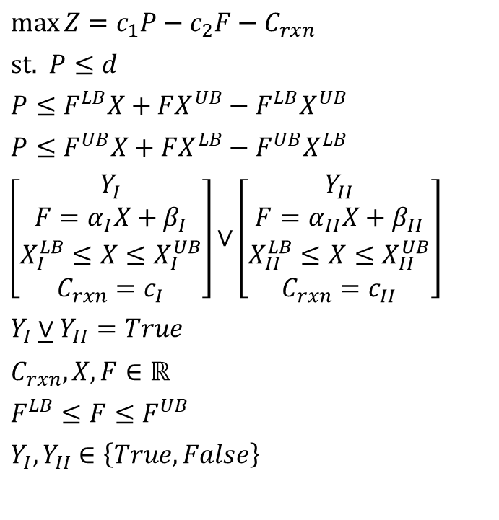
Advanced GDP Reformulations: Basic Steps
I
Basic step: intersection of disjunctions towards Disjunctive Normal Form
Tightens continuous relaxation of GDP
Optimal reactor selection example [1]
II
$$\max{Z}=c_{1}P−c_{2}F−C_{rxn}$$
$$\text{st}\text{. } P≤d$$
$$P≤F^{LB}X+FX^{UB}−F^{LB}X^{UB}$$
$$P≤F^{UB}X+FX^{LB}−F^{UB}X^{LB}$$
$$\left[\begin{aligned}Y_{I} \\ F=α_{I}X+β_{I} \\ X_{I}^{LB}≤X≤X_{I}^{UB} \\ C_{rxn}=c_{I}\end{aligned}\right]∨\left[\begin{aligned}Y_{II} \\ F=α_{II}X+β_{II} \\ X_{II}^{LB}≤X≤X_{II}^{UB} \\ C_{rxn}=c_{II}\end{aligned}\right]$$
$$Y_{I}\underline{∨}Y_{II}=True$$
$$C_{rxn},X,F∈ℝ$$
$$F^{LB}≤F≤F^{UB}$$
$$Y_{I},Y_{II}∈\left\{True, False\right\}$$
F
8
II
I
Relaxation
(No Basic Steps)
0
0
1
X
Relaxed objective=1.48
[1] Ruiz & Grossmann, 2010

Slide 22
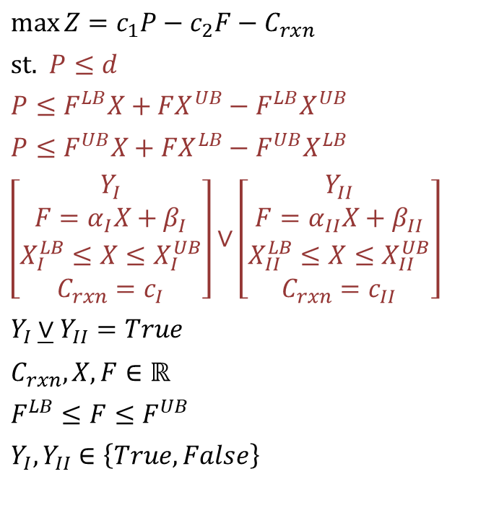
Advanced GDP Reformulations: Basic Steps
I
Basic step: intersection of disjunctions towards Disjunctive Normal Form
Tightens continuous relaxation of GDP
Optimal reactor selection example [1]
II
$$\max{Z}=c_{1}P−c_{2}F−C_{rxn}$$
$$\text{st}\text{. } P≤d$$
$$P≤F^{LB}X+FX^{UB}−F^{LB}X^{UB}$$
$$P≤F^{UB}X+FX^{LB}−F^{UB}X^{LB}$$
$$\left[\begin{aligned}Y_{I} \\ F=α_{I}X+β_{I} \\ X_{I}^{LB}≤X≤X_{I}^{UB} \\ C_{rxn}=c_{I}\end{aligned}\right]∨\left[\begin{aligned}Y_{II} \\ F=α_{II}X+β_{II} \\ X_{II}^{LB}≤X≤X_{II}^{UB} \\ C_{rxn}=c_{II}\end{aligned}\right]$$
$$Y_{I}\underline{∨}Y_{II}=True$$
$$C_{rxn},X,F∈ℝ$$
$$F^{LB}≤F≤F^{UB}$$
$$Y_{I},Y_{II}∈\left\{True, False\right\}$$
F
m.new_basic_step = apply_basic_step(
m.reactor_choice, m.max_demand,
m.mccormick[1], m.mccormick[2])
8
II
I
0
0
1
X
[1] Ruiz & Grossmann, 2010

Slide 23
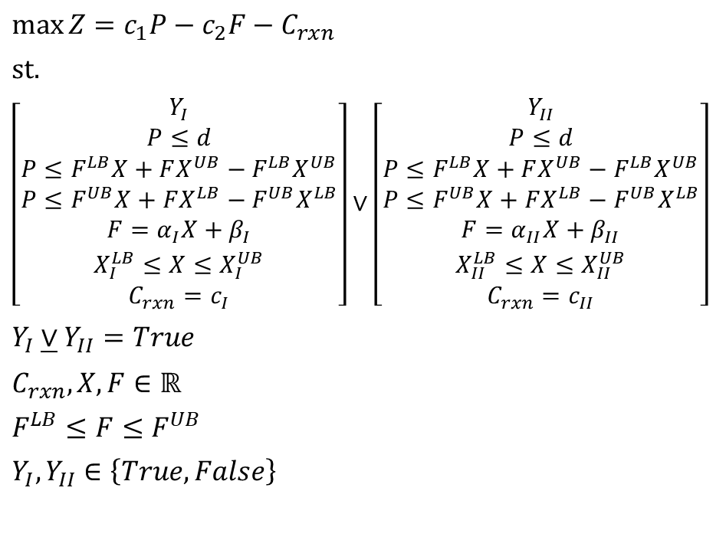
Advanced GDP Reformulations: Basic Steps
I
Basic step: intersection of disjunctions towards Disjunctive Normal Form
Tightens continuous relaxation of GDP
Optimal reactor selection example [1]
II
$$\max{Z}=c_{1}P−c_{2}F−C_{rxn}$$
$$\text{st}\text{. }$$
$$\left[\begin{aligned}Y_{I} \\ P≤d \\ P≤F^{LB}X+FX^{UB}−F^{LB}X^{UB} \\ P≤F^{UB}X+FX^{LB}−F^{UB}X^{LB} \\ F=α_{I}X+β_{I} \\ X_{I}^{LB}≤X≤X_{I}^{UB} \\ C_{rxn}=c_{I}\end{aligned}\right]∨\left[\begin{aligned}Y_{II} \\ P≤d \\ P≤F^{LB}X+FX^{UB}−F^{LB}X^{UB} \\ P≤F^{UB}X+FX^{LB}−F^{UB}X^{LB} \\ F=α_{II}X+β_{II} \\ X_{II}^{LB}≤X≤X_{II}^{UB} \\ C_{rxn}=c_{II}\end{aligned}\right]$$
$$Y_{I}\underline{∨}Y_{II}=True$$
$$C_{rxn},X,F∈ℝ$$
$$F^{LB}≤F≤F^{UB}$$
$$Y_{I},Y_{II}∈\left\{True, False\right\}$$
F
8
II
I
0
0
1
X
[1] Ruiz & Grossmann, 2010

Slide 24
Advanced GDP Reformulations: Basic Steps
I
Basic step: intersection of disjunctions towards Disjunctive Normal Form
Tightens continuous relaxation of GDP
Optimal reactor selection example [1]
II
$$\max{Z}=c_{1}P−c_{2}F−C_{rxn}$$
$$\text{st}\text{. }$$
$$\left[\begin{aligned}Y_{I} \\ P≤d \\ P≤F^{LB}X+FX^{UB}−F^{LB}X^{UB} \\ P≤F^{UB}X+FX^{LB}−F^{UB}X^{LB} \\ F=α_{I}X+β_{I} \\ X_{I}^{LB}≤X≤X_{I}^{UB} \\ C_{rxn}=c_{I}\end{aligned}\right]∨\left[\begin{aligned}Y_{II} \\ P≤d \\ P≤F^{LB}X+FX^{UB}−F^{LB}X^{UB} \\ P≤F^{UB}X+FX^{LB}−F^{UB}X^{LB} \\ F=α_{II}X+β_{II} \\ X_{II}^{LB}≤X≤X_{II}^{UB} \\ C_{rxn}=c_{II}\end{aligned}\right]$$
$$Y_{I}\underline{∨}Y_{II}=True$$
$$C_{rxn},X,F∈ℝ$$
$$F^{LB}≤F≤F^{UB}$$
$$Y_{I},Y_{II}∈\left\{True, False\right\}$$
F
8
II
I
Relaxation
(Basic Steps)
0
0
1
X
Relaxed objective with basic step=1.10
[1] Ruiz & Grossmann, 2010

Slide 25
Advanced GDP Reformulations: Basic Steps
I
Basic step: intersection of disjunctions towards Disjunctive Normal Form
Tightens continuous relaxation of GDP
Optimal reactor selection example [1]
II
F
Relaxation
(No Basic Steps)
Applying basic steps prior to the discrete relaxation
leads to a tighter relaxed feasible region
8
Relaxed objective
No basic step: 1.48
Basic step: 1.1
Real optimum: 1.01
Actual
Feasible
Region
0
0
1
X
Relaxation
(Basic Steps)
[1] Ruiz & Grossmann, 2010

Slide 26
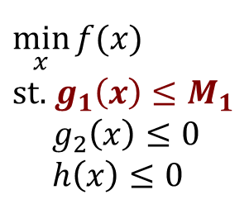
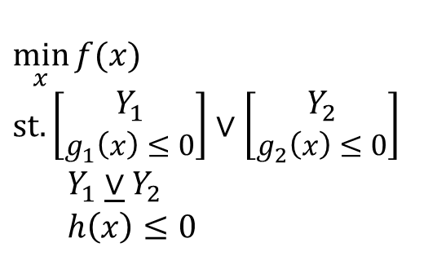

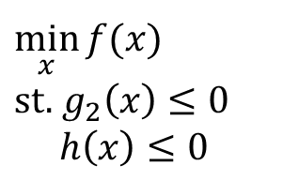
GDPopt: Direct logic-based solver
GDP model
Model transformation
(3) | specify logical realization
Information transfer
(1) initialize
(4) fix disjuncts
$$\min_{x}{f(x)}$$
$$\text{st}\text{.} \left[\begin{aligned}Y_{1} \\ g_{1}\left(x\right)≤0\end{aligned}\right]∨\left[\begin{aligned}Y_{2} \\ g_{2}\left(x\right)≤0\end{aligned}\right]$$
$Y_{1}\underline{∨}Y_{2}$
$h\left(x\right)≤0$
Linear GDP
(2)
BM/HR
MILP master
Reduced NLP sub-problem
(5) OA cut
GDPopt implements logic-based outer approximation (LOA) [1]
GDPopt exploits special model structure
NLP solution in reduced space
Flexible implementation
Automatic set-covering initialization
Support for callbacks
MINLP subproblem
GDPopt subproblem
$$\min_{x}{f(x)}$$
$$\text{st}\text{.} g_{1}\left(x\right)≤M_{1}$$
$g_{2}\left(x\right)≤0$
$h\left(x\right)≤0$
$$\min_{x}{f(x)}$$
$$\text{st}\text{.} g_{2}\left(x\right)≤0$$
$h\left(x\right)≤0$
Avoids $g_{1}\left(x\right)$ computation
How to use:
SolverFactory(‘gdpopt’).solve(model)
[1] Turkay & Grossmann, 1996

Slide 27
Case studies: Advanced Reformulations
Problem | Method | # vars | # constraints | Continuous Relaxation
8PP | HR | 84 | 196 | 67.40
8PP | Hybrid HR/BM | 37 | 84 | -140.29
8PP | BM | 37 | 83 | -435.40
ConsLayout | HR | 91 | 193 | 11,969
ConsLayout | Hybrid HR/BM | 31 | 57 | 1,350
ConsLayout | BM | 31 | 55 | 1,350
HENS | HR | 5719 | 7369 | 18,822
HENS | Hybrid HR/BM | 1031 | 1699 | 8,000
HENS | BM | 1031 | 1699 | 8,000

Slide 28
Case studies: GDPopt
Size
GDPopt
DICOPT + big-M
Problem | # vars | # constr | # disjtns | Solution | Time (s) | Solution | Time (s)
8PP | 38 | 52 | 5 | 68 | <1 | 68 | <1
ConsLayout | 24 | 48 | 6 | 41,710 | 6 | 41,573 | 2
HENS 1 | 208 | 250 | 32 | 112,223 | 3 | 108,767 | <1
HENS 2 | 3160 | 8326 | 33 | 513,937 | 395 | No solution
HENS 3 | 1024 | 1486 | 32 | 350,037 | 45 | No solution
HENS 4 | 132 | 334 | 44 | 190,281 | 14 | No solution
HENS 5 | 924 | 2122 | 44 | 112,034 | 145 | No solution
Notes:
HENS 1: conventional; HENS 2: single module discrete; HENS 3: multiple module discrete; HENS 4: optional module integer; HENS 5: optional module discrete

Slide 29
Summary
GDP gives logical framework to systematically approach discrete-continuous optimization problems
Pyomo.GDP offers first-class modeling language support for GDP models
Customizable: open-source, full access to modeling components within code
Ease-of-use: automatic reformulations from GDP to MILP/MINLP
Automated: computes big-M values for linear constraints automatically
New advanced capabilities:
Cutting-plane hybrid BM/HR reformulation
GDP basic step reformulation
GDPopt logic-based outer approximation solver

Slide 30

Thank you
Pyomo installation instructions:
Install python
Install Pyomo
pip install pyomo
pip install --user pyomo (No admin access)
pip install --upgrade pyomo (get the latest Pyomo release)
Install solvers
Get started:
from pyomo.environ import *
model = ConcreteModel()
SolverFactory(‘gdpopt’).solve(model, tee=True)
Open invite to students:
Collaborate on GDPopt enhancements
How to get GDPopt:
Pyomo version 5.4.3+? You already have it.
For help:
Github, StackOverflow
Disclaimer This presentation was prepared as an account of work sponsored by an agency of the United States Government. Neither the United States Government nor any agency thereof, nor any of their employees, makes any warranty, express or implied, or assumes any legal liability or responsibility for the accuracy, completeness, or usefulness of any information, apparatus, product, or process disclosed, or represents that its use would not infringe privately owned rights. Reference herein to any specific commercial product, process, or service by trade name, trademark, manufacturer, or otherwise does not necessarily constitute or imply its endorsement, recommendation, or favoring by the United States Government or any agency thereof. The views and opinions of authors expressed herein do not necessarily state or reflect those of the United States Government or any agency thereof.

Slide 31
Transformations: extending beyond Math Programming
Transformations map one model representation to another
Separate expression of a model from solution of the model
Defer decisions intended to improve tractability or reduce error until solution time
Support solver-specific customizations
Easily explore alternate model formulations
Automation eliminates transcription errors
Model transformations are key to Pyomo's extensibility
Open object model facilitates adding constructs that cannot be sent to standard optimization solvers
Transformations map new constructs into forms recognized by solvers
Transformations key to IDAES capabilities
Disjunctive programming
Dynamic systems
Model
+
Data
Compile
Problem
Transform
Solve

Slide 32

Disjunctive programming
Disjunctions: selectively enforce sets of constraints
Sequencing decisions: x ends before y or y ends before x
Switching decisions: a process unit is built or not
Alternative selection: selecting from a set of pricing policies
Disjunctions enforces a logical XOR(*) relationship
Additional logical constraints on the indicator variables
$$\bigvee_{i∈D_{k}}{\left[\begin{matrix}Y_{ik} \\ h_{ik}\left(x\right)≤0 \\ c_{k}=γ_{ik}\end{matrix}\right]}$$
$$Ω\left(Y\right)=True$$
Boolean "indicator variable"
Constraints enforced when indicator variable is True
Parameter values set when the indicator variable is True
* Strictly speaking, this is an OR and the XOR is enforced by $Ω\left(x\right)=True$, but in every model we have done, the effective relationship is an XOR

Slide 33
Pyomo: More than just mathematical modeling
Scripting
Construct models using native Python data
Iterative analysis of models leveraging Python functionality
Data analysis and visualization of optimization results
Model transformations (a.k.a. reformulations)
Automate generation of one model from another
Dynamic model → discretized model
Logic model → optimization model
Leverage Pyomo’s object model to apply transformations sequentially
Meta-solvers
Integrate scripting and/or transformations into optimization solver
Leverage power of Python to build “generic” capabilities
Progressive hedging, Benders' decomposition (stochastic programming decomposition)
GDPopt (logic-based outer approximation for disjunctive models)
Mindpy (Mixed-integer nonlinear programming)

Slide 34
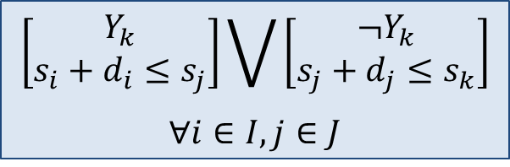
Disjunctive programming enables Conceptual Design
Pyomo's pyomo.gdp package supports expressing Disjunctions:
@model.Disjunction(model.I, model.J)
def SequenceIJ(m, i, j):
return [ m.start[i] + duration[i] <= m.start[j], m.start[j] + duration[j] <= m.start[i] ]
Standard reformulations (automatically) convert models to solvable forms
Big-M reformulation
Convex hull reformulation
General implementations of improved problem reformulations
Cutting planes-based algorithms for strengthening Big-M reformulations
Basic steps-based algorithms for generating tighter relaxations
Disjunction-aware solvers
Logic-based outer approximation (GDPopt)
$$\left[\begin{matrix}Y_{k} \\ s_{i}+d_{i}≤s_{j}\end{matrix}\right]\bigvee{\left[\begin{matrix}¬Y_{k} \\ s_{j}+d_{j}≤s_{k}\end{matrix}\right]}$$
$$∀i∈I, j∈J$$

Slide 35
Advanced GDP Reformulations: Basic Steps
m = ConcreteModel()
m.F = Var(bounds=(0, 8), doc="Flow into reactor")
m.X = Var(bounds=(0, 1), doc="Reactor conversion")
m.d = Param(initialize=2, doc="Max product demand")
m.c = Param([1, 2, 'I', 'II'], doc="Costs", initialize={
1: 2, # Value of product
2: 0.2, # Cost of raw material
'I': 2.5, # Cost of reactor I
'II': 1.5 # Cost of reactor II
})
m.alpha = Param(['I', 'II'], doc="Reactor coefficient",
initialize={'I': -8, 'II': -10})
m.beta = Param(['I', 'II'], doc="Reactor coefficient",
initialize={'I': 9, 'II': 15})
m.X_LB = Param(['I', 'II'], doc="Reactor conversion lower bound",
initialize={'I': 0.2, 'II': 0.7})
m.X_UB = Param(['I', 'II'], doc="Reactor conversion upper bound",
initialize={'I': 0.95, 'II': 0.99})
m.C_rxn = Var(bounds=(1.5, 2.5), doc="Cost of reactor")
m.max_demand = Constraint(expr=m.F * m.X <= m.d, doc="product demand")
m.reactor_choice = Disjunction(expr=[
# Disjunct 1: Choose reactor I
[m.F == m.alpha['I'] * m.X + m.beta['I'],
m.X_LB['I'] <= m.X,
m.X <= m.X_UB['I'],
m.C_rxn == m.c['I']],
# Disjunct 2: Choose reactor II
[m.F == m.alpha['II'] * m.X + m.beta['II'],
m.X_LB['II'] <= m.X,
m.X <= m.X_UB['II'],
m.C_rxn == m.c['II']]
], xor=True)
m.profit = Objective(
expr=m.c[1] * m.F * m.X - m.c[2] * m.F - m.C_rxn, sense=maximize)
I
II
$$\max{Z}=c_{1}FX−c_{2}F−C_{rxn}$$
$$\text{st}\text{. } FX≤d$$
$$\left[\begin{aligned}Y_{I} \\ F=α_{I}X+β_{I} \\ X_{I}^{LB}≤X≤X_{I}^{UB} \\ C_{rxn}=c_{I}\end{aligned}\right]∨\left[\begin{aligned}Y_{II} \\ F=α_{II}X+β_{II} \\ X_{II}^{LB}≤X≤X_{II}^{UB} \\ C_{rxn}=c_{II}\end{aligned}\right]$$
$$Y_{I}\underline{∨}Y_{II}=True$$
$$C_{rxn},X,F∈ℝ$$
$$F^{LB}≤F≤F^{UB}$$
$$Y_{I},Y_{II}∈\left\{True, False\right\}$$
[1] Lee & Grossmann, 2003

Slide 36


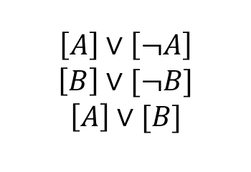


Advanced GDP Reformulations: Basic Steps
Basic step: intersection of disjunctions towards Disjunctive Normal Form
Tightens continuous relaxation of GDP
$$¬A$$
$$A$$
$$¬B$$
$$B$$
$$\left[A\right]∨\left[¬A\right]$$
$$\left[B\right]∨[¬B]$$
$$\left[A\right]∨[B]$$

Slide 37

Advanced GDP Reformulations: Basic Steps
Basic step: intersection of disjunctions towards Disjunctive Normal Form
Tightens continuous relaxation of GDP
$$¬A$$
$$A$$
$$¬B$$
$$B$$
$$\left[A\right]∨\left[¬A\right]$$
$$\left[B\right]∨[¬B]$$
$$\left[A\right]∨[B]$$
$$\left[A∧¬B\right]∨\left[B∧¬A\right]$$

Slide 38
Advanced GDP Reformulations: Basic Steps
Basic step: intersection of disjunctions towards Disjunctive Normal Form
Tightens continuous relaxation of GDP
$$¬A$$
$$A$$
$$¬B$$
$$B$$
$$\left[A\right]∨\left[¬A\right]$$
$$\left[B\right]∨[¬B]$$
$$\left[A\right]∨[B]$$
$$\left[A∧¬B\right]∨\left[B∧¬A\right]$$

Slide 39
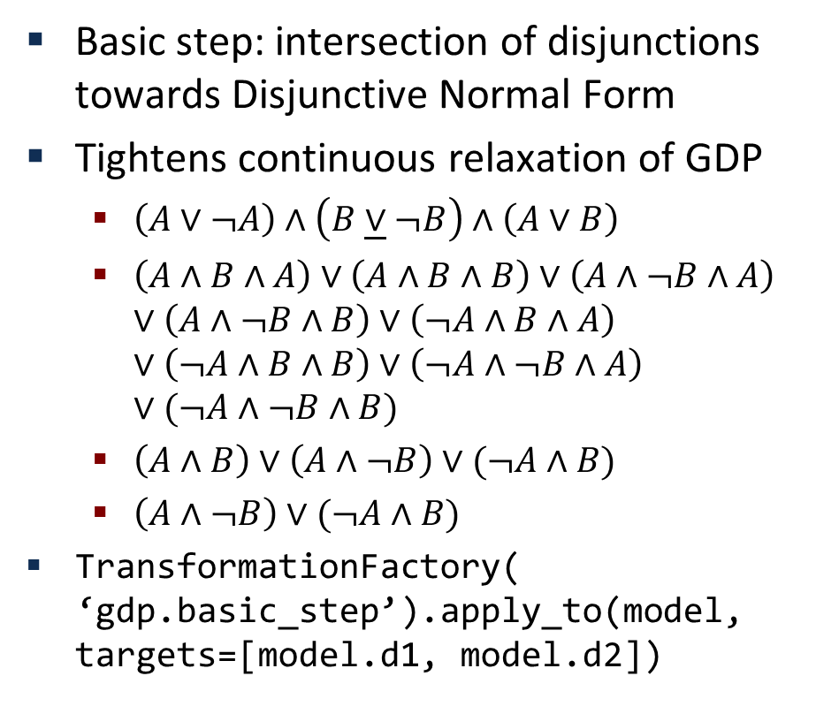
Advanced GDP Reformulations: Basic Steps
Basic step: intersection of disjunctions towards Disjunctive Normal Form
Tightens continuous relaxation of GDP
$\left(A∨¬A\right)∧\left(B\underline{∨}¬B\right)∧\left(A∨B\right)$
$\left(A∧B∧A\right)∨\left(A∧B∧B\right)∨\left(A∧¬B∧A\right)$ $∨\left(A∧¬B∧B\right)∨\left(¬A∧B∧A\right)$ $∨\left(¬A∧B∧B\right)∨\left(¬A∧¬B∧A\right)$ $∨(¬A∧¬B∧B)$
$\left(A∧B\right)∨\left(A∧¬B\right)∨(¬A∧B)$
$\left(A∧¬B\right)∨(¬A∧B)$
TransformationFactory( ‘gdp.basic_step’).apply_to(model, targets=[model.d1, model.d2])
$$¬A$$
$$A$$
$$¬B$$
$$B$$
$$\left[A\right]∨\left[¬A\right]$$
$$\left[B\right]∨[¬B]$$
$$\left[A\right]∨[B]$$
$$\left[A∧¬B\right]∨\left[B∧¬A\right]$$

