Slide 1
Internship Experience and Machine Learning Applications in Biomedical Engineering
Jeremiah Simmons

Slide 2
Outline
About me
Experiences
Machine Learning
Pattern Recognition
Application

Slide 3
A little about who I am
Junior here at APSU
Extracurricular: ROTC and Fiji
Research: Recently joined the FSW team

Slide 4
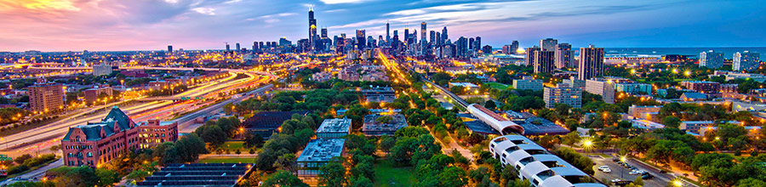
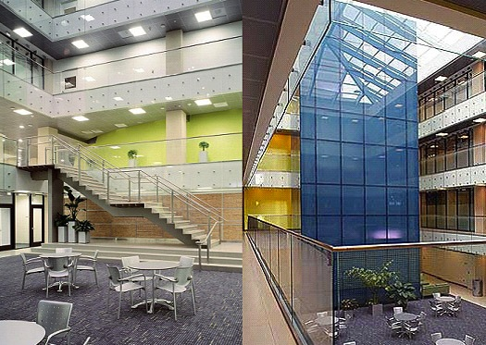

Where I Went: Illinois Institute of Technology

Slide 5


Experiences in Chicago

Slide 6
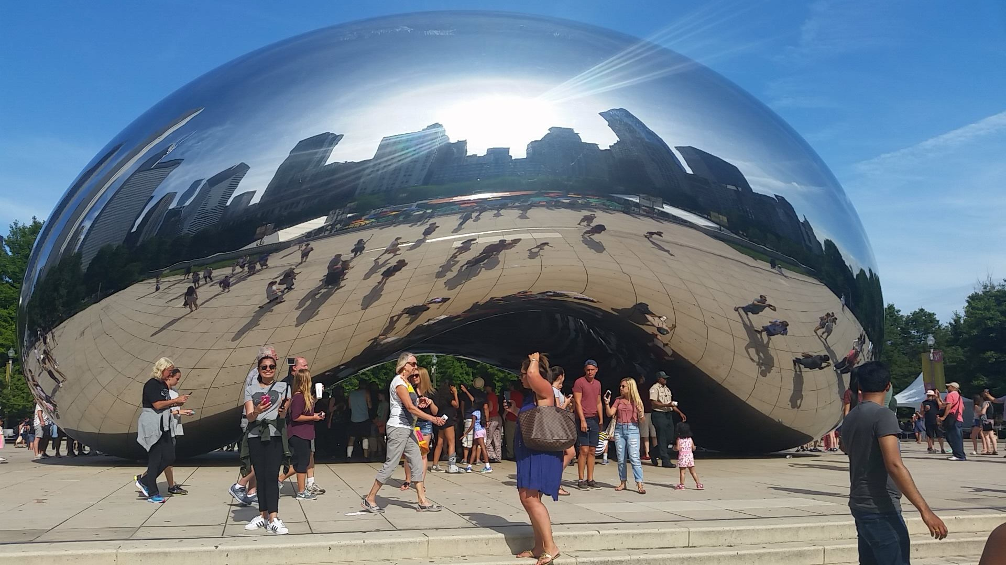


Slide 7
Other things I experienced
White Sox Games
Field Museum
The Art Institute of Chicago
Museum of Science and Industry
Met a lot of different people

Slide 8
What is Machine Learning
It is a type of artificial intelligence that provides computers with the ability to learn without being explicitly programmed. Focuses on the development of computer programs that can teach themselves to grow and/or change when exposed to new data.
What is Pattern Recognition
Similar and almost synonymous with machine learning; it is, in actuality, a branch of machine learning that focuses on patterns and regularities of data.

Slide 9
Methods – Pattern Recognition
Vocabulary
Principal Component Analysis
Linear Discriminant Analysis

Slide 10
Vocabulary
A feature vector is an n-dimensional vector of numerical features that represent some object
Variance, informally, measures how far a set of numbers are spread out from their mean.
A class is, for example, an instance, object type, or specific event. Usually labeled as a numerical integer: 0, 1, etc. But, sometimes a string name is used.
Classifier refers to a program we will “train” to define a decision boundary using pattern analysis with a training set of test data that holds statistical significance. This classifier should be able to accept new data and apply the previously found decision boundary to assign a class label to that new data.

Slide 11
Example
Class Label | Height (inches) | Weight (lbs)
Male (Ricky) | 71 | 240
Male (Jake) | 76 | 190
Male (Anthony) | 69 | 210
Male (Jacob) | 69 | 130

Slide 12
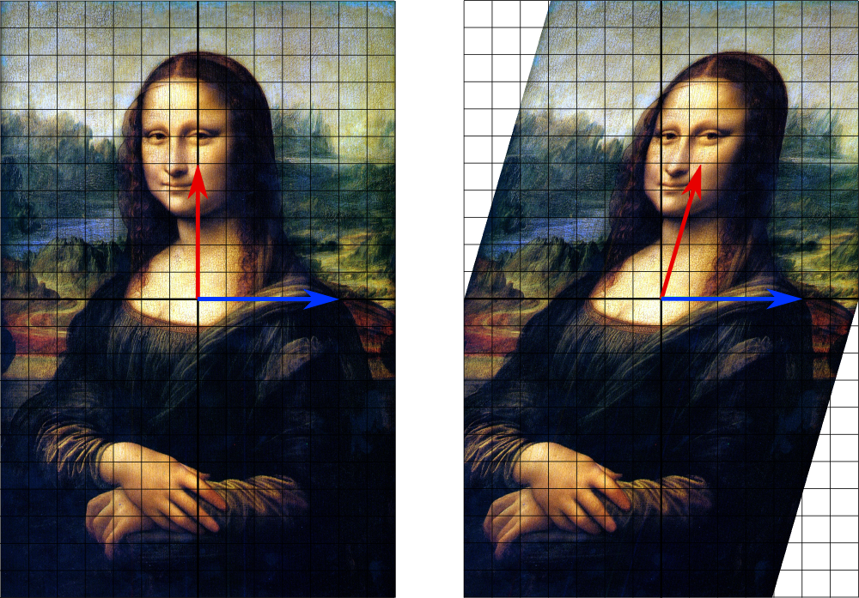
Vocab Cont.
Eigenvector or characteristic vector does not change directions when a linear transformation is applied. Geometrically an eigenvector, corresponding to a real nonzero eigenvalue, points in a direction that is stretched by the transformation.
Eigenvalue: A scalar number associated with an specific eigenvector, and determines how much a transformation stretches or scales an eigenvector. Can be zero.
Wikipedia

Slide 13
Principle Component Analysis
The goal is to find dimensions that are shared across all features vectors that contain good, representative data for the whole training set. Essentially PCA will reduce the data down to a smaller amount of dimensions while losing little to no statistical significance within the set.
Redundant data
Invariances

Slide 14
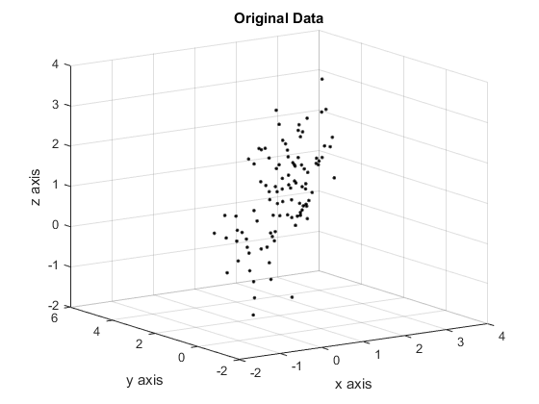

Slide 15
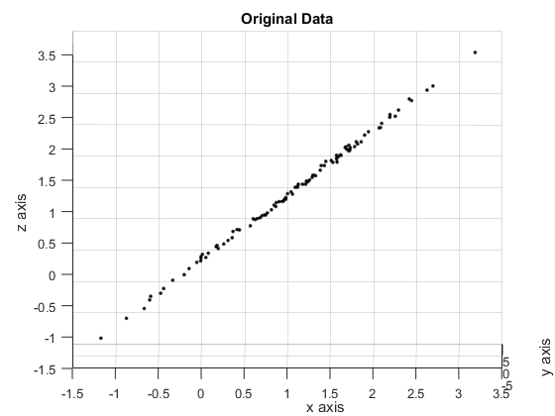

Slide 16
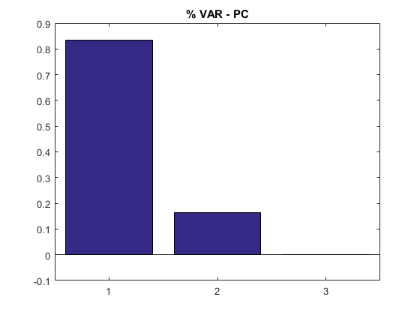

Slide 17
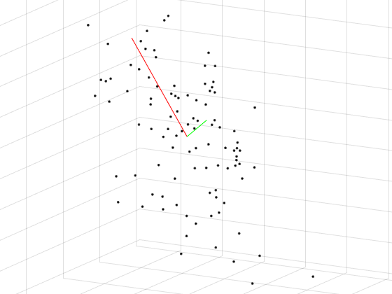

Slide 18
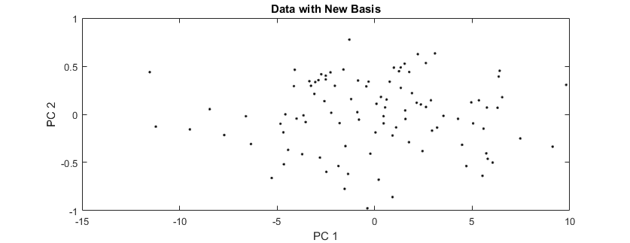

Slide 19
Linear Discriminant Analysis
A method used to find a linear combination of features that characterizes or separates two or more multivariate classes
LDA is a generalized version of Fisher’s linear discriminate analysis.
LDA or FDA work best with classes that are multivariate and have Gaussian distribution (normal distribution).
FLD video

Slide 20
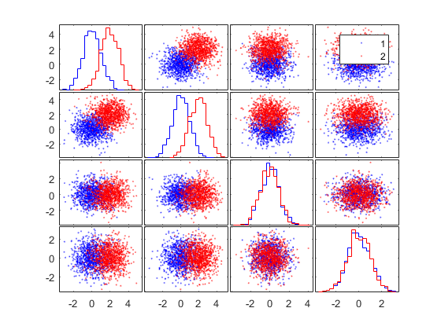

Slide 21
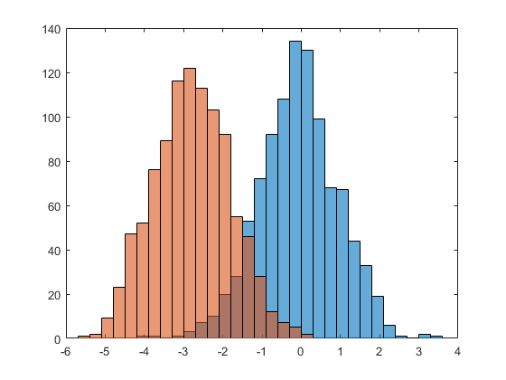

Slide 22
Applications of PCA and FDA/LDA
Scenario
What is a PET Scan
Training a Classifier
Performance (Confusion) Matrices
Training Methods

Slide 23
Scenario
We want to build a classifier that will classify between normal (NL) and Alzheimer’s Disease (AD) via PET (Positron Emission Tomography) scans.
AD is a serious disease that results in loss of memory, and major changes in speaking, personality, and ability to function generally.
Imagine we have either been given scans from a database with correct diagnosis or have conducted our own studies in conjunction with a local hospital beforehand.

Slide 24
What is a PET Scan
A PET scan measures glucose metabolism (utilization of sugar) within the brain. In AD patients, key brain regions stop function normally, and stop consuming resources at the normal rate.
Key brain areas are usually within the following three lobes: parietal, temporal, and frontal.
A full scan creates images of individual slices along the brain. These slices combine to create a false 3d image of the patient’s brain.

Slide 25
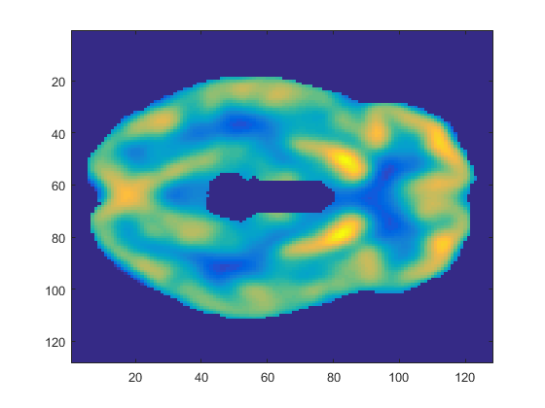
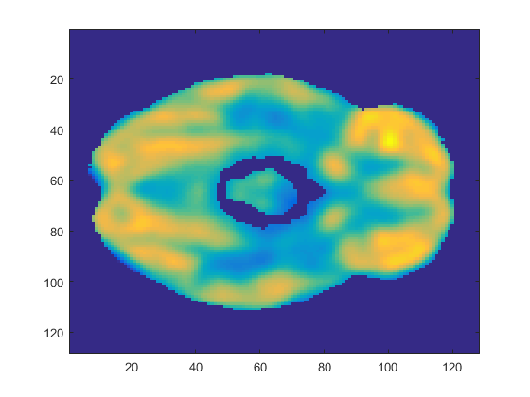
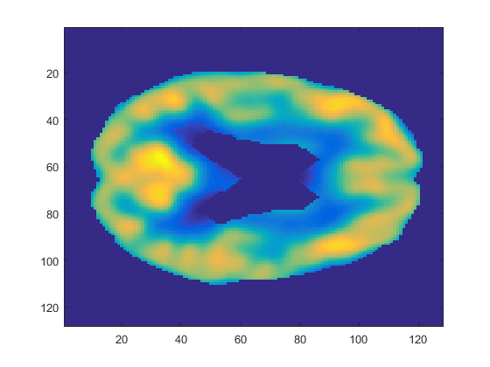
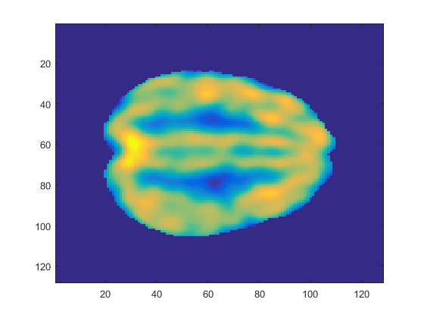
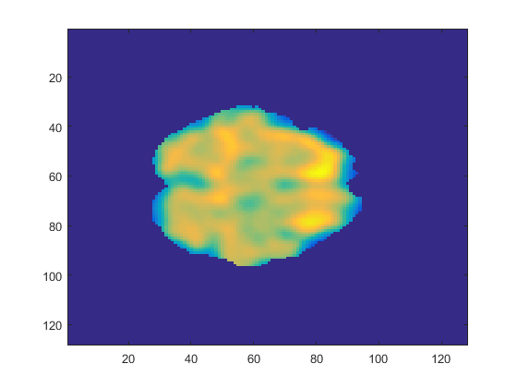
31 48
No Alzheimer’s
67 78

Slide 26
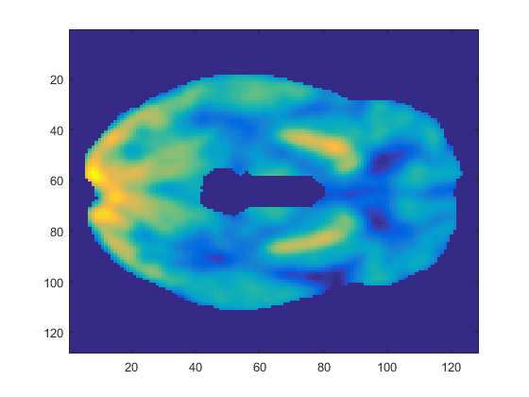
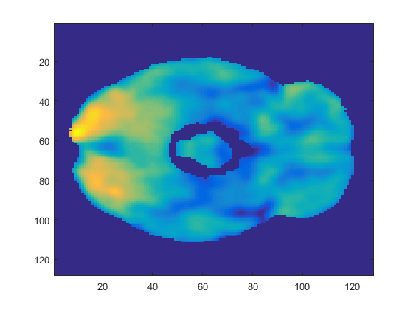
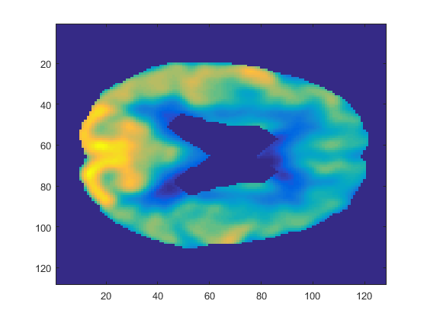
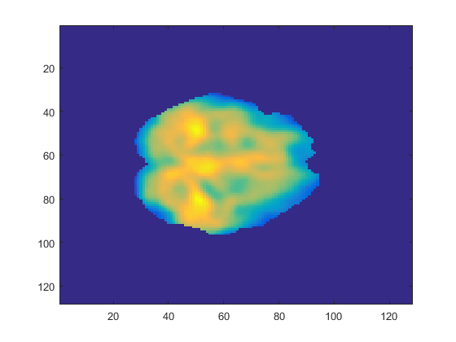
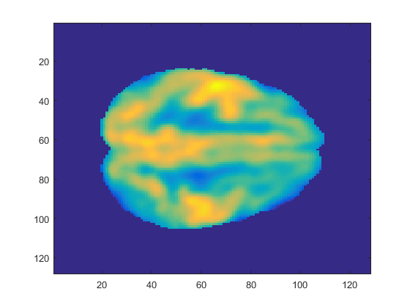
31 48
Alzheimer’s
67 78

Slide 27
Training a Classifier
PCA
LDA

Slide 28
PCA
Image a single scan, what are the images made of?
Pixels.
How is a pixel color determined?
By a numerical value, whether it be hexadecimal, decimal, or some other base-n system.
A single slice image in our training set is 128 by 128 pixels. And there are 91 total slices.
We use PCA to eliminate all redundant and invariant pixel values.

Slide 29
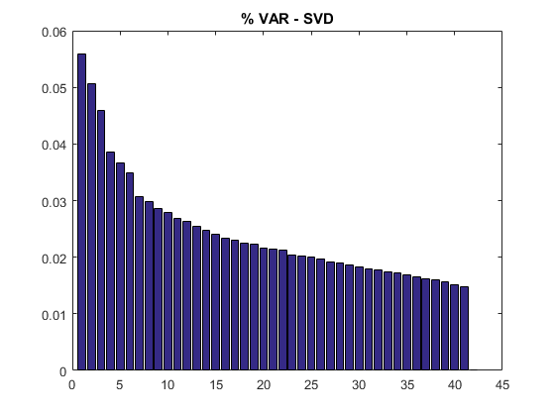

Slide 30
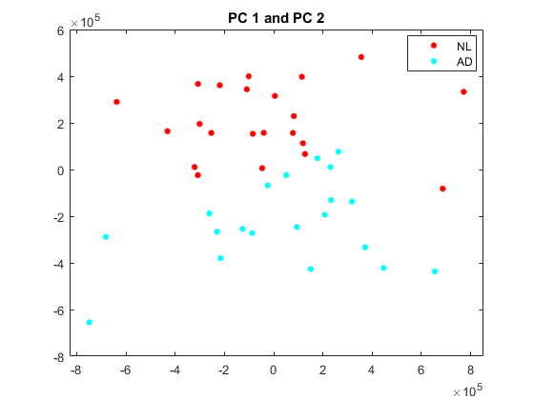
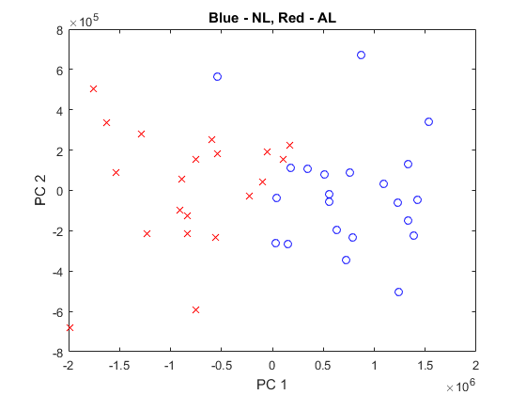

Slide 31
LDA
From looking at two of the dimensions in the PC modified-data it is clear that there may be some linear separation within the training set.

Slide 32
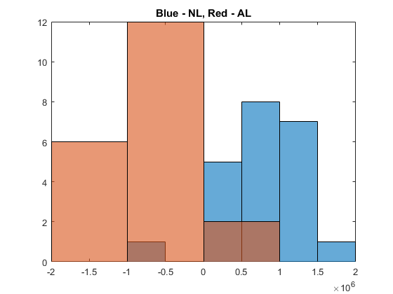

Slide 33
Discriminant Vector
After applying discriminant analysis, we can define a decision boundary or discriminant vector.
We then work backwards from the simplified vector and convert it back into a usable PET-like scan.

Slide 34
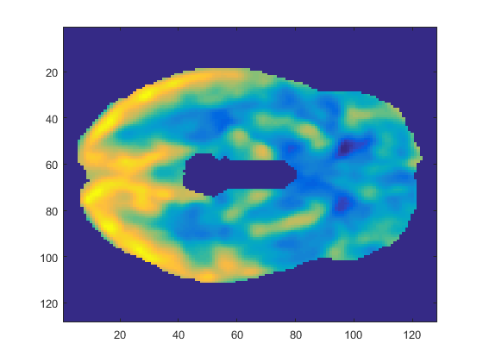
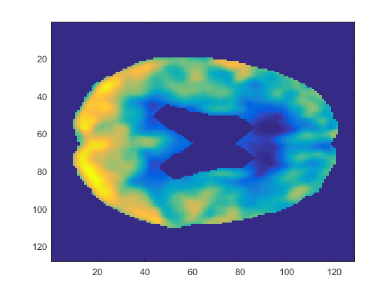
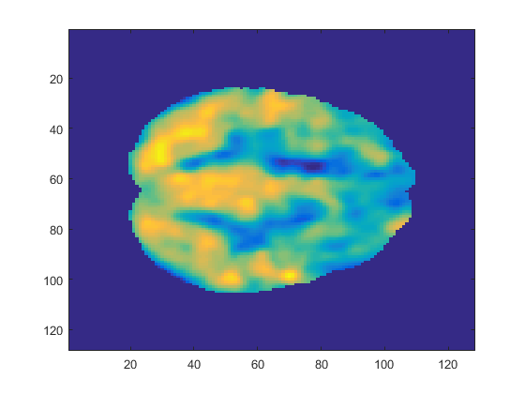
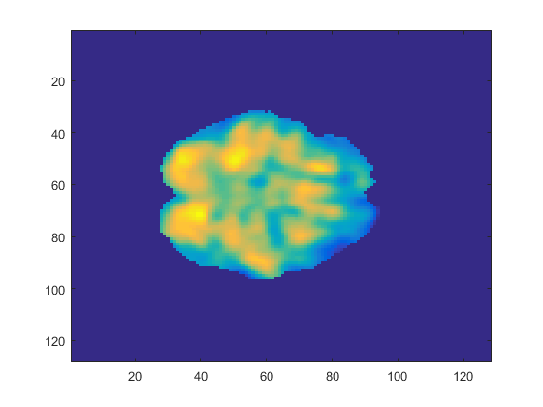
31 48
67 78

Slide 35
Performance (Confusion) Matrices
This allows you to determine the performance of your training set and classifier.
TP = True Positive
TN = True Negative
FP = False Positive
FN = False Negative
TP | FN
FP | TN

Slide 36
Other Methods
Cluster Analysis
Convex Analysis (also known as a Support Vector Machine (SVM))
Bayesian Decision Models
Neural Networks

Slide 37
Questions?

