Slide 1

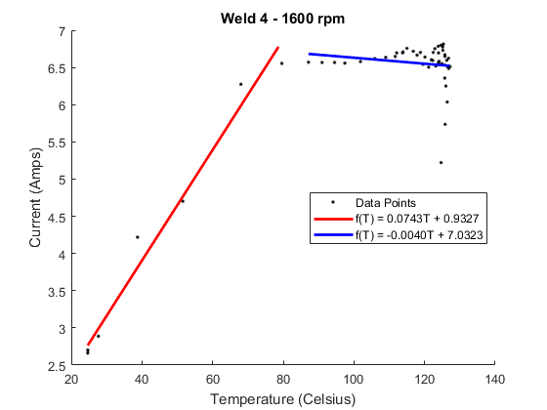
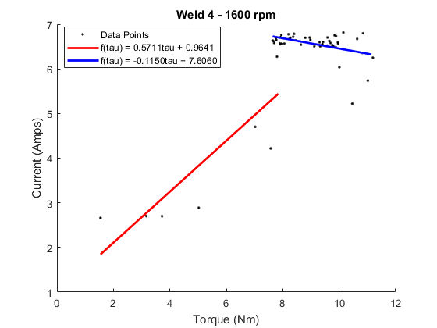
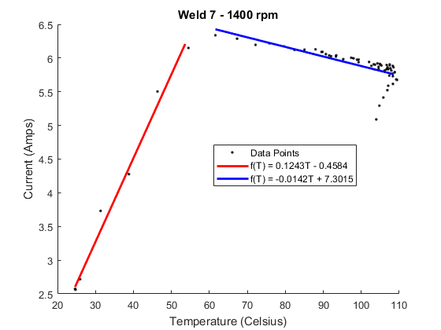
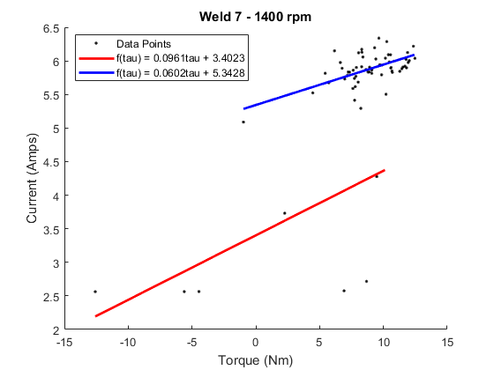
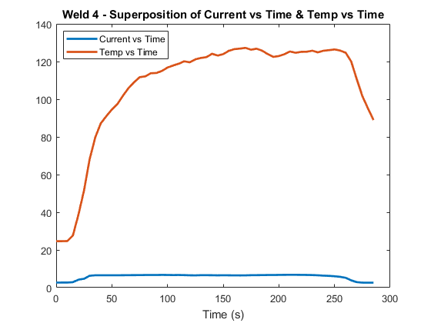
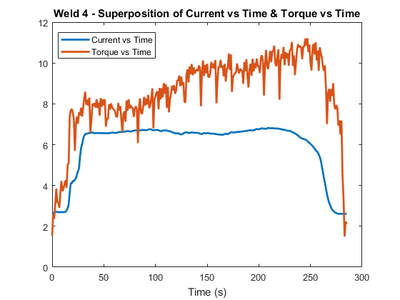
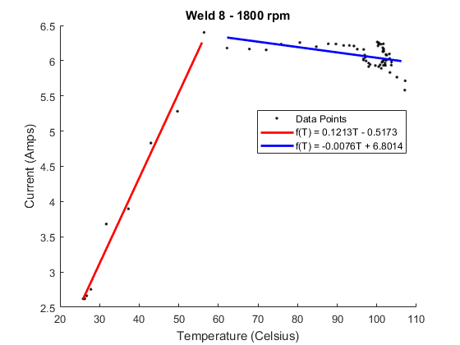
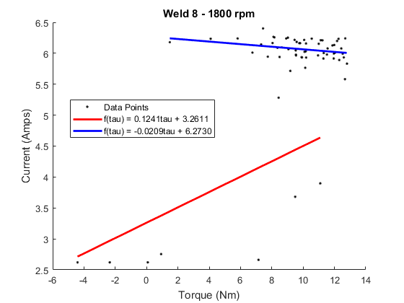
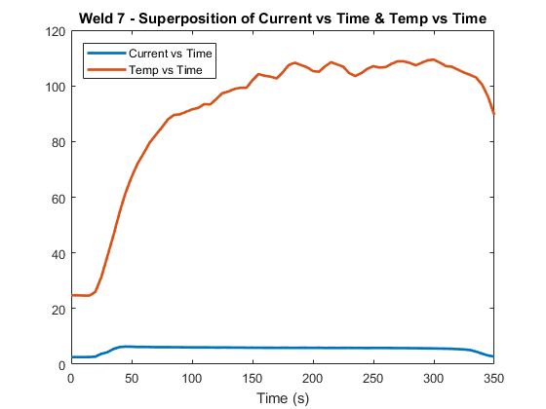
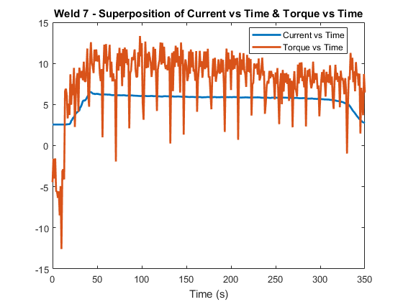
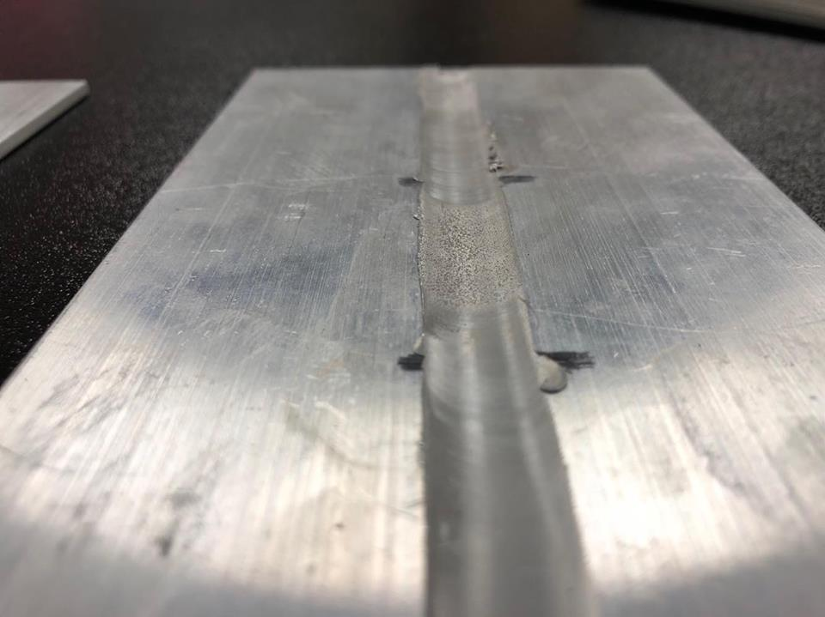
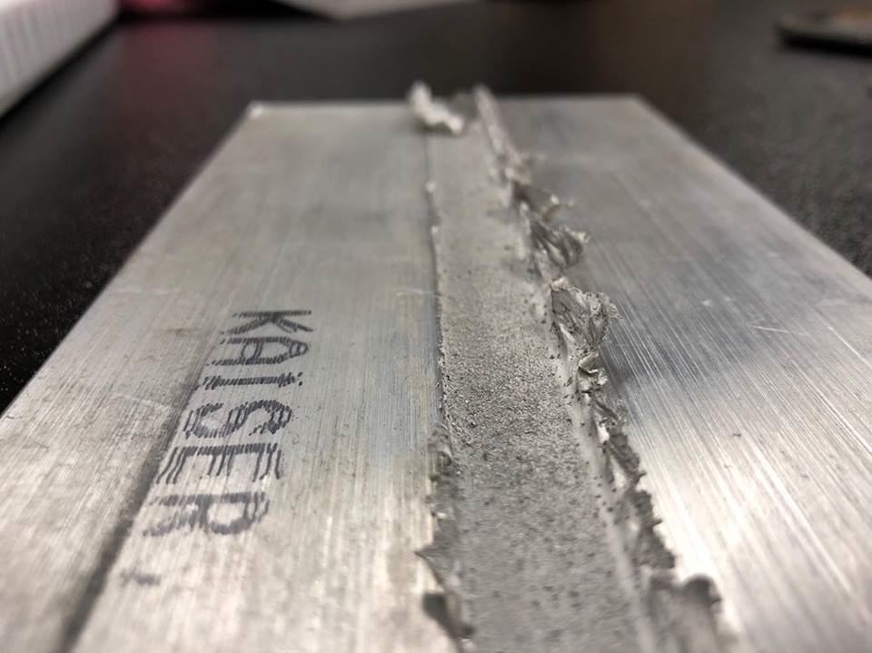
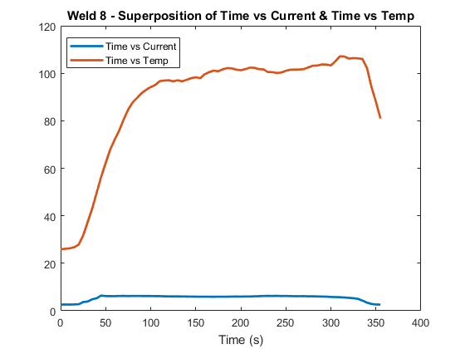
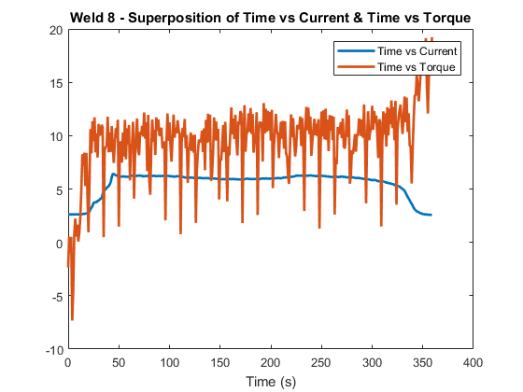
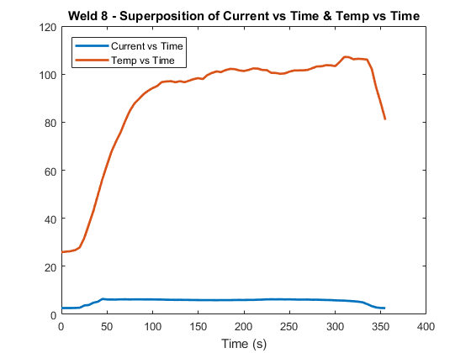
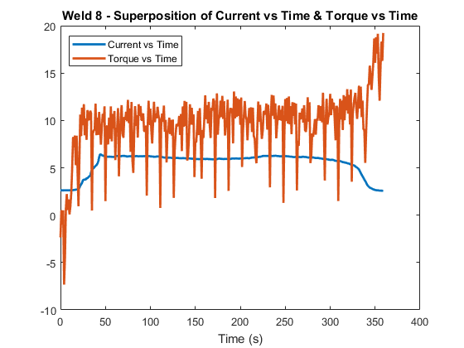
Linear Dependencies in Friction Stir Welding Conditions
Jeremiah Simmons, Dr. William R Longhurst
Department of Physics and Astronomy, Austin Peay State University, Clarksville, TN
ABSTRACT
CURRENT WORK
CONCLUSIONS
Friction stir welding is a solid-state process that joins materials using heat generation to soften the material to a state of plasticization, and mechanically inter-mixing the materials. The process generates a lower threshold of heat across the weld, therefore attaining a stronger weld through plasticizing rather than melting the materials together. In this study we observed conditions during the welding process including: position, heat distribution, current input, and torque across the tool. Three specific revolutions per minute (rpm) of the tool were observed: 1400, 1600, and 1800 rpm. Linear relationships were identified and analyzed between torque and current input, as well as heat distribution and current input. Post-weld analysis revealed linear slopes as small as |0.0209| Amps per Newton meters across the duration of the weld for torque-current relationships, and as small as |.0040| Amps per degree Celsius for the duration of the weld for heat-current relationships. These linear strategies could be effective control methods for future welds to procedurally detect the creation of weld defects.
Data was collected across multiple features of the weld to find relationships. Torque was acquired using a strain gauge attached to the tool. A thermocouple was also attached to retrieve thermal data. Position was tracked using potentiometers. Current input into the friction stir welding machine was also collected. So far three specific rpms have been observed: 1400, 1600, and 1800 rpms. As shown in the graphs below there are strong linear relationships observed between current and heat, as well as current and torque.
The important take away from these linear fits allows us to look at current to determine changes in the welding process. Most evident is the clear divide between tool plunge and weld data regions (See Current vs Temp & Current vs Torque graphs for all welds). This data can be used to train classifiers and determine discriminant vectors to procedurally identify points of transition in the welding process. More welds will reveal further patterns. For now it is unclear if the thermal, torque, or current data will reveal procedurally occurring points of flash along the weld. But, we can clearly observe the transition from tool plunge into full material immersion.
FUTURE WORK
Future work will focus on four specific areas:
Collecting more welding data.
Continue looking for patterns in the data to identify flash occurring during the weld (aside from the visual evidence).
Train classifiers that will label transitions (both stage transitions, and defect creation).
Build a system to procedural correct tool bit position, rpm, and transverse speed along the joint to avoid or fix defects during the weld
INTRODUCTION
Friction stir welding is based on the concept of tightly pressing a rotating tool onto the joint of different pieces of material. This generates heat due to friction between the surface of the tool, and the surface of the parent material. The parent material ideally plasticizes rather than melts to bind the joint to create a stronger weld than traditional welding practices. There is an inherent disadvantage to friction stir welding. It generally requires very large machinery to stabilize the materials against a back plate, to drive the tool into the materials, and withstand the torque exerted on the tool itself during the weld.
Defects may include voids, or flashing. X-ray or ultrasonic testing are commonly used to find voids or insufficient bonding depth into the joint. In previous work done at Austin Peay State University, voids caused by the welding process was examined. During normal welding conditions the frequency content showed a component around 14 Hz; however, when the tool encountered a void the 14 Hz component disappeared and the component in 1-4 Hz range increased.[1]
Another weld defect, flashing, is described by excess material being shoved up and away from the weld joint. Flashing, although the weld may still be within tolerance for adequate weld strength, causes the weld to be visually unacceptable and creates a safety hazard. Flashing must be milled or grinded off, post-weld, therefore taking time.
The figures above show data and conclusions drawn from the 4th weld. Top left shows current input as a function of temperature for both tool plunge (red) and the duration of the weld (blue). Top right is the same concept as before, but current as a function of torque. Bottom left and right graphs show raw data for heat and torque over time (respectfully) superimposed over current input as a function of time.
The figures above show data and conclusions drawn from the 7th weld. Top left shows current input as a function of temperature for both tool plunge (red) and the duration of the weld (blue). Top right is the same concept as before, but current as a function of torque. Bottom left and right graphs show raw data for heat and torque over time (respectfully) superimposed over current input as a function of time.
The figures above show data and conclusions drawn from the 8th weld. Top left shows current input as a function of temperature for both tool plunge (red) and the duration of the weld (blue). Top right is the same concept as before, but current as a function of torque. Bottom left and right graphs show raw data for heat and torque over time (respectfully) superimposed over current input as a function of time.
ACKNOWLEDGEMENTS
Top left image is a weld with very little flashing that occurred during the weld. Top right image is a weld with sever flashing occurring.
Thanks to Isaac C Wilbur, Brandon E. Osborn, Thomas Ruland, Bryan Gaither for their previous research with Dr. William R Longhurst on void detection in friction stir welding.
REFERENCES
[1] Longhurst, W, et al. Process Monitoring of Friction Stir Welding via The Frequency of the Spindle Motor Current. The Proceedings of the Institution of Mechanical Engineers Part B. Journal of Engineering Manufacture.

