Slide 1

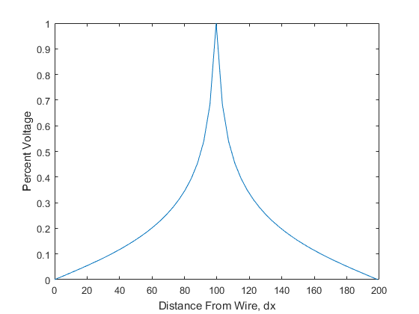
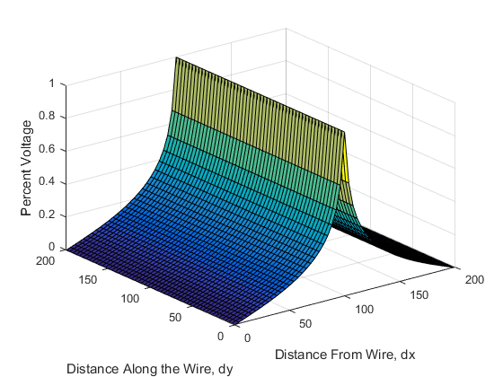
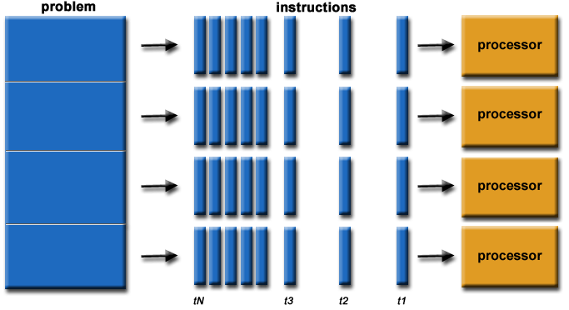
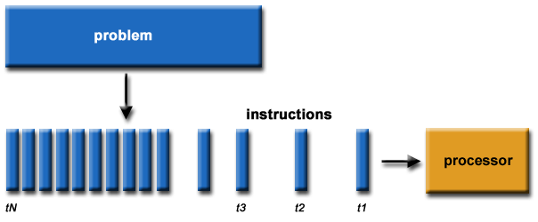
Parallelizing for Improved Optimization in
Computational Methods with Voltage Maps
Jeremiah Simmons (jsimmons22@my.apsu.edu)
Department of Physics and Astronomy, Austin Peay State University, Clarksville, TN
ABSTRACT
OPTIMIZATION METHODS
RESULTS
This poster presents an argument for why there is a continuing need to increase optimization in code to achieve faster execution times. The Gaussian elimination algorithm provides a benchmark for cycle time to be measured, and compared. Both sequential serial processing and a shared memory environment, using the OpenMP library, are applied to elimination in order to model a voltage map for a section of hanging power line. Linear systems in electricity and magnetism have been studied significantly for many years and the purpose of this poster is not to provide mathematical proofs of elimination; rather explore the efficiency of augmenting fixed CPU clock speed by implementing multiple CPU cores. Sequential serial computing is significantly slower than shared memory environment processing, by as much as 28.27 seconds .
The majority of the computational complexity when solving for the voltage map is found in the elimination after pivoting has been completed for a column. An C/C++ style example of initializing the parallel designated blocks with declarative statements, given by the OpenMp library, would look like the following:
xmult -> double
For pivot = 1:n - 1
#pragma omp parallel for private(xmult) schedule(runtime)
for i = pivot + 1:n
xmult = A[i][pivot] / A[pivot][pivot]
for j = pivot + 1:n
A[i][j] = A[i][j] – xmult * A[pivot][j]
endfor
B[i] = B[i] – xmult * B[pivot]
endfor
#pragma end parallel for
endfor
The voltage map array was a 3-dimensional array where the map was calculated a 2-dimensional slice at a time. The 3rd dimension covered the length of the power line segment. Due to symmetry, only half of the segment needed to be calculated, the other half is a mirror image since the power line is quadratic.
Both serial and parallel were run five times to increase sample size. Serial average execution time is 29.73 second, where parallel’s average execution is 2.22 seconds. As predicted the optimized, parallel model completed its computations significantly faster than serial. The individual trial runs are recorded in Table 1. Final resulting model had no difference, the optimization and speed of the two are the important two goals of parallelization, if done properly.
 | 1 Trial | 2 Trial | 3 Trial | 4 Trail | 5 Trail
Serial | 29.314 | 30.4793 | 29.2802 | 30.016 | 29.5592
Parallel | 2.22 | 2.21 | 2.22 | 2.22 | 2.21
INTRODUCTION
CONCLUSION
A voltage map is constructed by manipulating a physical representation of real space contained in an array matrix and solved using the linear equation Ax = B. The A matrix is an n by n matrix, and B is n length long.
Shared memory environment is when all CPU cores share the same storage device, such as a single hard drive disk; OpenMP performs best in this scenario. If the CPU cores were split between multiple storage devices message passing interface, or MPI, would be best. Parallelizing execution of code prioritizes load bearing upon each core, dividing the remaining computing onto each core instead of a single core, as in sequential processing. A hypothetical pathway for processing can be seen in Figure 1.
The importance for parallel code stems from the current physical cap of around 5 GHz clock speed for CPUs, although number of transistors still has room for growth. This is known as Moore’s Law. While we continue to be place more CPU cores, their clock speed will reach a threshold, pending a new discovery in the field of physics: solid-state materials.
As previously noted the execution time was significantly dropped lowered with the optimized method. But, to continue from the last topic in the results, “if done properly,” a couple of issues arise that are important to note. The syntax for parallelization is awkward, potentially leading to long debugging times. Also while initially attempting to make the parallelization to work using the parallel for it is possible to experience drastically slower execution times. This could be from the library being strictly optimized for very large arrays, missing syntax, or misplaced syntax.
REFERENCES
1. B. Blaise. “Introduction to Parallel Computing.” Lawrence Livermore National Laboratory. June, 2016.
2. P. Halpern. “CppCon 2014: Pablo Halpern ‘Overview of Parallel Programming in C++.’” n.p. October, 2014. https://www.youtube.com/watch?v=y0 GSc5fKtl8.
3. E. Anderson, Z. Bai, J. Dongarra, A. Greenbaum, A McKenney, J. Du Croz, S. Hammerling, J. Demmel, C. Bischof, D. Sorensen. “LAPACK: a portable linear algebra library for high-performance computers.” University of Tennessee, New York University, NAG Ltd., University of California, Berkeley, Argonne National Laboratory, Rice University. 1990.
4. L. Null, J. Lobur. “The Essentials of Computer Organization and Architecture 4th Ed.” Jones and Bartlett Learning. Pennsylvania State University. 2015.
5. OpenMP Architecture Review Board. Application Program Interface Version 4.5. n.p. November, 2015. http://www.openmp.org/wp-content/uploads/openmp-4.5.pdf.
6. R.E. Shaw, S. McGinn “Parallel Gaussian Elimination Using OpenMP and MPI.” University of New Brunswick, Department of Applied Statistics and Computer Science. 2002.
Figure 1: The right picture shows the sequence for sequential serial computing, the picture below shows an approximated sequence for parallel computing.
Figure 2: The above graph shows the solution from iterative integer steps along the power line.

