Slide 1
Version Control - Git

Slide 2
What is version control?
Ability to track history for document, project or application
Allows us to develop simultaneously – meaning we can work on the same code at the same time
Conflicts can be resolved – what if we each changed the same line of code?
History of every change + who, when and why
Reverse changes if needed
Can link to bug-tracking systems

Slide 3
VCS - Brief History
Source Code Control System (SCCS) – released in 1972 at Bell Labs
Revision Control System (RCS) – released in 1982 at Purdue
Concurrent Versioning System (CVS) – started in 1986; initial release in 1990
Apache Subversion (SVN) – initial release in 2000
GIT – by Linus Torvalds in 2005
Generation | Networking | Operations | Concurrency | Examples
One | None | One file at a time | Locks | SCCS, RCS
Second | Centralized | Multi-file | Merge before commit | CVS, SourceSafe, Subversion, TFS
Third | Decentralized | Changesets | Commit before Merge | Git, Hg, Bazaar
Notes:
The code that eventually evolved into the current version of CVS started with Brian Berliner in April 1989, with later input from Jeff Polk and many other contributors. Brian Berliner wrote a paper introducing his improvements to the CVS program—which describes how the tool was extended and used internally by Prisma, a third-party developer working on the SunOS kernel, and was released for the benefit of the community under the GPL. On November 19, 1990, CVS version 1.0 was submitted to the Free Software Foundation for development and distribution.^{[7]}
CVS introduced the implementation of branching into version control systems: the branching techniques in other systems all derive from the CVS implementation as documented in 1990.^{[8]} Whilst RCS did incorporate the concept of branches - they were for individual files only.
CVS has always solidly supported distributed, multi-site and offline operations due to the unreliability of the few computer networks that existed at the time CVS evolved.
Subversion was created by CollabNet Inc. in 2000, and is now a top-level Apache project being built and used by a global community of contributors

Slide 4
What is version control?
If I have an application like Angry Birds and I want to have multiple developers make changes to difference aspects of the application – how do I keep the changes separated, and more importantly, how do I reconcile any changes they made to a common element of the application.
Say, for example the scene I am writing requires the animation to be changed for one of the birds. How do we make sure your enhancement gets my new bird?

Slide 5
Terminology
Repository (aka Repo) | Actions
- | Add
Trunk - | Commit
Revision (aka version) | Branch (aka fork)
Head – latest version | Merge (aka integration)
History/changelog | Diff
Remote | Push – send change to another repo (like from local to github)
 | Pull – grab
 | Clone
Notes:
Repository (repo): The database storing the files.
Working Set/Working Copy: Your local directory of files, where you make changes.
Trunk/Main: The primary location for code in the repo. Think of code as a family tree — the trunk is the main line.
Revision: What version a file is on (v1, v2, v3, etc.).
Head: The latest revision in the repo.
Changelog/History: A list of changes made to a file since it was created.
Add: Put a file into the repo for the first time, i.e. begin tracking it with Version Control.
Branch: Create a separate copy of a file/folder for private use (bug fixing, testing, etc). Branch is both a verb (“branch the code”) and a noun (“Which branch is it in?”).
Diff/Change/Delta: Finding the differences between two files. Useful for seeing what changed between revisions.
Merge (or patch): Apply the changes from one file to another, to bring it up-to-date. For example, you can merge features from one branch into another.
push: send a change to another repository (may require permission)
pull: grab a change from a repository

Slide 6
Terminology
Repository (aka repo)
Where files and history are stored
Trunk (aka main, mainline, baseline or master)
Primary (unique) development path
Branch (aka fork)
a parallel path of development from the trunk
HEAD and head
Head = each commit point on trunk/branch
HEAD = the most recent commit on trunk/branch
Diff (aka delta or change)
Changes made 1 or more objects (files, etc) that are under VC
Notes:
Repository (repo): The database storing the files.
Working Set/Working Copy: Your local directory of files, where you make changes.
Trunk/Main: The primary location for code in the repo. Think of code as a family tree — the trunk is the main line.
Revision: What version a file is on (v1, v2, v3, etc.).
Head: The latest revision in the repo.
Changelog/History: A list of changes made to a file since it was created.
Add: Put a file into the repo for the first time, i.e. begin tracking it with Version Control.
Branch: Create a separate copy of a file/folder for private use (bug fixing, testing, etc). Branch is both a verb (“branch the code”) and a noun (“Which branch is it in?”).
Diff/Change/Delta: Finding the differences between two files. Useful for seeing what changed between revisions.
Merge (or patch): Apply the changes from one file to another, to bring it up-to-date. For example, you can merge features from one branch into another.
push: send a change to another repository (may require permission)
pull: grab a change from a repository

Slide 7
Terminology
Pull (aka checkout)
Retrieve a resource/object/file, etc from the repo
Add (aka import)
Add new files, etc to the repo
Commit (aka check-in)
Put working copy changes into repo
Merge
Combine code changes from different branches
Push
send change to another repo (like from local to github)
Clone (aka copy)
Make a copy of a repo
Notes:
Repository (repo): The database storing the files.
Working Set/Working Copy: Your local directory of files, where you make changes.
Trunk/Main: The primary location for code in the repo. Think of code as a family tree — the trunk is the main line.
Revision: What version a file is on (v1, v2, v3, etc.).
Head: The latest revision in the repo.
Changelog/History: A list of changes made to a file since it was created.
Add: Put a file into the repo for the first time, i.e. begin tracking it with Version Control.
Branch: Create a separate copy of a file/folder for private use (bug fixing, testing, etc). Branch is both a verb (“branch the code”) and a noun (“Which branch is it in?”).
Diff/Change/Delta: Finding the differences between two files. Useful for seeing what changed between revisions.
Merge (or patch): Apply the changes from one file to another, to bring it up-to-date. For example, you can merge features from one branch into another.
push: send a change to another repository (may require permission)
pull: grab a change from a repository

Slide 8
Version Control process
Stage
Commit
HEAD
Push
Pull
Branch
Edit
Notes:
Pull your code into a new branch
Make your edits
Stage them
Commit them to the local trunk
Push them to the master repository (ie guthub)

Slide 10
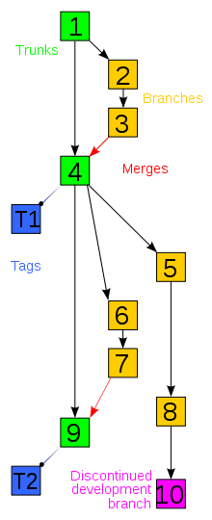
What does this history look like?
http://en.wikipedia.org/wiki/File:Revision_controlled_project_visualization-2010-24-02.svg

Slide 11

http://git-scm.com/about
git is an open source, distributed version control system
Latest build is available at
http://git-scm.com/
Pro Git – free documentation
http://git-scm.com/book
git video
http://git-scm.com/video/what-is-version-control
Notes:
A version control system or source code manager is one of many tools we use when building a website/web system
Its not a library or framework
To track the history of the source code
By taking snapshots of the source code at different times, when things go bad, we can switch to an earlier time
Create a branch and work on an experimental feature, so that the main branch is safe. The experimental branch can later be merged with the main branch
Allows to interact with copies of the same code on different computers. Allows multiple people to work simultaneously on copies of the same code
http://git-scm.com/book

Slide 12
History
2002 - Linus Torvalds uses BitKeeper for tracking Linux
April, 2005 - BK announces the removal of free license
April, 2005 - Linus start writing his own VCS – git
G is hard - British slang for an "unpleasant person”
June 16, 2005 – git is officially used to track Linux
Feb 14, 2007 – git 1.5.0 is released
Feb 2, 2014 – git 1.8.5.4 is the latest stable release

Slide 13
Design Goals
Speed
Simple Design
Support for thousand of parallel branches
Fully distributed
Able to handle large projects like Linux Kernel effectively
Ensure integrity

Slide 14
No Network Needed
Its design allows for offline work
Performing a Diff
Viewing file history
Committing changes
Merging branches
Obtaining any other revision of a file
Switching branches
Uses snapshot and delta compression
Notes:
Delta compression saves space by only saving the changes. Like journaling in RDBMS or non destructive changes in Adobe Lightroom

Slide 15
Objects
A "tree" is basically like a directory - it references a bunch of other trees and/or blobs (i.e. files and sub-directories)
A "commit" points to a single tree, marking it as what the project looked like at a certain point in time. It contains meta-information about that point in time, such as a timestamp, the author of the changes since the last commit, a pointer to the previous commit(s), etc.
A "tag" is a way to mark a specific commit as special in some way. It is normally used to tag certain commits as specific releases or something along those lines.
Notes:
Entire version history, branch data and content are hashed, compressed and stored locally to make it faster, better and easy to share.
A mutable index for current working directory and next revisions
An immutable append-only object database

Slide 16
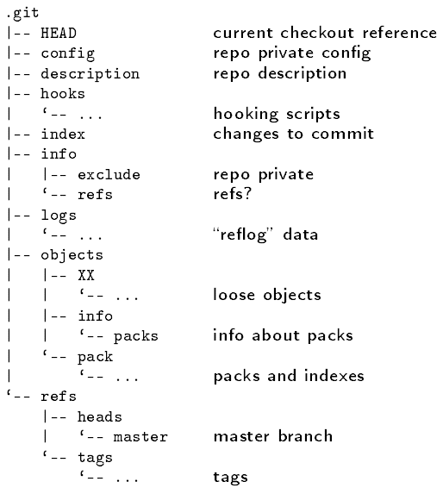
Repository
Git allows us to have our own version of a repository – so we can work on it in the same way. Trunk/Branches, etc…
Changes tracked locally
Snapshot storage
Delta storage (pack files)
Directed Acyclic Graph (DAG)
Notes:
In order to support the ability to push and pull changesets between multiple instances of the same repository, we need a specially designed structure for representing multiple versions of things. The structure we use is called a Directed Acyclic Graph (DAG), a design which is more expressive than a purely linear model.

Slide 17
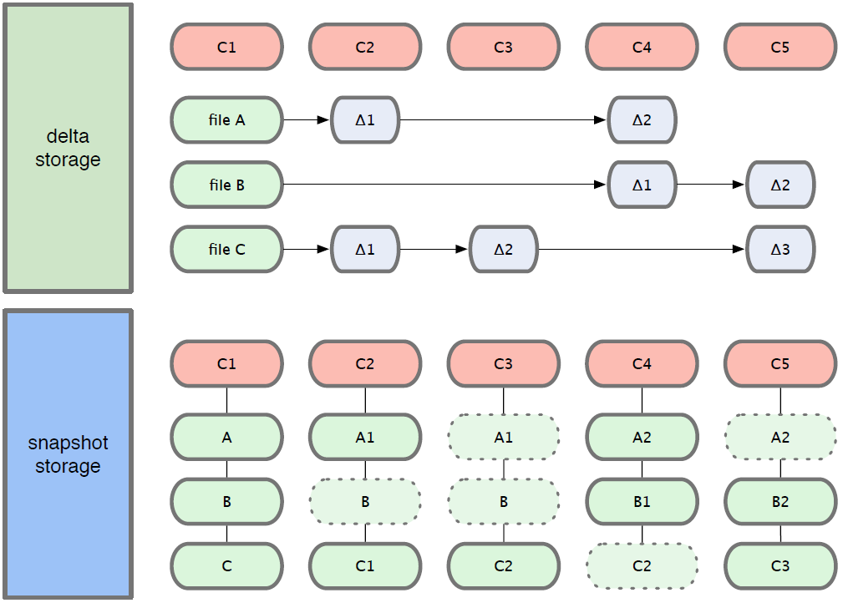
Tracking Changes

Slide 18
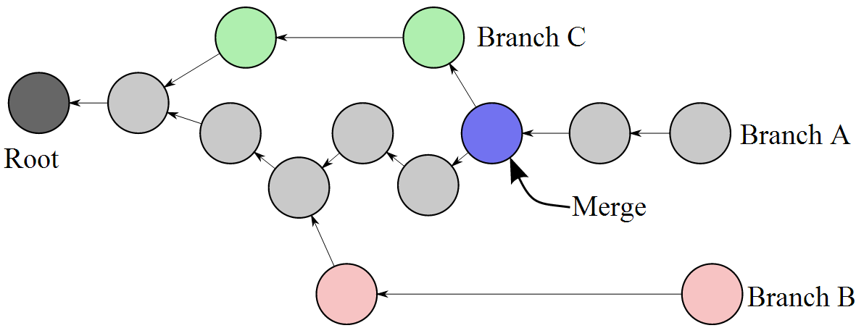
One giant Graph
git repository is one giant Directed Acyclic Graph (DAG)
A Git commit is a node in a graph, and nodes can point to other nodes that came before them.
Notes:
A DAG is a data structure from computer science which can be used to model a wide variety of problems. The DAG consists of the following elements:
Nodes. Each node represents some object or piece of data. In the case of a DVCS, each node represents one revision of the entire repository tree.
Directed edges. A directed edge (or “arrow”) from one node to another represents some kind of relationship between those two nodes. In our situation, the arrow means “is based on”. By convention, I draw DAG arrows from child to parent, from the new revision to the revision from which it was derived. Arrows in a DAG may not form a cycle.
A root node. At least one of the nodes will have no parents. This is the root of the DAG.
Leaf nodes. One or more of the nodes will have no children. These are called leaves or leaf nodes.

Slide 19
Basic Workflow
Create a local repository, Clone a remote repository or Pull the most recent copy into your local repo
Edit/Modify the files
Stage the files
Commit the files locally
Push changes to remote repo
Wash – Rinse – Repeat
Stage
Commit
Push
Pull
Edit
Notes:
Pull your code into a new branch
Make your edits
Stage them
Commit them to the local trunk
Push them to the master repository (ie guthub)

Slide 20
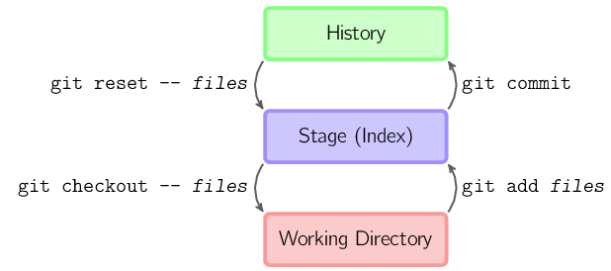
Basic Workflow
In usual workflow always use “git status” to see list of changes
Notes:
So running git commit will do nothing unless you explicitly add files to the commit with git add. If you're looking for the commit command to automatically commit local modifications we use the -a flag.

Slide 21
Basic Setup from a terminal
Install git (http://git-scm.org) and set basic global config parameters
$ git config --global user.name ”Richard Plotka“
$ git config --global user.email “rplotka@tsi400.com”
$ git config --global core.pager true
$ git config --global color.ui true
$ git config --global core.editor "subl -n -w”
Make sublime your default editor
(emacs) for emacs

Slide 22
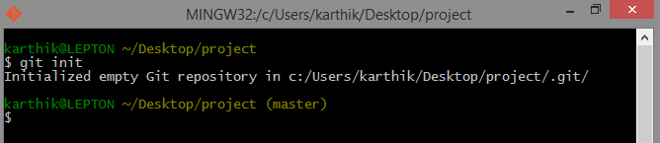

Initialize
Install git in your system
Using git init open your project folder,
The newly created .git folder holds everything about the git repository

Slide 23

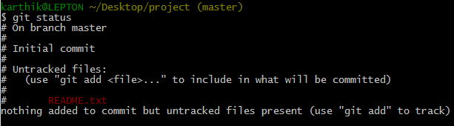
Staging the file
Create a README file (example text file) – often read.me on github
git status gives the status of the git repository
git add, adds the file to the staging area (stages the file)

Slide 24
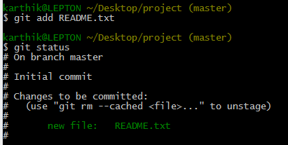
Staging the file
Staging area is where files are added before committing the file
Even if you change the actual file, only the changes that have been staged can be committed
$git add . → adds the entire folder and subfolders to the staging area

Slide 25
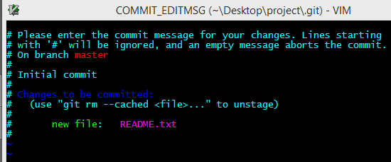
Committing changes
$git commit
Enter the commit message
$git commit –m ‘commit message’ → commits with a message
$git commit –a → to skip the staging part
$git commit –am ‘message’→ skip the staging part and commits with a message

Slide 26
Git Hosting
GitHub – Free accounts for open source projects and repositories are public only
bitBucket – free for 5 users and repositories can be private or public
Free GUI called Sourcetree
Integrated with Jira (paid) for issue tracking
Github ssh setup
https://help.github.com/articles/generating-ssh-keys

Slide 27
Basic Commands
Create a repo in github with exact same name (case sensitive)
Add a remote (ssh/https/git) to your local repository
$ git remote add origin git@github.com:yourgitUID/myproject.git
$ git pull origin master
$ git push origin master
$ git remote –v (lists all remotes)
$ git remote rm origin (remove)
Notes:
You should be able to see the file you created in git hub
git@github.com:ffdci/myproject.git

Slide 28
Basic Workflow
Branching and merging
$ git checkout –b test (create and switch to a branch)
$ git branch –l (list all branches)
$ git checkout master (switch to a branch)
$ git checkout –f master (forceful overwrite any local changes)
$ git merge test (merge the branch with master)
$ gitk (GUI view)
$ git push origin test (push the branch to remote)
$ git branch –D test (delete the branch)

Slide 29
Basic Workflow
Tags
Use annotated tags for releases while lightweight tags are meant for private or temporary object labels
$ git tag –a 1.4.0 –m”Latest release”
$ git tag -l

Slide 30
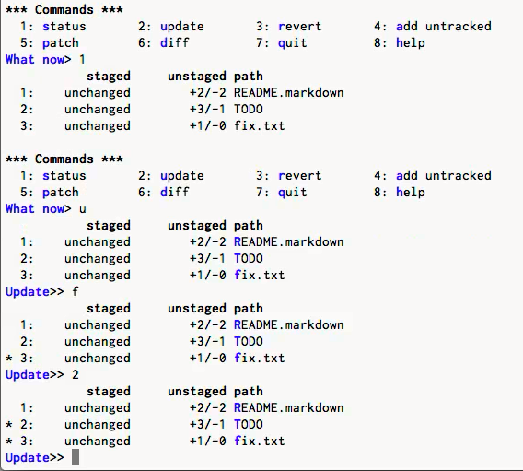
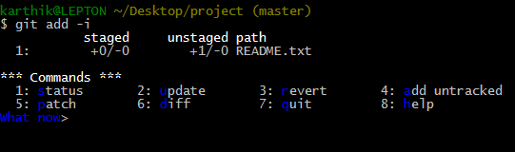
Interactive add
$git add –i
Opens the interactive add prompt.
Using interactive add we can add part of the file to the staging area and leave the remaining part unstaged.
Can use numbers or shortcuts to open sub prompts

Slide 31
Stash changes
Take the changes made, stash them aside
$git stash
Make change to a file
Stash the changes
can make changes to other files and commit them while keeping the stash
Can make multiple stashes as well.
To bring the stash back,
$git stash list -> lists the stashes
$git stash apply -> applies the stash which can be commited but leaves the stash in the stash list
$git stash pop -> pops the stash out of the stash list which can be committed later

Slide 32

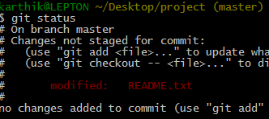


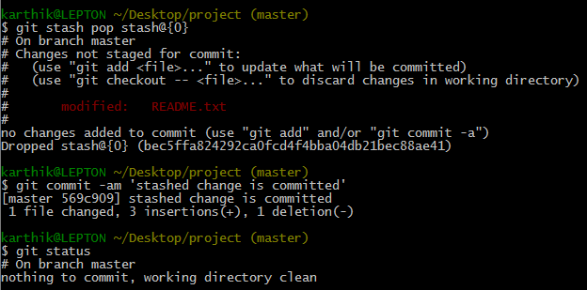
Stash changes

Slide 33
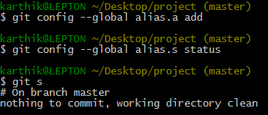
Shorten git commands
Create aliases for git commands
Eg:
$git config --global alias.a add
Becomes $git a
$git config --global alias.s status
Becomes $git s

Slide 34

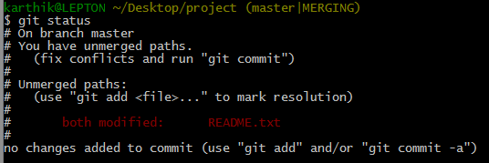
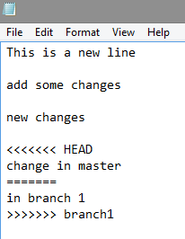
Merge conflicts
When trying to merge changes made in the same line in the same file from different branches.
The conflicting parts will be shown in the
file with their branch names..

Slide 35

Merge conflicts
Make the proper changes in the file, add to the stage and commit

Slide 36
Conclusions
Version Control – yesterday’s assets, still available tomorrow
Git/DVCS – Version control but everyone has their own sandpit until they push
Commit often; pull/push regularly
Branch often – branches/merges are cheap and keeps everyone’s work separate
Tag regularly – but don’t work on a tag
I recommend “git flow” branching model for software development
http://nvie.com/posts/a-successful-git-branching-model/

Slide 37
Links
Cheat Sheet - http://cheat.errtheblog.com/s/git
http://git-scm.com/downloads/guis
http://git-scm.com/docs
http://git-scm.com/documentation
http://readwrite.com/2013/09/30/understanding-github-a-journey-for-beginners-part-1#awesm=~oiX1Ab8Gha2Wh3
http://www.youtube.com/watch?v=tRTckrrCME4
https://www.atlassian.com/git/tutorial

Slide 38
Links
http://blip.tv/open-source-developers-conference/git-for-ages-4-and-up-4460524
Cheat Sheet - http://cheat.errtheblog.com/s/git
http://git-scm.com/downloads/guis
http://git-scm.com/docs
http://git-scm.com/book
http://git-scm.com/documentation
http://readwrite.com/2013/09/30/understanding-github-a-journey-for-beginners-part-1#awesm=~oiX1Ab8Gha2Wh3
http://git-scm.com/video/what-is-version-control
http://www.youtube.com/watch?v=tRTckrrCME4
https://help.github.com/articles/using-ssh-over-the-https-port

Slide 39
Bug Tracking

Slide 40
Bug Tracker
Is a software application designed to help quality assurance and programmers keep track of reported software bugs in their work

Slide 41




Bug tracking software
and many more….
Notes:
http://www.thegeekstuff.com/2010/08/bug-tracking-system/

Slide 42
Bugzilla
Bugzilla is a defect tracking system which allows developers to keep track of their bugs effectively
Developed using free open source tools and is itself free
Currently used by Mozilla, Linux Kernel, Gnome, KDE, Apache, Open Office, Eclipse etc..

Slide 43
What can Bugzilla do?
Track bugs and code changes
Communicate with teammates
Submit and review patches
Manage quality assurance (QA)

Slide 44
Features
Advanced Search capabilities
Email notifications
Bug lists in multiple formats
Scheduled reports
Reports / charts
File / Modify bugs by email
Time Tracking etc..
Notes:
http://www.bugzilla.org/features/

Slide 45
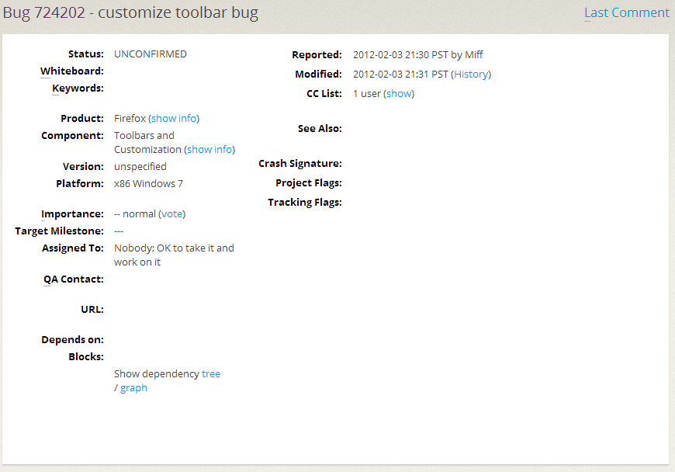
Sample bug
Notes:
https://bugzilla.mozilla.org/show_bug.cgi?id=724202

Slide 46
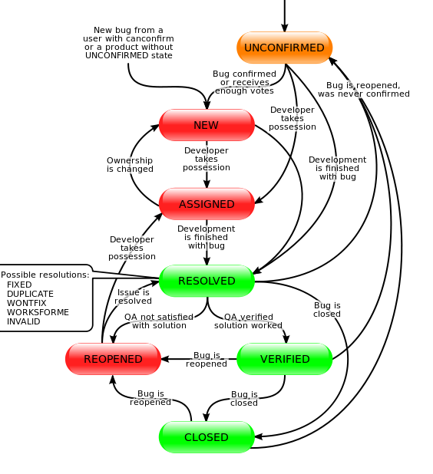
Lifecycle of a bug

Slide 47
Bug Tracking Further Reading
Bugzilla official: http://www.bugzilla.org/
Bugzilla@Mozilla: https://bugzilla.mozilla.org/
Documentation: http://www.bugzilla.org/docs/
Mantis Bug Tracker: http://www.mantisbt.org/
Wiki : http://www.mantisbt.org/wiki/doku.php
Documentation: http://www.mantisbt.org/documentation.php

Slide 48
Take Home Reading
Signup for a server for your projects – http://hosting.myrpi.org/
Consume
http://git-scm.com/book
http://git-scm.com/about
http://git-scm.com/downloads/guis
http://gitimmersion.com/
http://www.bugzilla.org/
https://maestrano.com/knowledge_center/pages/29-bugzilla-tutorial-get-started
http://www.mantisbt.org/
https://maestrano.com/knowledge_center/pages/34-mantis-bt-tutorial-get-started

