Slide 1
Mobile

Slide 2
Why Mobile
Past few years have seen a Mobile revolution
Global smartphones in use passed 1.5bn in ’14, 1.8bn in ‘15 and >2 billion expected by end of 2016
Add 1.2 bn tablets gets us close to 4 BILLION mobile devices – today. Right now. That’s why!!!
App stores play a huge role
2014 App store estimates
225,000 app downloads
store revenue >$8bn
US Mobile eCommerce market expected to be 25% in 2016
313,980,500,000 * .25 = 78,495,125,000
That’s 78 Billion Dollars purchased using mobile devices alone
Notes:
http://www.smashingmagazine.com/guidelines-for-mobile-web-development/
http://www.businessinsider.com/15-billion-smartphones-in-the-world-22013-2
I (Rick) believe the success of iPhone was largely driven by iTunes. (eg 0.99 apps) And Android only became a factor once they had an ecosystem – Google Play…I do not hold that Apple was visionary in the sense that the technology was coming in any event…They were however a clear first mover in the smartphone space…Samsung (2nd mover) was working on the technology from the 80s
Android is now larger in OS deployments - >80% of smartphone market, have more apps on their store, and have a larger percentage of paid downloads

Slide 3
How mobile?
Mobile Apps
Apple iOS – Swift (or web apps)
Android – Java (or web apps)
Windows mobile – .NET – but well, never mind …
But web apps too
Mobile Web
HTML5

Slide 4
Mobile Apps
What’s involved?
SDK – need API’s to hook into the OS
Emulators – need to be able to test multiple device layouts and platforms without going to each device initially
Test/Demo devices

Slide 5
iOS
Apple SDK
ObjectiveC or Swift
Xcode (almost exclusively until recently – IntelliJ AppCode)
Developer Network $99.00 per year

Slide 6
Android
Android SDK
Java
Any tool you like including
IntelliJ’s Android Studio
Google Android Developer’s Studio
Free

Slide 7
Windows
Windows 8 SDK
.NET compact framework
C#
Windows Emulator
Various IDE’s but Visual Studio expected
Free
But again - fuggetaboutit
…and remember, Web will work anyway

Slide 8
Others
RIM
Nokia
Linux Mobile?
All now are either coming out with Android devices (eg RIM) or tools/OSes that will work with Android (Sailfish OS)

Slide 9
Mobile Web Development

Slide 10
Constraints and capabilities
Capabilities
Constraints
Touch Screen
Internet Access
Input Devices
Sound
Bluetooth
GPs
Phone calls
Messages
Emails
Web Surfing
Dictation
NFC
Screen size
Hardware capabilities
Mobile chips, often no graphics chip
Reception
Internet depends on reception
Fragmentation
Different screensizes, OS etc
Attention span
A quick get it done mentality

Slide 11
Ergonomics
Human Factors & Ergonomics
Design for the way in which mobile phones are used by people
Areas of the screen that the thumb can reach comfortably
Ergonomics and Design can make a simple mobile web app and make it great

Slide 12
Mobile app over website
Performance
Using the hardware capabilities. Can work without internet connection. Does not have to compile through HTML/JS to work
Features
Inbuilt features and controls, animations etc are available only to native apps
Revenue
Apps are usually sold, the revenue model is much better for apps than mobile websites

Slide 13
Mobile Website over an app
Gives more control to you
Don’t have to think about adhering the guidelines / design language of a particular platform
Efficient
Much more cost/resource efficient than developing for different platforms
Technology
Write in HTML/CSS/JS as opposed to Swift, Java or C#
Cross platform
The web app will be available across all platforms
Getting richer by the day
Kendo, AngularMobileUI, PhoneGap, ReactNative, … and more

Slide 14
Touch screens
Use DOM touch events to work with a touch screen
Mouse Hover won’t work (usually) on touch devices
…But Pressure is - Peek and Pop - (Force touch)
Design clickable items keeping in mind the difference between tapping and clicking
Optimze images by loading images for appropriate screen size and resolutions
Notes:
https://developer.mozilla.org/en-US/docs/Web/Guide/Mobile
http://www.whatcreative.co.uk/blog/tips/designing-for-touch-screen/
https://developer.mozilla.org/en-US/docs/Web/Guide/API/DOM/Events/Touch_events?redirectlocale=en-US&redirectslug=Web%2FGuide%2FDOM%2FEvents%2FTouch_events

Slide 15
Cross-Browser development
Create websites which are compatible across browsers
Avoid browser-specific features like vendor-specific css properties
If using these features, make sure other browsers implement their versions of the features and target them
For browsers not supporting features, provide fallback
Tools like CSS Lint help find problems with cross browser code
Preprocessers like SASS and LESS help produce cross browser code

Slide 16
User agent sniffing
It's preferable for web sites to detect specific device features such as screen size and touch screens and adapt themselves accordingly
Sometimes web sites resort to parsing the browser's user agent string to distinguish between desktops, tablets, and phones, to serve different content to each type of device.
If so, make sure your algorithm is correct, and you aren't serving the wrong type of content to a device because you don't understand a particular browser's user agent string
guide to using the user agent string to determine device type

Slide 17
CSS Media Queries
CSS3
Specify different rules for different situations
Web, Mobile, Print, etc
@media
http://cssmediaqueries.com/
// normal style
#header-image {
background-repeat: no-repeat;
background-image:url('image.gif');
}
// show a larger image when you're on a big screen
@media screen and (min-width: 1200px) {
#header-image {
background-image:url('large-image.gif');
}
}
// remove header image when printing.
@media print {
#header-image {
display: none;
}
}

Slide 18

jQuery mobile
Touch optimized web framework for smartphones and tablets
Cross-platform support
Optimized for modern phones
Themable
Simply by applying a custom attribute to elements you can set very specific visual layouts
Notes:
http://jquerymobile.com/

Slide 19
jQuery mobile
Initialize simply by applying classes and custom attributes
HTML5 + CSS3
Based on web stack
Google hosted
Less than 15k size
Footprint is smaller
Apps won’t be native
Unlike other 3rd party tools like Titanium, phonegap etc apps won’t be compiled into native code

Slide 20
Getting started
Pages and dialogs
An element with a data-role = “page” attribute
Use <header>, <content>, <footer> tags as usual
A page can be made into a dialog. Add data-role=“dialog” attribute to the link to the page
AJAX navigation and transitions
AJAX navigation between pages with transitions
Default transition is fade. To set custom transition add data-transition attribute to the link
Contents & widgets
Inside the content container, any standard HTML elements can be added
jQuery mobile includes a wide range of touch friendly widgets
Notes:
http://view.jquerymobile.com/1.4.5/demos/

Slide 21
Getting started
Listviews
jQuery mobile includes a Diverse set of listviews coded as lists with data-role=‘listview’ attribute
Make the list into an inset module by adding a data-inset=“true”
Add a dynamic search filter with data-filter=“true”
Notes:
http://view.jquerymobile.com/1.4.5/dist/demos/intro/
Use the jQueryMobile_listviews.html file for demo purposes

Slide 22
Getting started
Loading Pages
A single .html file can have multiple pages
Pages are loaded asynchronously using AJAX
Link pages using id
Add custom transitions using data-transition attribute
slide (default)
pop (alert boxes)
flip
slide-up
slide-down
fade etc.
Notes:
http://view.jquerymobile.com/1.4.5/dist/demos/intro/
Use the jQueryMobile_loading pages.html for demo purposes

Slide 23
Getting started
Buttons
Can use <a>, <button>
Use data-role=“button”
Be default buttons are block level, to make them inline, use data-inline = “true” attribute
Forms
Form elements are enhanced and made touch-friendly
Use data-role=“fieldcontain” attribute to make use of some default styles from jQuery
Notes:
http://view.jquerymobile.com/1.4.5/dist/demos/intro/
Use the jQueryMobile_buttons.html for demo purposes
Use the jQueryMobile_forms.html for demo purposes

Slide 24
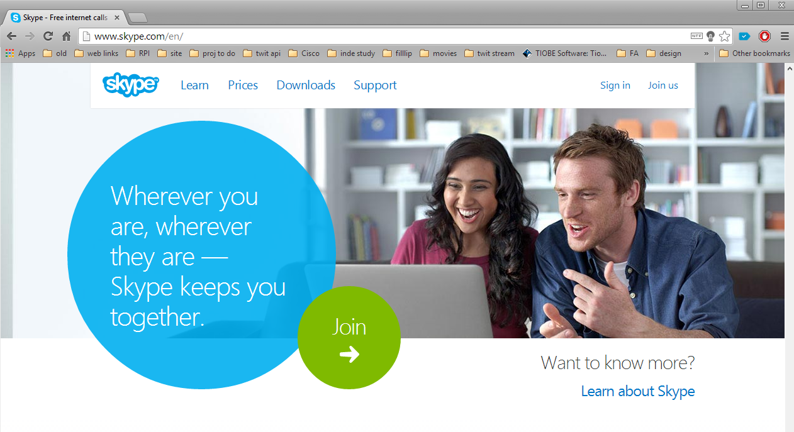
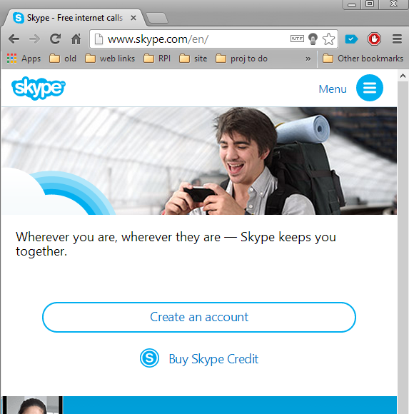
Responsive design
Design which is responsive to device size
Fluid Grid
Flexible images
CSS Media queries
Server side + Client side
Notes:
http://mobile.smashingmagazine.com/2012/04/19/why-we-shouldnt-make-separate-mobile-websites/
http://en.wikipedia.org/wiki/Responsive_Web_Design
Example: http://www.skype.com/en/
Shrink the browser window, the website itself will change based on the size of the window
According to Wikipedia
Responsive web design (RWD) is a web design approach aimed at crafting sites to provide an optimal viewing experience—easy reading and navigation with a minimum of resizing, panning, and scrolling—across a wide range of devices (from mobile phones to desktop computer monitors).
A site designed with RWD adapts the layout to the viewing environment by using fluid, proportion-based grids, flexible images, and CSS3 media queries, an extension of the @media rule.
The fluid grid concept calls for page element sizing to be in relative units like percentages, rather than absolute units like pixels or points.
Flexible images are also sized in relative units, so as to prevent them from displaying outside their containing element.
Media queries allow the page to use different CSS style rules based on characteristics of the device the site is being displayed on, most commonly the width of the browser.
Server-side components (RESS) in conjunction with client-side ones such as media queries can produce faster-loading sites for access over cellular networks and also deliver richer functionality/usability avoiding some of the pitfalls of device-side-only solutions.

Slide 25
Mobile First
Mobile too (or mostly)
SPA – Single Page Apps
Mobile friendly styles
jQuery Mobile
Bootstrap 2
Sencha
AngularJS
ReactJS
more
Mobile first
Idea that designs need to work across all platforms (or as many as feasible) out of the gate
Responsive Grid System
Media queries built-in
Bootstrap 3
Foundation 5
Mobile SPA frameworks
Sencha touch
Mobile AngularJS
React-mobile
more

Slide 26
Getting Started with Mobile
https://developers.google.com/webmasters/smartphone-sites/
http://www.smashingmagazine.com/guidelines-for-mobile-web-development/
http://view.jquerymobile.com/1.4.5/demos/
http://view.jquerymobile.com/1.4.5/demos/map-geolocation/

Slide 27
Getting started
Responsive Web Design is CSS intensive
Sass
{LESS}
Bootstrap 3 – on github - example
Foundation 5 – on github - example
Skeleton
YAML

Slide 28
Getting started
Responsive Web Design is CSS intensive
Angular JS - https://angularjs.org/
React JS - https://facebook.github.io/react/
Mobile Angular UI - http://mobileangularui.com/
React-Native - http://facebook.github.io/react-native/

