Slide 1
Web Frameworks

Slide 2
Web Frameworks
The web as an application framework
Assist software development by allowing programmers and designers to spend more time on meeting software requirements rather than dealing with the more standard low-level details of providing a working system
Notes:
A web application framework (WAF) is a software framework that is designed to support the development of dynamic websites, web applications, web services and web resources. The framework aims to alleviate the overhead associated with common activities performed in web development. For example, many frameworks provide libraries for database access, templating frameworks andsession management, and they often promote code reuse.

Slide 3
Pros and cons
Pros
Provide ready to use services for development
Promotes a standard way of doing things
Can onboard new developers easily
Concerns
Reduces flexibility
Extra learning curve depending on the complexity of the framework
Should evolve with the technology

Slide 4
Framework Requirements
Model-View-Controller (MVC)
Object-Relational mapping (ORM)
Web service support / REST
Intuitive URLs (Routing)
Scaffolding (in model)
Templating (in views)
Ajax integration
W3c standards compliance
Pluggable Architecture
Security
Steady performance
Unit and non-regression testing
Agile development
Good Documentation
Active community

Slide 5
MVC

Slide 6
Design Pattern
A design pattern is a
General solution to a commonly-occurring problem
is a template for solving a problem that can be used in many different problems or solutions
Isolates business logic from User interface
Enables Test Driven Development

Slide 7
What is MVC?
We covered this a bit in Intro and a bit more in Web Systems

Slide 8
What is MVC?
Model-View-Controller architecture is used for developing web-applications.
Used for decoupling between business logic and data presentation to web user.
Divides the web based application into three layers:
Model:
contains the business logics and functions that manipulate the application data.
View:
View is responsible for presentation aspect of application according to the current state of model data and query response to the controller.
Controller:
Controller accepts and intercepts user requests and controls the business objects to fulfill these requests.

Slide 9
MVC
Model
Manages application state
Respond to state query
Notify View changes
Exposes application functionality
State Query
State Change
Change Notification
View
Controller selects view
Renders the model
Sends user gestures to controller
Controller
Define application behavior
Maps user action to model update
Select View For Response
View Selection
User Gesture
Method Invocation
Events

Slide 10
Model Layer
Designed for
capturing logic and
data access code
Model layer is a self contained
Its functions are independent from the view and control layer
Mostly implemented using technologies
Java Data Objects, Data Access Objects etc.

Slide 11
View Layer
Designed for providing an interface to application for users
It is the channel for getting data in and out of the application
It does not contain any code for persisting data to or retrieving data from a data source.
Mostly implemented using technologies
HTML/JSP, XML/XSLT, XAML etc.

Slide 12
Controller layer
Designed as a connector between model and View layer, separating one from each other
Handles user interaction
Reads data from the view, control user input and send input data to the model
Sends command to the model to update its state.
Sends command to the associated view to change the view’s presentation of the model

Slide 13
Advantage of MVC
Separation of data from presentation layer
Ability of have multiple view of single data
It is less painful to change a data layer or business rules
Ability to have multiple interface for the same application

Slide 14
Now we have MVVM
Model <- -> View
Provides a way for us to move controller (C) into the View – creating a View-Model (VM)
Allows us more robust Web Apps
Facilitates SPA (Single Page Application)
Can be dangerous in that we are allowing the client to process data directly for the Model –
Can be complicated
Involves more overhead
Not ideal for simple apps
More on this in a bit . . .

Slide 15
MVC Frameworks

Slide 16

Struts
Apache Struts is a free, open-source, MVC framework for creating elegant, modern Java web applications.
It favors convention over configuration
Is extensible using a plugin architecture, and
Ships with plugins to support REST, AJAX and JSON.
Current version is Struts 2.3.16.
http://struts.apache.org/
http://struts.apache.org/primer.html
Notes:
http://struts.apache.org/
Apache Struts is a free, open-source, MVC framework for creating elegant, modern Java web applications. It favors convention over configuration, is extensible using a plugin architecture, and ships with plugins to support REST, AJAX and JSON.

Slide 17
Struts
It is a framework for building java-based Web application
using the Model-View-Controller (MVC) design pattern.
It allows us to fully decouple the business logic, control logic, and presentation code of the applications .
Struts also provides library and utility for making MVC development faster and easier
Notes:
http://struts.apache.org/birdseye.html

Slide 18
Struts 2
Not Struts 1.x!
The Struts 1.x web framework has reached its end of life (EOL) and is no longer officially supported
OpenSymphony WebWork had a more robust View architechture, Struts better on backend
WebWork + Struts + Apache Incubator
Struts 2 was hatched in ‘07 – Best of both worlds

Slide 19
Benefits
Built specifically for Developer Productivity,
Simple HTTP-free code
Easy Spring integration – also Ruby on Rails…
Reusable UI templates
Plug-in architecture
Easy conversions
Rich validation
Easy to test

Slide 20
Configuration Styles
Packaged actions (namespace)
Package inheritance
Wildcard mappings
Generic actions
Annotations
Ruby-On-Rails Rest-style mappings
Convention over configuration

Slide 21
Plug-in Architecture
Similar to Firefox and Eclipse
Add features by dropping in a jar
Several bundled plug-ins
Tiles
JFreeChart
JasperReports
REST-Style URI mappings
Plug-in registry growing steadily

Slide 22
Core Components
Actions
Interceptors
Results
(The Request pipeline)

Slide 23
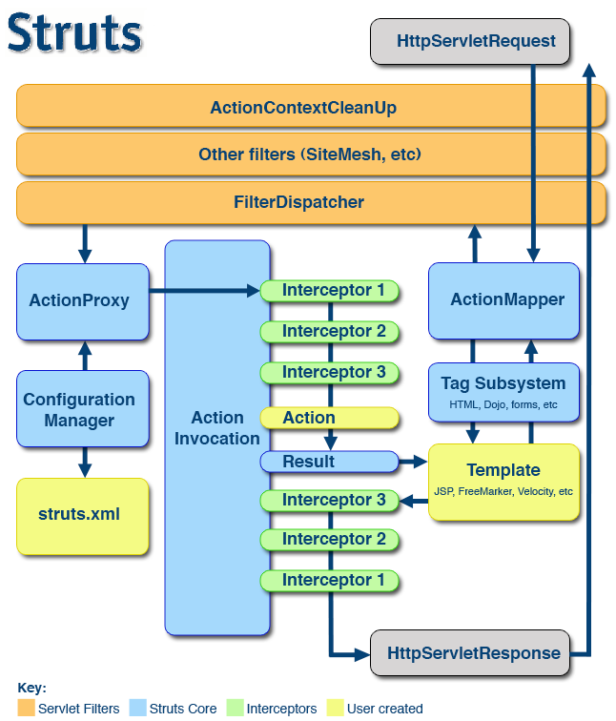
The Struts 2 Request Flow
Notes:
http://struts.apache.org/release/2.2.x/docs/the-struts-2-request-flow.html
In the diagram, an initial request goes to the Servlet container (such as Jetty or Resin) which is passed through a standard filter chain. The chain includes the (optional) ActionContextCleanUp filter, which is useful when integrating technologies such as SiteMesh Plugin. Next, the required FilterDispatcher is called, which in turn consults the ActionMapper to determine if the request should invoke an action.
If the ActionMapper determines that an Action should be invoked, the FilterDispatcher delegates control to the ActionProxy. The ActionProxy consults the framework Configuration Files manager (initialized from the struts.xml file). Next, the ActionProxy creates an ActionInvocation, which is responsible for the command pattern implementation. This includes invoking any Interceptors (the before clause) in advance of invoking the Action itself.
Once the Action returns, the ActionInvocation is responsible for looking up the proper result associated with the Action result code mapped in struts.xml. The result is then executed, which often (but not always, as is the case for Action Chaining) involves a template written in JSP or FreeMarker to be rendered. While rendering, the templates can use the Struts Tags provided by the framework. Some of those components will work with the ActionMapper to render proper URLs for additional requests.
Interceptors are executed again (in reverse order, calling the after clause). Finally, the response returns through the filters configured in the web.xml. If the ActionContextCleanUp filter is present, the FilterDispatcher will not clean up the ThreadLocal ActionContext. If the ActionContextCleanUp filter is not present, the FilterDispatcher will cleanup all ThreadLocals.
Largely Servlet API independent
Action instance is created for each request
Interceptors can be named stacks
Response can be anything you can dream up
HTML
XML
JSON
Stream

Slide 24
Action
Packaged according to like kind
Sort of like Java packages
ThreadLocal (safe)
Typically extend ActionSupport
Contain your domain model
Can be model driven
May contain multiple methods
Not tangled up with Servlet/API
Easy to test!
Notes:
To create a Model Driven action, implement the ModelDriven interface by adding a model property, or at least the accessor.
public Object getModel() ...
In the implementation of getModel, acquire an instance of a business object and return it. On the page, you can address any JavaBean properties on the business object as if they were coded directly on the Action class. (The framework pushes the Model object onto the ValueStack.) Many developers use Spring to acquire the business object. With the addition of a setModel method, the business object can be injected automatically.

Slide 25
Action Mapping
<package name="hr" namespace="/hr” extends="starter">
<action
name=“uri“ class=“class“ method=“method">
<result>destination</result>
</action>
<package>
Notes:
name - Target of URL
class– Action class to service response
method– If you wish to specify a method other than the default execute(), this is where you can do it

Slide 26
Interceptor
Intercepts request
Think AOP
Called before/after your action
Useful for cross-cutting concerns
Built-ins cover 98+% of all use cases
Configured at package or action level
Is central to the framework itself
Notes:
http://struts.apache.org/release/2.2.x/docs/interceptors.html

Slide 27
Interceptor Stack
An interceptor has a specific role
Parameter interception
Validation
Workflow
Named “stacks” provide pluggable lists pre-assembled for goal specific cases
defaultStack
fileUploadStack
modelDrivenStack
paramsPrepareParamsStack
Notes:
This is the basic stack included in the struts-default.xml file. You can always look inside the struts2-core-2.m.n.jar to see the details
<!-- Basic stack -->
<interceptor-stack name="basicStack">
<interceptor-ref name="exception"/>
<interceptor-ref name="servletConfig"/>
<interceptor-ref name="prepare"/>
<interceptor-ref name="checkbox"/>
<interceptor-ref name="params"/>
<interceptor-ref name="conversionError"/>
</interceptor-stack>

Slide 28
Result
What should be returned to requester?
Many provided out of the box
It’s easy to write your own
Graphics
JSON
PDF
It’s another configurable object
Notes:
JFreeChart plug-in demonstrates returning dynamic image files on the fly!
<result-types>
<result-type name="chart" class="org.apache.struts2.dispatcher.ChartResult" default="false">
<param name="height">150</param>
<param name="width">200</param>
</result-type>
</result-types>

Slide 29
Result Types
<result-types>
<result-type name="chain" class=“…"/>
<result-type name="dispatcher" class=“…" default="true"/>
<result-type name="freemarker" class=“…"/>
<result-type name="httpheader" class=“…"/>
<result-type name="redirect" class=“…"/>
<result-type name="redirectAction" class=“…"/>
<result-type name="stream" class=“…"/>
<result-type name="velocity" class=“…"/>
<result-type name="xslt" class=“…"/>
<result-type name="plainText" class=“…" />
<result-type name="plaintext" class=“…" />
</result-types>
Notes:
dispatcher - Includes or forwards to a view (usually a jsp). Behind the scenes Struts will use a RequestDispatcher, where the target servlet/JSP receives the same request/response objects as the original servlet/JSP. Therefore, you can pass data between them using request.setAttribute() - the Struts action is available.

Slide 30
Result Example
<action …>
<result name="success" type="dispatcher">
/employee/list.jsp
</result>
</action>
name and type are optional
name defaults to success
type default can be set by package
Notes:
name defaults to SUCCESS
type inherits the result declared to be “default” for the namespace

Slide 31
Configuration
Declaring the Web Site Capabilities
struts.xml
Core configuration file for framework
Can contain multiple packages
<struts>
<package name=“base" extends="struts-default">
<action...>
</package>
<include file=“hr.xml"/>
<include file=“logon.xml"/>
<include file=“preferences.xml"/>
</struts>
Notes:
<!DOCTYPE struts PUBLIC
"-//Apache Software Foundation//DTD Struts Configuration 2.0//EN"
"http://struts.apache.org/dtds/struts-2.0.dtd">
<struts>
<package name="starter“ extends="struts-default, jfreechart-default">
<result-types>
<result-type name="serialize“ class="acme.hr.result.SerializationToXml" />
</result-types>
<interceptors>
<interceptor-stack name="starterStack">
<interceptor-ref name="timer" />
<interceptor-ref name="scopedModelDriven" />
<interceptor-ref name="paramsPrepareParamsStack" />
<interceptor-ref name="timer" />
</interceptor-stack>
</interceptors>
<default-interceptor-ref name="starterStack" />
</package>
<include file=“base.xml" />
<include file=“preferences.xml" />
<include file="wizard.xml" />
</struts>

Slide 32
Configuration, contd..
struts-default.xml
Most of your packages will extend this
Directly/Indirectly
Contains about everything you need
Packages form inheritance hierarchies
The key sections are
package
result-types
interceptors/stacks

Slide 33
Tag Libraries
The UI
Tags are divided into 2 sets
UI
Form/Non-Form
Ajax
Leverages dojo
Generic
Control
if, else, iterator
Data
bean, text, url

Slide 34
Struts 2 Tags
Decoupled from underlying view technology
JSP
Velocity
FreeMarker
Markup via Freemarker templates

Slide 35
Validation
Validation Styles
Annotations
XML
Java
Form
<s:textfield key="age"/>
Action
private int age; get/set
Validator <ActionClassName>-validation.xml
<field name="age">
<field-validator type="int">
<param name="min">13</param>
<param name="max">19</param>
<message>Only people ages 13 to 19 allowed</message>
</field-validator>
</field>

Slide 36
Plug-ins
Strategic points in the framework where you can
Provide you own implementations
Add new features
Add functionality without modifying code
Open-Closed Principle
Struts 2 further reading
http://struts.apache.org/release/2.2.x/docs/guides.html

Slide 37

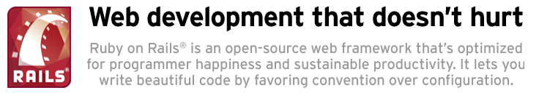
Ruby on Rails
Rails is a web application deployment framework written in Ruby
http://rubyonrails.org/

Slide 38
Rails – Guiding principles
DRY (Don’t Repeat Yourself)
CoC (Convention over Configuration)
REST (Representational State Transfer)

Slide 39
DRY
Every piece of knowledge must have a single, unambiguous, authoritative representation within the system
Don’t repeat yourself
Heavy lifting once
Refactor and organize the code
Changes in one place reflect everywhere

Slide 40
CoC - Convention over Configuration
Design paradigm to decrease the number of decisions that developers need to make, gaining simplicity, but not necessarily losing flexibility
Rapid development
Self explanatory code
Easier to understand, refactor, maintain, learn and collaborate

Slide 41

MVC on Rails
1
Router
2
Controller
4
5
3
View
Model
DB
Notes:
1. Browser posts request to Router
2. Router discovers controller to execute and Rails executes the controller
3. Controller calls Model and gets output
4. Controller sends the output to View
5. View renders User Interface

Slide 42
Further reading
http://guides.rubyonrails.org/ - Rails guides
http://ruby.railstutorial.org/ - Tutorial
http://tryruby.org/levels/1/challenges/0 - Try Ruby
http://railsforzombies.org/ - Rails for Zombies
http://railscasts.com/ - Rails casts
http://rubyonrails.org/screencasts/ - screencasts

Slide 43

Node.js
Node.js is a platform built on Chrome's V8 JavaScript runtime for easily building fast, scalable network applications.
Node.js uses an event-driven, non-blocking I/O model that makes it lightweight and efficient, perfect for data-intensive real-time applications that run across distributed devices.
http://nodejs.org/
Notes:
http://www.youtube.com/watch?v=jo_B4LTHi3I

Slide 44
Node.js is..
Server side JavaScript
NOT another web framework, but can create a web framework using NPM modules (like http or express)

Slide 45
Why Node.js
Non Blocking I/O
Based on Chrome’s V8 Engines (FAST!)
15,000+ modules
Active community
http://nodejs.org/community/
One language for frontend and backend
Javascript is the language of the web

Slide 46


Hello World

Slide 47
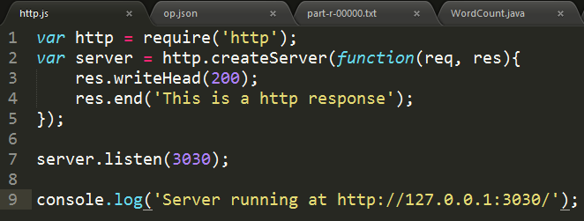

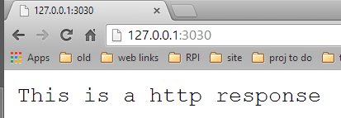
Simple Http Server
Notes:
Helloworld.js

Slide 48
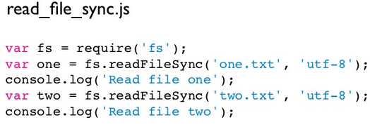

Non – Blocking I/O
Blocking I/O example
*one.txt is larger than two.txt

Slide 49
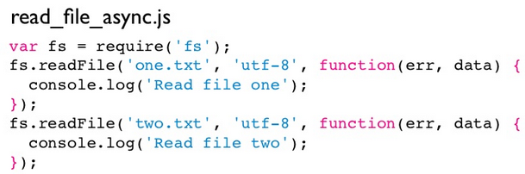

Non – Blocking I/O
Non - Blocking I/O example
*one.txt is larger than two.txt

Slide 50
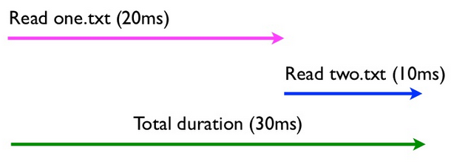
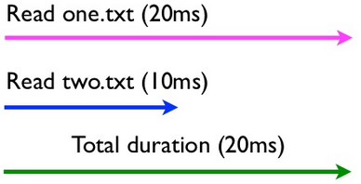
Non – Blocking I/O
Blocking I/O
Non - Blocking I/O
Notes:
Close to ideal for high concurrency / high throughput, single execution stack
Forces you to write more efficient code by parallelizing your I/O
Feels like AJAX in the browser
Examples

Slide 51
Examples
helloworld.js
webserver2.js
Node is extensible
it is NOT a web framework
it is Javascript on the server side.
For frameworks, we need to extend (require()) modules
Some of the more popular
http
socket.io
express – Web framework gaining in popularity
Ntwitter – twitter API framework

Slide 52

Node Package Manager
Any package can be installed by using npm install
The Node Package Manager otherwise knows as npm
Any package can be installed by using npm install
Add your programs to this index using npm publish
It’s a standard practice to install modules locally for your current project
npm install express
npm install –g express // global install
https://npmjs.org/
Notes:
Close to ideal for high concurrency / high throughput, single execution stack
Forces you to write more efficient code by parallelizing your I/O
Feels like AJAX in the browser

Slide 53
Further reading
Any package can be installed by using npm install
Tutorials
NodeSchool.io interactive lessons
Hello World
Hello World Web Server
Node.js guide
Node.js for Beginners
Screencasts
NodeTuts
NodeCasts
https://npmjs.org/
Notes:
Close to ideal for high concurrency / high throughput, single execution stack
Forces you to write more efficient code by parallelizing your I/O
Feels like AJAX in the browser
http://www.youtube.com/watch?v=jo_B4LTHi3I

Slide 54
CSS Frameworks
Frontend - revisited

Slide 55
CSS Frameworks
CSS Resets
Layout / Grid Systems
CSS preprocessors
Notes:
http://mashable.com/2013/04/26/css-boilerplates-frameworks/
SASS basics - http://sass-lang.com/guide
SASS vs LESS - http://css-tricks.com/sass-vs-less/
COMPASS - http://compass-style.org/

Slide 56
Why use a CSS framework?
Replace table-based layouts
Eliminate cross-browsing rendering issues
Generic and Reusable
Site agnostic
Flexible

Slide 57
CSS preprocessors
CSS preprocessors take code written in the preprocessed language and then convert that code into css
Allows the use of variables and then parse it to regular stylesheets
Notes:
http://www.urbaninsight.com/2012/04/12/ten-reasons-you-should-be-using-css-preprocessor

Slide 58
Extension of CSS3
What extensions?
Nesting
Variables
Mixins
Inheritance
Many more
Notes:
http://sass-lang.com/guide

Slide 59
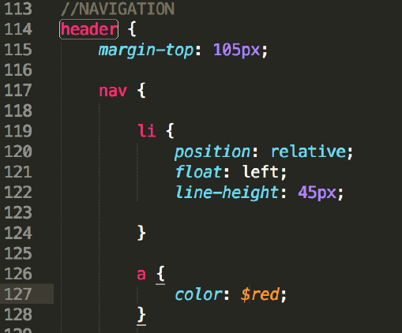
Nesting
Nest CSS selectors in a way that follows the same visual hierarchy of HTML

Slide 60
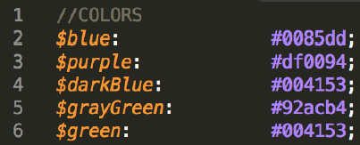
Variables
Way to store information that can be used throughout the stylesheet

Slide 61
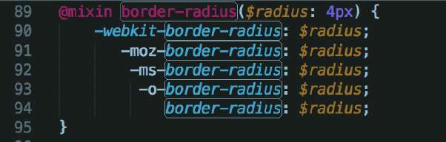
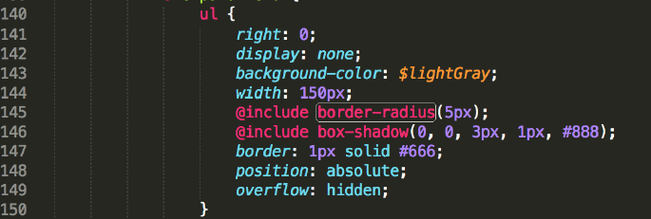
Mixins
A mixin lets you make groups of CSS declarations that you want to reuse throughout your site

Slide 62
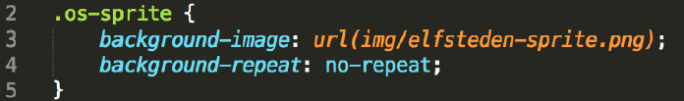
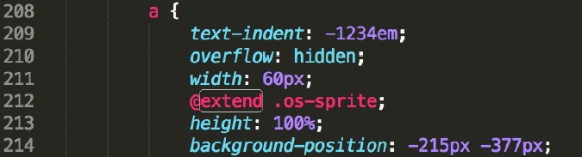
Inheritance
Using @extend lets you share a set of CSS properties from one selector to another
Helps keep the css DRY (Don’t Repeat Yourself)

Slide 63



The leading CSS Preprocessors
http://lesscss.org/
http://sass-lang.com/
http://compass-style.org/
http://learnboost.github.io/stylus/
http://visionmedia.github.io/nib/
Notes:
http://net.tutsplus.com/tutorials/html-css-techniques/sass-vs-less-vs-stylus-a-preprocessor-shootout/

Slide 64



The leading CSS Frameworks
YAML (Yet Another Multicolumn Layout)
Foundation 5
Bootstrap
Notes:
http://net.tutsplus.com/tutorials/html-css-techniques/sass-vs-less-vs-stylus-a-preprocessor-shootout/

Slide 65
Sass
A system that extends css and makes it more organized
Has two main parts
SassScript
Scripting language that extends CSS syntax, adding nested rules, variables, mixins, selector inheritance and more
SASS CSS pre-processor
Interprets SassScript and produces well formatted standard CSS

Slide 66
Compass
Compass is a open source CSS authoring framework
Compass uses Sass
Compass consists of a collection of helpful tools and SASS library that produces cross-browser CSS

Slide 67
The flow
Write your SassScript
@import Compass libraries into your SassScript file (optional)
Use a CSS preprocessor to interpret your SassScript
CSS files are produced by the preprocessor (use these in the website)

Slide 68
Javascript Frameworks
More Frontend

Slide 69
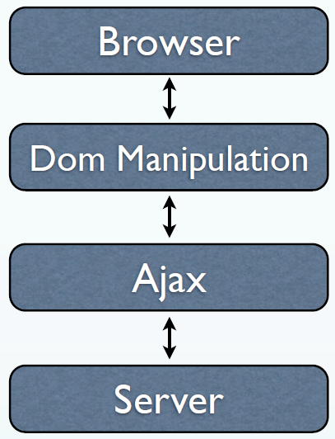
jQuery
It does give us easy access to DOM manipulation, ajax, animation, events etc.
It doesnʼt provide all the tools needed to build serious JavaScript web application

Slide 70
What we need..
Using only jQuery, it’s easy to create a mess of callbacks and selectors
We need,
Code base which is easy to modify / maintain...
To separate application concerns & keep the code decoupled
Could be a single-page application (SPA) with multiple views of the data, but require no hard page refresh?
Good performances / experiences

Slide 71
What’s missing in jQuery
Client-side Template
Modular / Structure organization
Browser State Management (location.hash)
Manageable routing to your application
Dependency management
Remote / Local Persistent layer
Architecture patterns (like MVC, Delegation)
Support Testing

Slide 72
MVC pattern in JS
Models represent status and behaviors, Interact with data...
Views can be considered the UI. Link events to methods and generate dynamic HTML.
Controller sits between Models and Views.
JS MVC frameworks offer a simple way to separate concerns and provide much needed structure to web apps

Slide 73








Lot of choice for trying to keep client-side javascript clean
http://todomvc.com/

Slide 74

Categorizing
Flexible
Barebones
Low Learning curve
Opinionated
Lots of features
Higher learning curve

Slide 75
Backbone’s MVC
Models: represent data that can be created/validated, destroyed & listened to for changes. Collections are sets of models.
Views: display the modelʼs data / provide the user interface layer
Controller: methods for routing client-side URL fragments

Slide 76
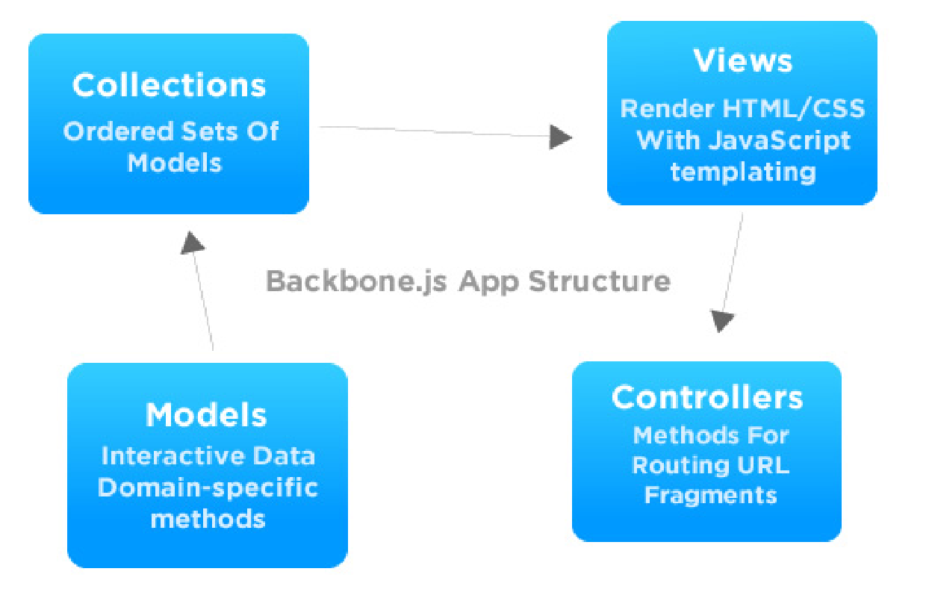
Backbone’s MVC

Slide 77
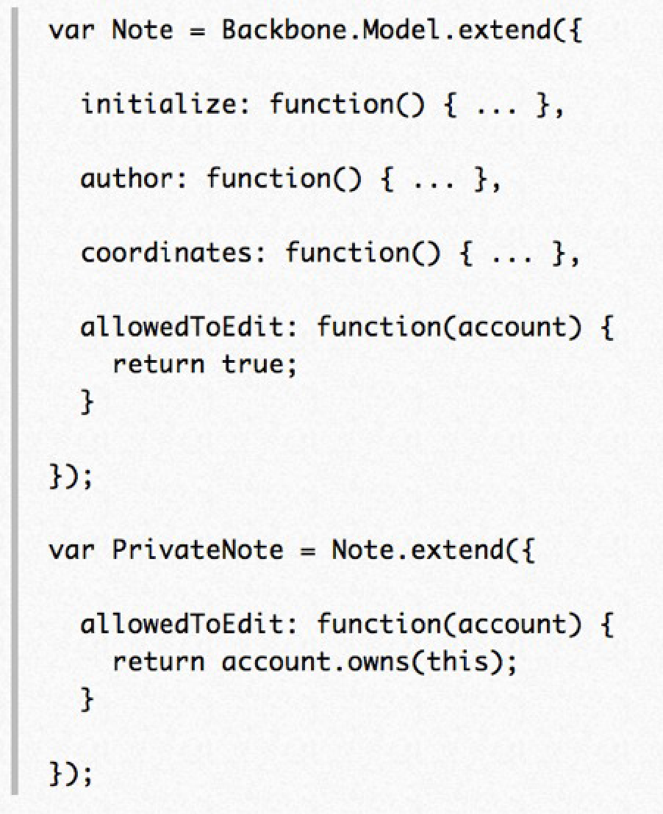
Backbone’s Model
Notes:
Models are the heart of any JavaScript application, containing the
interactive data as well as a large part of the logic surrounding it:
conversions, validations, computed properties, and access control. You
extend Backbone.Model with your domain-specific methods, and Model
provides a basic set of functionality for managing changes.

Slide 78
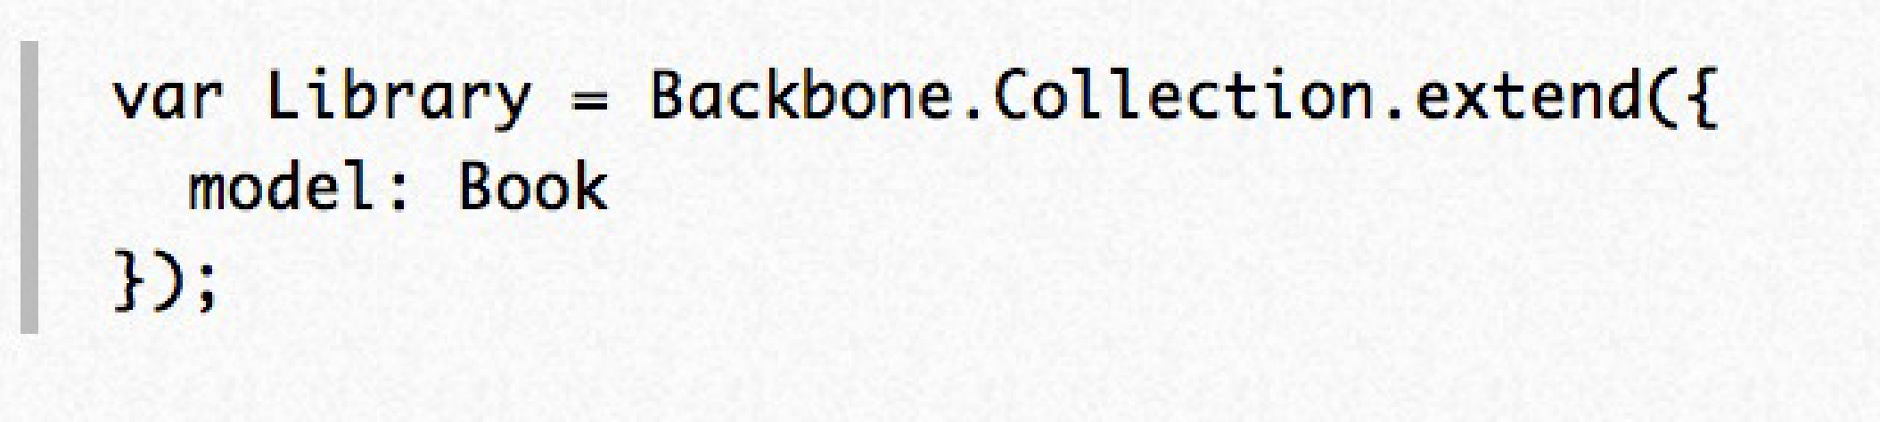
Backbone’s collection
Collections are ordered sets of models.
Collections may also listen for changes to specific attributes in their models
Notes:
Collections are ordered sets of models.
Collections may also listen for changes to specific attributes in
their models

Slide 79
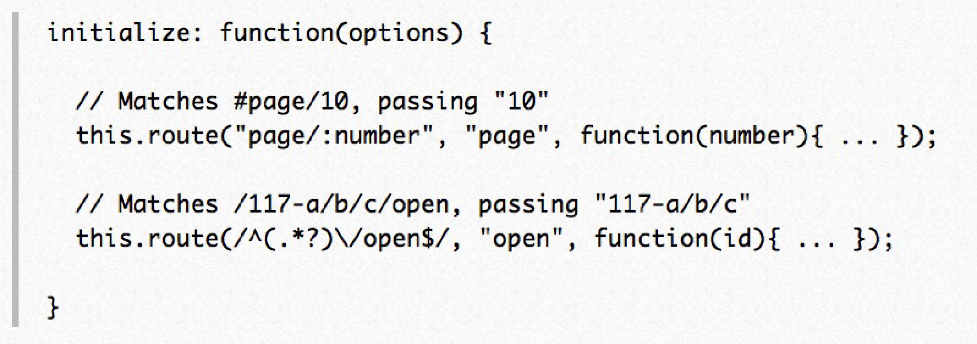
Backbone’s controller
Controller provides methods for routing clientside URL fragments, and connecting them to actions and events.

Slide 80
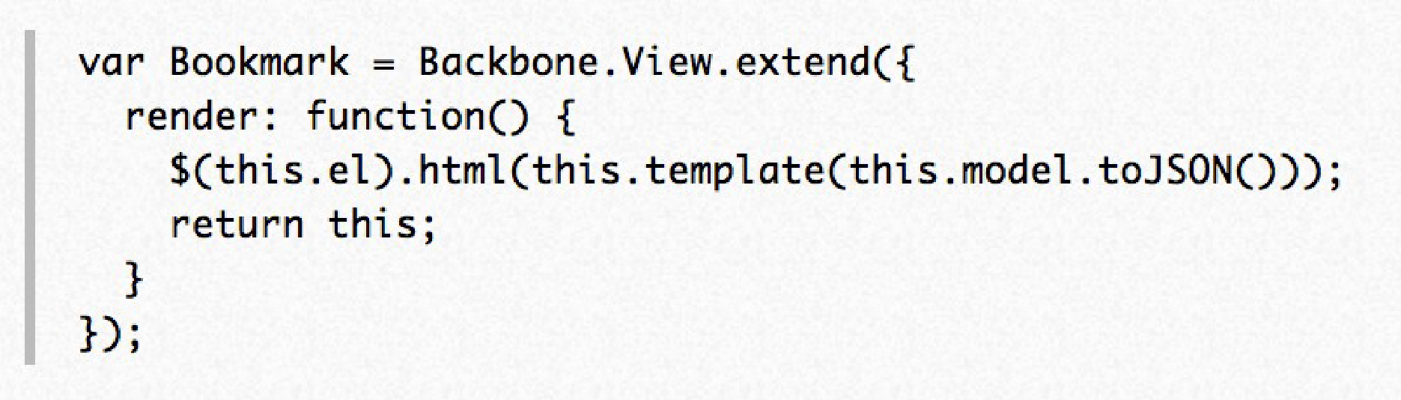
Backboneʼs View
Backbone views are used to reflect what your applications’ data models look like. They are also used to listen to events and react accordingly.

Slide 81
More about Backbone
http://documentcloud.github.io/backbone/
http://backbonetutorials.com/

Slide 82
Clear up a couple of things
Node
Also known as Node.js, Node is the JavaScript environment on which we run our server-side JavaScript code. It is based on the V8 JavaScript engine. All of the JavaScript code you write, or install and run from packages from NPM, GitHub, etc. is executed by the Node runtime environment.
CoffeeScript
CoffeeScript is, plain and simple, a programming language that compiles down to JavaScript. Its purpose is to expose all the power of JavaScript in a simpler way. It's important to keep in mind that all CoffeeScript code just gets compiled to JavaScript when you run it; the differences are purely syntactical. Its website has much more information.
Backbone
Backbone can be likened to as a Model-View-Controller framework for JavaScript. It was originally written for the browser; it helps keep your client-side JavaScript clean by implementing most common MVC patterns (as well as a couple other things), allowing you to more easily connect your client-side JavaScript to your server-side code.
Express
Express is a web framework for Node.js built on Connect. It is similar in many aspects to Sinatra for Ruby. It allows you to easily create web sites with routing, layouts/partials/views, sessions, and more. There are a lot of third-party modules for Express, making it pretty easy to get exactly the kind of stack you need.

