Slide 1
Predicting Titanic Survival Rates with a Multi-Layer Perceptron
Q320 Final Project
Josh Isaacson

Slide 2


Broad Motivation
Goal: learn how to implement a neural network on a relatively large dataset and validate its performance
Dataset: Titanic: Machine Learning from Disaster
Predict if a passenger survived the Titanic or not

Slide 3
Multi-Layer Perceptron
Supervised learning model
Model makes a guess, then evaluates the error, then makes changes to minimize it
Backpropagation
Classification
Problem of IDing where a new instance belongs
Basis of a training set of data with known membership
Hidden
Inputs
Outputs

Slide 4
Data Exploration
Data is split into:
Train.csv
Trains the model and is used to choose features
Test.csv
Validates the model’s performance on new data
Predict whether or not each passenger survives the Titanic

Slide 5
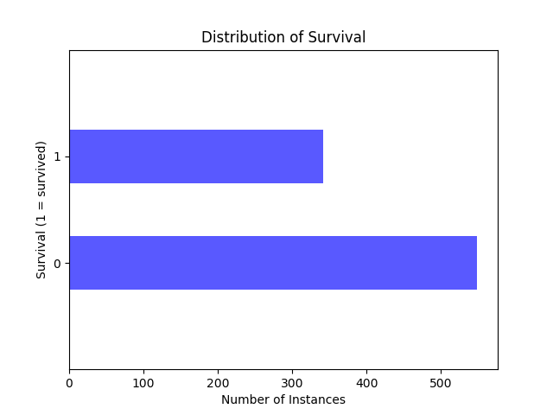
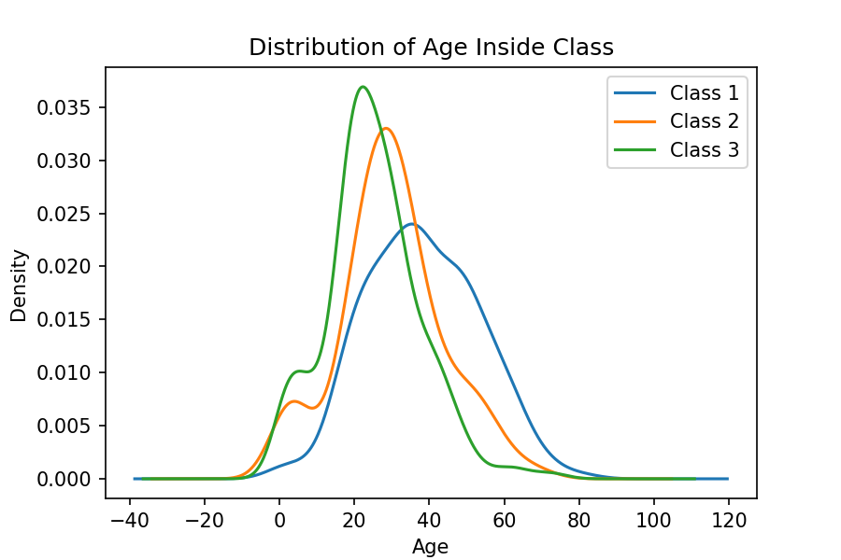
Data Exploration – Cont.

Slide 6
Pre-Processing
Dropped PassengerId, Name, Ticket, and Cabin Columns
Not useful to analysis
Set 0 = female, 1 = male in Sex Column
Set variables to the 3 types of Class
Filled NaN spaces in Ages by:
Created random generator based on avg, standard dev, and sum of null instances
Filled NaN space in Fare

Slide 7
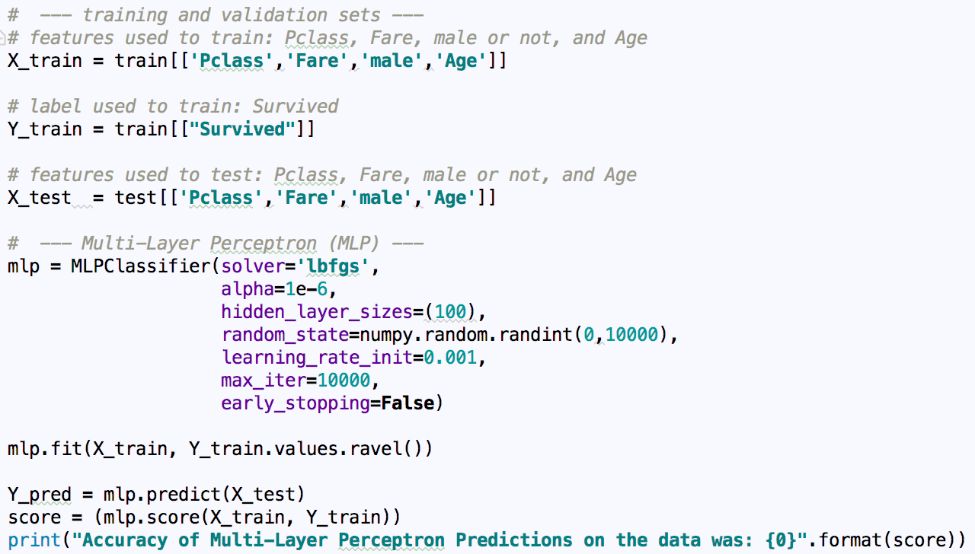
Classifier Implementation
features used to train:
Pclass
Fare
Sex -> male
Age
label used to train:
Survived

Slide 8
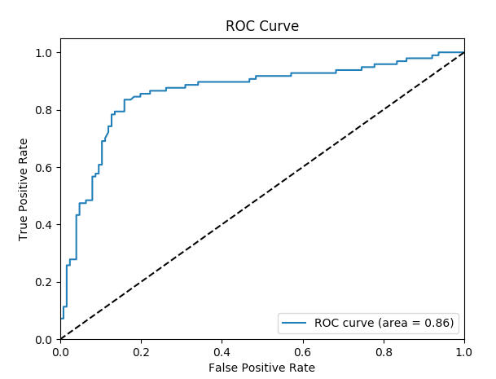
Interpretation of Results
ROC Curve (Receiver Operating Characteristic)
Accuracy measured by area under the curve
(Greater area is better)
The area really measures discrimination
Ability of the test to correctly classify those who survived and those who didn’t

Slide 9

Sources
https://www.kaggle.com/c/titanic
http://scikit-learn.org/stable/modules/neural_networks_supervised.html
http://www.dataschool.io/roc-curves-and-auc-explained/
https://github.com/jsisaacs/Q320-Final-Project

