Slide 1
Feature Selection and Classification for Simulated Data Set
Name : Jayanth Sivakumar
Kaggle Team Name : RandomForest

Slide 2

Challenges
The dataset is very big (n = 600,p = 40000)
Loading the dataset is very time consuming
Train Set = 187.241s
Test Set = 291.925s
It takes ~ 8 minutes to load both the datasets
Parallel Computing helps overcome these challenges and improves the running time
Using the R package’s bigmemory, It has the support for loading very huge datasets
It loads the dataset as big.matrix type
Loading both the datasets using bigmemory has been substantially reduced to 1.4 Minutes
It is very fast and efficient.

Slide 3
Variable Selection
R package’s bigstep that supports parallel computing, performs modified stepwise selection procedure
In the first step the likelihood ratio tests between two regression models are performed:
with only the intercept
with the intercept and every single variable from the matrix X .
P-values are calculated and variables with p > minpv (threshold) are excluded from the model selection procedure.
In the second step (multi-forward) we start with the null model and add variables which decrease crit.multif (in order from the smallest p-value).

Slide 4
Variable Selection
The step is finished after we add maxf variables or none of remaining variables improve crit.multif.
Then the classical backward selection is performed (with crit ).
When there is no variables to remove, the last step, the classical stepwise procedure, is performed (with crit ).

Slide 5
Variable Selection
SelectModel is the function from bigstep which does the variable selection
It takes the matrix of type big.matrix and normal matrix type
Dataset was loaded as big.matrix because of the high dimensionality
fitLogistic option in the function fits the logistic model and calculate the log likelihood.
It returns the names of the variable in the final model.
Finally, the datasets have been filtered with these variables in both training and test set.
Using these filtered datasets, the models have been created.

Slide 6
Model Creation and Assessment
Before variable selection, Lasso for classification was trained on the whole dataset.
It took a long time and the accuracy was 75% in Kaggle.
After selecting the variables using bigstep, the accuracy improved to 96%
After the variable selection, the training and test set was filtered with these selected from selectModel
The original dataset is split into training set and validation set (70 – 30) using this filtered dataset
Split dataset is used for training on Lasso using repeated CV.

Slide 7
Model Creation and Assessment
For the best performing model, the error on the validation set for each repeats was saved
Based on the less validation error, the respective tuning parameters and the model was selected
Apart from training the filtered dataset on Lasso, several other algorithms were used
SVM was used to fit on the filtered dataset and it performed equally well like Lasso

Slide 8
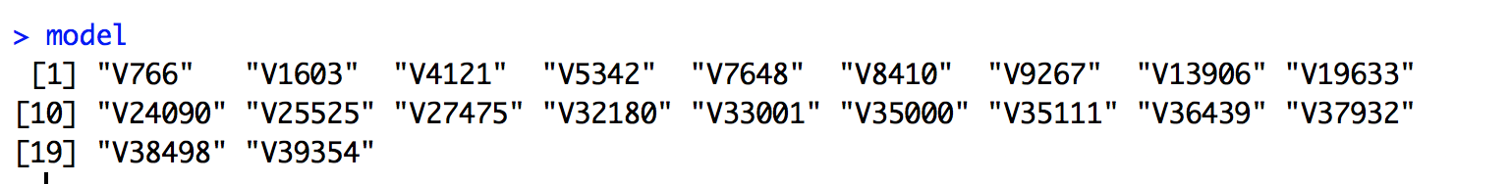
Selected Variables
Only 20 variables were used to find the best performing model
Using Lasso, the filtered dataset with these 20 variables gave the highest accuracy on the validation set as well as on Kaggle Entry.
The Variables are

Slide 9
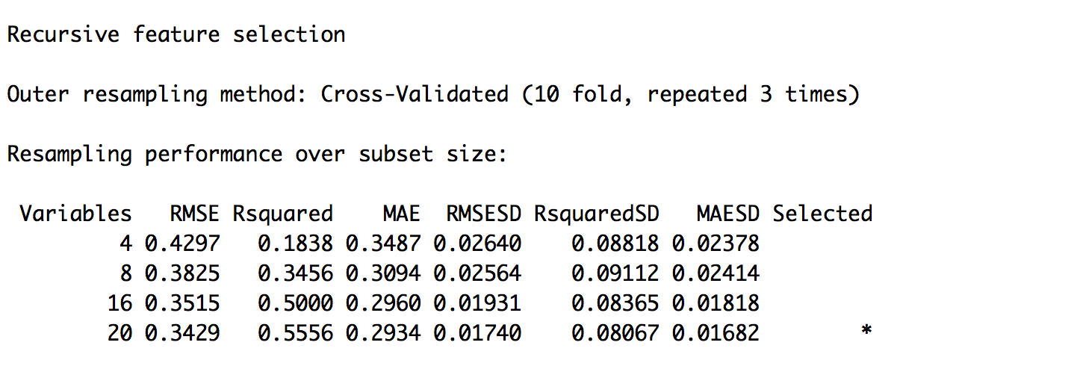
Variable Importance
The plot shows the variable importance,
To check if the variables selected outperformed, Recursive Feature Selection has been used
As you can see the selected model from RFS is with 20 variables.
All these 20 variables have very less P-value.
On the other hand, the correlation between these variables and the outcome is high showing that these variables are the strong predictors.

Slide 10
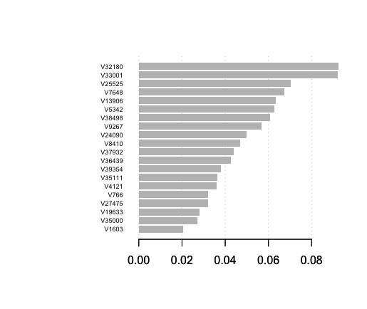

Slide 11
Learners
Learners | Variable Selection? | Training Error | Validation Error | Kaggle Test Error
Lasso | Yes | 0 | 0.0333333 | 0.02143
SVM* | Yes | 0 | 0.0333333 | 0.025
Logistic Regression* | Yes | 0 | 0.02 | 0.06667
Biglasso | No | 0 | 0.1833333 | 0.18472
Elastic Net | No | 0 | 0.2 | 0.29286
*Without variable selection – stack overflow error

Slide 12
Thank you!

