Slide 1
Aditi Careers Mobile Application
Sketches for iOS platform

Slide 2
Salient Features
One single app for all careers related information
Easy and aesthetic user experience
Ability to set favourites to track specific openings
Location aware app to filter positions by current location
Share openings by mail, sms, Facebook and Twitter
View Aditi news and social feeds in the app.
Aditi employees can use the app to refer friends.
iCloud integration to select and upload resumes.

Slide 3
Sketches

Slide 4
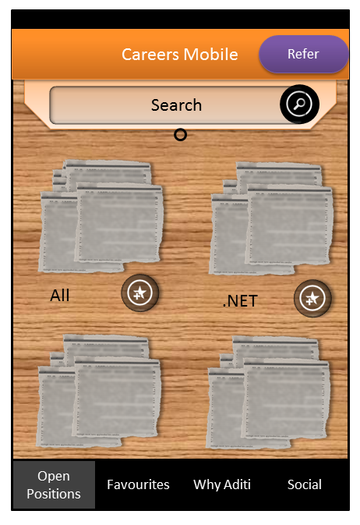
Home Screen – Open Positions

Slide 5
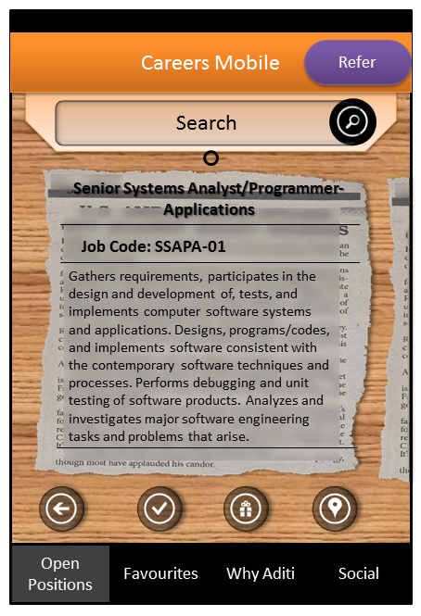
Home Screen – Positions List

Slide 6
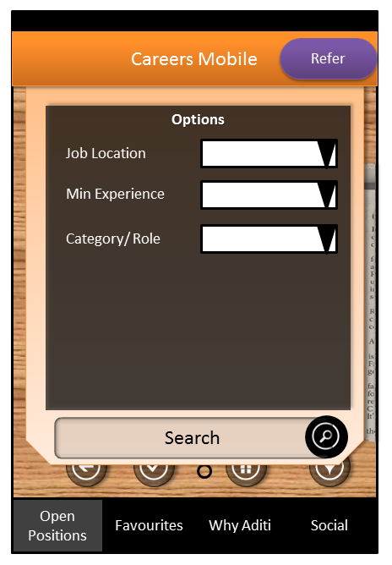
Home Screen – Search Curtain

Slide 7
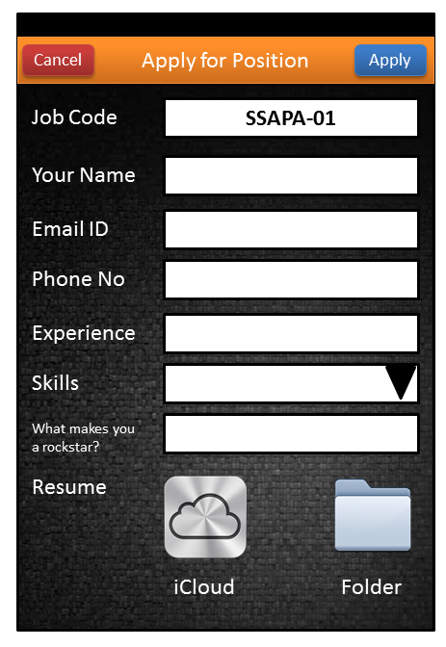
Apply for a Position

Slide 8
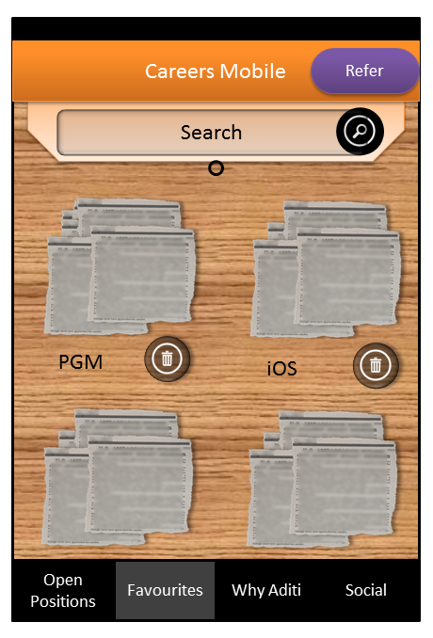
Home Screen – Favourites

Slide 9
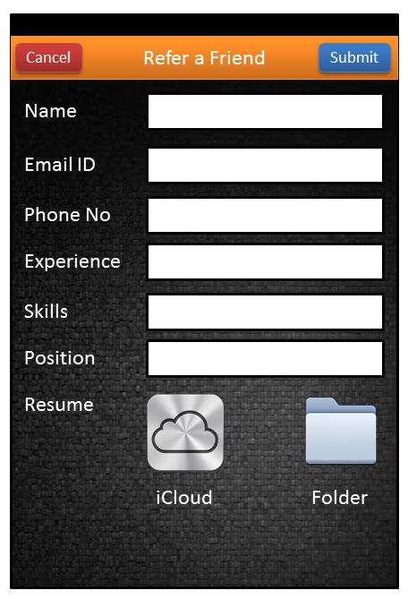
Refer a Friend

Slide 10
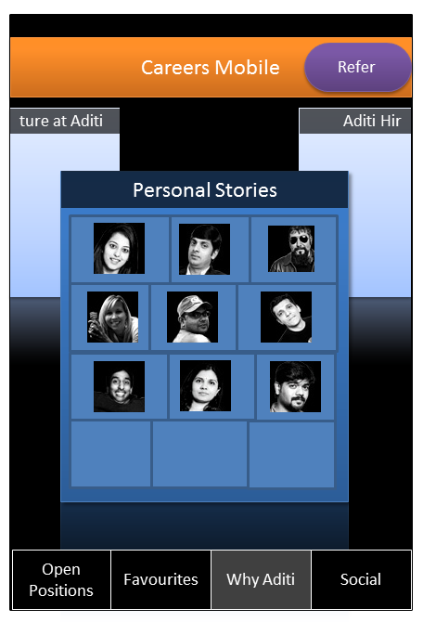
Home Screen – Why Aditi

Slide 11
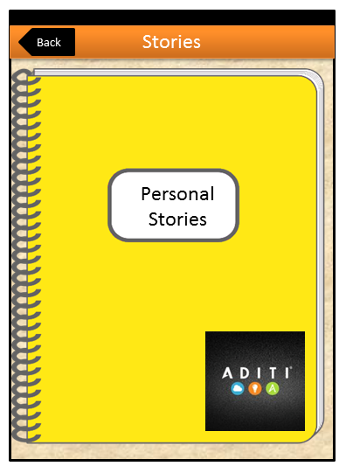
Personal Stories

Slide 12
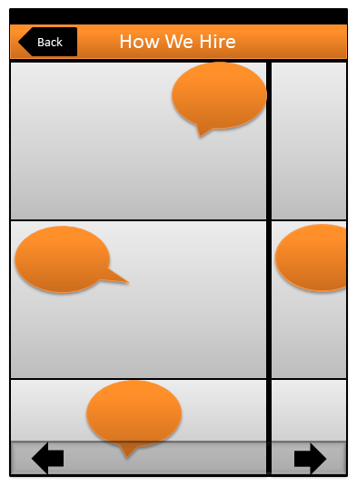
How We Hire Comic

Slide 13
Thank You

