Slide 1
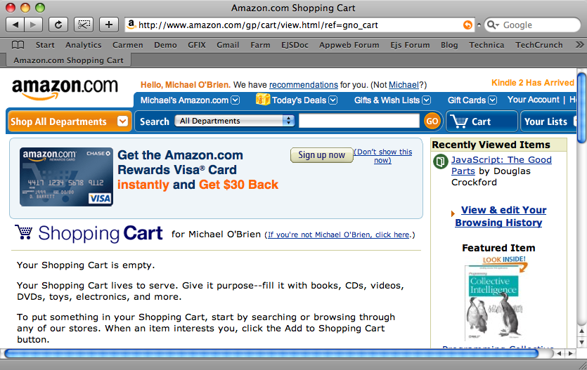
Controller
Model
View
Database

