Slide 1
Start ABC
Start ST
Start IMP
Start IMP
Drill
Stop ABC
Stop ST
Stop IMP

Slide 2
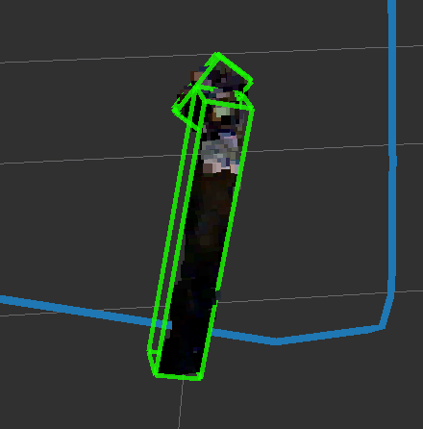
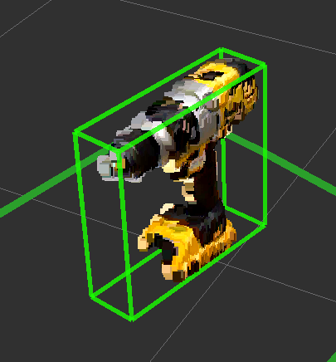
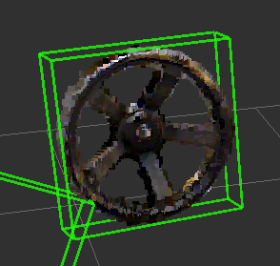
Start ABC
Start ST
Start IMP
Start IMP
Drill
Recog
Handle
Stop ABC
Stop ST
Stop IMP
Recog
Drill
Recog
Valve

