Slide 1

Subject n°3:
Classification of Micro-Calcification, to predict breast cancer
SKAF Joey
Techniques of Artificial Intelligence

Slide 2

TABLE OF CONTENTS
01
03
02
04
Introduction
Task 2
Presentation of the topic and its content
Predicting Breast Cancer
Task 1
Conclusions
Classifying micro-calsification
Possible improvements
2/32

Slide 3

01
Introduction

Slide 4
Introduction
Breast Cancer
In 2020, there were 2.3 million women diagnosed with breast cancer and 685 000 deaths globally*
By an early diagnostic of the disease, avoid the cancer being lethal
To do so : analyze micro-calcifications in women’s breast (shape, texture)
(*) According to the World Health Organization website : https://www.who.int/news-room/fact-sheets/detail/breast-cancer
4/32
Notes:
Breast cancer is unfortunatly a common cancer that impacts women. According to the World Health Organization, in 2020, there were 2.3 million women diagnosed with breast cancer and 685 000 deaths globally.

Slide 5
Introduction
Goal
Predict breast cancer, given a dataset of micro-calcifications of multiple individuals
→ Machine Learning techniques
5/32

Slide 6
Introduction
Questions to answer
Task 1: How well can you classify individual micros assuming all micros per subject have the same label?
Task 2: How well can you classify whether a subject has cancer based on your classification of the multiple micros per subject?
6/32

Slide 7
Introduction
Dataset
3561 micro-calcifications
96 patients that has cancer or not (specified in the last column with 0 : no cancer and 1 : cancer)
152 different features measurable
7/32

Slide 8
Introduction
Machine learning algorithms used
Logistic Regression algorithm on a dimensionally reduced dataset (we use the Principal Component Analysis method).
Support Vector Machine
Neural Network
Neural Network on a dimensionally reduced dataset (i.e. applying PCA on the dataset)
8/32

Slide 9
Introduction
Important remark
Dataset is unbalanced
We use F1 score that is adapted to counter this problem
False negatives case : patient has/had cancer, but the model predicts it as "no cancer"
Thus, we also calculate the number of false negatives case ( 1 – Recall )
9/32

Slide 10



02
Task 1
Classifying micro-calsifications

Slide 11

Approach
Because there is a strong correlation between micro-calcification and breast cancer, we can say that having cancer implies having malignant macro-calcification but because we assume all micros have the same label, having breast cancer implies that all the macros are malignant. And the same for the equivalence here : no-breast cancer ↔ all micros are benign. So, we will do a supervised learning, saying that label "breast cancer" is equivalent, in our problem, to "malignant/benign macro-calcification".
11/32

Slide 12
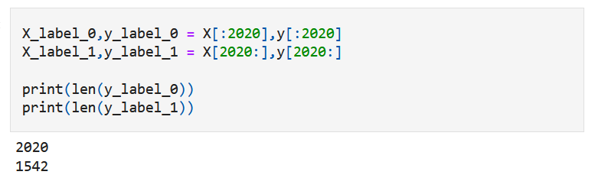
Task 1
Loading the dataset
Dataset is unbalanced
12/32

Slide 13
Task 1
Pre-processing the dataset
Divided it into label 0 label 1
Do a train-test-split to have training set, validation set and test set
We want the same proportion in each set (personal choice, see “Conclusions” part)
We reshuffle everything
Standardize and PCA on X train/val
13/32

Slide 14
Task 1
Validation part
We do model selection on the base of a cross-validation
Give a good estimate of the error out-of-sample (optimistic bias on the error)
Allows us to pick the best model: trade-off between F1 score and False Negative Score
We select by hand the “best” model
14/32

Slide 15
Task 1
Results
We choose NN with PCA to do the task 2
15/32

Slide 16
03
Task 3
Predicting Breast Cancer

Slide 17
Approach
Given the learning algorithm we acquired in the first step, we can classify the micros and give them a label (even if the label is wrong), we do not have anymore the hypothesis of all micros having the same label. So we will add as a feature of the calcification, the column "malignant/benign macro-calcification", and based on that, we will do a supervised learning, with as the supervised label, the "breast cancer" column.
17/32

Slide 18
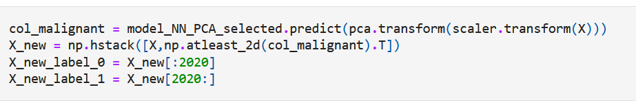
Task 2
Label "malignant/benign macro-calcification"
Then, same pre-processing than task 1
Same model selection
18/32

Slide 19
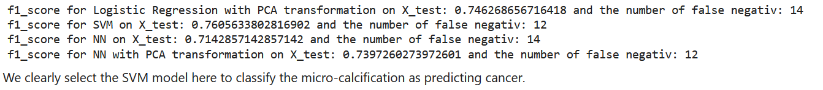
Task 2
Results
!!!
19/32

Slide 20
04
Conclusions

Slide 21
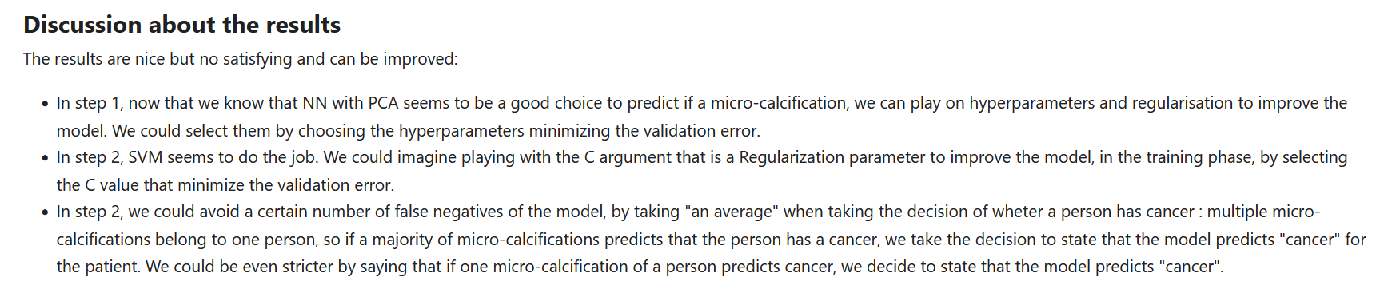
Conclusions
What I’ve written in the paper
21/32

Slide 22
Conclusions
What I want to add today
Terrible idea to select a model regarding the test errors :
We are interfering in the test part, we are LEARNING a model
We do a kind of model selection and the error we have is not the error out-of-sample but an optimistic bias of it.
Model selection back to validation part
Optimizing parameters of each model by doing a grid search
Other solution : put the 4 models together (aggregation technique) and use them as an Ensemble (be careful we are not overfitting/losing in generalization)
22/32

Slide 23
Conclusions
What I want to add today
Balance the Dataset (afterwards, an extract of my Statistical Foundation Machine Learning Oral Presentation)
23/32

Slide 24
Main Idea
Observe the effects of a dataset’s imbalance on the performances of a learning process, here SVM
Do it on a real dataset
Do it on a synthetic dataset, by unbalancing it little by little
24/32

Slide 25
Real dataset case
Detecting breast cancer from images.
One instance of the table : a micro-calcification
Micro-calcifications:
Are tiny white calcium deposits in the breast
Are very easy to see on mammography
Micro-calcifications appear as a natural process of ageing
Binary classification problem on 3562 instances, 152 attributes.
Labels : has or not cancer, that here we will approximate by “micro-calcification being benignant or malignant”.
25/32
Notes:
Because there is a strong correlation between micro-calcification and breast cancer, we can say that having cancer implies having malignant macro-calcification but because we assume all micros have the same label, having breast cancer implies that all the macros are malignant. And the same for the equivalence here : no-breast cancer <=> all micros are benign. So, we will do a supervised learning, saying that label "breast cancer" is equivalent, in our problem, to "malignant/benign macro-calcification".

Slide 26
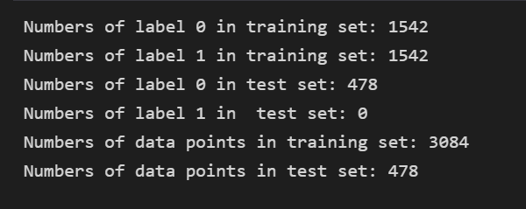
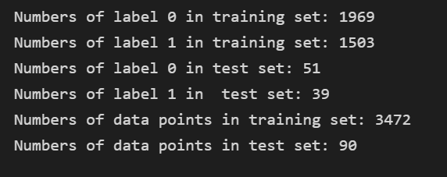
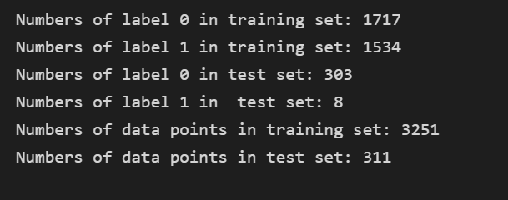
Real dataset case : approaches’ description
Test 3 configurations :
We balance the training dataset, and use 478 data points having label 0 for the test set.
We keep the same proportion of label 0 and 1 in the training and the test set, we keep a high number of data points
We do a trade-off between the two cases above
First configuration
Second configuration
Third configuration
26/32

Slide 27
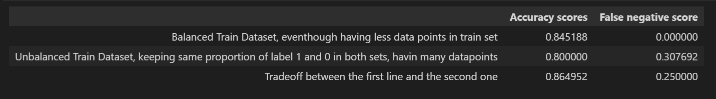
Real dataset case : results
“We observe that the third case performs the best according to the two error metrics, chosen. We could nuance this result, especially the false negativ scores, by saying the limited number of label 1 in the test set, but still, the way we calculte it allows us to be pretty confident about the two scores. We can deduce that having a balance training set is important for the performance of our model, but we cannot neglect its number of points : we need to keep it high to perform well, especially when the number of datapoints initially is limited.
“ From the report
Got a bit overwhelmed…
27/32

Slide 28
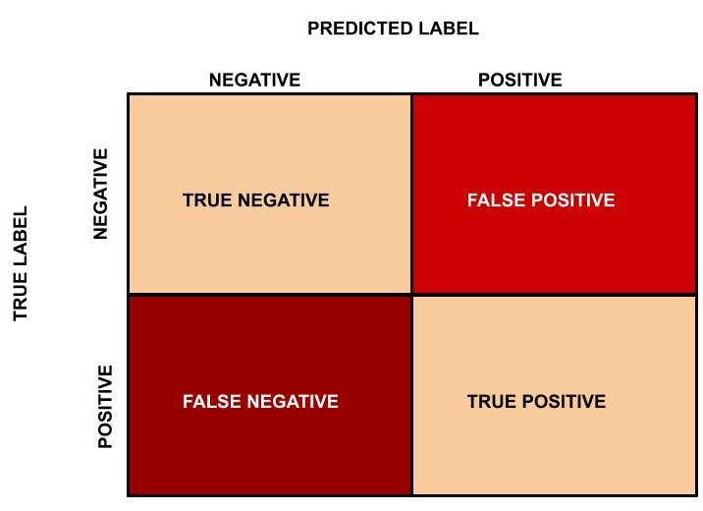
Little reminder : confusion matrix
28/32

Slide 29
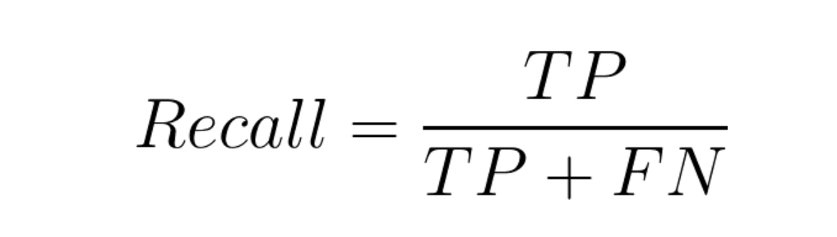
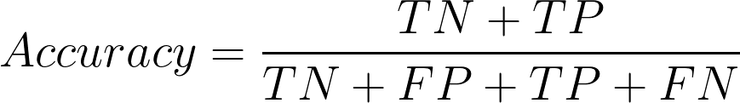
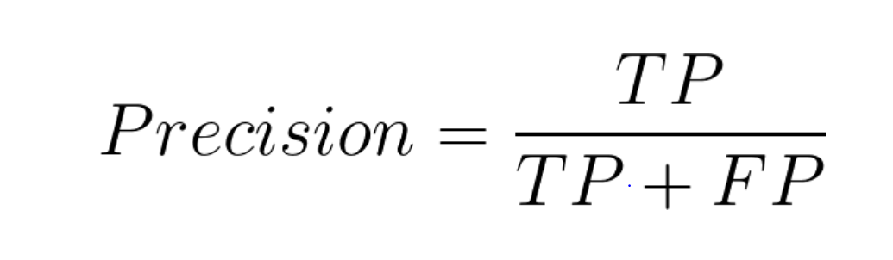
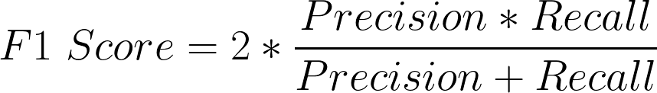
Little reminder : formulas
29/32

Slide 30
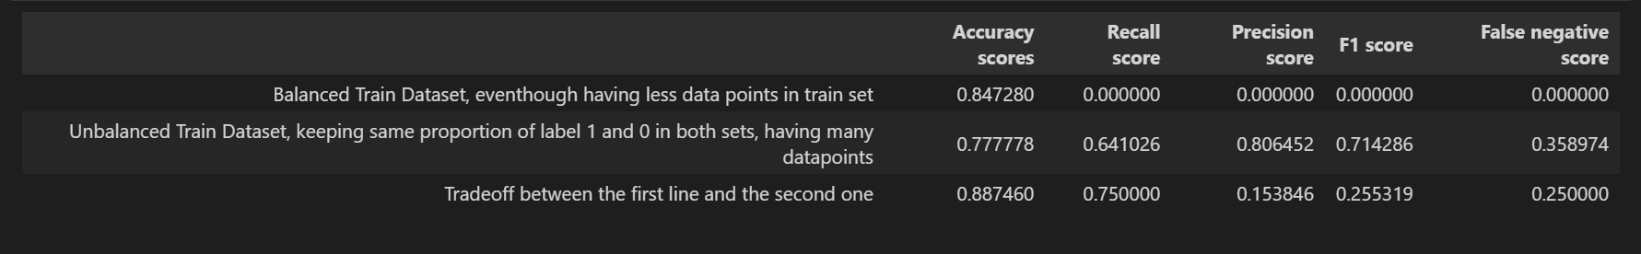
Real dataset case : results with caveats
30/32

Slide 31
Thank you for your attention !

Slide 32
RESOURCES
https://towardsdatascience.com/the-5-classification-evaluation-metrics-you-must-know-aa97784ff226
https://towardsdatascience.com/train-test-split-and-cross-validation-in-python-80b61beca4b6
SFML courses materials (slides, exercises)
32/32

