Slide 1
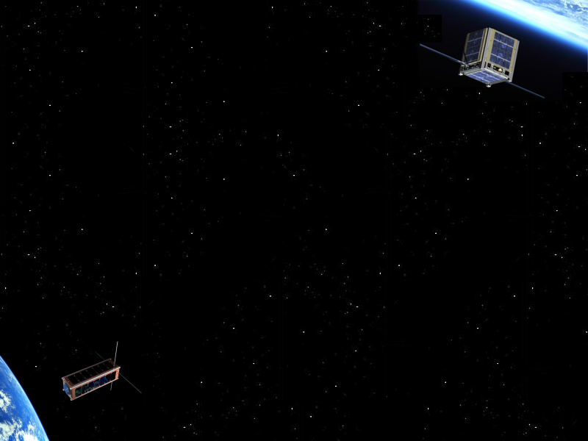

CubeSat
with Jérôme Skoda
Contents
1. What is CubeSat?
2. Standard functions
3. Features
Conclusion

Slide 2
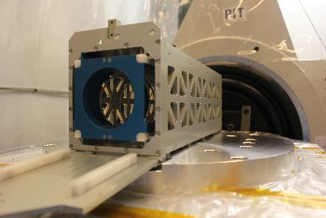
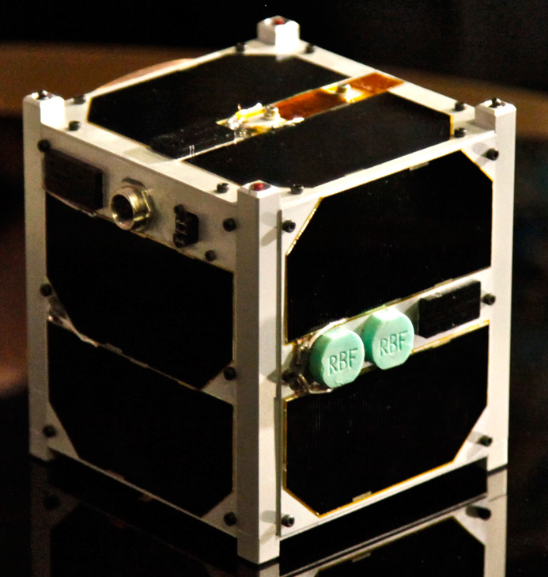
What is CubeSat?
Used for space research
Lowcost: 50 to 100 k€
Modular design
Miniaturized:
1U: 10×10×10 cm (1 liter)
2U: 20×10×10 cm
3U: 30×10×10 cm
More launch opportunities
Figure 1 : CubeSat Orbital Deployer
Figure 2: ESTCube-1
Notes:
Speed – able to exploit parallelism, especially with data intensive applications

Slide 3
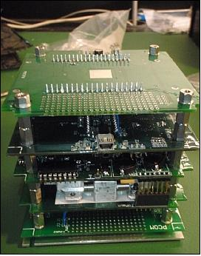
Standard functionality
Attitude Determination and Control System (ADCS)
On-Board Computer (OBC)
Communication system
Power system
Payload
Figure 3: Interior of cubesat
Notes:
Speed – able to exploit parallelism, especially with data intensive applications

Slide 4
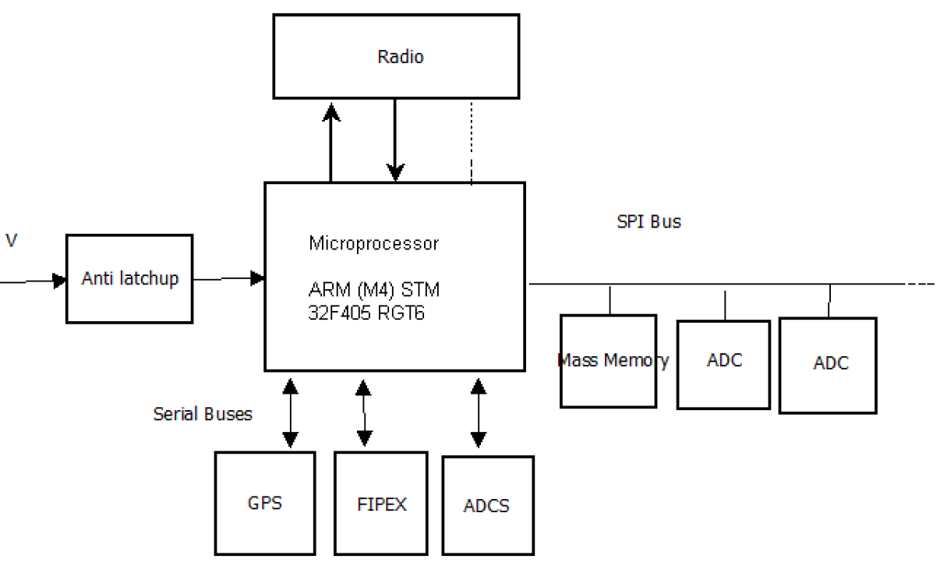
Features
On-Board Computer:
Processor: Power efficient (ARM)
OS: FreeRTOS
Programming language:
C, C++, VHDL, Verilog
Communication system
Data rate: 1 Mbit/s
Protocol: AX.25 / FX.25
Frequency band: 2,0GHz to 2,3GHz
Others technologies used:
FPGA / PSCOC
Source: SpaceCube, X-CubeSat and IgoSat
Figure 4: X-CubeSat Design Overview

Slide 5
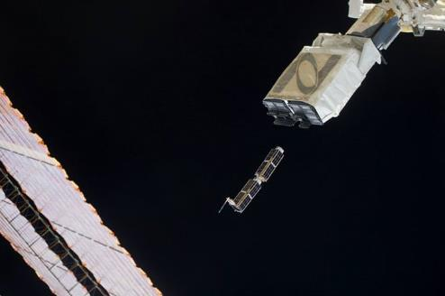
Conclusion
CubeSats offer more opportunities to launch new technologies into space
Figure 5: CubeSat Deployer on the ISS

Slide 6
Reference
“CubeSat: A new Generation of Picosatellite for Education and Industry Low-Cost Space Experimentation”, H Heidt, J Puig-Suari, A Moore, S Nakasuka, R Twiggs, 2000
“The cubesat approach to space access”, A Toorian, K Diaz, S Lee, 2008
Special thanks
Spacelab of IUT de Cachan

