Slide 1
Network Monitoring & Deep Packet Inspection
Wissam Mallouli
wissam.mallouli@gmail.com

Slide 2
Personal Background
Expertise in
Formal methods
Protocol design & engineering
Monitoring techniques
Evaluation and optimization
Working on several European research projects
→Still coding from time to time (between us)

Slide 3
Protocol development lifecycle
Génération
automatique des tests
de conformité
Expression
des besoins
Test de conformité
Conception
- préliminaire
- détaillée
Conception
formelle
Vérification
Test de fonctionnement
- test d'intégration
- test unitaire …
Génération
automatique du code
Implantation

Slide 4
Ingénierie des protocoles
Les différentes étapes du cycle de vie des protocoles
Expression des besoins
Conception
Description Formelle développement
Vérification
Implantation
Test et validation
Déploiement
Maintenance

Slide 5
Seminar plan
Network monitoring
Needs for network monitoring
Measurements (what, where and how)
Limitations (briefly)
Deep Packet Inspection
What is DPI and why it is needed
Application classification
Traffic attributes extraction
Security monitoring with DPI
Abstract description
Challenges
Security properties

Slide 6
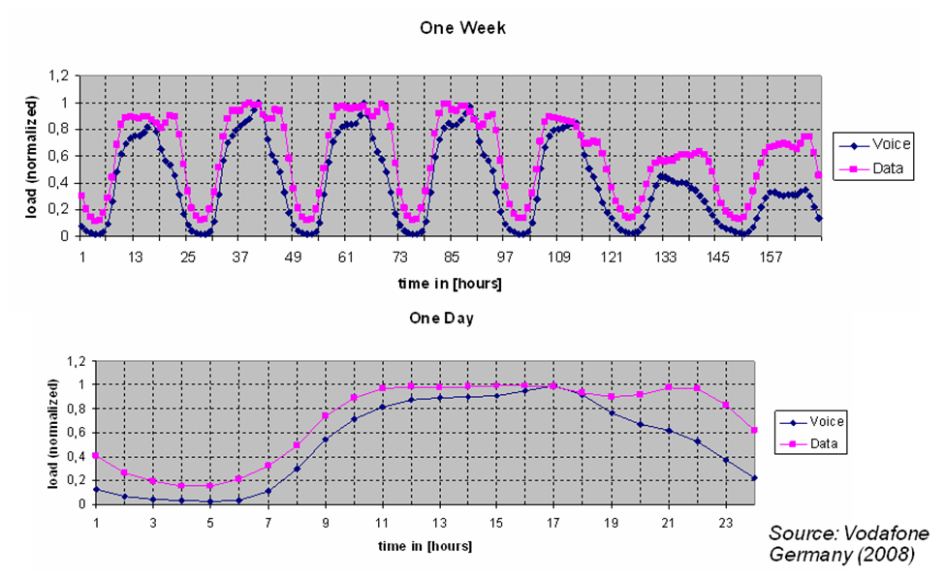
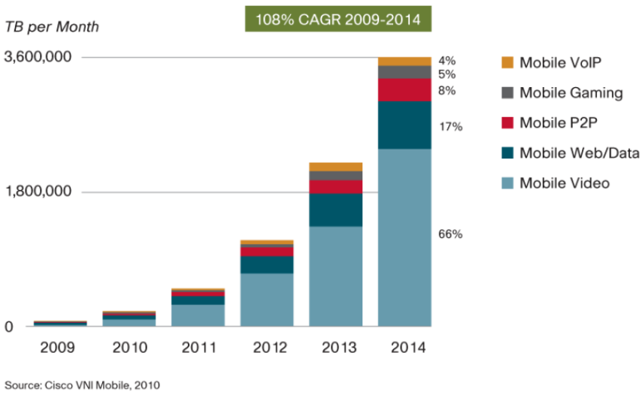
Need for network monitoring Understand / Plan
Need to have a clear visibility over the network
Status, traffic trends, peak time, evolution, etc.
Aggressive pricing the week-end/night
3.5 billion mobile broadband users by 2015
Traffic increase 30 times (wrt 2010)
Understanding
the drivers of this growth
applications/usages
→ contribute for a successful network planning

Slide 7
Need for network monitoring Diagnose & react
Remote User
Typical problem
Remote user arrives at regional office and experiences slow or no response from corporate web server
Where to begin?
Where is the problem?
What is the problem?
What is the solution?
Without proper network monitoring, these questions are difficult to answer
Regional Offices
WWW Servers
Corp Network

Slide 8
Need for network monitoring Diagnose & react
Remote User
Typical problem
Remote user arrives at regional office and experiences slow or no response from corporate web server
Where to begin?
Where is the problem?
What is the problem?
What is the solution?
Without proper network monitoring, these questions are difficult to answer
Regional Offices
WWW Servers
Corp Network

Slide 9
Need for network monitoring Problems might still occur!
The Amazon Web Services Outage (April 2011)
Elastic Block Store: storage database for Amazon’s EC2.
EBS clusters (Database nodes)
Control Plane Services (accepts user requests and directs them to appropriate EBS clusters)
Inter node communication on high bandwidth network and a lower capacity network as a back-up.
Manual Error with routine Network Upgrade Procedure (traffic directed to the low capacity network)
many nodes were isolated.
Etc. (for more info follow the link below)
Tens of sites and businesses impacted for 3 long days
(Source) http://aws.amazon.com/message/65648/

Slide 10
What is network monitoring
Process of observing or inspecting the network at different points
With the objective of
Drawing operation baselines
Produce reports
Notify on abnormal operation
Provide input to network management
Can be used to
Understand the behavior of the network
Detect faults and abnormal operation
Network planning & resource optimization
Network security (Intrusion & Attack Detection)
Performance, quality & SLA monitoring
CRM, Marketing
Sit above traffic measurements
Gather traffic measures and performance indicators
Analyze and correlate the measures in order to make a diagnosis
Notes:
To be able to optimize the available bandwidth
59% of institutions do not monitor or manage bandwidth at all (Belcher, 2005)

Slide 11
Network monitoring: Basics
Monitoring application
Interface for real-time monitoring.
Gathers, aggregates and correlates collected measures
Measurement unit
This performs the measurements
Performance analysis unit
This is where the measurements will be performed.
Observation points
Store collected data in a database for post analysis (trends, history, reporting …).
Calculate indicators (QoS parameters, KPIs).
Collects the required information for analysis.
The more observation points we have, the more accurate data we get.

Slide 12
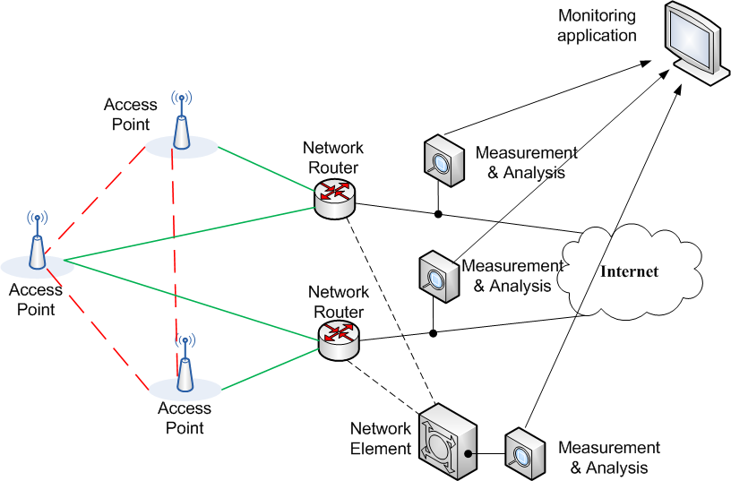
Network monitoring: Basics

Slide 13
Seminar plan
Network monitoring
Needs for network monitoring
Measurements (what, where and how)
Limitations (briefly)
Deep Packet Inspection
What is DPI and why it is needed
Application classification
Traffic attributes extraction
Security monitoring with DPI
Abstract description
Challenges
Security properties

Slide 14
Complexity of network measurements
Size, complexity and diversity of the networks
understand cause-effect relationships is difficult
Measurement is not an objective!
meaningless without careful analysis
Analysis depends on the monitoring objective
Need to define
What, where, how to measure?

Slide 15
Determining What to Measure
Before any measurements can take place one must determine what to measure
Definition of metrics is closely related to the monitoring objective
There are many commonly used network performance metrics
CAIDA Metrics Working Group (www.caida.org)
IETF’s IP Performance Metrics (IPPM) Working Group

Slide 16
Determining What to Measure
Example: Performance metrics can be classified into
Network metrics
Latency
Throughput
Arrival rate
Link utilization, bandwidth
Loss rate
Application metrics
Response time
Connection setup time
availability
User quality metrics (depends on the application)
Mean opinion score (VoIP)
Quality of experience (Video – through estimation)

Slide 17
Determining How to Measure
Active measurements
Passive measurements

Slide 18
Determining How to Measure
Active measurements
Send test traffic into the network
Generate test packets periodically or on-demand
Measure performance of test packets or responses
Popular tools
Ping: RTT and loss
Traceroute: path and RTT
Problems:
Impose extra traffic on network and distort its behavior in the process
May impact the behavior of the network (self interfering)

Slide 19
Determining How to Measure
Passive measurements
Observing network traffic at the measurement point(s)
Packet capture (wireshark)
Flow-based measurement tools (routers)
SNMP tools (mostly used)
Perform analysis for various purposes
Used to perform various traffic usage/characterization analysis/intrusion detection
Problems
LOTS of data!
Privacy issues
Performance issues (wire speed packet capture and analysis)

Slide 20
Comparison of active/passive measurements
 | Active measurements | Passive measurements
Configuration | Multi-point | Single or multi-point
Data size | Small | Large
Network overhead | Additional traffic | - Device overhead - No overhead if splitter is used
Purpose | Delay, packet loss, availability | Throughput, traffic patterns, trends, & detection
CPU Requirement | Low to Moderate | High

Slide 21
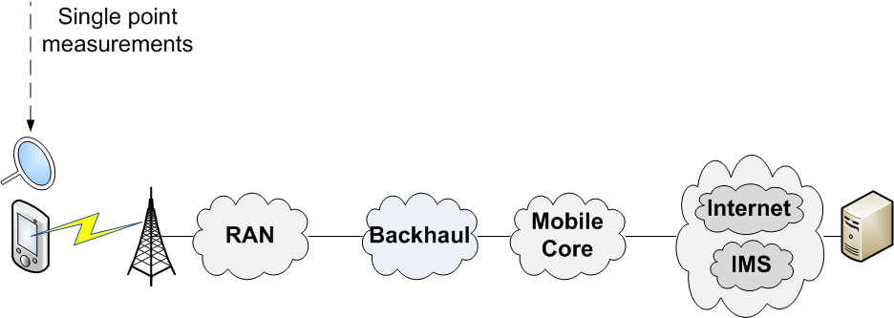
Determining Where to Measure
Single point measurements
Provide partial view of the network

Slide 22
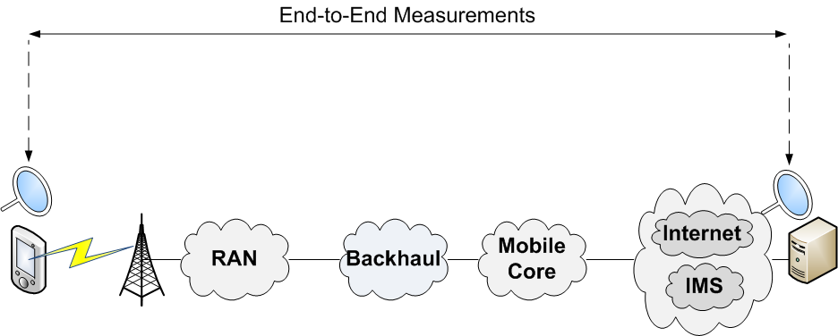
Determining Where to Measure
End-to-end measurements
Provide a view on the performance between the the end points

Slide 23
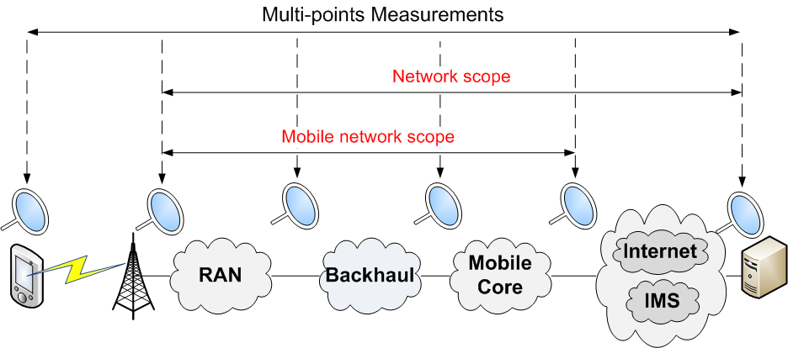
Determining Where to Measure
Multi point measurements
Provide a view on the performance in the different “monitored” segments of the network

Slide 24
Seminar plan
Network monitoring
Needs for network monitoring
Measurements (what, where and how)
Limitations (briefly)
Deep Packet Inspection
What is DPI and why it is needed
Application classification
Traffic attributes extraction
Security monitoring with DPI
Abstract description
Challenges
Security properties

Slide 25
Limitation of measurements
For years, monitoring used primarily
Global traffic measures provided by Simple Network Monitoring Protocol
Traffic data provided by routers (netflow data)
These information are always of great interest
However, are they sufficient?

Slide 26
Limitation of measurements
What if we need to know:
Who’s using Skype, P2P, VoD, etc.?
Most popular applications on the network
Proportion of VoIP calls with bad quality
Quality of experience for video streaming
New means for providing accurate traffic measures is required
Deep Packet Inspection is a good candidate

Slide 27
Seminar plan
Network monitoring
Needs for network monitoring
Measurements (what, where and how)
Limitations (briefly)
Deep Packet Inspection
What is DPI and why it is needed
Application classification
Traffic attributes extraction
Security monitoring with DPI
Abstract description
Challenges
Security properties

Slide 28
Deep Packet Inspection
What is DPI and why it is needed
Application classification
Traffic attributes extraction

Slide 29

What is DPI
Technology consisting of digging deep into the packet header and payload to “inspect” encapsulated content
Content may be spread over many packets
Packet Header Layers
Packet Payload / Application Layers
L2
L3
L4
L5 – L7
Ethernet
Internet Protocol (IP)
Transport Layer (TCP/UDP)
Email (SMTP, POP3, IMAP)
Web (HTTP/S)
Instant Messaging (IM)
Peer-to-Peer (P2P) Applications
Deep Packet Inspection

Slide 30
Why to DPI
Network Visibility
Understand how bandwidth is utilized
What is the application mix
Who is using what, where and when?
Traffic Management (Application Control)
Block undesired traffic (spam, worms, etc.)
Prioritize and shape traffic (limit P2P, QoS, QoE)
Advanced policy enforcement
Zero Facebook, OTT services, per application policy rules
Network management
Advanced billing (abandoning the unlimited data plans)
New pricing may appear soon (user defined preferred applications for free, fees applies for the rest of applications)
Security
Understand network attacks
Core component in next generation firewalls
Etc.

Slide 31
Inside DPI
Group packets belonging to the same session
Application classification
Detect application type (Skype, Bittorrent, etc.) or application family
Considered as the core of DPI
Protocol decoding and attribute extraction
Parse the packet structure (this depends on the protocol & application)
Get protocol attributes (IP @, port numbers, …)
Get session attributes
Events and attributes may involve different packets
Attached file of an email

Slide 32
DPI Drivers
Bandwidth (market driver)
High penetration rate for broadband
At home: ADSL2+, VDSL2, FTTx
Mobile: 3G+ and 4G
Bandwidth per user is ramping up (fixed and mobile)
Legal Interception (legislation driver)
Requirement for service providers
DPI is a core component
More Bandwidth
More Applications

Slide 33





Market drivers: Applications
Video
Expected to reach 60% of mobile traffic
Continue to be highly popular (~ 40-60% BW)
VoIP
Use encryption BitTorrent, eMule
Viable choice for providers (Warner Bros, Spotify)
Skype, GoogleTalk, Yahoo!Voice, Facebook?
Serious competitor for traditional telephony!
P2P
Web video (Youtube, daily motion, video channel) + Telcos (IPTV & VoD)
Gaming
Consoles & PC offer “over the network” gaming experience
Stringent Bandwidth & Latency requirements
Social
Increasing traffic with diverse media contents (embedded video)
High signalling overhead (short frequent sessions)

Slide 34
Seminar plan
Network monitoring
Needs for network monitoring
Measurements (what, where and how)
Limitations (briefly)
Deep Packet Inspection
What is DPI and why it is needed
Application classification
Traffic attributes extraction
Security monitoring with DPI
Abstract description
Challenges
Security properties

Slide 35
Application classification: the challenge
High number of applications and protocols
Same Application – Different Implementations/versions
Bittorrent has more than 30 different client implementations
IM or VoIP don’t use similar protocols
Evolving Architectures
Client/server, Cashes, P2P, Client’s network surroundings: Firewall/NAT, Proxy
Various Clients: PC, Smartphone, Gaming Console
Symmetric vs. Asymmetric
Frequent Updates
Can vary from every year to every month
Typically will affect protocol format
Use of Encryption (Obfuscation)
Primarily designed for counter measuring operator’s throttling and monitoring efforts (eMule, Bittorrent)
In some cases protect proprietary implementation (Skype)
Need to differentiate use
“Good” (legit streaming, SW updates) vs. “Bad” (pirated file sharing) P2P
Need to recognize application subtleties for proper actions
Example: MSN IM – block VoIP & Streaming, allow Chat

Slide 36
Application classification: Techniques
Classification techniques
Port based classification
Pattern matching based classification
Statistical classification

Slide 37
Application classification Evaluation criteria
Completeness
Ratio of the application detection count over the expected detection count
Low detection completeness indicates many false negatives.
A false negative is the inability to classify a flow of application A as a flow of application A.
Accuracy
Ratio of the correct detections over the detection count
Measures how correct the detection technique is
It may not be more than 100%.
The lack of accuracy leads to false positives
A false positive is the classification of application B as being application A.
Impacted if the classification technique is weak
Target: reduce false positives and false negatives in order to reach a sufficient enough accuracy

Slide 38
Analysis by Port Numbers
Reasoning:
Many applications and protocols have assigned port numbers (and widely used)
Example: email
Incoming POP3: 110 (995 if using SSL)
Outgoing SMTP: 25
The Good - It’s easy ☺ The Bad - It’s too easy ☹
Many applications disguise the traffic using ports usually used by different protocols (80, 25, 110, …)
Firewall and Nat traversal
New or unknown protocols
Applications that choose a random port number
Accuracy ~ 30 – 70 % (close to 0% for some applications: P2P)

Slide 39
Analysis by Port Numbers
Basic header information (port numbers)

Slide 40
Analysis by Pattern Matching
Reasoning:
Many applications have pure textual identifiers
Defined in the application or protocol specification documents (RFCs, 3GPP, ITU)
Ex: HTTP request must start with
“Method URI HTTP/1.1”
Easy to search for
Very easy if in a specific location within a packet
Uniqueness not always guaranteed
Risk to have false positives!
Pattern may involve different packets
Track the connection state and signature matching

Slide 41



Analysis by Pattern Matching
Signature over several packets found
information regarding connection state

Slide 42
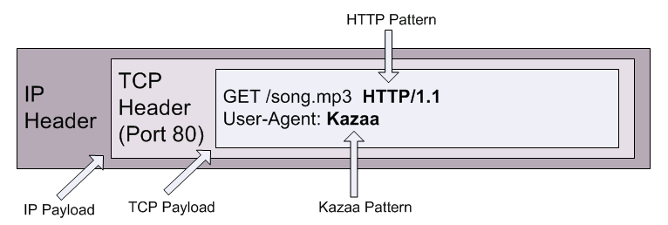
Analysis by Pattern Matching

Slide 43
Behavior and statistical analysis
Many protocols have statistical and behavioral “signatures” that are not related to the data contents:
Packet size
Inter-arrival delay
Specific exchange that can be assimilated to a state machine
The detection requires a number of packets
Example
Very close inter-arrival delays with low deviation from the average (VoIP)
Extremely effective analysis when application uses encryption or obfuscation
Or simply when access to the payload is not possible
Classification in the dark

Slide 44
Behavior and statistical analysis
Skype (Old Version) connection setup
Client
Server
UDP Messages
18 byte message
11 byte message
23 byte message
Either 18, 51 or 53 byte message

Slide 45
Packet classification: an expensive operation
High memory and processing requirements
Will increase with the number of supported protocols and applications
Requires dedicated high capability hardware
Multi-core technology
Line rate packet capture capabilities
How it can be optimized???

Slide 46
Packet Classification: Optimization perspectives (1)
Observation: traffic flows with the same server IP@ and port number will most probably have the same application type
Idea:
Cache server identifiers (IP@ and port number) along with the application class/type
Work mostly for client/server based applications
P2P traffic still needs to be classified
Overall gain though
Preliminary evaluation shows a global gain of 30 ~ 60 % (vary with the application mix)
Looks very promising
Results to be confirmed on large scale evaluation

Slide 47
Packet Classification: Optimization perspectives (2)
Observation: If a user is currently using an application, he will most probably use it again in the very near future
Take yourself as examples ☺
Idea:
Prioritize the classification by checking first the protocols and applications the user has recently used
Require to maintain a cache per user (few items 5-10)
Why not to combine both ideas
Cache of server identifiers and application types
Per user cache of recently used applications

Slide 48
Seminar plan
Network monitoring
Needs for network monitoring
Measurements (what, where and how)
Limitations (briefly)
Deep Packet Inspection
What is DPI and why it is needed
Application classification
Traffic attributes extraction
Security monitoring with DPI
Abstract description
Challenges
Security properties

Slide 49
From classification to attributes and events extraction
Application classification is a first step towards accurate traffic information extraction
How can we get the HTTP method (Get, Post, etc.) if we don’t know the type of the traffic
When the application type is known decoding becomes “easy”
What are traffic attributes?
Protocol field derived from the packet data: IP@, attachment size, encoding type, etc.
Flow parameter: packet mean size, inter-arrival delay, packets lost, reordered, etc.
The application class can be considered as a traffic attribute

Slide 50
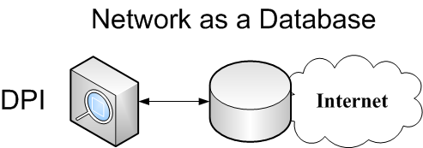
Attribute extraction with DPI
With the extraction capability, DPI can provide input for other mechanisms as:
Security analysis
User quality analysis
Imagine the network as a database and DPI as an engine to extract data from this database!

Slide 51
Network as a Database
Select user_id, perceived_quality Where (application = Video AND protocol = RTP)
Select flow_id Where (application = email AND attachment is executable)

Slide 52
Seminar plan
Network monitoring
Needs for network monitoring
Measurements (what, where and how)
Limitations (briefly)
Deep Packet Inspection
What is DPI and why it is needed
Application classification
Traffic attributes extraction
Security monitoring with DPI
Abstract description
Challenges
Security properties

Slide 53
Security Monitoring with DPI
Abstract description
Challenges
Security properties

Slide 54
The HBGary Hack
HBGary - experts in computer security
computer forensics and malware analysis tools to enable the detection, isolation, and analysis of worms, viruses, and trojans
implementing intrusion detection systems and secure networking
performs vulnerability assessment and penetration testing of systems and software
rootkit.com is a respected resource for discussion and analysis of rootkits
CEO Aaron Barr wanted to unmask Anonymous
Those responsible for co-ordinating the group's actions, including the denial-of-service attacks that hit MasterCard, Visa, and others late last year
Anonymous response
HBGary's servers were broken into, its e-mails pillaged and published to the world, its data destroyed, and its website defaced. As an added bonus, a second site owned and operated by Greg Hoglund, owner of HBGary, was taken offline and the user registration database published
(source) http://arstechnica.com/tech-policy/news/2011/02/anonymous-speaks-the-inside-story-of-the-hbgary-hack.ars/1

Slide 55
The HBGary Hack
 | Attack Method | Attacked System | Vulnerability | Lost Assets
1 | SQL Injection | CMS on HBGary Federal's website, hbgaryfederal.com | CMS with missing validity check of SQL Parameters | usernames, e-mail @ & password hashes
2 | Password cracking using rainbow tables | Password hashes from 1 | Hashes without salt, weak passwords | clear text passwords
3 | Unauthorized use of passwords from 2 | E-mail, Twitter accounts, and LinkedIn accounts of HBGarry officials | Password double use | Email accounts of HBGary officials
4 | Unauthorized use of passwords from 2 | Machine running support.hbgary.com | Password double use | Non-superuser account of HBGary official
5 | Privilege escalation | Machine running support.hbgary.com | Privilege escalation vulnerability, system not up to date | Full access to HBGary's system, gigabytes of backups and research data
6 | Social engineering | Machine running rootkit.com |  | Integrity of rootkit.com

Slide 56
The HBGary Hack: Where can security monitoring help?
 | Attack Method | Attacked System | Vulnerability | Lost Assets
1 | SQL Injection | CMS on HBGary Federal's website, hbgaryfederal.com | CMS with missing validity check of SQL Parameters | usernames, e-mail @ & password hashes
2 | Password cracking using rainbow tables | Password hashes from 1 | Hashes without salt, weak passwords | clear text passwords
3 | Unauthorized use of passwords from 2 | E-mail, Twitter accounts, and LinkedIn accounts of HBGarry officials | Password double use | Email accounts of HBGary officials
4 | Unauthorized use of passwords from 2 | Machine running support.hbgary.com | Password double use | Non-superuser account of HBGary official
5 | Privilege escalation | Machine running support.hbgary.com | Privilege escalation vulnerability, system not up to date | Full access to HBGary's system, gigabytes of backups and research data
6 | Social engineering | Machine running rootkit.com |  | Integrity of rootkit.com
SQL injection: In top ten most known vulnerabilities
(Top ten vulnerabilities are responsible for 60% of software bugs!)
Multi-lines security system: Is it possible to detect security attacks (SQL injection in this case) by inspecting the data encoded in inbound traffic?

Slide 57
Security monitoring with DPI: Abstract description
The concept:
Detect the occurrence of events on the network
Input provided by DPI
Event can be: packet arrival, HTTP POST request, etc.
Inspect and analyze the succession of events to detect properties
Property: Succession of events that are linked with “time” and “logical” constraints
If we detect event “A”, then we MUST detect event “B” before 10 seconds
The idea:
Monitor the network looking for the occurrence of properties.

Slide 58
Security monitoring using DPI: Abstract description
Example: SQL injection
www.abcd.com/page?name=Select * Where 1
The events events:
HTTP GET request
URL parameter contains SQL statement
The property
It is not allowed to have a URL parameter containing SQL statement in an HTTP GET request
If the property is detected on the network then most probably there is an attack attempt!
Nice Theory! But very challenging

Slide 59
Security monitoring using DPI
Challenges
The number of events that can occur on a network is huge!
Solution: Use DPI for the events extraction
Group events/attributes by application and add new ones when needed
The expressivity of the properties (need to combine time and logical constraints)
Complex analysis and processing especially in high bandwidth links
Optimization techniques, multi-core implementations, smart traffic filtering

Slide 60
Properties Expressivity
Considering security monitoring, properties can be used to express:
A Security rule describes the expected behavior of the application or protocol under-test.
The non-respect of the Security property indicates an abnormal behavior.
Set of properties specifying constraints on the message exchange
i.e. the access to a specific service must always be preceded by an authentication phase
An Attack describes a malicious behavior whether it is an attack model, a vulnerability or a misbehavior.
The respect of the Security property indicates the detection of an abnormal behavior that might indicate the occurrence of an attack.
Set of properties referring to a vulnerability or to an attack
A big number of requests from the same user in a limited period can be considered as a behavioral attack

Slide 61
Properties Expressivity
A security property is composed of 2 parts:
A Context
A condition to verify
The “Context” and “condition” of a property are composed of:
Simple events
Conditions on attributes (IP @ equal to 1.2.3.4)
Complex events linked by
Logical operators (AND/OR/NOT)
Chronological operator (AFTER/BEFORE)

Slide 62
Properties Expressivity
A security property is composed of 2 parts:
A Context
A condition to verify
The “Context” and “condition” of a property are composed of:
Simple events
Conditions on attributes (IP @ equal to 1.2.3.4)
Complex events linked by
Logical operators (AND/OR/NOT)
Chronological operator (AFTER/BEFORE)
If an HTTP Response is received (this is the context)
Then an HTTP request should have been received before (condition to verify)

Slide 63
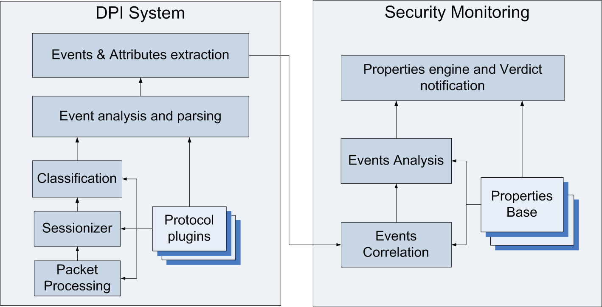
Security monitoring with DPI

Slide 64
THANK YOU
Wissam Mallouli
wissam.mallouli@montimage.com

Slide 65
shawez@jnu.ac.in
Lucie.poggi@agroparistech.fr
Mohamed-reda.belbahri@espci.fr
mariabargues1@gmail.com

