Slide 1
COSE471 · DATA SCIENCE · KOREA UNIVERSITY
Surface Style is Coachable.
The Signature is Not.
Can an LLM imitate a student's writing style once the content is held fixed?
Team [nickname] · Members A · B · C · D

Slide 2
“Looks human” ≠ “is human”
AI-text detectors usually confuse two different things:
WHAT is said (content) vs. HOW it is said (style).
We hold content fixed and coach only the style — then ask which part of “human” an LLM cannot fake.
CONTENT
Held FIXED — each LLM answer must cover that student's keywords.
STYLE
The ONLY variable — coached harder each round (R0 → R2).
COSE471 Term Project · Motivation
2/11

Slide 3
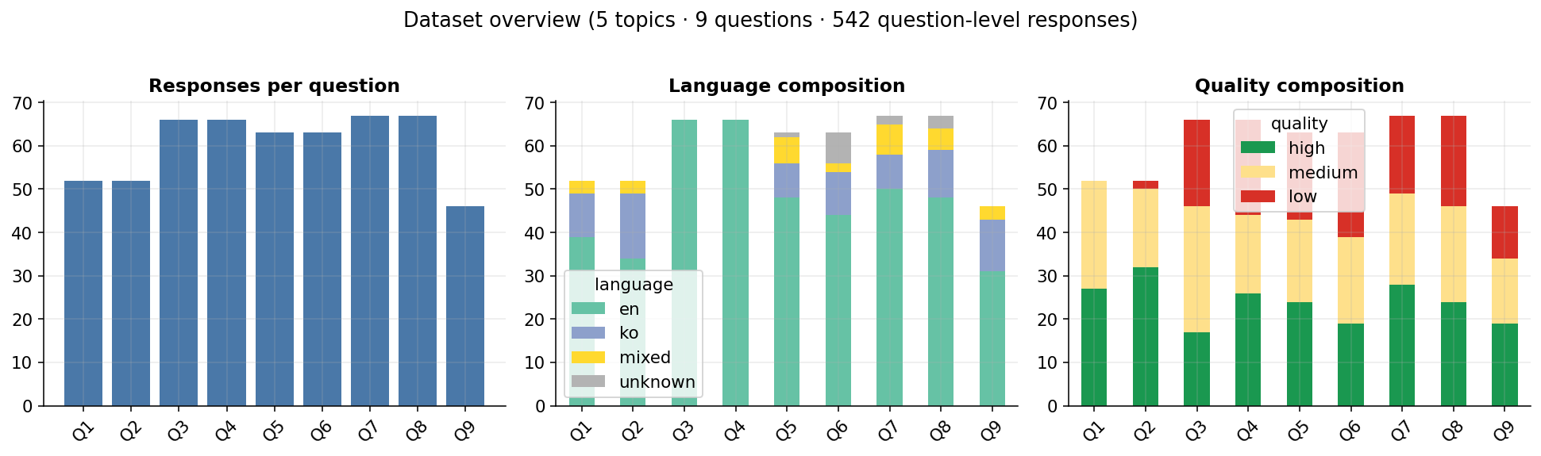
Real in-class discussion data
Written by our own class — mixed languages, uneven length, genuine messiness.
5
9
542
69
421
topics
questions
responses
students
English-original
(analysis set)
COSE471 Term Project · Data understanding
3/11

Slide 4
Fix the content, coach only the style
keywords
content fixed,
all rounds
R0 naive
R1 light
R2 aggressive
style coaching only — persona, temperature fixed
STYLE7 — targeted detector
7 surface features the prompt explicitly coaches (length, 1st-person, hedging…).
STYLO — independent judge
function words + char n-grams + punctuation. Never targeted. Disjoint from STYLE7.
Two course techniques: ① Classification (per-question, leakage-proof AUC) + ② Outlier Detection (LOF). Generator GPT-5-mini ≠ judge.
COSE471 Term Project · Methodology
4/11

Slide 5
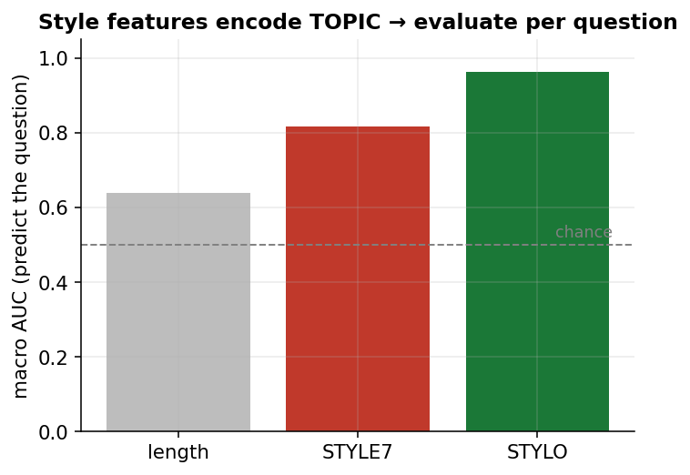
Style encodes topic — so we never pool
Using humans only, style predicts WHICH question a response answers:
STYLE7 AUC 0.82 · STYLO AUC 0.96
Features carry topic, not just authorship → we evaluate strictly per question (no topic leakage).
COSE471 Term Project · Methodology check
5/11

Slide 6
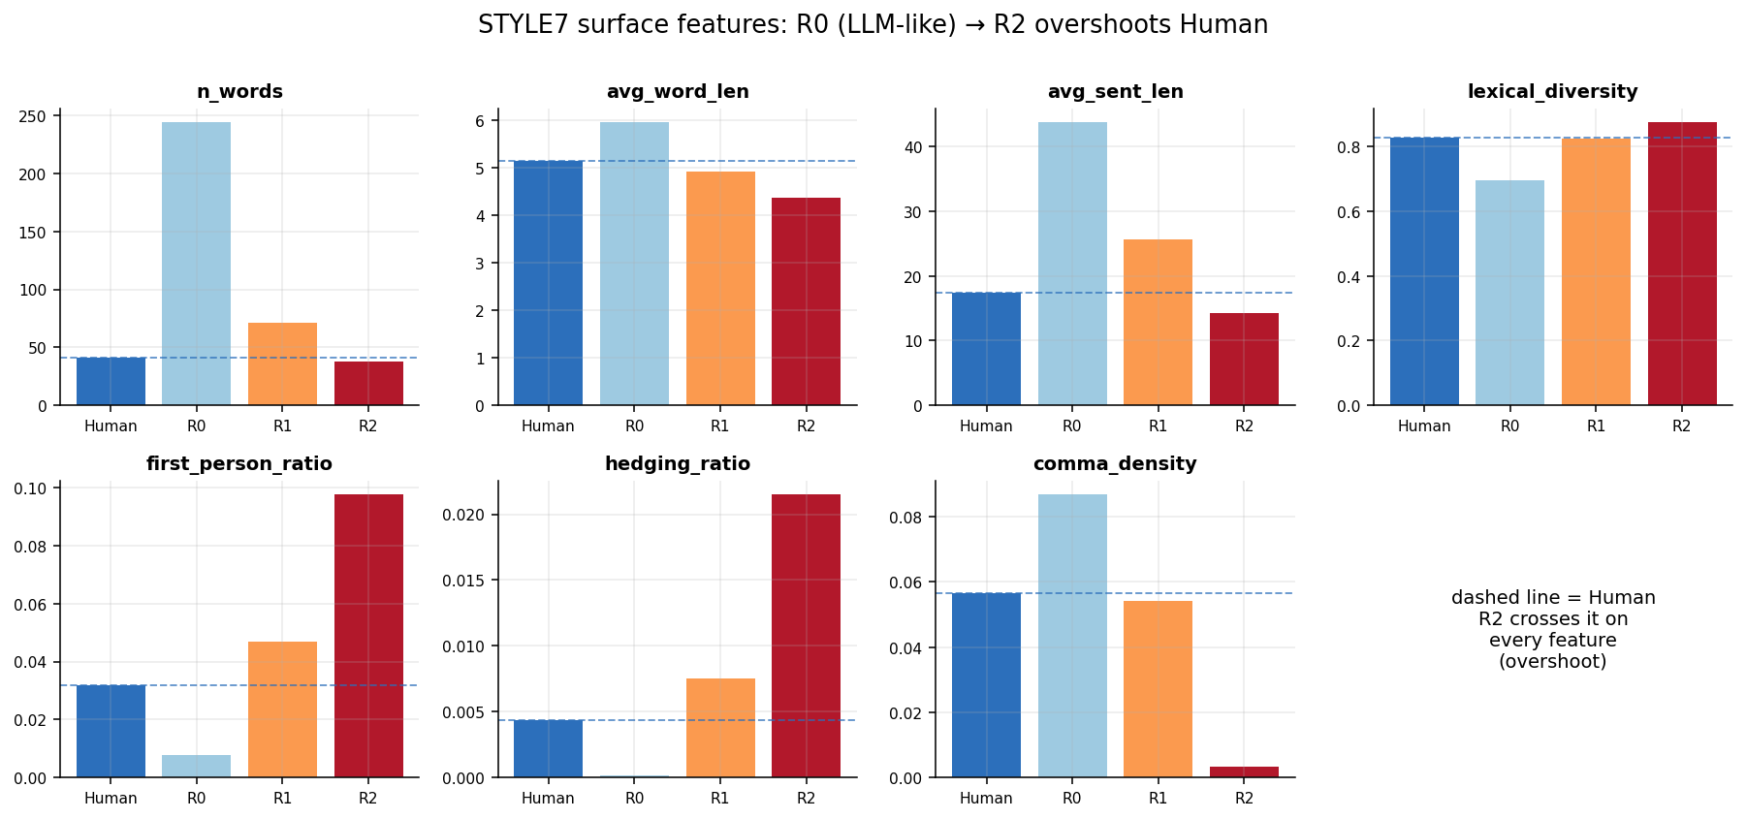
The LLM “tell” — and the overshoot
Naive R0
~6× longer, polished, ~zero hedging, impersonal.
Coached R2
Overshoots humans on every feature (crosses the dashed line).
Surprise (data-driven)
Humans hedge MORE than naive GPT — our plan's assumption was backwards.
COSE471 Term Project · Results
6/11

Slide 7
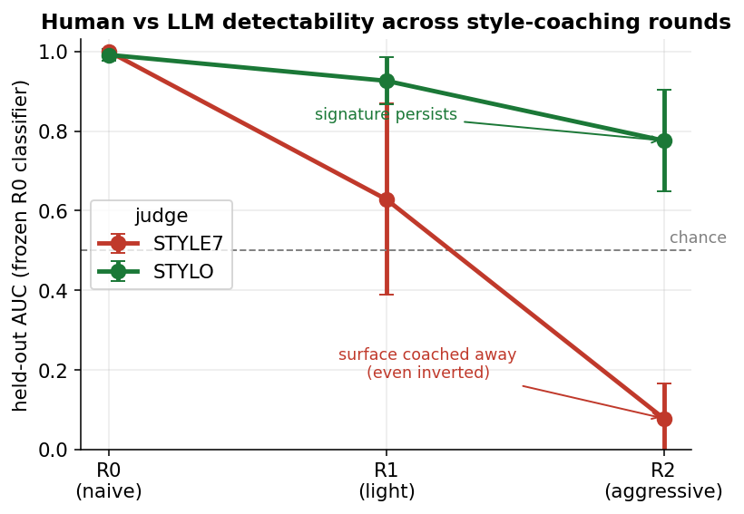
Surface breaks, signature holds
Frozen R0 classifier scored on held-out humans, per question.
STYLE7 @ R2
0.08
surface coached away — inverted past humans
STYLO @ R2
0.78
independent judge still detects the LLM
Same answers — opposite verdicts.
COSE471 Term Project · Results — headline
7/11

Slide 8
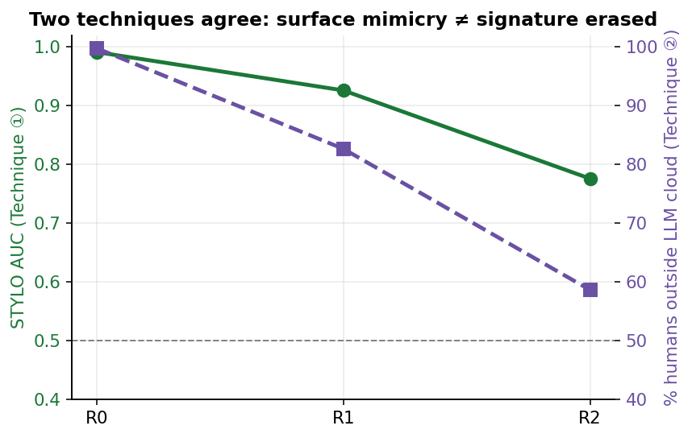
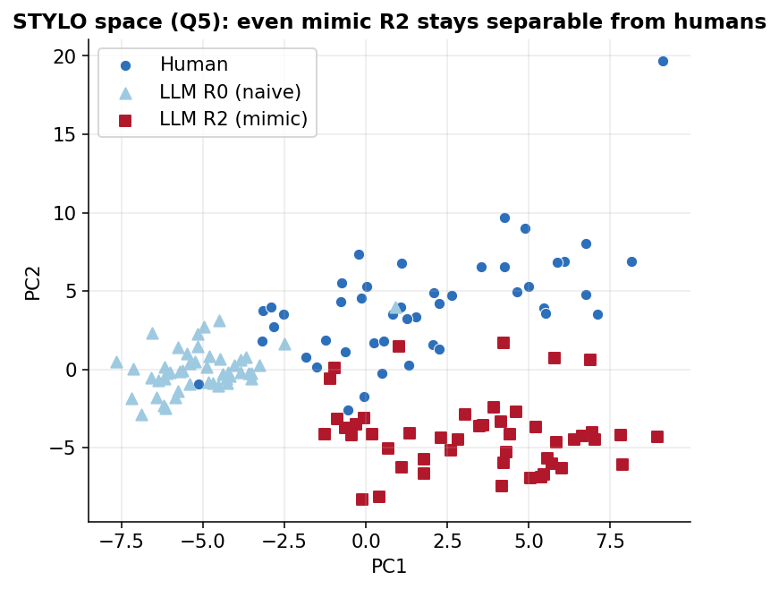
Two methods, one verdict
Classifier (STYLO AUC 0.78) and Outlier-LOF (59% of humans still outside the LLM cloud) — distance-based, not a re-run — agree the signature survives imitation.
COSE471 Term Project · Results — two techniques
8/11

Slide 9
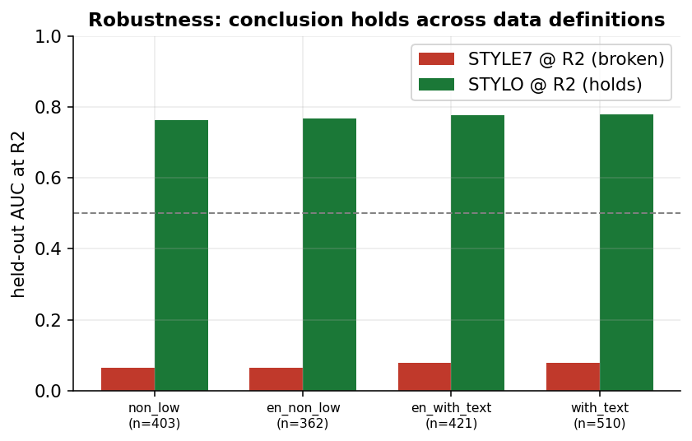
Not an artifact
The pattern holds across 4 data definitions:
English-only (0.78) ≈ translation-included (0.76)
→ not a machine-translation artifact.
At R2 human (41w) ≈ LLM (38w)
→ the residual 0.78 is not a length artifact.
COSE471 Term Project · Results — robustness
9/11

Slide 10
The signature is the human part
When content is fixed, prompt-level coaching erases the LLM's surface tells — but cannot erase its stylometric signature.
0.08
0.78
59%
STYLE7 @ R2
STYLO @ R2
humans outside
LLM cloud
Limitations: STYLO also drops (partial, not immune) · R2 is a caricature (overshoot) · ESL-vs-native register → future work.

Slide 11
Thank you
Questions & Discussion
Reproducible: config.yaml → generate → classify → round_eval → outlier_lof → figures
Team [nickname] · Members A · B · C · D

