Slide 1
An Analysis of Hospital Readmissions & Home Health Care Quality
Data Science Capstone Project, March 5th, 2018 Cohort
Presented by Jonathan King

Slide 2

Introduction:
Per CMS, there was a 17.6% 30-day readmission rate for Medicare enrollees in 2005.
Readmissions cost $15 billion dollars that year.
In 2013 the Affordable Care Act (ACA) responded to these costs by establishing the Hospital Readmission Reduction Program (HRRP)
By calculating the ratio between expected and actual readmissions the HRRP created the readmission ratio. This ratio would be used to calculate a financial penalty to hospitals who had excessive readmission ratios (>1.0).
In 2012 the ACA also created the Independence at Home Demonstration Program (IAH).
The IAH program provided chronically ill Medicare patients health care services in their homes, which resulted in:
$25 Million in Cost Savings
Reduction in Hospital Readmissions
Patient Savings of $3,070 in the first year.
Patient Savings of $1,010 in the following year.
The IAH program ended in 2017, but Home Health Care (HHC)providers still provide services to chronically ill patients in their homes.
How might HHC affect hospital readmission ratios?

Slide 3











Interested Parties:
Home Health Care Agencies
Hospitals
U.S. Government

Slide 4
Primary Datasets and Merging:
Hospital Readmission
Home Health Care Quality
Source : CMS
File Format: csv
Features: 12
Observations: 19,830
Data from conclusion of HRRP review in 2016
Each record a hospital and unique service pair (i.e. COPD, heart failure, hip-knee replacement
Source: CMS
File Format: csv
Features: 54
Observations: 11,678
Quality Measures taken quarterly. Data taken from 2016 report.
Each record a unique HHC Agency and it’s quality measure ratings.
Three datasets created through merger of different keys:
Observations grouped and merged by state. (Separate HHC quality dataset used)
Observations grouped and merged by zip code and state.
Hospital observations merged to grouped HHC observations via zip code.

Slide 5
Additional Datasets and Merging:
Additional datasets were used in the creation of the primary three data sets listed in the previous slide.
Point of Service Zip Codes
HHC Quality by State
Additional Quality by State
Source: CMS
File Format: csv
Features: 103
Observations: 469,651
Required to attach Zip Codes to Hospital Readmission Data.
Merged via Name Key.
Source: CMS
File Format: csv
Features: 24
Observations: 51
Quality Measures taken quarterly. Data taken from 2016 report.
Each record a state.
Used for dataset grouped and merged by state (data set 1 in previous slide).
Source: CMS
File Format: csv
Features: 8
Observations: 55
Additional Quality Measures taken quarterly. Data taken from 2016 report.
Each record a state.
Merged by state key.
Also used in dataset grouped and merged by state.
Hospital Readmission

Slide 6
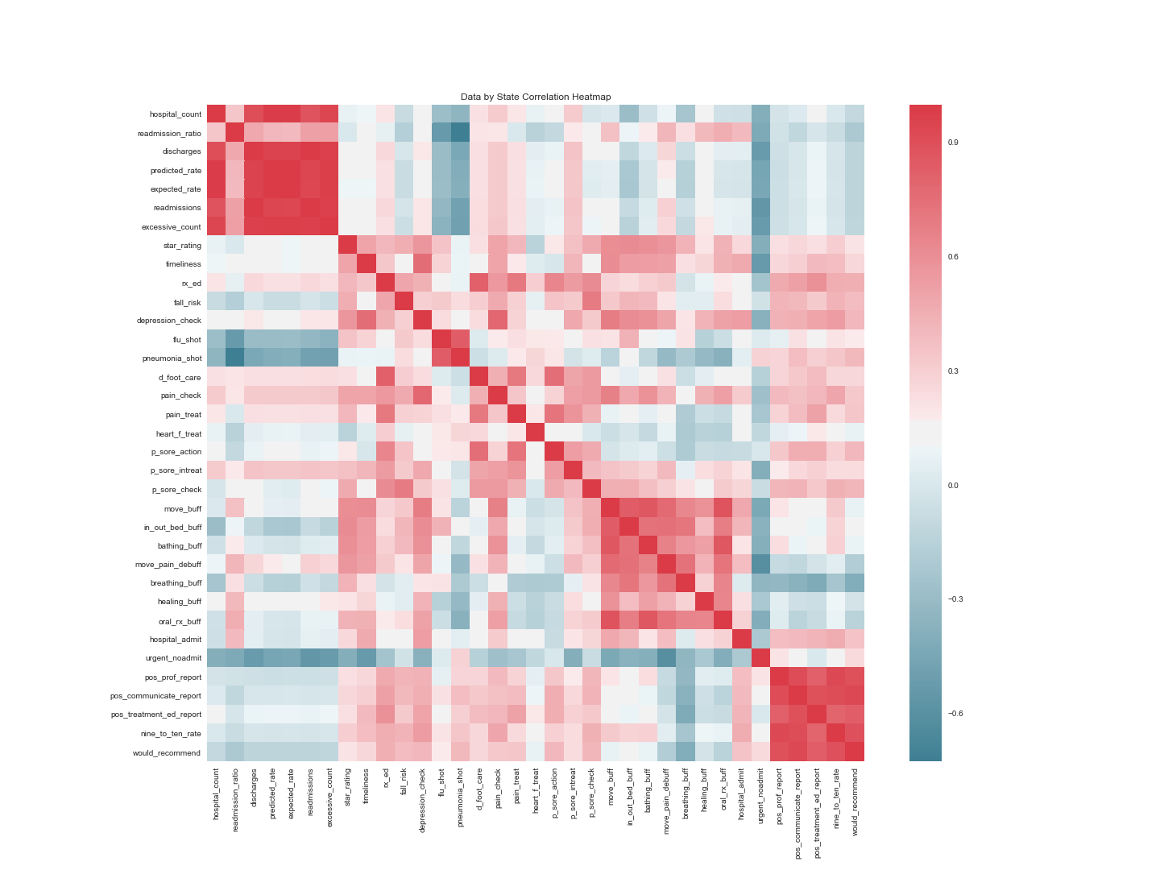
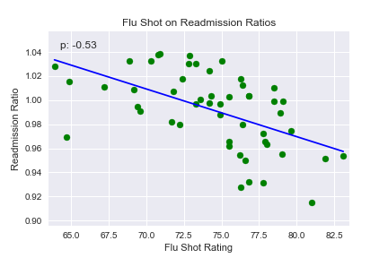
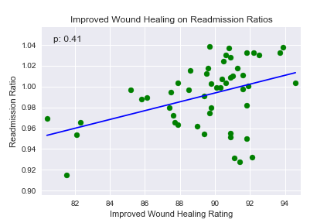
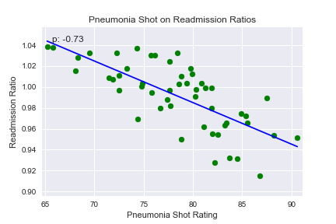
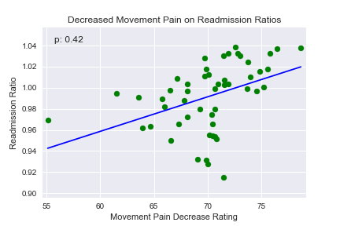
Data Exploration: Grouped by State
The primary goal of this research was to find relationships between HHC Quality and readmission ratios.
The observations grouped by state revealed some promising relationships.
Total Observations: 51

Slide 7
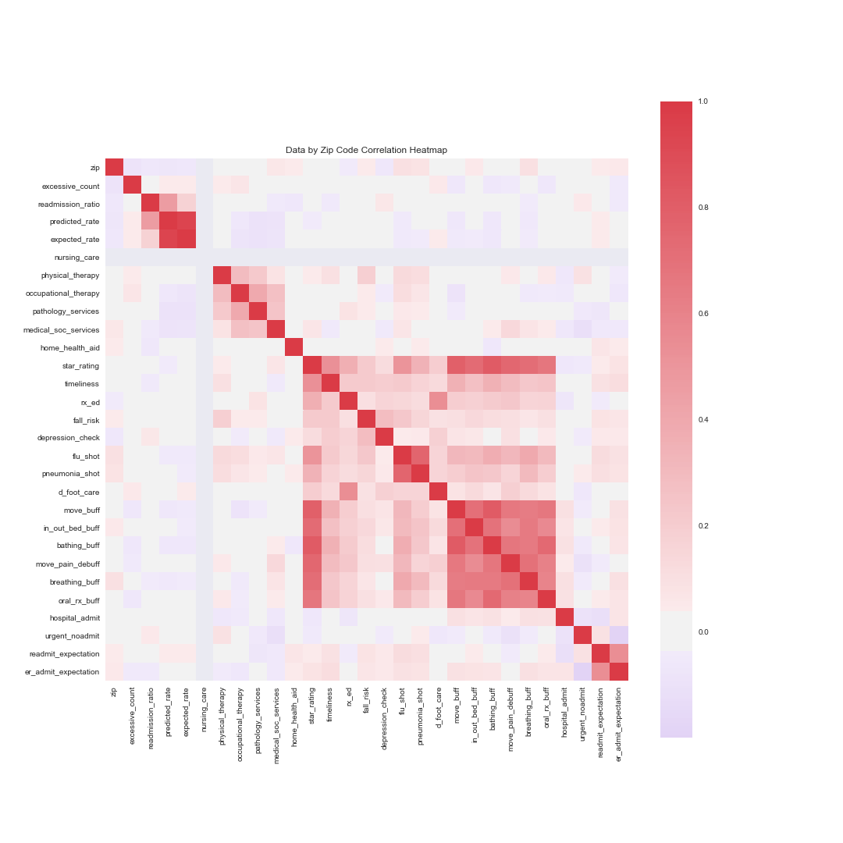
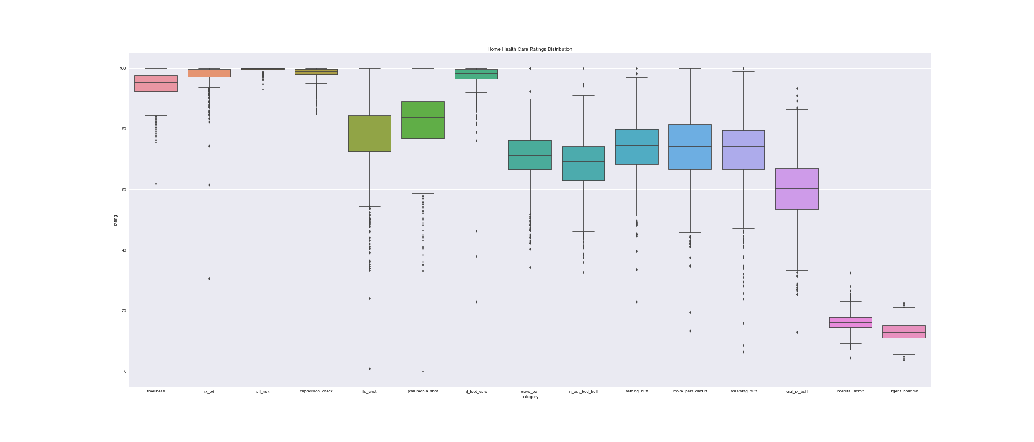
Data Exploration: Grouped by Zip Code
Uncertain of the applicability of these relationships. A new dataset was drafted grouping by zip code to see what relationships withheld a significant increase to the number of observations.
Much to my surprise, the relationships seen in the data by state all but vanished.
Since there is a wide range of variation in the data, could scaling the features reveal relationships currently muted out by noise?
Total Observations: 820

Slide 8

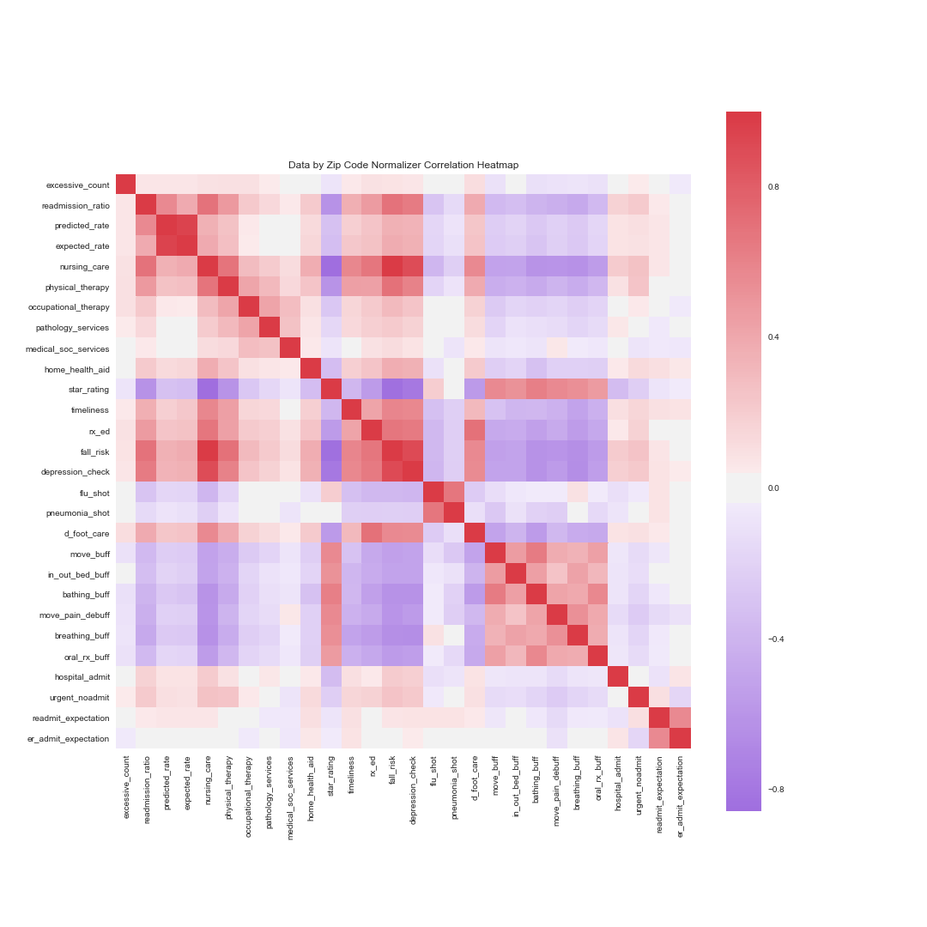
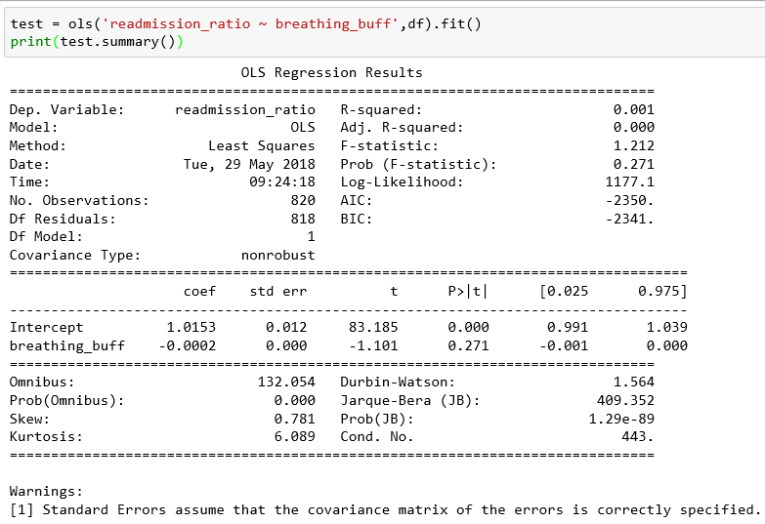
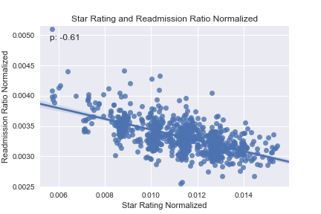
Data Exploration: Scaling Attempts
Numerous scaling techniques were attempted to uncover relationships within the data by zip code.
Scikit-Learn’s Standard Scaler
Statsmodels’ Ordinary Least Squares
Scikit-Learn’s Normalizer
As seen above, both the Standard Scaler and OLS models did not uncover any significant relationships in the data by zip code.
Despite revealing significant relationships, the data scaled by using the Normalizer model was ultimately rejected.
The Normalizer model scales by observation and not by feature. As such, these relationships would be weak at best and not significantly actionable for the client.

Slide 9
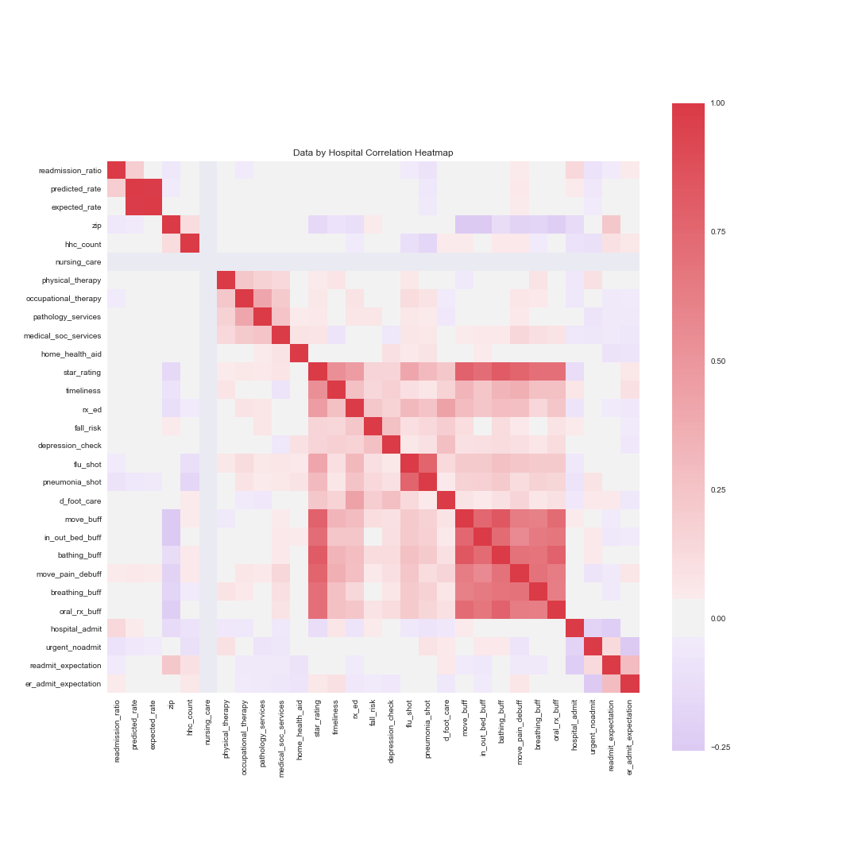
Data Exploration: Grouped by Hospital
In a final attempt to uncover relationships with readmission ratios, the number of observations was increased significantly by creating a dataset that used each hospital observation paired with the HHC quality measures data grouped and merged by zip code.
The relationships with readmission ratio remained weak at best.
Interestingly, flu shot, pneumonia shot, and decreased movement pain ratings display weaker correlations in the same direction as they did in the grouped by state dataset.
After multiple models of reviewing the available data, it does not appear that there are any significant relationships between HHC quality and readmission ratios.
However, there is information in this analysis that an HHC client would find both actionable and useful.
Total Observations: 5,882

Slide 10
Conclusion and Next Steps:
As mentioned previously, an actionable relationship between CMS’ HHC quality measures and hospital readmission ratios was not discovered within the available data.
This does not mean HHC does not impact readmission ratios. Additional HHC features not associated with quality may have significant relationships with readmission ratios. Some HHC features to research could be:
Hospital readmission is a complex problem and many factors outside of HHC providers are in play as well. Some additional readmission features to analyze could be:
Amount of funding to HHC Agencies.
Number of clinical staff in each HHC Agencies.
Number of clients each HHC Agency provides services to.
Total number of unique services provided by each HHC Agency.
Top diagnoses associated with readmissions.
Number of Urgent Care facilities in proximity to individual hospitals.
Quality ratings of each hospital.

Slide 11
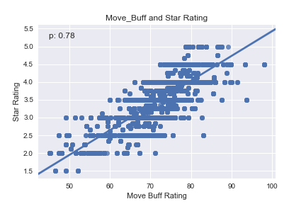
Star Rating Analysis Recommendation:
While there is little actionable data regarding readmission ratios for HHC Agencies, there was one series of relationships that would be of high interest to HHC Agencies. This series was prevalent throughout every dataset created in this analysis. . .
Star Ratings!!!
Data by State
Data by Zip Code
Data by Hospital
There are clear relationships with star rating and quality measures.
Some measures have stronger correlations than others.
Star ratings are important to HHC Agencies and are published quarterly by CMS to a consumer friendly website.
A supervised machine learning program could be constructed to help increase the star rating of a HHC client.

Slide 12
Thank You!
Jonathan King
Email: jsking751@gmail.com
https://www.linkedin.com/in/jonathan-king-24601
https://github.com/jsking751

