Slide 1
Predicting Health Plan Tier Enrollment
Data Science Capstone Project, March 5th, 2018 Cohort
Presented by Jonathan King

Slide 2
Introduction:
The Affordable Care Act (ACA) requires insurance carriers who offer health plans through State or Federal Marketplaces to offer plans based around the Metallic Tiered System.
Tiers Include:
Catastrophic
Bronze
Silver
Gold
Platinum
Each tier is hierarchical with Catastrophic plans having the lowest monthly premiums and highest potential cost-share and Platinum plans having the highest monthly premium and lowest potential cost-share.
The primary focus for any insurance carrier is risk mitigation. Making useful predictions empowers these carriers to reduce their risk and offer better services for their consumers.
This project aims to predict consumer choices on metallic tiers given county demographic data, and can be used for efficient marketing and creating risk reduction programs.

Slide 3

Potential Clients:

Slide 4
Primary Dataset and Merging:
2015
Primary
2016
Complete Dataset:
Source: CMS
Format: .csv
Features: 41
Observations: 4,536
Each records is an individual county.
Main Dataset contains raw counts for all features and targets.
Additional Datasets built from this file.
Age
Age
Ethnicity
Ethnicity
Merged 2015 Dataset:
Source: CMS
Format: .csv
Features: 40
Observations: 2,109
Each record is a county.
Merged 2016 Dataset:
Source: CMS
Format: .csv
Features: 41
Observations: 2,427
Each record is a county.
APTCs
APTCs
Tier Choice
Tier Choice
Income
Income
CSRs
CSRs
Renewal Type
Renewal Type

Slide 5
Additional Datasets:
Two additional Datasets were spawned out of the original Complete Dataset.
The first dataset is the target values (tiers) transformed into a percent of Total Plan Selections (TPS). (i.e. Gold Tier Selections / TPS)
The second dataset is a transformation of all features into a percent of TPS.
* The second dataset was ultimately dropped as new demographic data would never be received as a percent of TPS, and thus not useful for making predictions.
*
Primary Complete Dataset
*
Targets as % of TPS
Features as % of TPS

Slide 6
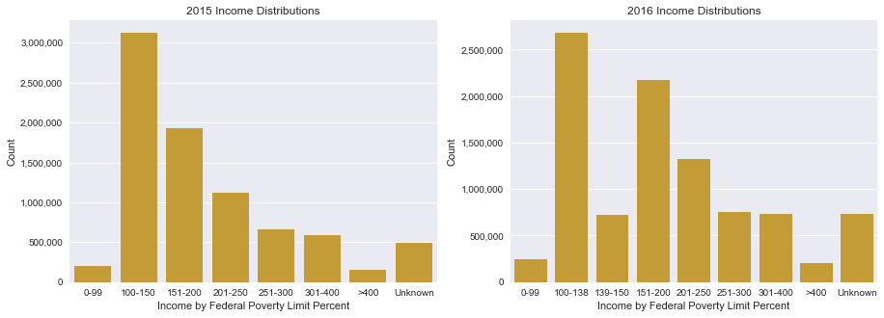
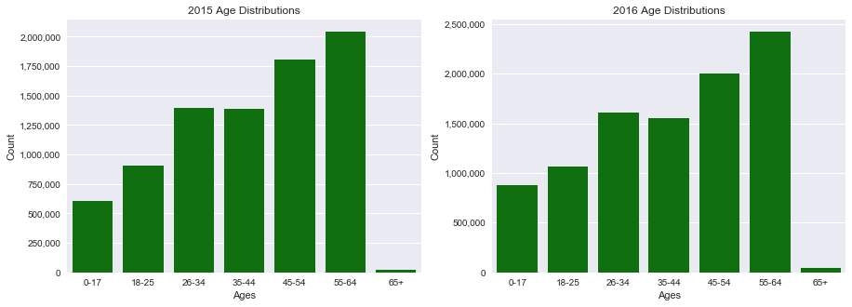
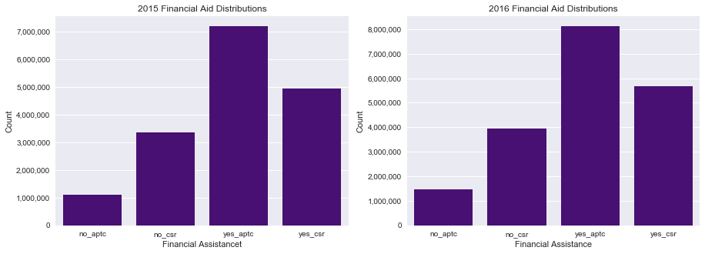
Data Exploration: Distributions
Distributions for 2015 and 2016 plan selections were relatively consistent:

Slide 7
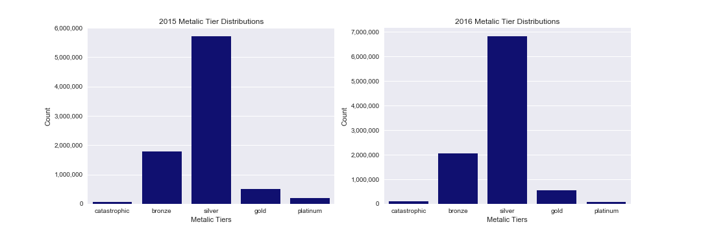
Data Exploration: Tier Selections
Tier Selections also remained fairly consistent between years.
Due to low selection count and high regulation, a predictive model for the Catastrophic tier was abandoned. While one could be built, its practical application would be limited at best.

Slide 8
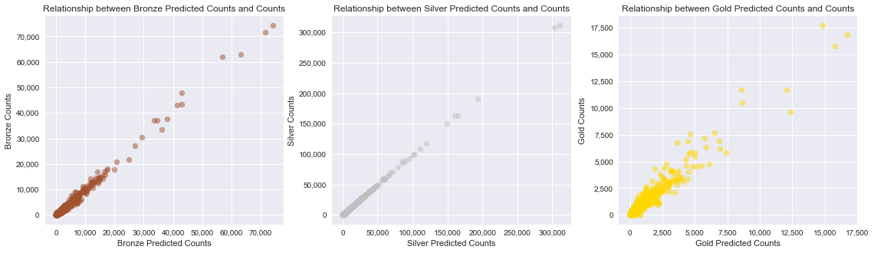
Huber Regression: Bronze, Silver, Gold
The best predictive model for Bronze, Silver, and Gold tiers was created by using the Huber Regressor algorithm on the Primary Complete Dataset.
The model produced the following results:
R^2 Scores of: .987, .999, .911
RMSEs of: 346, 311, 196
The RMSEs, while seemingly high, are acceptable as many of the target values are in the tens of thousands.

Slide 9
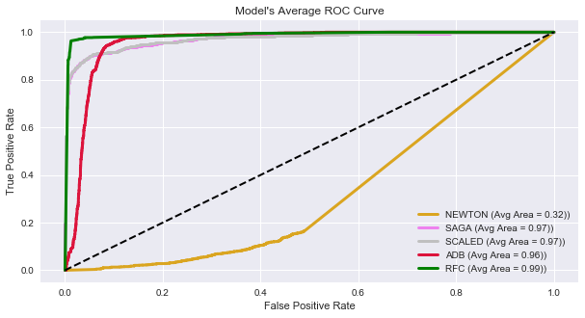
Random Forests: Platinum
The best predictive model for the Platinum tier was created by using the Random Forest Classifier algorithm on the Targets as Percent of TPS Dataset.
To further optimize the model the target data was binned into 5% bins. I.E. Class 0 = (0% - 4%),
Class 1 = (5% - 9%) ect.
A total of 4 classes were created as the Platinum tier did not exceed 15% of TPS for any observation.
The model produced the following results:
Training Accuracy of .968
Test Accuracy of .963

Slide 10
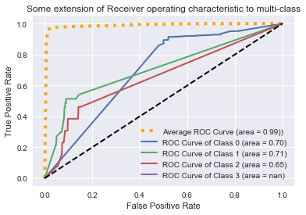
Recommendations and Next Steps: Optimization
The individual classifiers in the Random Forest model were not as strong as they should be.
Time spent building a working Deep Learning model may be worth further investigation. However, the current results for the best models are more than acceptable, and further optimization of said models is possibly a better time investment.
Creating a classifier model for Bronze, Silver, and Gold tiers using client directed binning may create another useful model.
Adding client proprietary data could improve model performance further.
Further optimization using bootstrapping on the Platinum tier data could further improve the individual classifiers for the current best model.

Slide 11
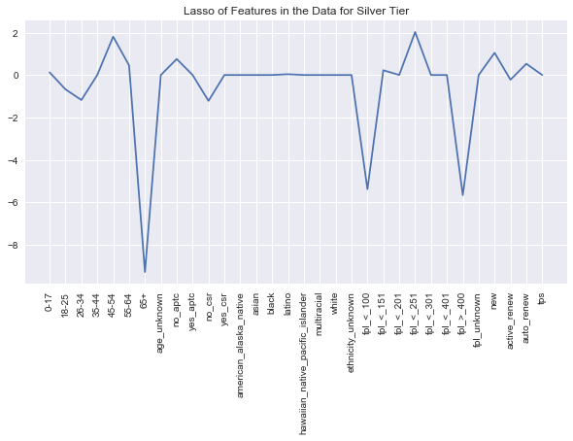
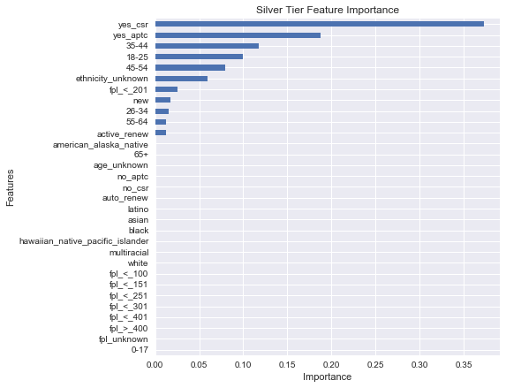
Recommendations and Next Steps: Feature Analysis
Reviewing feature importance for each tier could provide valuable information.
Creating tier products specifically tailored to the important demographics uncovered in feature analysis could give a competitive edge in the marketplace.

Slide 12
Thank You!
Jonathan King
Email: jsking751@gmail.com
https://www.linkedin.com/in/jonathan-king-24601
https://github.com/jsking751
Sources:
https://www.healthcare.gov/choose-a-plan/plans-categories/
https://data.cms.gov/browse?category=Marketplace%20-%20Qualified%20Health%20Plan%20

