Slide 1
Minimal Models for
Receipt-Free Voting
Juraj Skripsky
Semester Project
23rd October 2001 - 1st March 2002

Slide 2
Outline
Introduction to Digital Voting
Vote-Buying and Coercion
  Receipt-Freeness
Existing Protocols
Practical Models
Theoretical Aspects
Conclusions
Notes:
Vote-Buying and Coercion: Part of “Privacy”!

Slide 3
Digital Voting
The Vision
vote from anywhere you wish
do so using a PC and the Internet
voting system guarantees…
  availability
  correctness
  privacy

Slide 4
Standard Model
Adversary
Authority₁
Authority₂
Voter
Authority₃
Authority₄
Voter
Authority
Bulletin Board
Voter
+1
0
Voter
-1
+1
insecure channels
adversaries see all channels all the time
PKI
multiple authorities and a bulletin board
Why use THIS model?
Minimal model sufficent for many protocols
Notes:
(- _synchronous_ insecure channels)
(- anonymous channels)
(- no physically secure modules, no physically secret channels)

Slide 5
Vote-Buying and Coercion
Somebody wants a voter to cast a particular vote. He might...
offer him money
threaten him
Vote-Buyer / Coercer
Authorities
Voter
Bulletin Board
What kind of cooperation do we allow between...
voter and adversary?
adversary and authorities?
Adversaries
Prevention
Scalability
Coercion Vote-Buying
coercer vote-buyer and voter
impossible ?
low very high
Notes:
VB and C are attacks that have been looked at only recently.
(relatively new field in voting)
Scalability for VB will become clearer in the sequel
No notion is strong than the other!
-> I concentrated on vote-buying (more realistic)

Slide 6
Receipt-Freeness
The adversary wants to make sure the “right” vote was cast.
Vote-buying and coercion will become unattractive if the voter...
is unable to generate a proof (“receipt”) of the vote he has cast
is able to generate a fake receipt
Vote-Buyer / Coercer
Receipt-Freeness
no sharp definition
very subtle property
Authorities
Voter
?
Bulletin Board
Notes:
Receipt -> high scalabilty in Vote-Buying

Slide 7
Receipt-Freeness in the Standard Model
It’s not possible!
Proof (sketch):
voter claims to have cast the vote v
knows transcript voter - authorities
knows all secrets of voter
in- and outgoing communication of voter determines his vote
Vote-Buyer / Coercer
simulation of voter’s computer proves or disproves the claimed vote v
Authorities
Voter
Bulletin Board

Slide 8
Existing Protocols
There already exist numerous receipt-free protocols:
BT94, SK95, Oka97, HS00, Hir01, BPP⁺01,…
But they rely on additional rather unrealistic assumptions on the communication model!
untappable channels
voting booth
We want…
realistic assumptions leading to a practical model
minimal number of additional assumptions

Slide 9
Practical Models
A Second Look at the Standard Model
Could a slight modification allow for receipt-freeness?
Standard Model:
insecure channels
adversaries see all channels all the time
PKI
multiple authorities
bulletin board
It seems impossible to tap all channels of the Internet all the time!
Aspects
when, how many and which channels are tapped
description of tapping capabilities (of the adversary)
introduction of tapping probability
importance of topology
useful model for a “partially tappable” network

Slide 10
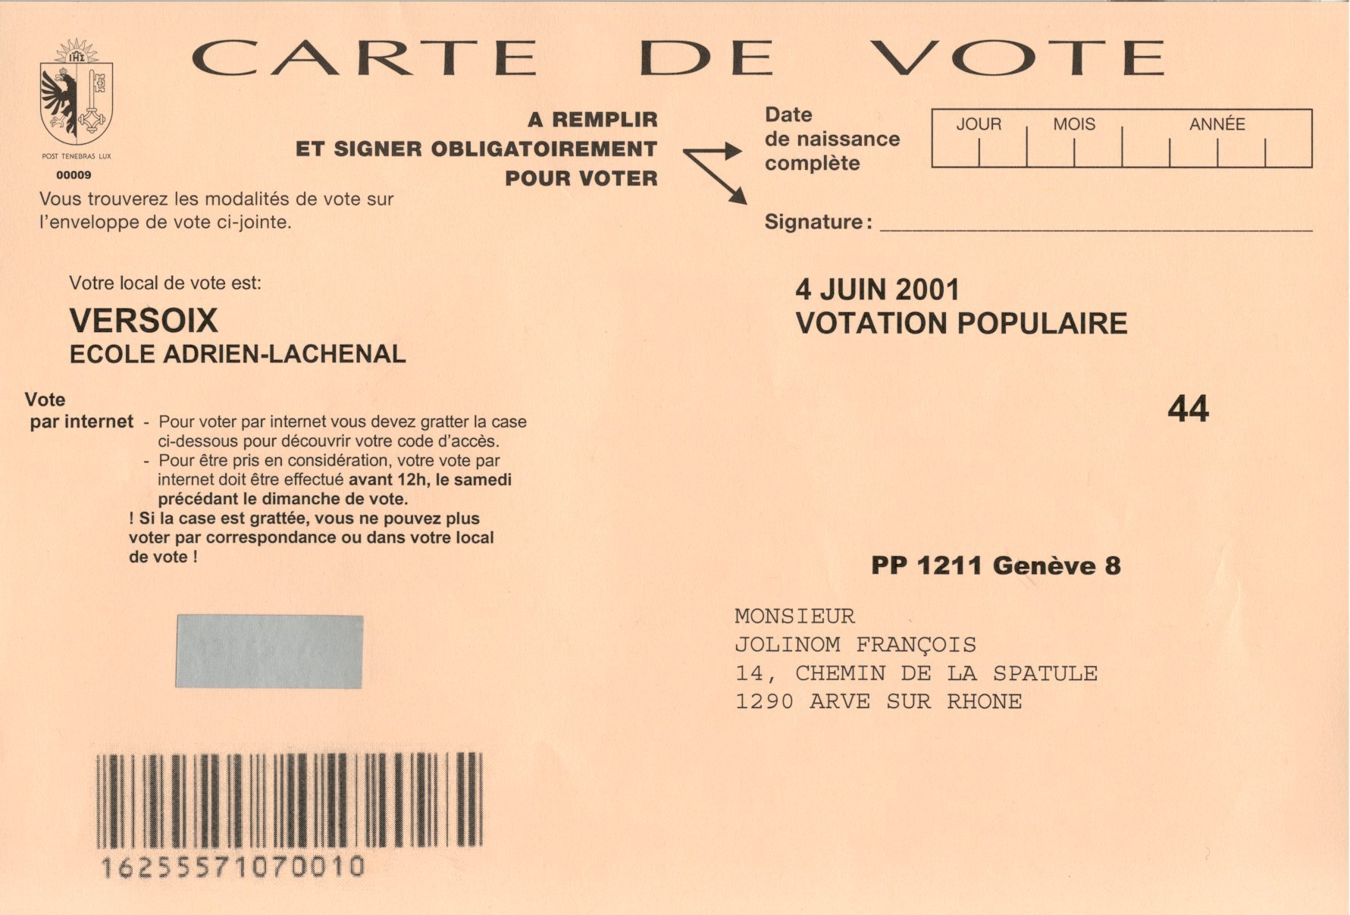
Practical Models
The traditional voting system won’t go away anytime soon.
Coexistence of traditional and digital systems
Geneva
Voter receives his ballot by
mail. He can either…
use this ballot in the traditional way
vote over the Internet using the secret number on the ballot
Notes:
Could we use “traditional tools” to our advantage?

Slide 11
Practical Hybrid Models
We use both systems. What “tools” do they offer?
letters sent by mail
one or more hidden numbers (maybe stacked one upon the other)
stack of papers in designated order
multiple ways to cast a vote
  Internet
  mail
  “in persona”
  …and combinations of the above
Example: “Last Ballot” Approach
voter may cast many ballots
only the last one is considered for tallying
Notes:
“in persona” (optional untappable channel)

Slide 12
Theoretical Aspects
How do traditional and digital tools compare (equivalency, superset…)?
  mail vs. untappable channels
  voting booth vs. untappable channels
  …
Can one be replaced with the other?
  is there a convenient traditional replacement for
  virtual voting booths or untappable channels
To what extent can we achieve correctness and receipt-freeness
at the same time?

Slide 13
Conclusions
Receipt-freeness is indeed a very subtle property
There is no simple way to add receipt-freeness to a general voting protocol
Existing protocols rely on unrealistic assumptions
  often assumptions are not explicitly stated
  many were partially or completely broken
Important to focus on one exact definition
  Vote-Buying much more important than Coercion
Hard to find a non-trivial model for “partially tappable” network
Combination of traditional and digital voting systems offers endless possibilities to construct voting protocols
Notes:
Combination …
-> good chance to come up with something useful

