Slide 1
MODULE 1 Fundamental Concepts

Slide 2
Learning Objectives
Define key terms: M&V, ECM, baseline, adjusted baseline model, avoided energy use, statistical model, physical model, and ESCO.
Explain the fundamental theories that drive most measurement and verification (M&V) protocols and standards: the counterfactual method and performance verification
Recognize the importance of modeling in the implementation of the counterfactual method
Differentiate between models based on energy data (statistical) and physical models (simulation)
Discuss KPIs
Discuss the roles of judgment and uncertainty in M&V
Articulate the scope of a CMVP’s work

Slide 3
What Is M&V?
At its core, measurement and verification (M&V) is a process that includes a wide range of measurement, verification, and analysis techniques for quantifying the results of resource efficiency and resource management activities.
Role of professional judgment – planning, communicating
Role of technical implementation – tools, data, analyis
Importance of understanding – limited time and $$$
These icons refer to the different “domains” of M&V: technical, regulatory, commercial, and legal. We will discuss them at length in the next module.

Slide 4
THE CENTRAL CHALLENGE OF M&V
"How do we know what WOULD HAVE happened?"
We can measure:
✓ What DID happen before (baseline data)
✓ What DID happen after (actual performance)
We CANNOT measure:
✗ What WOULD HAVE happened without the project
M&V's solution: Build a defensible MODEL
- Based on baseline relationships
- Adjusted for actual conditions
- Validated and transparent. This is COUNTERFACTUAL REASONING.
Everything in this course builds on this concept.

Slide 5
Baseline vs. Counterfactual
The Baseline is evidence.
The Counterfactual is inference.
Don’t confuse the two.

Slide 6
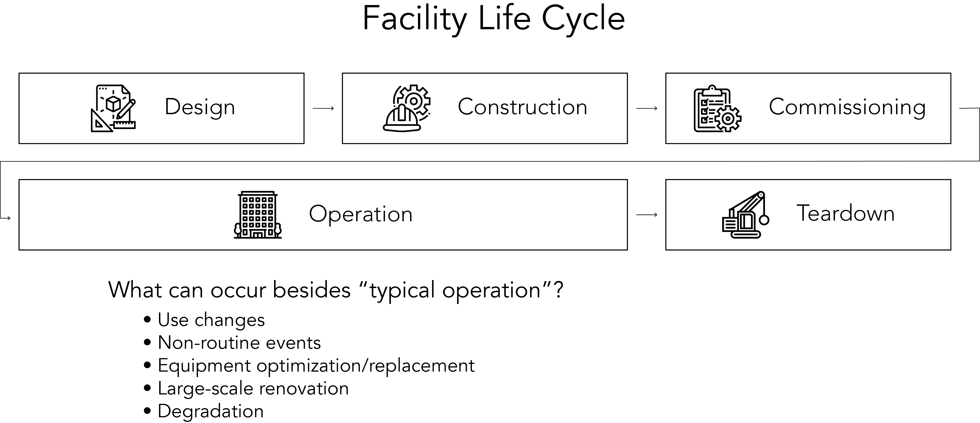
M&V typically occurs at this point in a facility’s life cycle.
NIST Life Cycle Costing: https://www.energy.gov/femp/building-life-cycle-cost-programs?nrg_redirect=156356

Slide 7
Denominator
Value
Service
Compliance – Code – Indoor environment
Production
Output
Benefit

Slide 8
Baseline vs. Counterfactual - A Critical Distinction"
"The Baseline is evidence"
"The Counterfactual is inference"
"Don't conflate the two”

Slide 9
The Counterfactual Method
Counterfactuals are an essential part of how humans learn about the world and how our actions affect it. While we can never walk down both the paths that diverge in a wood, in a great many cases we can know, with some degree of confidence, what lies down each.
—Judea Pearl and Dana Mackenzie The Book of Why: The New Science of Cause and Effect
Further Reading: Simon, Herbert A., and Nicholas Rescher. “Cause and Counterfactual.” Philosophy of Science 33, no. 4 (1966): 323–40.
Notes:
Instructor Note: Discuss story of certain factory and company where they don’t believe in counterfactuals—they only believe what they can measure.

Slide 10
The Counterfactual Method
The statement "you can't prove a negative" emphasizes that counterfactual claims can never be empirically confirmed with certainty. Instead, they must be rigorously and transparently supported through structured assumptions, logical inference, and evidence-based modeling.
Notes:
Instructor Note: Discuss story of certain factory and company where they don’t believe in counterfactuals—they only believe what they can measure.

Slide 11
Buildings Evolve
Anyone involved in Measurement and Verification (M&V) must understand Stewart Brand's concepts in "How Buildings Learn" because M&V relies on accurately modeling and measuring building performance over time. Brand emphasizes that buildings are not static—they continuously evolve due to changes in occupancy, usage patterns, technology, and infrastructure. Recognizing this evolution helps M&V practitioners better anticipate changes, refine their baseline models, and differentiate actual savings from performance variations driven by how buildings adapt.

Slide 12
What Is Energy (and carbon) Management?
Replacing equipment, assets
New technology (efficiency improvement)
Replacement on burnout (degraded performance)
Effective Useful Life (EUL) / Remaining Useful Life (RUL)
Optimizing operation (controls, setpoints)
Fuel switching (electrification)
Meeting the needs of the grid (Flex, Load-shifting)

Slide 13
Brief History of Energy Management
Videos? Saudi Oil, Carter, Current…
As the four domains evolve – so does Energy Management

Slide 14
History of M&V Documents
CADMAC 1994
https://www.calmac.org/cadmac-protocols.asp
FEMP 1995 – EPACT 1992 > Video > now v5
NEMVP 1996
IPMVP 1997 >>> 2022
ASHRAE 14 >>> 2004 – 2014 - 2024

Slide 15





M&V, Step by Step
Plan
Measure and collect data
Develop baseline model
Measure and collect data
Report
Adjust baseline model
Installation of ECM
Notes:
Instructor Note: Consider asking learners if they feel that the diagram should be circular rather than linear. Have them justify their answers.

Slide 16
M&V, Step by Step
Adjusted Baseline
Baseline
Actual
Temperature (independent variable)
Notes:
Instructor Note: Walk through the process

Slide 17
Hurdles
M&V Plan
Successful Settlement

Slide 18
Satisfaction vs. Settlement: A Critical Distinction
M&V is about SETTLEMENT (quantifiable, rule-based), not satisfaction (conversational, subjective)
Satisfaction (Qualitative)
Settlement (Quantitative) ← M&V
Assessed by words & ongoing dialogue
Assessed by agreed-upon rules & metrics
How Success Is Measured:
• People keep talking
• Positive feelings expressed
• Relationship continues
• Trust maintained through conversation
• Subjective: 'Are you happy?'
Examples: Customer service,
therapy, consulting relationships
How Success Is Measured:
• Pre-agreed rules implemented
• Quantifiable metrics met
• Documented evidence provided
• Calculations follow agreed method
• Objective: 'Did we follow the plan?'
Examples: M&V, legal contracts,
engineering specifications
Key Distinction:
Satisfaction = 'Do stakeholders feel good?' (Subjective, conversational)
Settlement = 'Did we follow the agreed-upon rules?' (Objective, quantifiable)
M&V Success = Implementation of pre-agreed quantifiable methodology

Slide 19
Related Disciplines
Auditing
Commissioning
Monitoring-Based Commissioning/Continuous Cx
Benchmarking
KPI/Performance Assurance

Slide 20
1) Performance Verification
Equivalent to IPMVP “Option A.”
Ensures that a system or component meets its specified performance standards.
Direct assessment of a system’s actual performance.
Equipment Checks: Direct inspections and tests of machinery and equipment to ensure they function as intended.
Benchmarking: Comparing the system’s performance against industry standards or similar systems.
IPMVP is a registered trademark of EVO. AEE is using the term “IPMVP” only to refer to the protocol.
Notes:
Mention that this is what many people consider M&V. Measure that the ECM is working. Short term or continuouislu.

Slide 21
Two Approaches to Verification
Understanding the fundamental difference:
Performance Verification
Counterfactual Method (Savings)
Compare to TARGET / SPECIFICATION
Compare to BASELINE EVIDENCE
Does equipment meet design specifications?
Is system operating as intended?
Are performance targets achieved?
Compare to: Manufacturer specs, design values, contractual targets
What WAS happening before project?
What WOULD HAVE happened without project?
Requires baseline data / model
Compare to: Historical energy use, adjusted baseline model
Example:
Example:
VFD motor rated at 95% efficiency.
Measurement shows 94.8% efficiency.
Conclusion: ✓ Meets specification (within tolerance)
Baseline: Building used 500 MWh/year
Post-retrofit: Building uses 400 MWh/year
Conclusion: 100 MWh avoided energy use ('savings')
Key Distinction: Performance Verification = 'Did we build it right?' (target)
Counterfactual Method = 'What changed compared to baseline?' (evidence)

Slide 22
Key Performance Indicators (KPIs)
A quantifiable metric used to evaluate the effectiveness of a particular system, process, or intervention in achieving specified performance objectives.

Slide 23
What is a Building Performance Standard (BPS)?
- Outcome-based policy for existing buildings
- Applies performance targets (energy/GHG)
- Examples: EUI thresholds, carbon limits
- Goal: Reduce emissions, improve efficiency

Slide 24
How BPS Functions as a KPI
- BPS = policy-imposed KPI
- Traditional KPI = voluntary
- BPS = mandatory target
- Metrics: kBtu/sqft, kg CO2e/sqft
- Compliance deadline: e.g., 2030
Penalties for non-compliance!!

Slide 25
Benefits of Framing BPS as a KPI
- Aligns stakeholders
- Enables accountability
- Scalable for ESG, PACE
- Supports risk management

Slide 26
2) The Counterfactual Method
Most M&V techniques rely on an approach called the counterfactual method, which assesses “savings”.
This approach is used to calculate the avoided energy use achieved by an energy efficiency project over time.
This concept can be applied to other resources as well—for instance, water and gas.
Notes:
Transition Language (for instructor): "This is THE most important conceptual distinction in M&V. Students who confuse baseline with counterfactual struggle throughout the course. Let me be very clear:
The BASELINE is what we measured before. It's historical data. It's evidence.
The COUNTERFACTUAL is what we infer would have happened without the intervention. It's our inference, our model.
We use the baseline to BUILD the counterfactual, but they are not the same thing.
Learning Objective Alignment: "Define key terms: baseline, adjusted baseline model" (Module 1)
Discussion Prompt: "Why can't we just extend the baseline line forward? What changes?"
Common Student Error to Address: Students often say "compare to baseline" when they mean "compare to adjusted baseline model (counterfactual)"
Web Links to Reference:

Slide 27
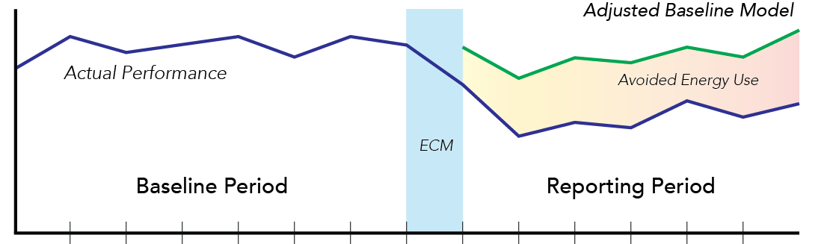
Adjusted Baseline Model Minus Actual Performance Equals “Savings” (Avoided Energy Use)
Notes:
Instructor Note: Emphasize that this (trying to mimic baseline behavior) applies mainly to counterfactual methods. Performance verification doesn’t do this.

Slide 28
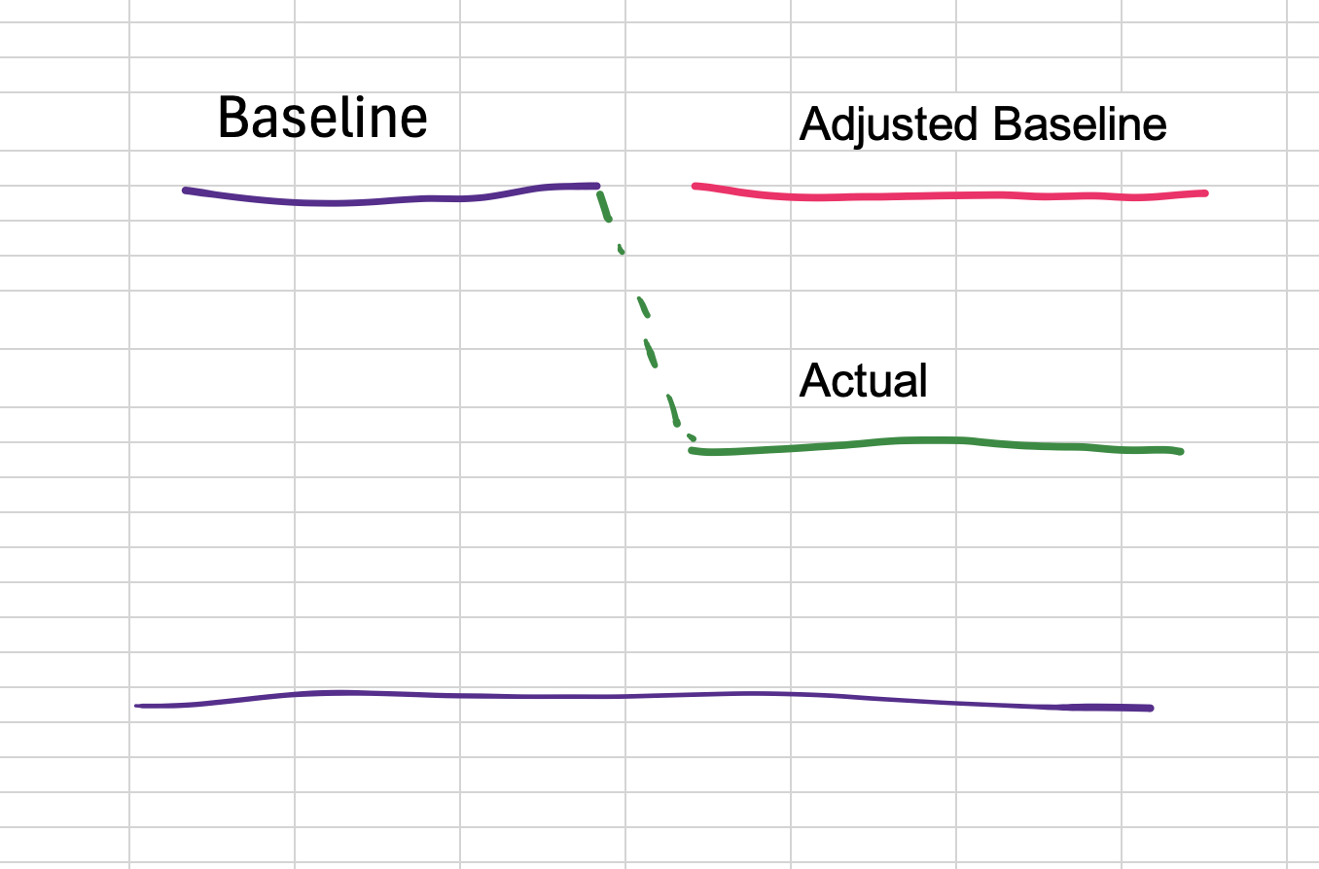
Adjusted Baseline Model Minus Actual Performance Equals “Savings” (Avoided Energy Use)
Notes:
Instructor Note: Emphasize that this (trying to mimic baseline behavior) applies mainly to counterfactual methods. Performance verification doesn’t do this.

Slide 29
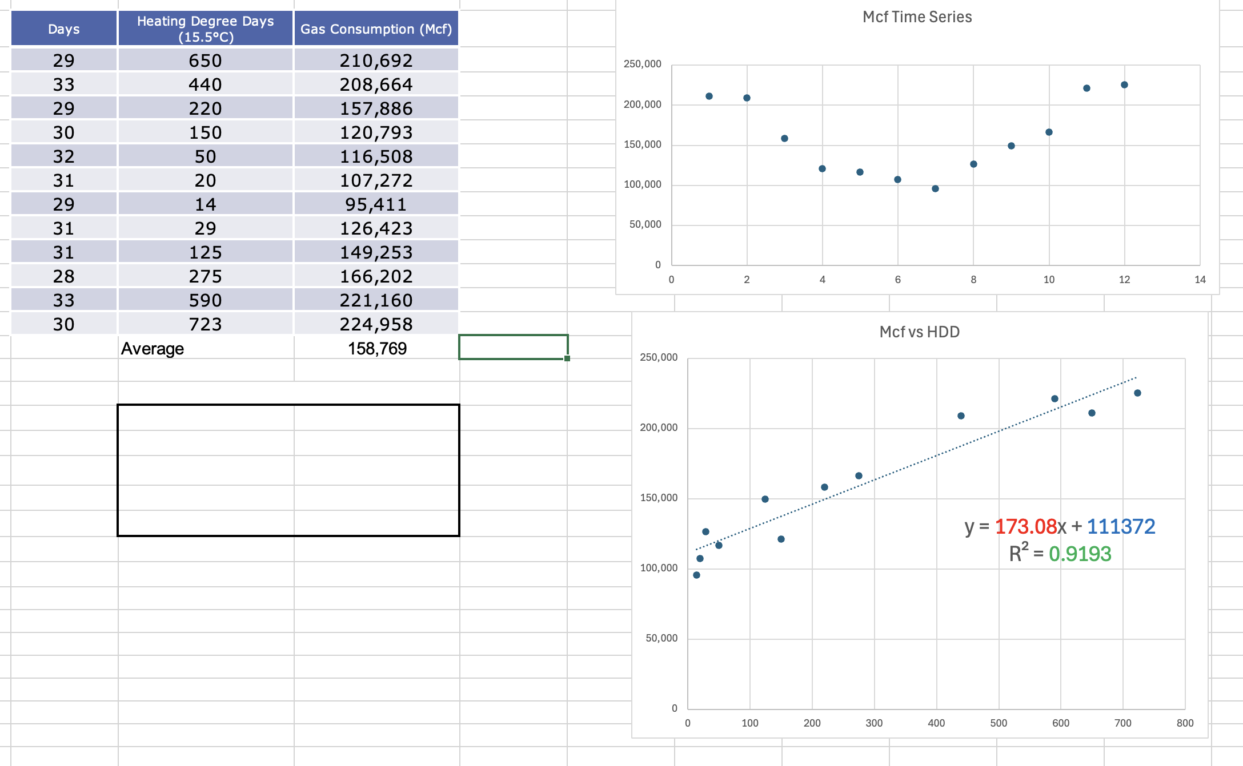
Adjusted Baseline Model Minus Actual Performance
Notes:
Instructor Note: Emphasize that this (trying to mimic baseline behavior) applies mainly to counterfactual methods. Performance verification doesn’t do this.

Slide 30
The Counterfactual Method
How to do it: Compare actual post-implementation performance to “what would have happened” had the project not been implemented. Simple, right?
 | Pre-Implementation | Post-Implementation
Factual | Baseline (metered energy) | Actual performance (measured during the reporting period)
Counterfactual (inference) |  | Adjusted baseline model
Notes:
Instructor Notes
The first law of ESCO dynamics: no matter what happens, the ESCO might try to prove that more resources would have been used if not for the intervention.
The only way to ensure that the adjusted baseline is “real”—i.e., not ”gamed”—is to develop and follow a solid M&V plan.

Slide 31
Counterfactuals – Two Types
Longitudinal
Cross-Sectional
Longitudinal benchmarking compares the energy usage in a fixed period for a building, system, or component to a baseline period of the same length, to determine if performance has deteriorated or improved, to set goals for a building or system, or to monitor for unexpectedly high usage.
Cross-sectional benchmarking is the process of comparing a building’s energy efficiency relative to a peer group. It is the first step to determine if a building has the potential to improve its efficiency. It is usually done at the whole-building level, to assess a building’s overall energy efficiency.
Source: Lawrence Berkeley National Laboratory, Energy Information Handbook: Applications for Energy-Efficient Building Operations
Notes:
Instructor Note: Discuss benchmarking use of these terms vs. “savings.”

Slide 32
Modeling
The counterfactual method presupposes a means of comparing expected performance to a project’s actual performance. In other words, the CMVP must construct a model.
Creating a baseline model is just as important as measuring actual energy use before and after a project’s implementation.
Without a baseline model, a CMVP can’t calculate avoided energy use.
Another word for model is “inference”.
All models are wrong, but some are useful.
—George Box, statistician
Notes:
Instructor Notes
Modeling can apply to both performance verification and counterfactual methods. But the latter is much more involved and difficult.
Regarding the George Box quotation: set expectations! That’s the key to a successful settlement.
Instructor Note: "For students who want to go deeper into spurious correlations and the limits of statistical inference:"
Tyler Vigen - Spurious Correlations: https://tylervigen.com/spurious-correlations

Slide 33
Terminology -
Models
Theoretical
Structural
Implementation
Approach
Method
Technique
“Way”
Process
Tool
Option

Slide 34
Terminology - Models, Approaches, and Methods
Different M&V protocols use different terms - understanding the hierarchy helps you navigate the literature
Model Types
Terminology Hierarchy
Theoretical
Structural
Implementation
Approach
Method
Technique
Process
Tool
Option
Note: IPMVP uses 'Options' | FEMP uses 'Approaches' | ASHRAE uses 'Methods'
Same concepts, different terminology

Slide 35

Spherical Cow
A dairy farm’s milk production was low, so the farmer asked the local university for help. A multidisciplinary team of professors was assembled, headed by a theoretical physicist, and weeks of intensive on-site investigation took place. The scholars then returned to the university, notebooks filled with data, where the task of writing the report was left to the team leader. Shortly afterward, the physicist returned to the farm, saying to the farmer, “I have the solution—but it works only for spherical cows in a vacuum.”
Notes:
Instructor Note: Ask participants what they think the “lesson” of this story is.
(Response Sought: The concept of the “spherical cow” refers to the practice of simplifying real-world problems for the sake of the feasibility of computational analysis—especially when the simplification undermines the model’s practical applicability.)

Slide 36
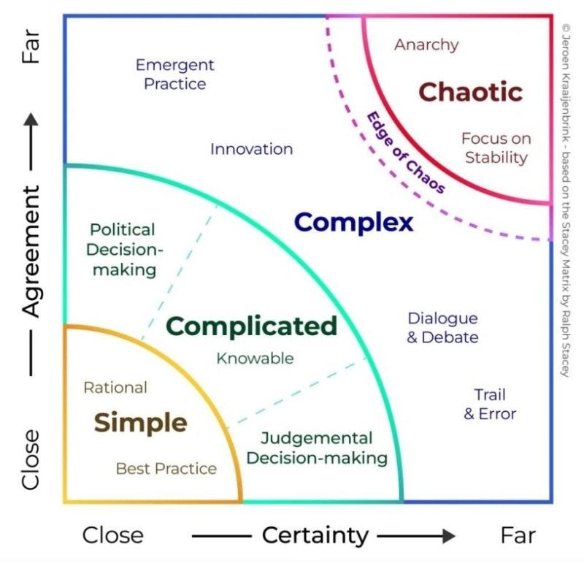
Navigating Complexity
The Stacey Matrix¹ was developed and published by Ralph Douglas Stacey. It is designed to help understand the factors that contribute to complexity and choose the best management actions to address different degrees of complexity. It was not specifically designed to address project delivery but is just as relevant to that area as any other.
Notes:
Instructor Note: Ask participants what they think the “lesson” of this story is.
(Response Sought: The concept of the “spherical cow” refers to the practice of simplifying real-world problems for the sake of the feasibility of computational analysis—especially when the simplification undermines the model’s practical applicability.)
Also cynefin approach.

Slide 37
Other Uses for Models
Models (physical) can also be used to investigate issues like interactive effects and non-routine adjustments.
Interactive effects: The influence of an ECM on the energy use of other equipment in a facility beyond the measurement boundary (the conceptual line demarcating the space in which measurements of equipment and systems will occur).
Non-routine adjustments: Adjustments that must be made to account for changes to elements of the baseline that were not expected to change during the reporting period.

Slide 38
Other Uses for Models
Predicting: An educated guess or estimate about what might happen in the future. Predictions can be based on past data and trends, but they can also be based on intuition, expert knowledge, or other subjective factors CEM/CEAs do this with audits – ASHRAE Level 1-3
Forecasting: A prediction of future conditions or events based on a combination of past data and current trends.
Digital Twin?
Notes:
Instructor Note: Explain that we will discuss this use of models in the sections on whole facility and retrofit isolation.

Slide 39
Three Types of Models
Statistical <- HYBRID ->
Physical
Attempt to identify correlations and other patterns in actual measured data
Can be Frequentist or Bayesian.
Frequentist: Estimates the probability of obtaining a certain result under repeated random sampling
Bayesian: Treats probability as a measure of belief or uncertainty, rather than as a frequency of occurrence.
Near-synonyms: Simulation or causal, physics-based, or first principles model
Try to represent the dynamics of underlying systems
Advanced example: digital twin.
Simpler examples available in class materials folder online
AI Examples

Slide 40
Types of Models in M&V
Three approaches to modeling energy use and predicting counterfactual baseline
Statistical Models
Hybrid Models
Physical Models
Data-Driven
• Use measured data
• Find correlations
• Regression analysis
• Time-series
Examples:
• Linear regression
• TOWT models
• Change-point
• Machine learning
Combined
• Use both data
AND physics
• Calibrate physics
models with data
• Statistical on
physics outputs
Examples:
• Calibrated
simulation
• Grey-box models
• RC models
Physics-Based
• Use engineering
principles
• First principles
• Heat transfer
• Mass balance
Examples:
• EnergyPlus
• eQUEST
• TRACE
• Spreadsheet calcs
Choice depends on: available data, required accuracy, budget, timeline, and stakeholder needs

Slide 41
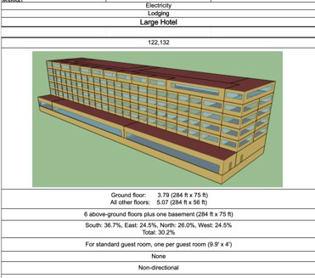
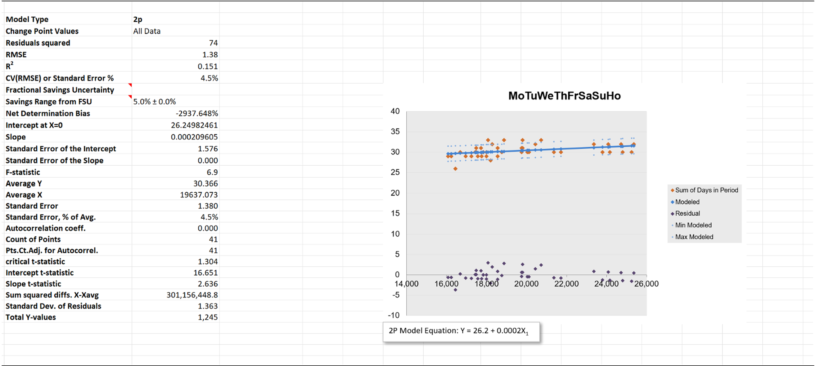
Types of Models
Statistical
Physical
Notes:
Instructor Note: Consider showing examples of simple models.

Slide 42
Statistical Models: CausalImpact
A tool for simple Bayesian analysis for M&V.
Uses a Bayesian structural time series model to estimate what the outcome variable (e.g., energy consumption) would have been in the absence of the intervention, then compares it to the observed outcome variable to estimate the causal effect of the intervention.
https://google.github.io/CausalImpact/CausalImpact.html

Slide 43
“Justify” your Statistical Model
Correlation is not causation
Build a simple physical “explanation” of the observed energy values.
Justify any statistical inference of predicted energy.

Slide 44
Physical Models: Tools
Energyplus-MCP – Wow!!!
TRACE 3D is simulation software for creating detailed physical models of buildings: https://www.ibpsa.us/best-directory/trace-3d-plus/
MATLAB and Simulink: https://www.mathworks.com/solutions/mathematical-modeling.html
Notes:
https://www.sciencedirect.com/science/article/pii/S2352711025003334
https://github.com/LBNL-ETA/EnergyPlus-MCP

Slide 45

[MIT meteorologist Kerry Emanuel] articulated a distinction between two types of hurricane forecasts. One is purely statistical. “You have a long record of the phenomenon you’re interested in. And you have a long record of what you consider to be viable predictors—like the wind in a large-scale flow of the atmosphere, or the temperature of the ocean, what have you,” he said. “And without being particularly physical about it, you just use statistics to relate to what you’re trying to predict to those predictors” […]
There is an alternative, however, when you have some knowledge of the structure behind the system. This second type of model essentially creates a simulation of the physical mechanics of some portion of the universe. It takes much more work to build than a purely statistical method and requires a more solid understanding of the root causes of the phenomenon. But it is potentially more accurate.
Notes:
Instructor Notes
A good discussion of these topics can be found in FiveThirtyEight, “Model Talk: How Climate Models Work” (podcast): https://fivethirtyeight.com/features/how-climate-models-work/
Other analytic industries share our challenge—how to create ”forecast” models that will hold up throughout the reporting period.

Slide 46
The Role of the CMVP
A CMVP should have a range of knowledge and abilities:
Grasp the counterfactual method, including its limitations
Know the limits of science and engineering
Understand the different contexts in which M&V is applied
Appreciate the trade-offs required when performing M&V
Develop or review M&V plans
Understand who the stakeholders are
Ensure good communication with stakeholders
Assemble an effective M&V team
Design and manage projects
Notes:
Instructor Note: Here is a quip from one of the course creators: “M&V is too important to be left to engineers.” —Steve Kromer, PE

Slide 47
Additional Expertise Required
But a CMVP likely won’t be an expert in all the skills necessary to perform every kind of M&V. Know when to bring in experts in areas such as …
Energy efficiency proposal evaluation
Engineering consulting
Utility rate structures and financial forecasting
Detailed metering systems
Certain forms of data and statistical analysis
Simulation modeling

Slide 48
Types of Stakeholders
The CMVP should be aware of the various stakeholders, both direct and indirect, often involved in M&V projects:
ESCO
Utility
Client
Facility users
Financer
Regulator
Government agency
Program implementer
Program evaluator
ESG evaluator

Slide 49
The Multiple Roles of CMVPs
In any energy efficiency project, there may be multiple CMVPs working on behalf of different parties and playing various roles. Consider the Saudi Arabian context:
ESCO: Private company working under the Super ESCO
CMVP collects audit data and submits M&V plan.
Super ESCO: Tarshid
CMVP reviews audit and M&V plans from ESCOs.
Regulator: Saudi Energy Efficiency Center (SEEC)
CMVP approves audit and M&V plans from Tarshid.
Notes:
Instructor Notes
Tarshid is Saudi Arabia’s national energy services company, “a result of a collaborative effort between the Ministry of Energy, Ministry of Finance, and the Saudi Energy Efficiency Center.”
Super ESCOs are governmental entities created to serve the public sector, develop the capacity of private ESCOs, and facilitate project financing.

Slide 50
Professional Judgment
Because of the role of hypotheticals in the counterfactual method, there is no single correct way to perform M&V, and there is no such thing as definitive “truth” in reporting avoided energy.
As a result, certified measurement and verification professionals must always exercise some degree of judgment.
And Technicians!!! Not everyone wants to deal with uncertainty!

Slide 51
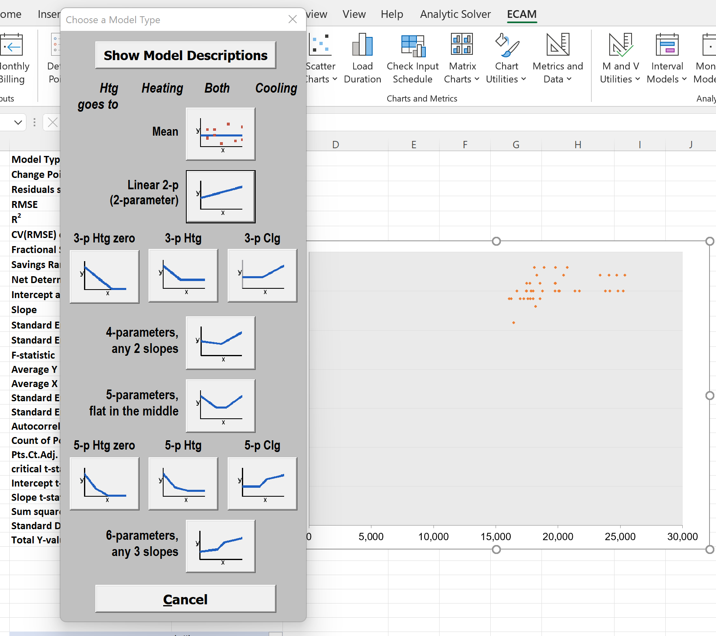
Notes:
Instructor Notes
Which is the right model for this data? ​Each model will give a slightly different answer. ​Exercise judgment!​ [Continues on next slide.]
Discuss ECAM here. Open the link to a simple model. Demonstrate this pull down menu.

Slide 52
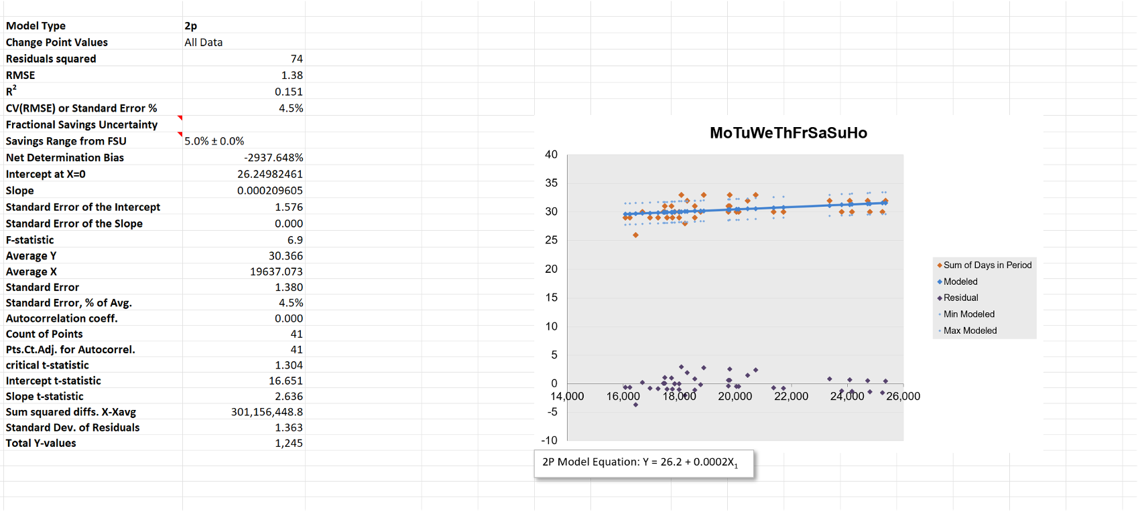
Notes:
Instructor Notes
Highlight the Statistical Terms—discuss that we will be going over all these later.
Discuss “Statistics” spreadsheet (Hannah Seeger).

Slide 53
Professional Judgment
Even so, all parties to an energy management project must regard the adjusted baseline model as sensible or “accurate.”
The basic goal of M&V: that reasonable people can agree that the process has been conducted with sound judgment.
Different people will select different models.
Need to compromise.
Consider costs and benefits.

Slide 54
Uncertainty (and Statistics)
In M&V, there are many potential sources of uncertainty:
Modeling
Sampling
Measurement
For the CMVP, uncertainty mainly comes into play in two ways:
In planning: How can uncertainty be used to develop an optimal and cost-effective plan? Where is Murphy’s Law going to rear its head?
In reporting: How is uncertainty “quantified” and communicated?
Notes:
Instructor Note: Add an example report with something like “125,000 kWh ± 1000 kWh @ 90% confidence level.” Then, highlight the confidence interval and confidence level of the final result. Repeat this throughout the class. This can be implemented on a whiteboard or chart in the classroom.
Show how baselines can have uncertainty of all three types.

Slide 55

Sources of Uncertainty in M&V
Three types of uncertainty affect both baseline and reporting periods:
Measurement Uncertainty
Sampling Uncertainty
Modeling Uncertainty
Meter accuracy (±1-2%)
Sensor precision
Calibration drift
Installation errors
Data acquisition errors
Sample size effects
Selection bias
Temporal sampling
Spatial sampling
Confidence intervals
Model selection
Model fit (RMSE)
Coefficient errors
Extrapolation risks
Parameter estimation
These uncertainties apply to BOTH periods:
Baseline Period
Reporting Period
Measurement: Meter accuracy in baseline data collection
Sampling: Limited baseline data points, fixture surveys
Modeling: Baseline model fit (CV(RMSE), R²), parameter estimates
Measurement: Meter accuracy in post-retrofit data
Sampling: Spot measurements, verification samples
Modeling: Counterfactual uncertainty follows baseline model uncertainty
Key Concept: Counterfactual uncertainty is a function of Baseline model uncertainty
Notes:
"The baseline model has a certain uncertainty based on its CV(RMSE) - that's the 'quality' of the model fit to baseline data.
When we start the reporting period, we're asking: 'Does this model still work?' After 1 month, we have limited evidence. After 12 months, we have strong evidence - twelve successful 'predictions' (actually, representations) that validated the model.
That's why FSU has √months in the denominator. Not because we're getting better at predicting, but because we're accumulating evidence the model still represents reality.
Think of it like this: The model's inherent uncertainty (CV(RMSE)) is fixed - that was determined during baseline. But our confidence that it still applies grows with more reporting data. FSU quantifies that growing confidence."

Slide 56
Fractional Savings Uncertainty
The 'adjusted baseline model’ contains the RMSE from the baseline model. But this diminishes over time. (See FSU in Statistics)

Slide 57
Uncertainty Examples in M&V
Example 1: Whole Building Regression (Modeling Uncertainty)
Baseline Model: Energy = 100,000 + 50 × HDD (R² = 0.92, RMSE = 15,000 kWh/month)
CV(RMSE) = RMSE / Mean Energy = 15,000 / 300,000 = 5.0%
Post-retrofit savings: 60,000 kWh/year
Fractional Savings Uncertainty (FSU) ≈ 2 × CV(RMSE) / √(months) = 2 × 5.0% / √12 = 2.9%
Reported savings: 60,000 kWh/year ± 1,740 kWh (at 68% confidence)
Example 2: Lighting Retrofit (Sampling Uncertainty)
Baseline: 500 fixtures, sample 50 fixtures (10%) to measure wattage
Sample mean: 95W, Sample std dev: 12W
Standard error (SE) = σ / √n = 12 / √50 = 1.7W
Confidence interval (95%): 95W ± (1.96 × 1.7) = 95W ± 3.3W → [91.7W, 98.3W]
Baseline uncertainty: ±3.5% from sampling
Total baseline load: 500 fixtures × 95W × 3,000 hrs = 142,500 kWh/yr ± 5,000 kWh
Note: Larger samples reduce uncertainty (n=100 → SE=1.2W, CI=±2.4W)
Example 3: Chiller Retrofit (Measurement Uncertainty)
Measurement equation: Energy = Flow × ΔT × Cp × time
Component uncertainties:
• Flow meter: ±1.5% (calibrated, class 1)
• Temperature sensors: ±0.3°C (at ΔT = 10°C → ±3%)
• Time: negligible
Combined measurement uncertainty (root sum square):
U_total = √[(1.5%)² + (3%)²] = √[0.0225% + 9%] = 3.4%
Baseline measurement: 1,000 MWh/yr ± 34 MWh (baseline period)
Reporting measurement: 850 MWh/yr ± 29 MWh (reporting period)
Savings: 150 MWh/yr, Combined uncertainty: √(34² + 29²) = 45 MWh → Savings = 150 ± 45 MWh (30%)
Key Takeaway: All three uncertainty types must be considered in M&V planning. Larger uncertainties require more conservative M&V approaches or increased measurement rigor.

Slide 58
Uncertainty
🎲
❓
🔄
Aleatory
Epistemic
Ontological
Natural variation of inputs and parameters
Inherent randomness in system behavior
Can be quantified as standard error or RMSE
Lack of knowledge about the system
Could be reduced with better data or measurement
Parameter estimation errors
Uncertainty about system structure or existence
Non-routine events: unknown system changes
Static factors that changed
M&V Example:
Weather variation, occupancy patterns
M&V Example:
Unknown equipment specs, infiltration rates
M&V Example:
Equipment failure, tenant changes, new loads
Further Reading: Nathan Wayne Porter and Vincent Andrew Mousseau,
"Understanding Aleatory and Epistemic Parameter Uncertainty in Statistical Models."
Notes:
Note: Talk about epistemic humility – we aren’t going to be able to learn everything.

Slide 59
Uncertainty
Because the M&V process cannot produce a perfect answer that contains no uncertainty, the CMVP must ask, “How much M&V is enough?”
In other words, it is necessary to balance M&V efforts, which aim at reducing uncertainty, and cost.
Risk Management: The process of identification, analysis, and acceptance or mitigation of uncertainty in investment decisions.
—Investopedia

Slide 60
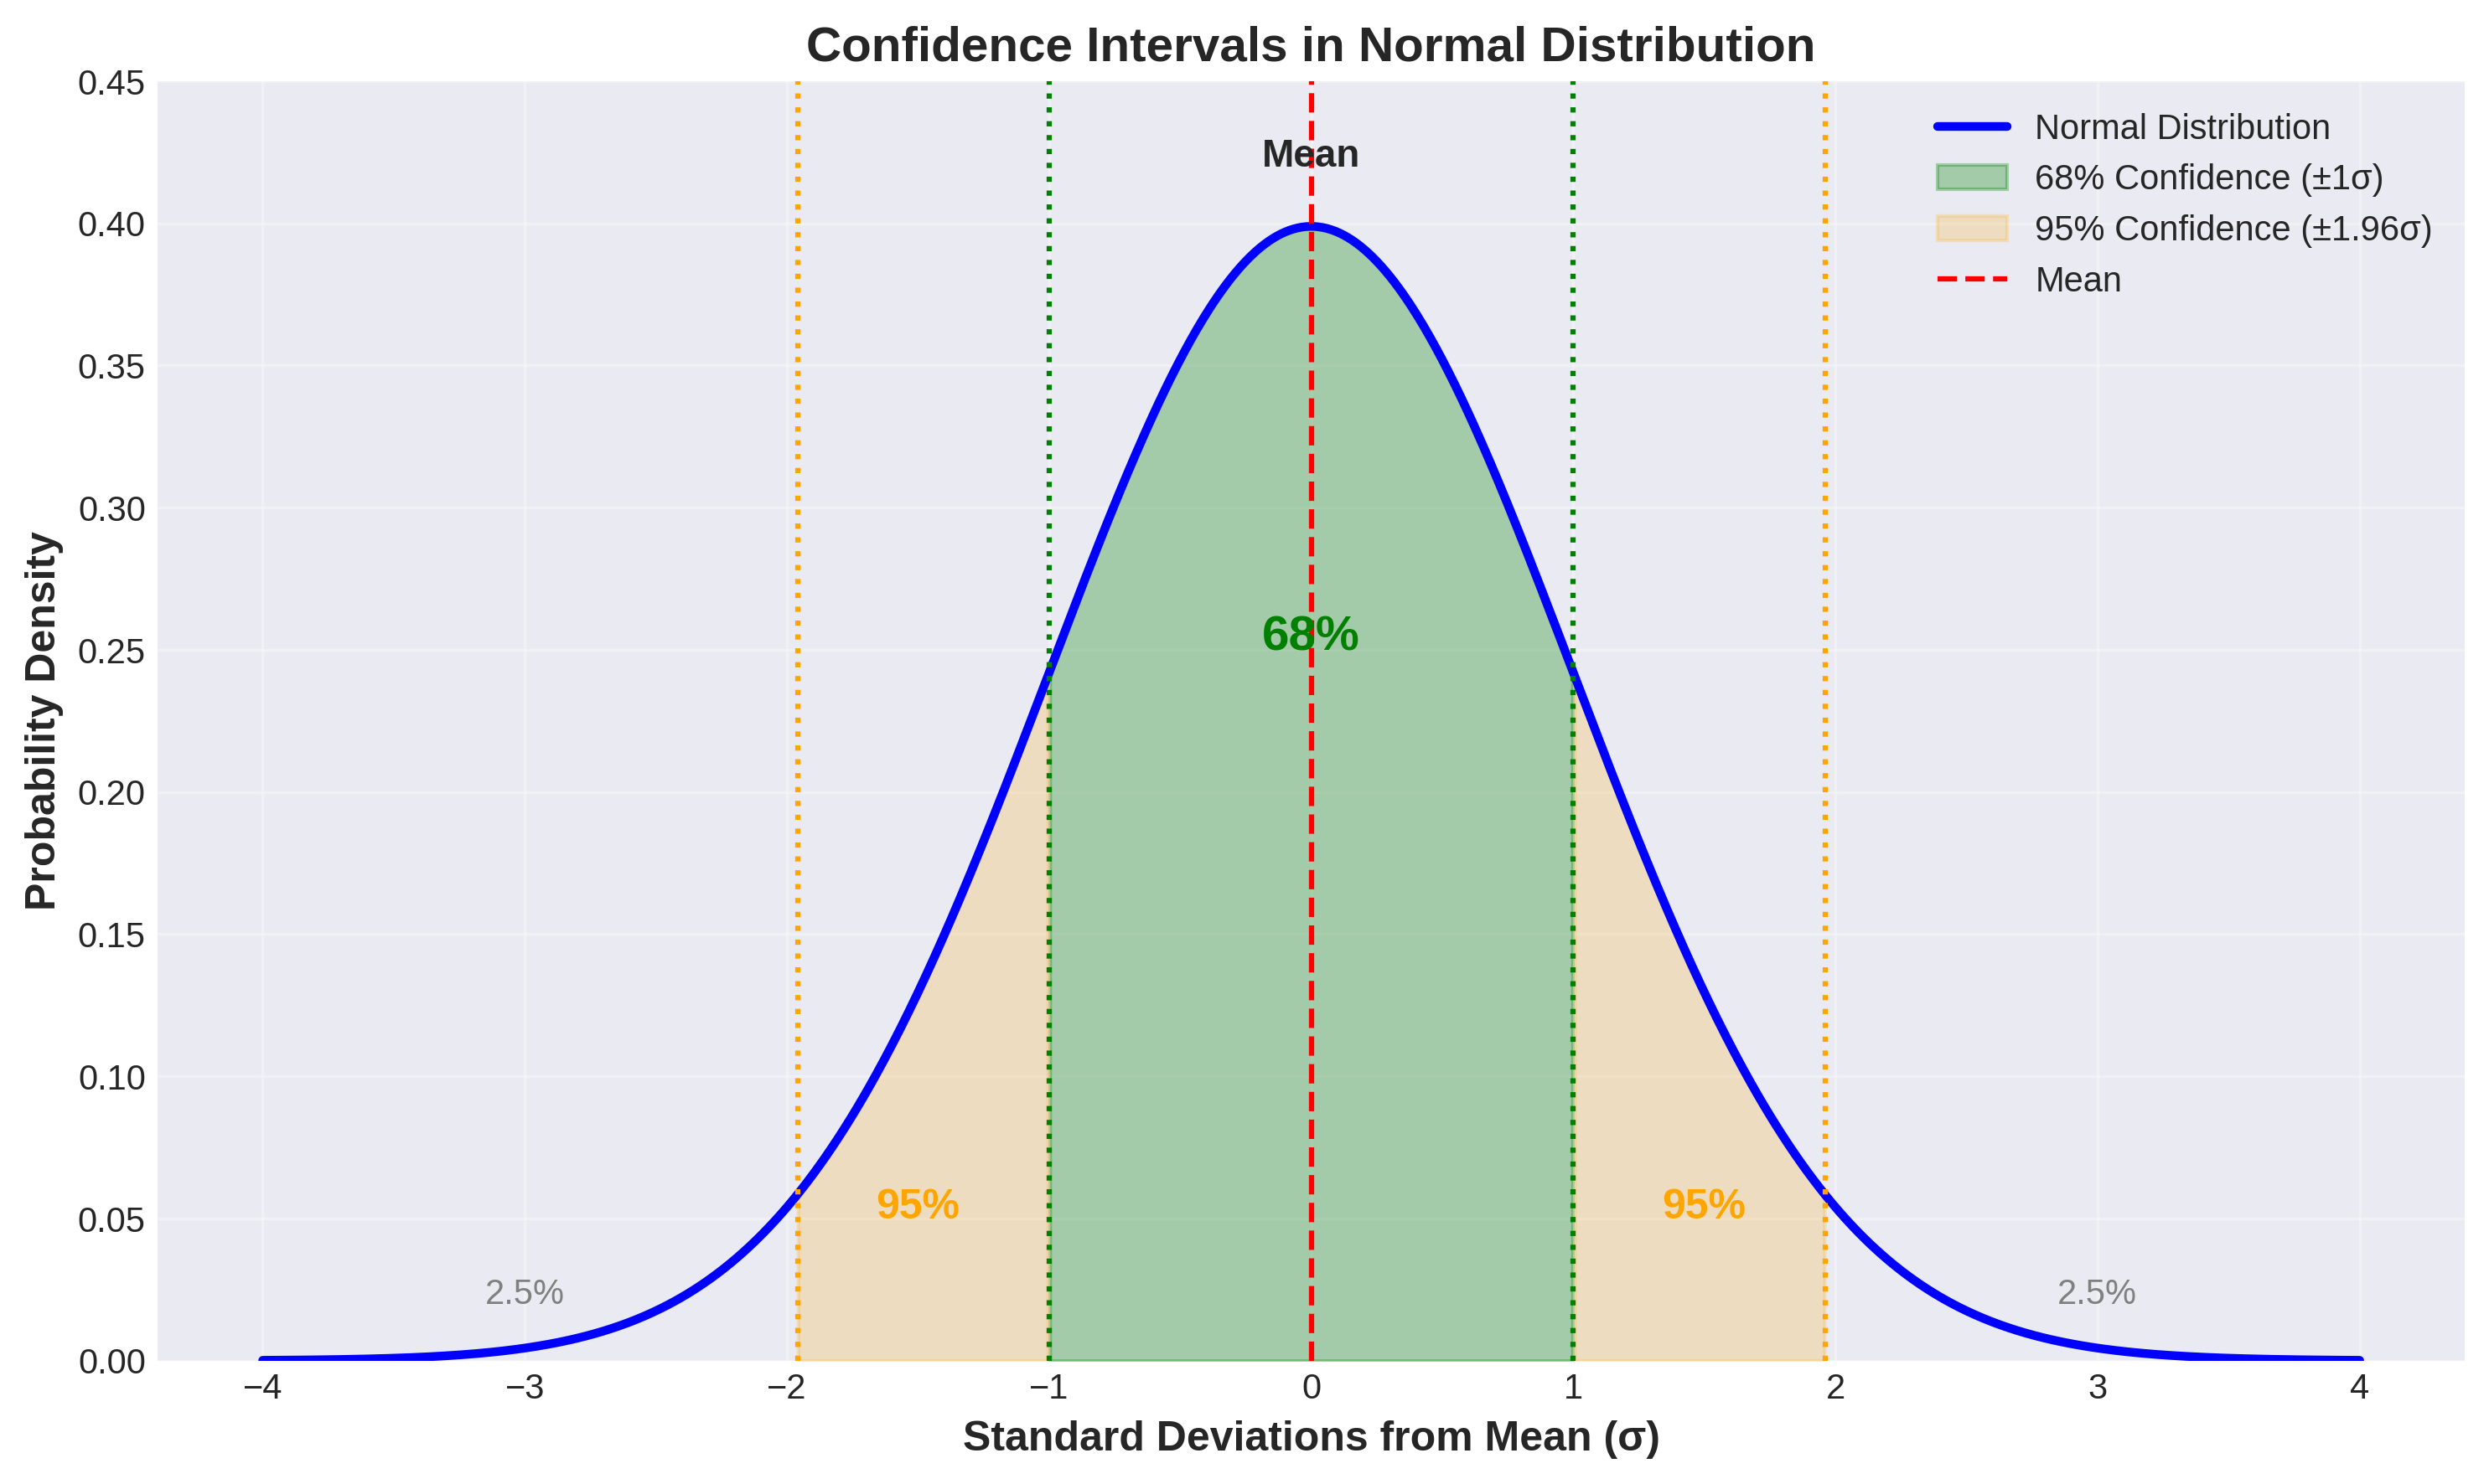
Understanding Confidence Intervals
Key Concept: 68% confidence = ±1 standard deviation (σ), 95% confidence = ±1.96σ
In M&V, we typically report at 90% or 95% confidence levels

Slide 61
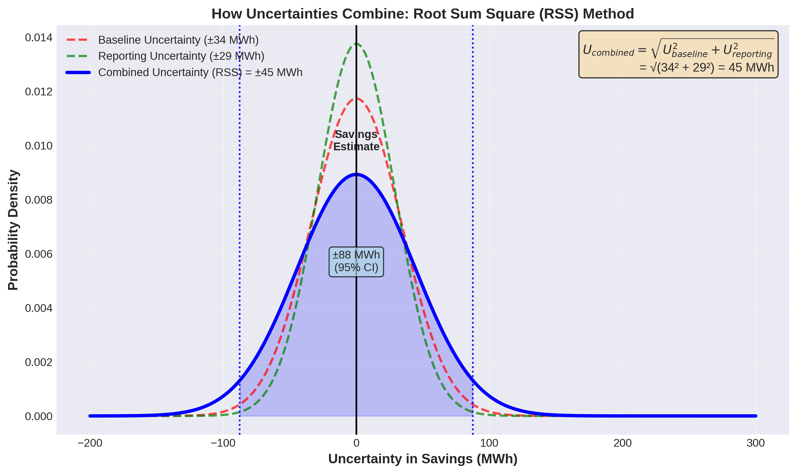
Three Sources of Uncertainty in M&V
Measurement
Sampling
Modeling
Meter accuracy
Sensor precision
Calibration drift
Installation errors
Sample size effects
Selection bias
Temporal sampling
Confidence intervals
Model fit (RMSE)
Coefficient errors
Extrapolation risks
Parameter estimates
Apply to BOTH Baseline and Reporting Periods
BASELINE PERIOD
REPORTING PERIOD
Measurement: Meter accuracy in data collection
Sampling: Limited baseline data points
Modeling: Baseline model fit (CV(RMSE))
Measurement: Meter accuracy post-retrofit
Sampling: Verification spot measurements
Modeling: Counterfactual = Baseline model

Slide 63
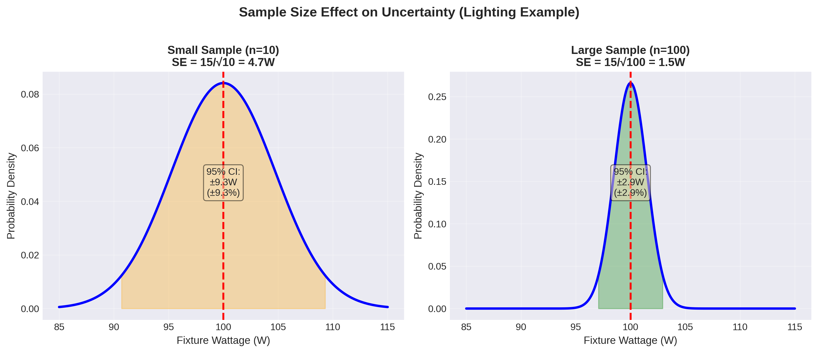
Example 2: Sampling Uncertainty (Lighting)
Calculation Example
500 fixtures total, sample 50 (10%) | Sample mean: 95W, std dev: 12W
Standard Error (SE) = 12 / √50 = 1.7W | 95% CI: 95W ± (1.96 × 1.7) = 95W ± 3.3W
Baseline: 500 × 95W × 3,000 hrs = 142,500 ± 5,000 kWh/yr | Uncertainty: ±3.5%
Key Insight: Doubling sample size (n=100) reduces uncertainty to ±2.4W (±2.5%)

Slide 64
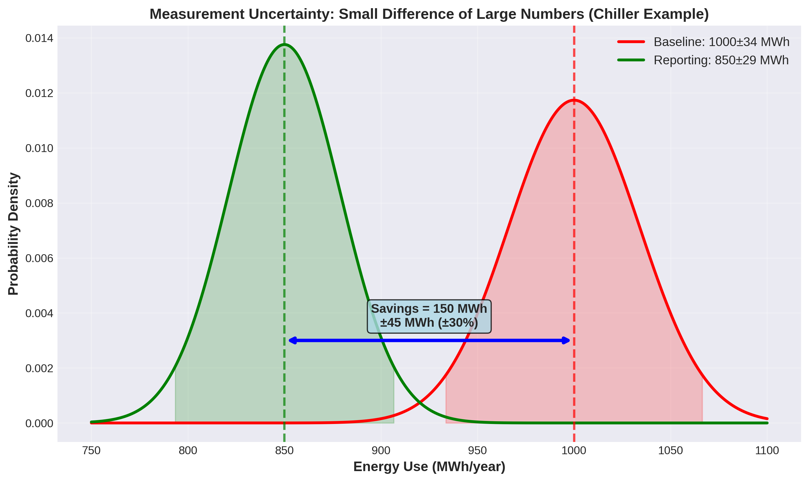
Example 3: Measurement Uncertainty (Chiller)
Calculation Example
Measurement: Energy = Flow × ΔT × Cp | Flow meter: ±1.5%, Temp sensors: ±3%
Combined (RSS): √[(1.5%)² + (3%)²] = 3.4% | Baseline: 1,000 ± 34 MWh, Reporting: 850 ± 29 MWh
Savings: 150 MWh | Combined uncertainty: √(34² + 29²) = 45 MWh
Result: 150 ± 45 MWh (±30%) | Small difference of large numbers → high relative uncertainty

Slide 65
Key Takeaways: Uncertainty in M&V
1. Three Types of Uncertainty
Measurement (meter accuracy), Sampling (sample size effects), Modeling (RMSE/CV(RMSE))
All three affect BOTH baseline and reporting periods
Must consider ALL types in M&V planning
2. Counterfactual Uncertainty = Baseline Model Uncertainty
The adjusted baseline model has the SAME uncertainty as the baseline model (with one reading)
Why? Because it IS the baseline model applied to current conditions
This is why baseline model quality (low CV(RMSE)) is critical
3. Uncertainties Combine Using Root Sum Square (RSS)
U_total = √[(U₁)² + (U₂)² + (U₃)²] | Example: √[(34)² + (29)²] = 45 MWh
For savings: Small difference of large numbers → high relative uncertainty
Rule of thumb: Savings should be >2× measurement/modeling uncertainty
Typical Uncertainty Values in M&V
Measurement: ±1-3% (revenue-grade meters) | Sampling: ±3-10% (depends on sample size)
Modeling: ±5-20% CV(RMSE) (whole building) | FSU: Target <10% (good M&V), <20% (acceptable)
Confidence levels: Typically 90-95% in M&V reporting
Bottom Line: Quantify ALL uncertainty sources → Identify dominant source → Focus reduction efforts where they matter most

Slide 66
Examples of Risks
Stock Market: Investing in individual stocks carries the risk of price volatility. For example, if you buy shares in a tech company, the stock price can fluctuate significantly in response to market news, economic conditions, or company-specific factors.
Market Risk: Market risk, also known as systematic risk, is the risk associated with broader economic factors that affect all investments. For example, an economic recession can lead to a decline in the value of various asset classes, impacting the overall market.
Credit: When lending money, there is a risk that the borrower may default on their loan payments. This is known as credit risk. For instance, when you buy corporate bonds, there is a risk that the issuing company may not be able to meet its debt obligations.
Currency: If you invest in foreign assets or trade internationally, you are exposed to currency risk. Fluctuations in exchange rates can impact the value of your investments. For instance, if you invest in a foreign stock and the value of the foreign currency drops, your investment’s value in your home currency may decrease.

Slide 67
Examples of Rewards
Stock Market: Historically, the stock market has provided higher returns compared to safer investments like bonds or savings accounts. Investors who accept the volatility and risk of the stock market can potentially earn significant rewards through capital appreciation and dividends.
High-Yield Bonds: High-yield or junk bonds offer higher interest rates compared to investment-grade bonds. Investors who are willing to take on the credit risk associated with these bonds can potentially earn greater interest income.
Venture Capital Investments: Investing in startups and early-stage companies involves high risk, but it can also yield substantial rewards if the company becomes successful. Venture capitalists often seek significant returns on their investments when funding innovative companies.
Options and Derivatives: Options and derivatives can offer the potential for large returns, but they are highly leveraged and come with significant risk. Traders who use these financial instruments can profit from price movements in underlying assets but may also face substantial losses.

Slide 68
How Much M&V Is Enough?
One answer is “the minimum that is both acceptable to all parties and meets the project and outside requirements.”
Another answer is “as little uncertainty as possible.” But then another question arises: what is the cost of reducing uncertainty, and what is the benefit?

Slide 69
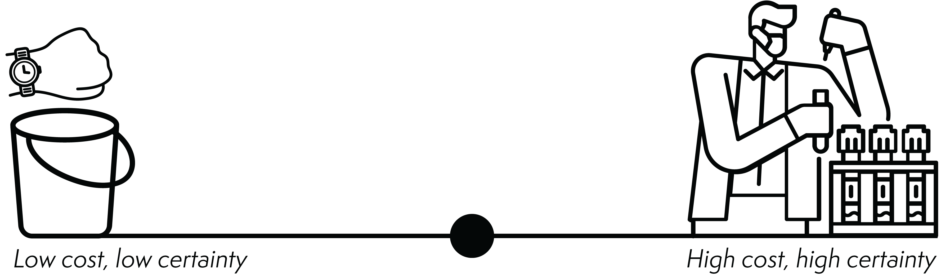
How Much M&V Is Enough?

Slide 70
How much M&V is enough? is always an open question. A CMVP works within contextual constraints to determine the optimal amount of M&V.

Slide 71
Uncertainty and Savings
The relationship between uncertainty and savings can be confusing.
Remember: More or less uncertainty doesn’t mean more or less savings.

Slide 72
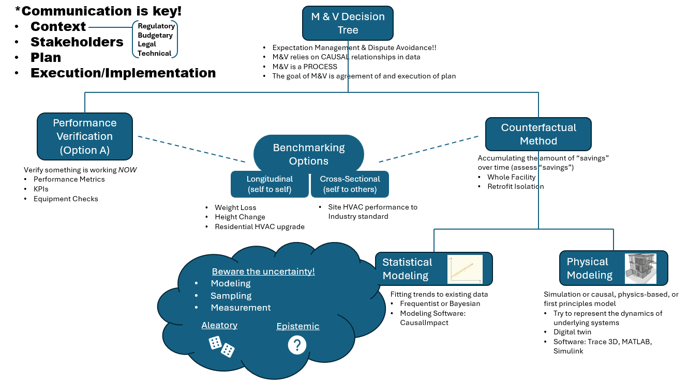

Slide 73
Key Takeaways
The counterfactual method, which compares actual performance observed during the reporting period to a prediction of “what would have happened” had the project not been implemented, is the fundamental theory that drives most M&V protocols and standards.
The other significant approach is performance verification—direct assessment of a system’s actual performance to determine whether it meets specified performance standards.
What distinguishes a CMVP is that a CMVP must exercise skilled professional judgment when conducting M&V.

Slide 74
Discussion
How do “savings” compare to…
Benchmarks?
Energy Star Portfolio Manager?
Performance Standards?
Performance Targets?
Net Zero Concept?
Notes:
Instructor Note: What policies drive all these constructs?

Slide 75
Module 1: Fundamental Concepts
Why is professional judgment essential in the application of the counterfactual method in M&V, and what are some examples of when it is most critical?
What is the difference between a baseline and an adjusted baseline model, and why must M&V practitioners agree on the process ahead of time?
How do aleatory and epistemic uncertainty affect the planning and reporting phases of an M&V project? Give a practical example of each. What about ontological?

