Slide 1
MODULE 2 Contextual Considerations (Who cares?)

Slide 2
Learning Objectives
Define key terms: energy efficiency project, M&V 2.0, Super ESCO, utility program, UESC, ESG, Carbon Credits
Recognize the primary types of contextual considerations of M&V activities: technical, regulatory, commercial, and legal
Identify guidelines, standards, and protocols for M&V activities and their issuing organizations
Name guiding principles of M&V activities
Explain how M&V projects can vary in cost, risk, and scope

Slide 3

The Importance of Context
Every M&V project occurs within a context. For a CMVP, the primary characteristics of a project’s context are …
Notes:
Instructor Note: “Legal” encompasses contracts as well as disputes between parties.

Slide 4
Domain Evolution -
Slide 1: M&V Risks – Overview
• M&V projects face risks in four domains: Government/Regulatory, Financial/Commercial, Legal/Contractual, and Technical/Physical.
• Quantifying risks in each domain enables targeted mitigation and increases project robustness.
Notes:
Instructor Note: “Legal” encompasses contracts as well as disputes between parties.

Slide 5
M&V Risks – Overview
• M&V projects face risks in four domains: Government/Regulatory, Financial/Commercial, Legal/Contractual, and Technical/Physical.
• Quantifying risks in each domain enables targeted mitigation and increases project robustness.
Notes:
Instructor Note:
“In the government and regulatory domain, the major risks include non-compliance with standards, inadequate documentation, and inability to adapt to policy changes. Most projects are subject to audits or inspections, and a lack of transparency can undermine the integrity of reported savings. Always design your M&V plan to exceed current regulatory expectations and maintain a clear audit trail.”

Slide 6
Government / Regulatory Risks
• Non-compliance with required standards or reporting
• Documentation gaps or inadequate audit trails
• Failure to adapt to policy or regulatory changes
• Incorrect baseline calibration or data leading to regulatory rejection
• Insufficient transparency or auditability
Notes:
Instructor Note:
“Today we’ll explore the main risk domains in Measurement and Verification projects. By understanding where risks arise—governmental, financial, legal, and technical—we can ensure our protocols address the real challenges of implementing and defending energy savings claims. This roadmap improves credibility, reduces disputes, and strengthens outcomes for all stakeholders.”

Slide 7
Financial / Commercial Risks
• Over- or under-estimate of savings affecting payments or incentives
• Cost overruns in metering, data handling, or reporting
• Uncertainty or errors leading to payment disputes or delays
• Investment value loss due to baseline or reporting errors
• Risk of savings manipulation or data fraud
Notes:
“On the financial and commercial front, quantifying risks is vital to securing payment, incentives, and project success. Overstating savings may lead to clawbacks or disputes, while cost overruns in M&V can erode project value. Likewise, uncertainty or errors can delay payments and cause friction between parties. Independent review and robust savings calculations serve as best practices for risk mitigation.”

Slide 8
Legal / Contractual Risks
• Ambiguous contract language creating disputes
• Breach of M&V contractual requirements
• Unenforceable M&V plans in court
• Disputes over measurement period, boundary, or adjustments
• Failure to follow contractual dispute-resolution steps
Notes:
Instructor Note: “Legal” encompasses contracts as well as disputes between parties.
“Legal and contractual risks center on the enforceability and clarity of M&V plans. Ambiguous language or breach of contract can trigger costly disputes. Always ensure contracts faithfully capture the M&V process, define remedies for nonperformance or dispute, and include third-party resolution where needed. This approach reduces legal uncertainty and helps all parties trust the results.”

Slide 9
Technical / Physical Risks
• Meter or sensor failure and uncalibrated instruments
• Missing, corrupted, or incomplete data records
• Model selection or specification errors
• Overlooked interactive effects or non-routine adjustments
• Insufficient data frequency or duration for statistical confidence
Notes:
Instructor Note: “Technical and physical risks arise from failures in measurement instruments, data quality, and inappropriate model selection. These risks are usually the most visible but can also be overlooked, especially during operation. Consistent calibration, validated data management, and rigorous model documentation help prevent these problems and maintain project credibility.”

Slide 10
Risk Quantification & Management
• Regularly assess, quantify, and track these risks throughout the project
• Assign specific mitigation strategies to each risk
• Maintain documentation and review procedures for continuous improvement
Notes:
Instructor Note“The key to successful risk management in M&V is quantifying, tracking, and actively mitigating each risk. Doing so not only protects project value, but also equips your team to respond effectively to surprises. Routine documentation and periodic reviews promote continuous improvement and adaptability in the face of emerging risks.”
These notes are designed to keep your delivery focused, encourage engagement, and provide context for each risk domain as you present your slides.

Slide 11



Energy Savings Performance Contracting (ESPC)
A financing mechanism used primarily by the public sector to pay for energy-related improvements in buildings and facilities.
Instead of relying on appropriations or traditional borrowing, agencies can partner with energy service companies (ESCOs) to fund and implement upgrades.
The key characteristic of ESPC is that the resulting cost savings (in terms of reduced utility bills) are used to pay for the financing of the upgrades.

Slide 12

An Example
A performance contract for a project in Dubai must conform to local regulations while also accounting for commercial considerations such as local utility prices and cost of capital. It must also reflect technical characteristics—e.g., what energy assets are used in that region, and what constraints do climate and geography impose?
Notes:
Instructor Note: Colors correspond with the color of the icons (regulatory, legal, commercial, technical).

Slide 13
ESPC – shared or guaranteed?
Guaranteed Savings: The Energy Service Company (ESCO) guarantees a minimum amount of energy savings. If actual savings fall short, the ESCO pays the difference. The client typically finances the project independently.
Shared Savings: The ESCO finances the project, and both the ESCO and the client share the achieved energy savings. There's no guaranteed minimum, and payments depend entirely on actual savings.
Key Difference:
Guaranteed savings shifts performance risk to the ESCO but financial responsibility to the client.
Shared savings shifts both performance and financial risks primarily to the ESCO, with the client sharing only actual achieved savings.
Notes:
Instructor Note: Colors correspond with the color of the icons (regulatory, legal, commercial, technical).

Slide 14
It’s Not Just Engineers
Procurement Officers
Contract Administrators
Oversee the acquisition of services and equipment (required for M&V projects)
Select and engage with vendors and service providers.
Ensure cost-effective and timely procurement while maintaining quality standards.
Liaise with technical teams to understand specific requirements.
Ensure compliance with regulatory and commercial frameworks.
Manage contracts (related to M&V projects).
Draft, review, and negotiate contract terms.
Ensure contracts align with project objectives and regulatory standards.
Handle any contract modifications or extensions.
Mitigate potential disputes and liaise with legal teams when necessary.
Notes:
Instructor Note: These are examples of other roles that can play a crucial role in M&V projects.

Slide 15
Energy Efficiency Projects
An energy service company (ESCO) implements an energy conservation measure (ECM) at a facility.
The facility’s energy efficiency improves, leading to cost savings for the facility’s owner.
The facility’s owner repays the ESCO from cost savings.

Slide 16
What Is a Utility Program?
An energy efficiency program sponsored by a utility. Utilities sponsor many energy efficiency programs, for several reasons.
It is typically less expensive to source energy through efficiency measures than through the generation of new energy.
Efficiency measures allow utilities to continue to meet customers’ needs during periods of high demand.
Some national and subnational (e.g., state or municipal) governments require utilities to sponsor energy efficiency programs.
Utility-sector energy efficiency programs save electricity and natural gas at less than half the cost of new energy supplies.
—American Council for an Energy-Efficient Economy
Notes:
PSEG Full page description of rules

Slide 17
Energy Efficiency Programs
A utility or government agency sponsors a program with rate payer or taxpayer monies.
An implementer facilitates program implementation to generate end use savings.
The utility submits savings to the regulating entity and pays the implementer for successful implementation.

Slide 18
An Example
A utility in California is bound by local regulations to reduce grid demand by 2025 following the prescribed M&V plan. The utility hires an implementor to deliver the savings, and the regulator hires an evaluator to review the submitted savings following the prescribed EM&V plan. The utility will evaluate the program’s success based on total resource costs, incentive payments, and total savings submitted.​

Slide 19
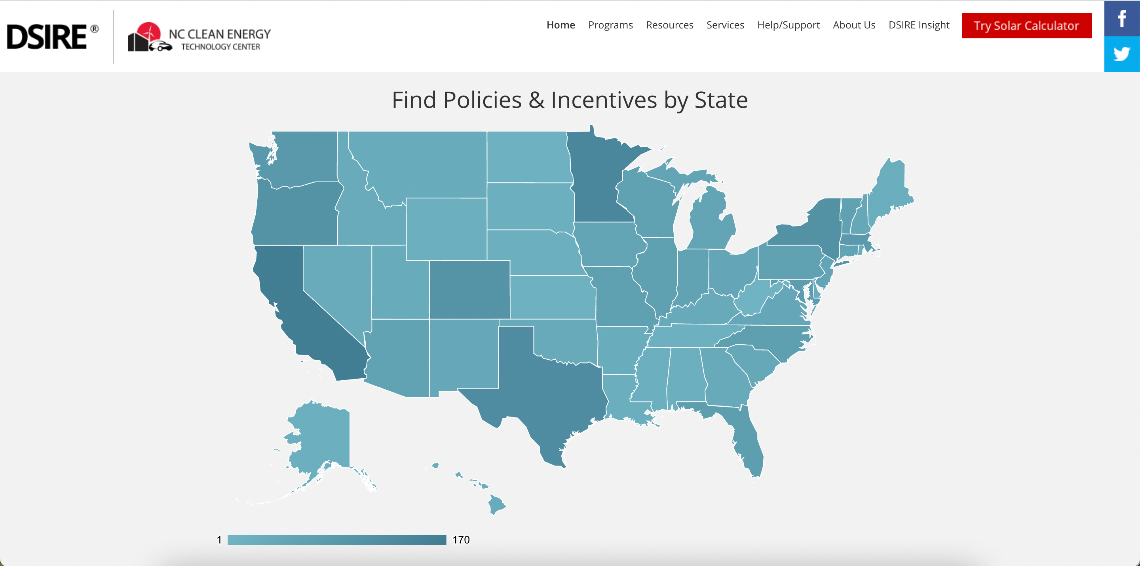

Notes:
Instructor Note: DSIRE: Database of US Utility Programs. If possible, instructor should find a similar slide for the relevant region. However, the takeaway is that policies and incentives can vary dramatically.

Slide 20

Concept: Savings By Design Programs
These programs provide incentives to designers to build facilities that are better than the required energy code.
Many have evaluations that require M&V to determine if the newly built buildings are actually operating per the improved design.

Slide 21
Utility Program Considerations
In utility program contexts, M&V and EM&V play complementary roles. An M&V plan guides how a project or program will be implemented, whereas an EM&V plan guides how a program or portfolio will be evaluated.
Similarly, an implementor will be hired to design and/or carry out an M&V plan, whereas an evaluator will be hired to design and/or carry out the EM&V plan.
In most cases, utilities, regulators, implementors, and evaluators are all involved in M&V and EM&V planning processes.

Slide 22
Timing
M&V planning usually occurs either at the start of a new utility program or the start of a new program cycle. If modifications to M&V plans are required, they tend to be made at the start of a new program cycle.
Program cycle durations can vary across utilities and regulators. It is important to understand the timing of these cycles to adequately plan for proposed changes to M&V and EM&V plans.

Slide 23
Other Possible Contexts
A Super ESCO program on behalf of the US federal government
A government incentive program in New South Wales, Australia
A strategic energy management (SEM) program in California
ISO 50001
A tax incentive program in South Africa
IRA Tax Incentives – 179D
Carbon trading
FLEXmarket—the future of M&V?
Utility Energy Service Contracts (UESC)
Notes:
Instructor Note: M&V 2.0 and FLEXmarket are discussed at length later in the module.

Slide 24
Other Possible Contexts (cont)
ESG Reporting Frameworks
GHG Protocol - corporate carbon accounting
GRESB - real estate sustainability benchmarking
ISO 14064 - greenhouse gas inventory verification
Notes:
Instructor Note: M&V 2.0 and FLEXmarket are discussed at length later in the module.

Slide 25
Other Possible Contexts (cont)
"Carbon Accounting and M&V"
Operational carbon vs. embodied carbon
Scope 1, 2, 3 emissions
M&V role in carbon credit verification
Real-time carbon attribution (emerging)
Notes:
Instructor Note: M&V 2.0 and FLEXmarket are discussed at length later in the module.

Slide 26
M&V 2.0
In recent years, advanced metering infrastructure and sophisticated data analytics tools have proliferated. Together, these developments have ushered in “M&V 2.0,” characterized by the following:
Granularity: Advanced metering infrastructure automatically measures energy use data at a granular level (hourly or sub-hourly).
Automated Analysis: Automated analysis of granular data allows for precise and near-real-time performance measurement.

Slide 27
M&V 2.0 > AMI 2.0?
And now, sub-second meters – more later on this
Granularity: Identify loads
Automated Analysis: Detailed analysis

Slide 28
FLEXmarket
An aggregator (ESCO) implements energy efficiency projects at residential or commercial sites, which are connected by meter to the FLEXmarket platform.
Advanced metering systems collect hourly data at enrolled sites and measure outcomes against baseline models.
The aggregator is paid for reducing demand or shifting demand away from peak hours.
FLEXmarket is a platform for the sharing of energy use data.
It was originally implemented in northern California.

Slide 29
Consider the project’s context when applying M&V concepts.

Slide 30
Guidelines, Standards, and Protocols
There are numerous guidelines, standards, and protocols issued by governmental and professional organizations that define M&V and describe it as a process and set of concepts. For example:
ISO 50015:2014
ASHRAE Guideline 14
FEMP’s M&V Guidelines
Abu Dhabi M&V Protocol Guidance Document
IPMVP
SANS 50010:2018
These documents all center on the same core concept: the counterfactual method. However, they may vary in other respects because they serve different needs and contexts.
IPMVP is a registered trademark of EVO. AEE is using the term “IPMVP” only to refer to the protocol.

Slide 31
Guidelines, Standards, and Protocols Names Change. Concepts Evolve and Adapt.
Acronym | Name
BMVP | Building M&V Protocol
NEPAL | National Energy Project Agreement Language​
NEMVP | North American Energy M&V Protocol
IPMVP | International Performance M&V Protocol
IPMVP is a registered trademark of EVO. AEE is using the term “IPMVP” only to refer to the protocol.
Notes:
Instructor Note: NEMVP defined Options A/B/C. IPMVP defines Options A/B/C/D​. In this training, we sometimes refer to Performance/Operation. Protocols are written by committees of human beings—they change over time to reflect current needs.

Slide 32
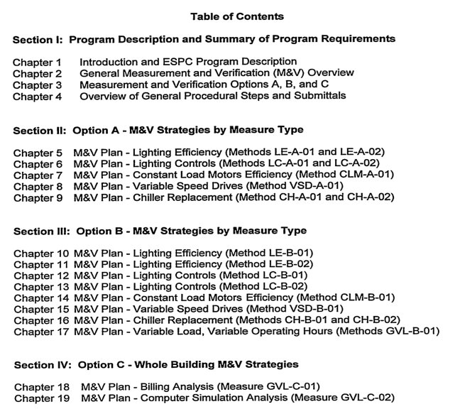
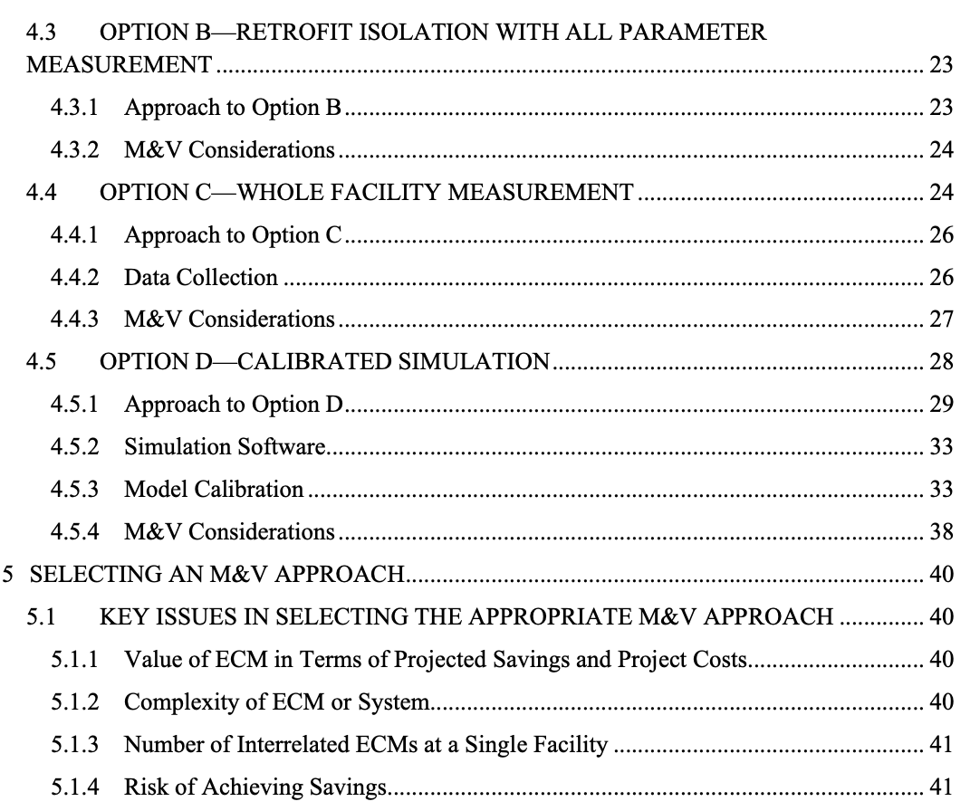

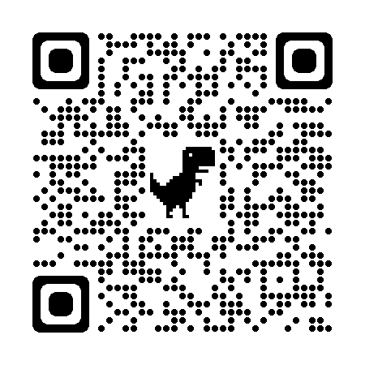
Guidelines, Standards, and Protocols Names Change. Concepts Evolve and Adapt.
FEMP Guidelines Version 1
FEMP Guidelines Version 5
Notes:
Instructor Note: These are excerpts from the table of contents for versions 1 and 4 of the FEMP guidelines, intended to illustrate that the organization and presentation of M&V knowledge and protocols has evolved. The QR codes link to the complete documents.

Slide 33
FEMP 4.0
No longer specific to federal projects
Strengthens Option A by defaulting to annual measurement of key parameters
Refocuses Option C to stress short-term applicability
Clarifies Option D approach in performance period
Provides recommended M&V approaches for most ECMs
Modifies M&V annual report template for added clarity in documenting agency impacts to savings
Adds requirement to enter annual report findings in Project Builder Revises and condenses the document, moving many auxiliary sections to stand-alone documents available on the FEMP website
Source: U.S. Department of Energy

Slide 34
Professional Judgment
As noted in Module 1, the CMVP must rely on professional judgment to some extent when developing an M&V plan.
This reality—that there is no single “right answer” for any particular M&V project and that some degree of professional judgment always comes into play—has led to the formulation of guiding principles rather than technical rules.

Slide 35
Guiding Principles
IPMVP recommends that all M&V activities should be …
Accurate
Complete
Conservative
Consistent
Relevant
Transparent
IPMVP is a registered trademark of EVO. AEE is using the term “IPMVP” only to refer to the protocol.

Slide 36

Guiding Principles
... but perhaps the most important principle in M&V is clear communication with all parties.
Notes:
Instructor Note: Soft Skills. Know your audience. Discuss key terms and concepts.

Slide 37
Avoiding Disputes
Watch for Warning Signs
Sudden changes in communication.
Unexpected site conditions.
Excessive change requests.
Payment delays.
Unaddressed errors.
Optimize Communication
Define roles and responsibilities.
Schedule regular meetings and progress reports.
Establish systems for communication and documentation.

Slide 38
Avoiding Disputes
Have a Solid M&V Plan
Outline roles and procedures.
Define baseline/performance metrics.
Specify data collection methods.
Detail reporting requirements.
Other Tips
Have clear and unambiguous contract stipulations.
Maintain high ethical standards.
Promptly address mistakes.
Ensure data transparency and verification.

Slide 39
Cost and Risk
Cost: The budget set aside for M&V can vary significantly depending on a project’s needs, the resources available, and the value of the M&V work.
Should be a central consideration in virtually any M&V project.
Risk: Risk is another important element of a project’s context. Any situation where the results of M&V impact the payment of benefits (settlement) entails risk for the parties paying and receiving those funds.
Addressed primarily in contracts
Notes:
Instructor Note: “The value of M&V work”: In some South African contexts, tax incentives apply only when a 10 percent threshold for avoided energy use has been reached. This increases the value of the M&V work significantly.

Slide 40
Cost and Risk
Each context has a particular risk structure. The cost of performing M&V is directly related to the distribution of risk among stakeholders.
The risks in a utility program are borne by the ratepayer, the implementor, and the customer.
In a performance contract, the facility owner and ESCO share risk.
The CMVP should be aware of a project’s risk structure.

Slide 41
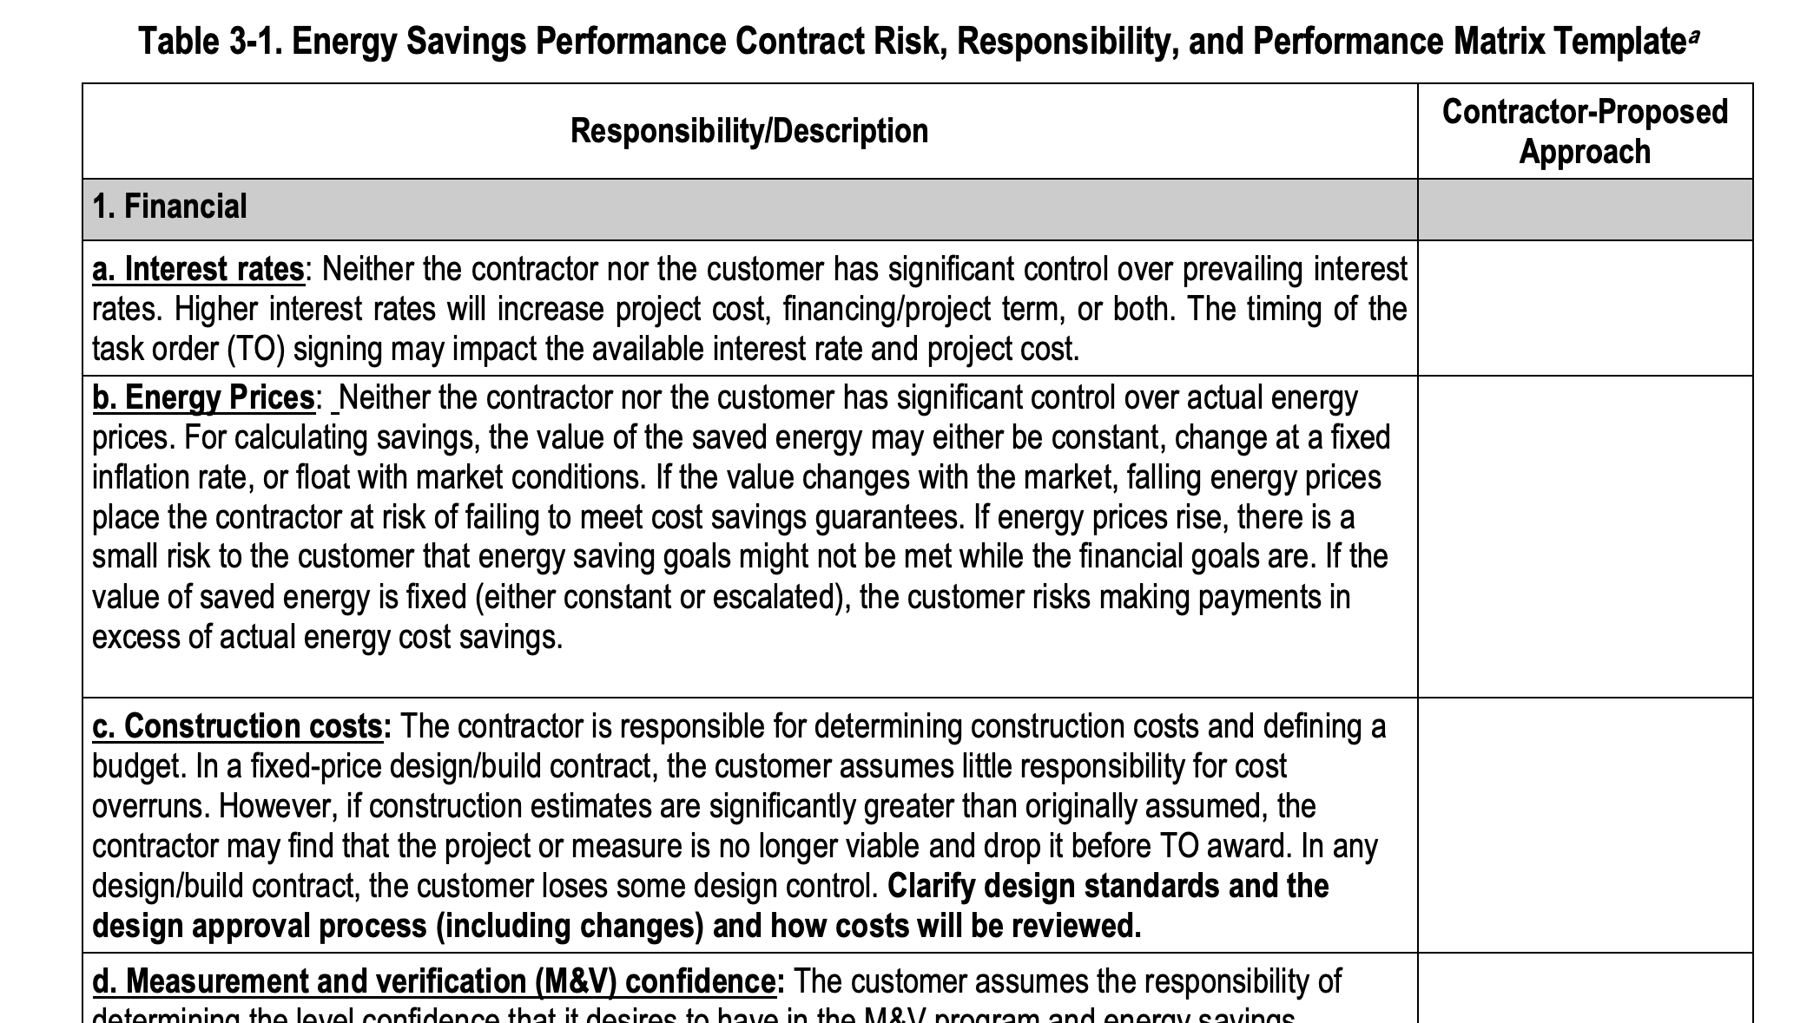
Notes:
Instructor Note: Screenshot from FEMP 4.0.

Slide 42
Scope of Analysis
Depending on the context, M&V activities can range from minimal assessment of project performance to detailed scientific research.
Generally, an increase in analytical complexity means an increase in cost.
Some relatively simple M&V can be performed by technicians, while complicated pre- and post-implementation research is often conducted by PhD holders. A CMVP will fall somewhere in the middle, a “practical” researcher.

Slide 43
Key Takeaways
The primary contextual considerations for M&V projects are technical, commercial, legal, and regulatory.
A CMVP should develop an M&V plan appropriate for a project’s context.
A CMVP should be able to identify and communicate with all stakeholders.
A CMVP should aim to harmonize expectations to assure mutual agreement on the outcome.

Slide 44
Module 2: Contextual Considerations
How could regulatory, commercial, technical, or legal factors change your approach to developing an M&V plan for a project in a different country or sector?
Why is it important for a CMVP to identify and communicate with all project stakeholders before implementing an M&V plan?
What is the value of aligning M&V activities with established guidelines, standards, and protocols (like IPMVP or FEMP), and how might misalignment impact a project's success?

