Slide 1
MODULE 4 Defining a Baseline and Incorporating Routine and Non-Routine Adjustments
Notes:
Instructor Note: The content of this module is the heart and soul of the counterfactual method. It is what differentiates M&V from targeting, benchmarking, or simple measurements for verification.

Slide 2
Learning Objectives
Define key terms: baseline, baseline period, independent variable, static factor, routine adjustment, non-routine adjustment, avoided energy/costs, normalized savings, and backcasting
Develop and adjust a baseline model that stakeholders consider fair and relevant for the duration of the reporting period
Explain the role of routine and non-routine adjustments in the counterfactual method

Slide 3
M&V, Step by Step
Plan
Measure and collect data
Develop baseline model
Measure and collect data
Report
Adjust baseline model
Installation of ECM

Slide 4
M&V, Step by Step
Plan
Measure and collect data
Develop baseline model
Measure and collect data
Report
Adjust baseline model
Phases of Construction
Partial Credit

Slide 5
What Is a (Classic) Baseline?
The baseline is a characterization of the energy use and operating conditions during a specified period of time prior to implementation. This “specified period of time” is also known as the baseline period.
The baseline provides the basis for the development of the baseline model against which an energy conservation project’s actual performance is compared.
Exception: Physics models may come afterward for new construction.

Slide 6
Judgments Involved in Defining a Baseline
How long should the baseline period be?
Is the load variable or constant?
Are current operations expected to continue in the reporting period?
Are service levels currently adequate?
What is the measurement boundary?
What’s in and what’s out?

Slide 7
Judgments Involved in Defining a Baseline
RUL = Remaining Useful Life
EUL = Effective Useful Life
Degradation / Mean Time to Failure
Dual Baselines
Code Baselines
What “Should Have Happened?”
As opposed to “existing conditions” baseline
Industry Standard Practice
Life Cycle Costing covers RUL / EUL (but not code)

Slide 8
Service Levels /Productivity
Indoor Environmental Quality (IEQ)
Beyond just air quality, IEQ also encompasses factors such as exposure to natural light and pleasant views, comfortable sound conditions, and the ability of inhabitants to adjust lighting and temperate to their liking.
Sustainable Facilities Tool | U.S. General Services Administration: https://sftool.gov/learn/about/1/indoor-environmental-quality-ieq
ASHRAE: https://www.ashrae.org/technical-resources/bookstore/indoor-air-quality-guide

Slide 9
Baseline vs. Baseline Model
The baseline contains all the data required to build a useful baseline model.
The baseline data is collected within a period of time called the baseline period.
The baseline model is the foundation of the counterfactual method. It is adjusted (as necessary) throughout the reporting period.
Example: An office building in New York has different heating and cooling needs throughout the year. When measuring the performance of updates to the facility’s HVAC system, a CMVP should select a baseline period (typically one full year) to capture the effects of seasonal changes.
Notes:
Instructor Note: “Coverage factor” is another term for the full range of conditions. ASHRAE requires a coverage factor of at least 90%.

Slide 10
THREE DISTINCT "BASELINE" CONCEPTS
1️⃣ BASELINE PERIOD
Time frame for data collection
Example: "January 1 - December 31, 2024"
2️⃣ BASELINE DATA
Actual measurements from that period
Evidence of what DID happen
Example: "12 months of utility bills"
3️⃣ BASELINE MODEL
Mathematical relationship from data
Tool for predicting what WOULD happen
Example: "Energy = 500 + 2.5×HDD + 0.3×Occupancy"
⚠️ Your M&V plan must specify ALL THREE.

Slide 11
Create and Validate the Baseline Model – Monthly Example
Use specific baseline data
Identify relevant variables
Identify outliers
Specify a valid model
Document inputs
Document static factors
Archive all baseline data
Days | Heating Degree Days (15.5°C) | Gas Consumption (Mcf)
29 | 650 | 210,692
33 | 440 | 208,664
29 | 220 | 157,886
30 | 150 | 120,793
32 | 50 | 116,508
31 | 20 | 107,272
29 | 14 | 95,411
31 | 29 | 126,423
31 | 125 | 149,253
28 | 275 | 166,202
33 | 590 | 221,160
30 | 723 | 224,958

Slide 12
Adjustments (Classic)
To ensure we are comparing apples to apples, the baseline model must be adjusted to reflect the current conditions. What results is called the adjusted baseline model.
There are two types of adjustments: routine and non-routine.

Slide 13
Routine and Non-Routine Adjustments
Routine adjustments reflect expected changes in independent variables—changes in weather from season to season, for instance. They occur often during the reporting period.
By contrast, non-routine adjustments must be made to account for changes to static factors—that is, elements of the baseline that were not expected to change during the reporting period.
Common reasons for non-routine adjustments:
Expansion or renovation of the facility
Addition or removal of equipment
Changes in usage patterns

Slide 14
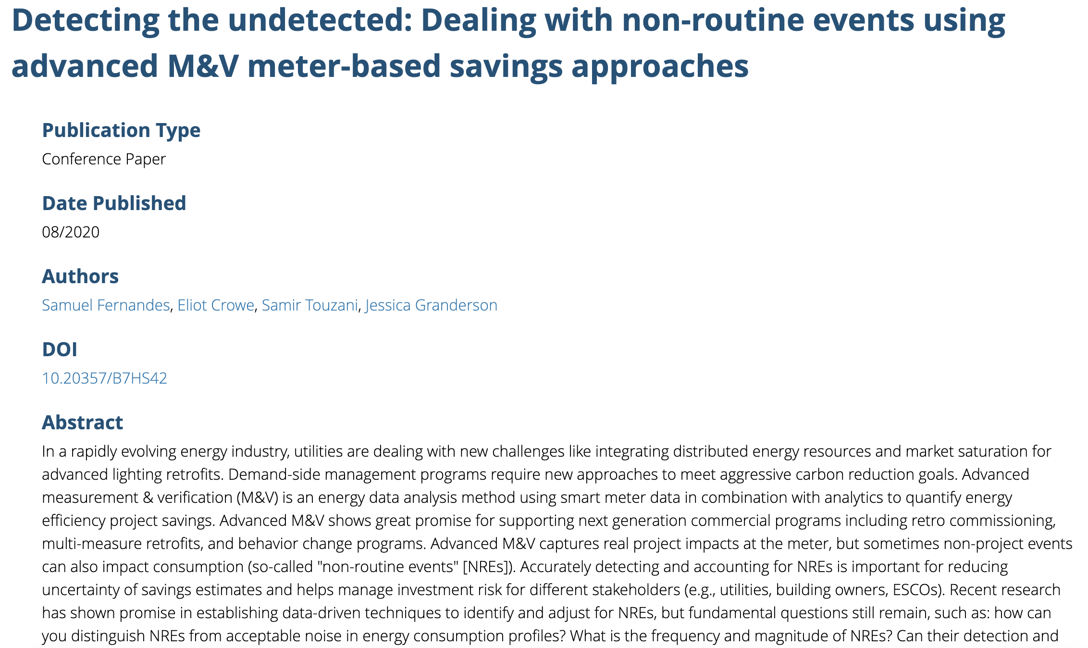
Notes:
Instructor Note: Non-routine event detection through M&V 2.0.

Slide 15
Note on Weather Data
Typical meteorological year vs. actual weather data.
A typical meteorological year (TMY) dataset offers an annual set of hourly weather data that represents typical conditions for a specific location over an extended timeframe, like 30 years.
National Laboratory of the Rockies: https://www.nrel.gov/docs/fy08osti/43156.pdf

Slide 16
Choosing a Common Set of Conditions
It is unlikely that operating conditions—weather, facility usage, etc.—during the reporting period will be identical to those during the baseline period.
For this reason, measurements taken during the two periods CAN be normalized to a common set of conditions so that a valid comparison can take place.

Slide 17
Avoided vs. Normalized vs. Backcasting
Avoided energy/costs: Baseline model is adjusted to reflect reporting period operating conditions.
Normalized savings: Reporting period energy use and baseline are adjusted to reflect a set of “typical” operating conditions.
Backcasting: Reporting period energy use is adjusted to reflect baseline period operation conditions.
In other words, data from the reporting period is used to create a reporting period model. This is useful when “better” data is available for the reporting period than for the baseline period.

Slide 18
Example of Backcasting
Baseline period energy use data is only available at the annual level. Baseline independent variable data is available at the required interval.
No useful model of the baseline period can be made, so the CMVP should develop a model using data from the reporting period.
Apply the baseline period independent variable data to the reporting period model and compare the baseline consumption to the adjusted reporting period model.
Notes:
Instructor Note: This approach is rarely used. It should be relied on only when avoided energy and normalized don’t work.

Slide 19
Program Reporting
Realization Rate – (ExAnte vs. ExPost )
A metric that compares the actual observed impact of an energy management activity to the estimated or predicted impact. It is usually expressed as a percentage and helps gauge the effectiveness of ECMs.
Realization Rate = (Actual Impact / Estimated Impact) × 100%
A realization rate of 100% indicates that the actual impact perfectly matched the estimated impact. Values greater than 100% mean actual impact exceeded estimates, while values less than 100% mean the ECM underperformed relative to expectations.

Slide 20
External Requirements
What additional requirements have outside stakeholders imposed? For example:
Government-mandated reporting of energy use and/or environmental impact.
Qualification and skills requirements—certifications, accreditations, etc.
What external requirements are there in your local context?

Slide 21
Scenario – Module 4
In the previous module’s scenario, the Triple Monarch Hotel planned to undergo a major energy retrofit, adding variable frequency drives to six air handling units and four dedicated outdoor air systems and upgrading to LED lighting.
What are the potential independent variables?
If a whole building approach were chosen, what data should be collected to establish the baseline?
If the retrofit isolation approach were chosen, what data should be collected for each ECM?
Notes:
Instructor Note: Feel free to customize as desired.

Slide 22
Key Takeaways
The baseline period should be extensive enough that it is representative of the range of expected operating conditions.
Routine adjustments account for expected changes to independent variables. Non-routine adjustments account for unexpected changes to static factors. (sometimes temporary, sometimes permanent)
Data from the baseline period and reporting period must be considered for possible adjustments (routine and non-routine) so that a valid/fair comparison can be made.

Slide 23
Module 4: Defining a Baseline and Adjustments
What key factors should be considered when selecting the period to use for a baseline in an M&V project?
How do routine and non-routine adjustments ensure that comparisons between baseline and reporting periods are fair?
Explain the benefits and limitations of normalizing data for weather or usage changes when quantifying energy savings.

