Slide 1
MODULE 7 Planning

Slide 2
Learning Objectives
Define key terms: operational verification, commissioning, program, portfolio, EM&V, implementer, evaluator
List the typical contents of M&V plans
Write M&V plans that are coordinated with their corresponding contracts, account for project context, and consider costs and benefits to all stakeholders
Discuss special considerations related to plan development in utility program contexts

Slide 3




M&V, Step by Step
Plan
Measure and collect data
Develop baseline model
Measure and collect data
Report
Adjust baseline model
Installation of ECM
Notes:
Instructor Note: Clarify that planning takes place both before and after the site visit. A site visit is required to learn about the wiring configuration and opportunities for metering.

Slide 4
For M&V to work, all parties must agree ahead of time on how the counterfactual—the adjusted baseline model—will be designed/calculated.
This is what an M&V plan tries to ensure.

Slide 5
Considering Costs and Benefits to All Stakeholders
M&V planning must take into consideration the total cost of performing the work, including all the costs involved in …
Deploying metering
Retrieving and analyzing data
Reporting results
Maintaining regulatory compliance

Slide 6
Typical Contents of M&V Plans for an ESPC
Executive summary and/or overview: General project information, including goals, description of ECMs, and expected savings.
Baseline conditions: Summary of static factors during the baseline period.
Methods: Detailed explanations of measurement approach, baseline model development, processes for non-routine adjustments, and savings calculations.
Schedule of M&V activities and reporting: Clear schedules for operational verification and other M&V activities as well as the submission of post-installation and annual reports.
Risk and responsibility matrix: Thorough breakdown of various stakeholders’ risks and responsibilities throughout the M&V project.

Slide 7
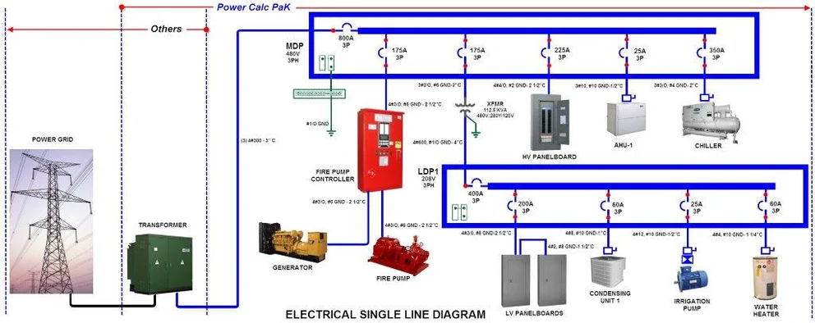
Example: Real Single Line Diagram
INSERT YOUR REAL DIAGRAM IMAGE HERE
PLACEHOLDER FOR
YOUR REAL
SINGLE LINE DIAGRAM
JPG IMAGE
(Delete this shape and insert your image here)
Teaching Points for Your Diagram:
• Identify the main meter location • Trace power flow from utility to loads
• Find potential sub-metering points • Note measurement boundaries for different ECMs

Slide 8
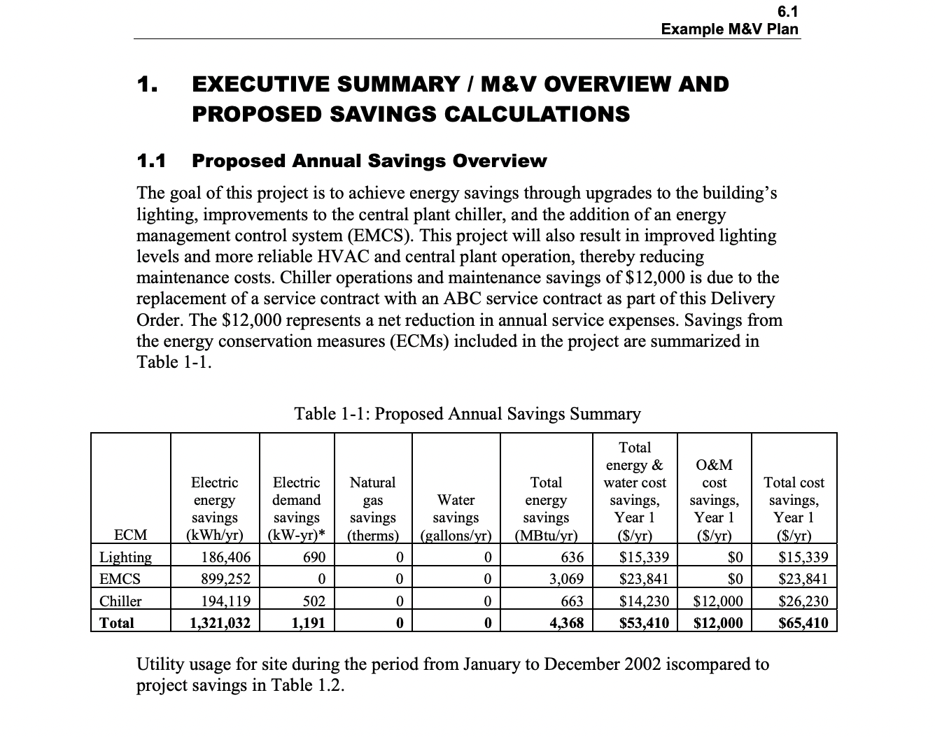
Sample Plan
FEMP: Example Measurement & Verification Plan for a Super ESPC Project
Notes:
Instructor Note: This sample plan uses Options A and B.
Have Hannah S. create a spreadsheet to accompany this example. OR another example.
Basic math
Sampling calculations

Slide 9
Plans and Contracts
When M&V supports a contract—typically an energy savings performance contract—the first step of the CMVP should be to review the contractual arrangement between the parties.
The contract should address:
Long-term operational responsibility and risk allocation
Static factor inventory and updates
Schedules for activities and deliverables
Appropriate baseline period
Processes for non-routine adjustments

Slide 10
Other Contextual Considerations
Besides contractual requirements, the M&V plan should reflect …
Regulatory and program rules
Relevant guidelines, standards, and protocols
The project’s sector—industrial, commercial, institutional, or residential

Slide 11
Risks and Responsibilities
M&V confidence: The customer assumes the responsibility for determining the level of confidence that it desires to have in the M&V program and energy savings determinations. The desired confidence will be reflected in the resources required for the M&V program, and the ESCO must consider the requirement before submitting the final proposal. Clarify how project savings are being verified (e.g., equipment performance, operational factors, energy use) and the impact on M&V costs.
Delays: Both the ESCO and the customer can cause delays. Failure to implement a viable project in a timely manner costs the customer in the form of lost savings and can add cost to the project (e.g., construction interest, remobilization). Clarify schedule and how delays will be handled.

Slide 12
Risks and Responsibilities
Operating hours: The customer generally has control over operating hours. Increases and decreases in operating hours can show up as increases or decreases in savings depending on the M&V method. Clarify whether operating hours are to be measured or stipulated and what the impact will be if they change. If the operating hours are stipulated, the baseline should be carefully documented and agreed to by both parties.
Load: Equipment loads can change over time. The customer generally has control over hours of operation, conditioned floor area, intensity of use (e.g., changes in occupancy or level of automation). Changes in load can show up as increases or decreases in “savings” depending on the M&V method. Clarify whether equipment loads are to be measured or stipulated and what the impact will be if they change.

Slide 13
Risks and Responsibilities
Weather: A number of energy and water conservation measures are affected by weather, which neither the contractor nor the customer has control over. Clearly specify how weather corrections will be performed (usually routine adjustments).
User participation: Many energy conservation measures require user participation to generate savings (e.g., control settings). The savings can be variable, and the ESCO may be unwilling to invest in these measures. Clarify what degree of user participation is needed and use monitoring and training to mitigate risk.

Slide 14
Risks and Responsibilities
Operations: Clarify which party will perform equipment operations, the implications of equipment control, how changes in operating procedures will be handled, and how proper operations will be assured.
Preventive maintenance: Clarify how long-term preventive maintenance will be ensured, especially if the party responsible for long-term performance is not responsible for maintenance. Clarify who is responsible for performing long-term preventive maintenance to maintain operational performance throughout the contract term. Clarify what will be done if inadequate preventive maintenance impacts performance.

Slide 15
Risks and Responsibilities
Equipment performance: Clarify who is responsible for initial and long-term performance, how it will be verified, and what will be done if performance does not meet expectations.
Equipment repair and replacement: Clarify who is responsible for performing replacement of failed components or equipment replacement throughout the term of the contract. Specifically address potential impacts on performance due to equipment failure. Specify expected equipment life and warranties for all installed equipment. Discuss replacement responsibility when equipment life is shorter than the term of the contract.

Slide 16
Utility Program Considerations
First, some important terminology:
A program consists of a series of related energy efficiency projects sponsored by an organization such as a utility or government agency.
Similarly, a portfolio is a collection of energy efficiency programs sponsored by such an organization, employing various technologies across a range of contexts.
Evaluation, measurement, and verification (EM&V) refers to the evaluation of reported savings (ex post) to the submitted savings (ex ante) to determine if regulatory compliance has been met and the savings are accurate.

Slide 17
Scenario – Module 7
Barlow-Fox, an ESCO, has approached a food and beverage conglomerate and offered to install technology in its production facilities that purports to extend equipment life, lower maintenance costs, and reduce electricity consumption.
Barlow-Fox estimates that the technology would reduce energy consumption by about 5 percent. It has proposed installing the technology under a shared savings agreement, which would allow the client to avoid the upfront costs of purchasing and installing the technology.

Slide 18
Scenario – Module 7
An initial agreement has been reached to install and pilot the technology in a limited number of food production facilities. Within the agreement, a whole facility method of performance verification has been defined.
As M&V lead, you must assemble a team for this project. Which personnel do you choose and why?

Slide 19
Key Takeaways
An M&V plan should indicate how the adjusted baseline model will be calculated in a way acceptable to all stakeholders.
Conventionally, M&V plans include an overview, an account of baseline conditions, an explanation of methods, a schedule of M&V activities and reporting, and a risk and responsibility matrix.
M&V plans should align with relevant contracts and/or program guidelines.

Slide 20
Module 7: Planning
Why is it important to align the contents of your M&V plan with both the contract and the needs of all identified stakeholders?
What roles and responsibilities should be assigned in an M&V plan to manage project risk and ensure timely completion?
How can a well-developed M&V plan help prevent or resolve disputes between ESCOs, clients, and other parties?

