Slide 1
MODULE 9 Reporting

Slide 2
Learning Objectives
Explain the typical goals and contents of M&V reports
Characterize the relationship between M&V plans and reports
Discuss special considerations related to reporting in utility program contexts
Discuss the world of carbon emissions and ESG reporting
Building Standards – potential fines
Carbon Accounting

Slide 3
M&V, Step by Step
Plan
Measure and collect data
Develop baseline model
Measure and collect data
Report
Adjust baseline model
Installation of ECM

Slide 4
Planning and Reporting
The report is the primary deliverable of most M&V activities. For this reason, the M&V plan should clearly describe expectations for the report.
One straightforward way of showing stakeholders what they should expect from the report is to include a sample report as an appendix to the plan.

Slide 5
Valuation Methods
Most (but not all) M&V plans describe how to “value” estimated reductions in dependent variables.
Valuation methods can range from incredibly simple—for example, $0.12 per kWh saved—to incredibly complex.
Stakeholders should agree upon the valuation method in advance of implementation.
Whatever the valuation method, it should be applied to both the adjusted baseline and measured reporting period values.
Examples –
Energy_Value_Two_Streams_Simple_3Tier_v2_ALL.xlsx
Energy_Value_8760_LoadShape_Savings.xlsx

Slide 6
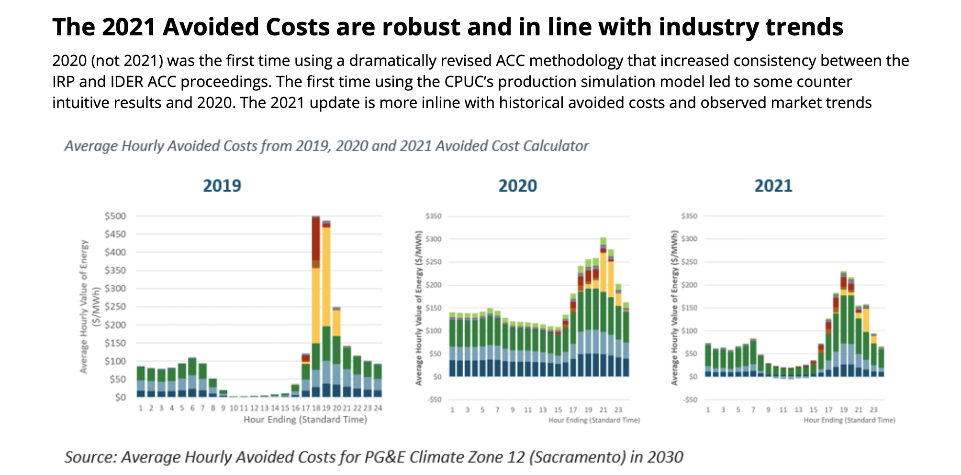
Valuation Methods
Notes:
Tariff or incentive for avoided costs.

Slide 7
Valuation Methods
https://www.ethree.com/public_proceedings/energy-efficiency-calculator/?utm_
https://energycodeace.com/content/section-1002-calculation-of-time-dependent-valuation-tdv
https://www.cpuc.ca.gov/dercosteffectiveness?utm_
https://www.synapse-energy.com/sites/default/files/inline-images/AESC%202024.pdf?utm_
Notes:
Tariff or incentive for avoided costs.

Slide 8
How to choose which set to use
Program cost-effectiveness in CA → CPUC ACC.
Building code compliance/analyses in CA → TDV (and emerging Long-Term System Cost materials for 2025 code cycle).
EE program screening in New England/Mid-Atlantic → AESC 2024.
New York utility BCA and DER tariffs → BCA Handbooks and VDER Value Stack.
Pacific Northwest utility programs → Council/RTF/ProCost values.
If you tell me which state(s) you’re teaching from, I can pull the exact current workbook(s) and point your students to the right tabs (e.g., hourly vs monthly values, capacity by season/shape, GHG adders).

Slide 9
Why Load Shape Matters Now
In an era of time-varying rates and real-time carbon accounting
Energy rates vary by time-of-use (TOU), season, and demand charges
A kWh saved during peak hours is more valuable than off-peak
Load shape reveals the distribution of energy use over time
Traditional M&V (total kWh) is insufficient for modern rate structures
https://cost-avoidance-calculator.streamlit.app
WHEN you save matters as much as HOW MUCH you save
Example: California moved to mandatory TOU rates. Same kWh savings now worth 2-3x more if timed correctly.

Slide 10
What Is Load Shape?
A profile of energy consumption across time:
• Hourly
• Daily
• Seasonally
Key for identifying:
• Demand peaks
• Valley periods
• Timing of use
24-Hour Load Profile Example
Enables modeling of:
• Cost impacts
• Carbon intensity
• Grid stress
• Targeted efficiency measures
Off-Peak
Mid-Peak
On-Peak
Critical Insight:
Reducing peak load has disproportionate value:
• Higher energy rates
• Demand charge savings
• Higher carbon intensity
• Grid reliability benefits

Slide 11
Shifting from kWh to $ Impact
Same energy, different value
Traditional M&V
Modern M&V 2.0
Focused on energy (kWh) savings
Total annual reduction
Flat rate assumption
Example: 365,000 kWh saved
Time-specific impacts monetized
Hourly/seasonal distribution
TOU rate structures
Savings ≠ Value unless shaped
Example: Same 1,000 kWh Saved - Different Times
Off-Peak Savings:
1,000 kWh @ $0.08/kWh
= $80 value
On-Peak Savings:
1,000 kWh @ $0.25/kWh
= $250 value
Same energy, 3x the value!
Plus additional demand charge savings during peak periods

Slide 12
Designing for Load Shape Impact
Optimize not just QUANTITY saved, but WHEN it's saved
Target High-Value Periods
Use Interval Data
Focus on peak hours
High-price times
High-carbon intensity
Hourly or 15-min data
Time-varying rate models
8760 analysis
Load Shifting Strategies
Grid-Aware Controls
Battery storage
Demand response
Thermal storage
Real-time pricing signals
Carbon intensity tracking
Dynamic optimization
M&V must capture WHEN savings occur
Not just total kWh, but the hourly/seasonal distribution

Slide 13
Communicating Load Shape to Stakeholders
Visual tools make timing impacts intuitive:
• Heatmaps (8760 hours)
• Hourly load plots
• Carpet plots
• Time-of-day comparisons
Link changes in shape to:
• Financial outcomes
• Environmental impact
• Grid benefits
Example: Annual Heatmap by Value
Months
Benefits of Load Shape Analysis:
✓ Builds trust through transparency
✓ Aligns on project value
✓ Identifies optimal measures
✓ Supports time-varying settlements
✓ Enables carbon accounting
✓ Critical for demand response
Hours: 0 → 24
Low $
Mid $
High $
Peak $

Slide 14
CO₂ Emissions Calculations
Carbon dioxide emissions equivalents of the energy savings from a project can be calculated using standard conversion factors.
The conversion factor will vary depending on the resource type—electricity, gas, or renewable energy—and may vary based on time of day and other factors as well.
More real time carbon attribution is now available.
Notes:
https://www.epa.gov/climateleadership/scope-1-and-scope-2-inventory-guidance

Slide 15
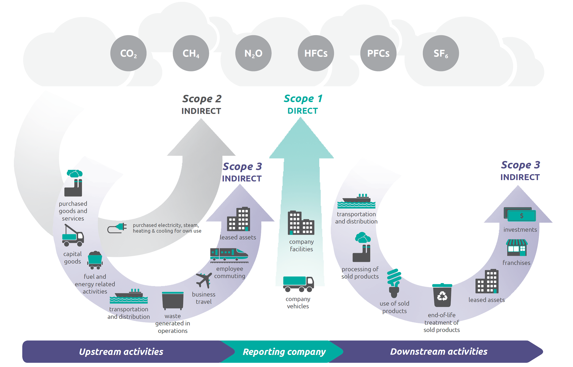

Slide 16


Sustainability Reporting
U.S. DOE
U.S. EPA

Slide 17
Compliance Reporting ($$) Building Performance Standards
U.S. DOE
States/Cities

Slide 18
The best laid schemes o’ Mice an’ Men
Gang aft agley [often go awry]
—Robert Burns, “To a Mouse” (1785)

Slide 19
The best laid plans of mice and men …
Murphy’s Law: “Anything that can go wrong will go wrong.”
It is essential that a process exists for documenting any deviations from the plan as well as all stakeholders’ agreement to the changes.

Slide 20
Typical Contents of an M&V Report
For this reason, M&V reports should include …
Descriptions of all static factors that have changed
Transparent explanations of how non-routine adjustment values have been determined
Additionally, a report’s raison d’être is to provide ...
Details about the calculations used to arrive at the reported savings values, with reference to valuation methods outlined in the plan

Slide 21
Utility Program Considerations
Utility program reporting can occur at the end of a program cycle, a program year, or project implementation. This process typically consists of two main components:
A descriptive report outlining relevant customer information, project information, and M&V methodology
A calculation file containing all relevant raw data, data transformations or corrections, calculations, and explanations

Slide 22
Key Takeaways
The report is the primary deliverable of most M&V activities.
An M&V report has two basic objectives: to justify reported savings values and address any non-routine adjustments.
CMVPs must increasingly tailor their reports to multiple audiences, including ESG and Carbon emissions reporting

Slide 23
Module 9: Reporting
Why should the M&V plan clearly specify the expected format and content of the final report?
What constitutes a ‘successful settlement’ in M&V reporting, and how is this outcome negotiated among stakeholders?
Describe methods to transparently present uncertainty and non-routine adjustments in a final M&V report.

Slide 24
Conclusion
M&V is either/both performance verification and savings determination.
The goal of M&V is a successful settlement.
Savings determination relies on the counterfactual method.
The counterfactual method relies on a model of the baseline.
Context matters. Who will review the results? What do they require?
There are many judgments a CMVP needs to make.
There is always uncertainty. Knowing how much can be useful.
The role of the CMVP is to build and guide a team over the many hurdles to arrive at successful settlement.
Good luck!

