Slide 1
Where the Variance Is
Contact-aware vs baseline demonstrations
Suresh Kumaar Jayaraman
22 October 2026

Slide 2
What we found, in order
Each step was measured, and each narrowed the cause.
• 1. The demonstrations are worse as data
  • Action divergence 1.74–2.12× worse — before any policy is trained.
• 2. Policies trained on them are worse
  • 3.6× BC-MLP, 3.9× BC-RNN, 1.7× ACT. Three architectures, same sign.
• 3. The damage is in the ARM, not the hand
  • Per-block validation loss: arm ~7.5–7.9×, hand 2.6–3.2×.
• 4. The arm is where a stochastic planner drives
  • 59% of contact-aware frames are RRT output. Baseline has none.
• So the mechanism is planner non-determinism — not operator inconsistency.

Slide 3
Policies trained on contact-aware data are worse
Validation loss on held-out episodes — lower is better.
Algorithm
Baseline
Contact-aware
Gap
BC-MLP (8-fold CV, 12 seeds)
0.0968
0.3477
3.6×
BC-RNN (8-fold CV, 6 seeds)
0.0851
0.3362
3.9×
ACT (8-fold CV, 6 seeds)
0.1896
0.3199
1.7×
• Cohen d = −8.08, −9.80, −8.16. All p < 0.0001.
• Losses are NOT comparable across algorithms — MSE for BC, L1+KL for ACT. Only the within-row ratio is meaningful.
• ACT narrows the gap most, as its chunking and CVAE latent should. It does not close it.
• robomimic identifies BC-RNN as the architecture most tolerant of mixed-quality data. It did not rescue this.

Slide 4
The damage is in the arm, not the hand
Same training runs, validation loss split by joint block.
Block
BC-MLP
BC-RNN
Pooled (23 joints)
3.36×
3.95×
Arm (7 joints)
7.86×
7.51×
Hand (16 joints)
2.60×
3.20×
• Both blocks significant (d = −10.3 and −9.0), but the arm gap is ~3× the hand gap.
• This closes the obvious objection: the FINGER labels were partly reconstructed, the ARM labels never were — and the arm is where the gap is.
• Baseline's own structure inverts: there the hand is the harder block (0.121 vs 0.047). Certification made the arm the hard part.

Slide 5
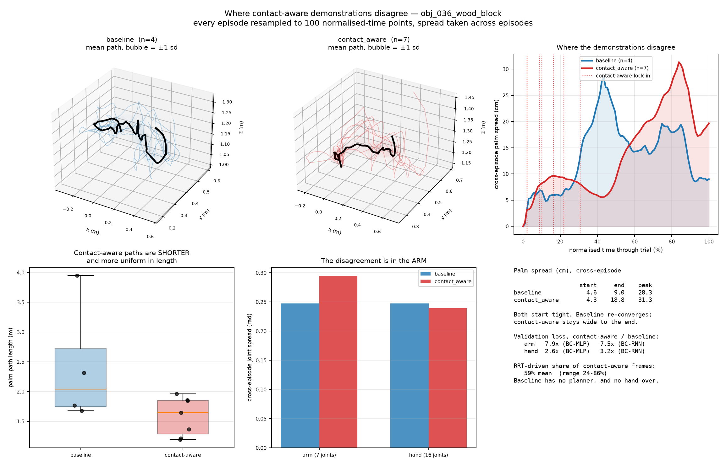
Where the demonstrations disagree
Every episode resampled to 100 normalised-time points; spread taken across episodes.
• Both conditions start tight (~4.5 cm). Baseline re-converges by the end (9.0 cm); contact-aware stays wide (18.8 cm).
• Dotted lines are contact-aware lock-in times — they span 2% to 31% of the trial.
• Note the paradox, bottom left: contact-aware paths are SHORTER and more uniform in LENGTH (sd 0.29 m vs 0.85 m). Tidier motion, less learnable data.

Slide 6
Reading that figure
Three things it shows that a ratio cannot.
• The disagreement is not uniform in time
  • Baseline peaks mid-trial (the operator hunting for a grasp) then converges as the task completes.
  • Contact-aware peaks LATE and stays there — the episodes end in different places.
• Lock-in timing is scattered, not clustered
  • The planner takes over anywhere from 2% to 31% of the way through, so no two episodes hand over at the same stage.
• Shorter paths, worse data
  • Contact-aware motion is tidier by path length and more uniform in duration — the smoothness metrics the curation literature favours would score it BETTER.
  • Those metrics would have been wrong here.

Slide 7
What drives the arm after lock-in
Over half of each contact-aware episode is planner output, and it is in the labels.
Baseline
Contact-aware
RRT-driven share of frames
0%
59% mean
Range across episodes
—
24–86%
Hand-over event
none
lock-in, 2–31%
• extract.py reads control_phase only to pick a label-recovery method — it never filters rows, so PLAN and REACH frames are training labels.
• RRT is sampling-based: the same start and goal give a different path every call.
• So the pipeline replaced variable HUMAN arm motion with variable PLANNER arm motion — and the planner's variation is unconditioned on anything the policy observes.

Slide 8
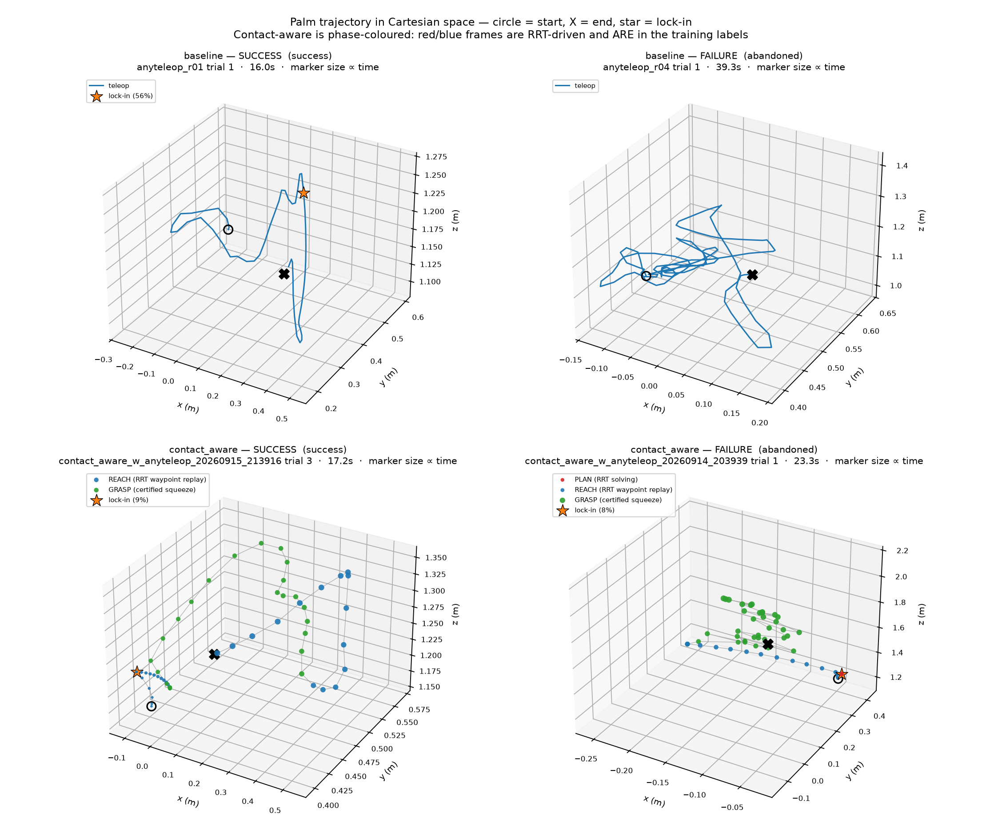
One episode each, success and failure
Contact-aware panels are phase-coloured; marker size grows with time.
• The piecewise-linear blue segments in the contact-aware panels are RRT waypoints, not human motion.
• Baseline failure (top right, 39 s) shows the operator looping near the object — a different failure mode entirely.
• Caveat: both failures are 'abandoned' trials from outside the 31-episode comparison set, which kept successes only.

Slide 9
Why shared autonomy made this worse
Assistance did reduce variability — in the part it directly controls.
• Where the certificate helped
  • Hand action VARIANCE is 0.80× — the one metric where contact-aware wins. The certified squeeze is more repeatable.
• Where it hurt
  • Arm action variance 1.80× worse; arm validation loss ~7.5× worse. The approach to the grasp is what fell apart.
• The mechanism
  • The certificate hands control to a stochastic planner at an unpredictable moment. Variability was not removed — it was relocated from the fingers to the arm, and made less learnable on the way.
  • A human's variation correlates with the scene; RRT's correlates with its random seed.

Slide 10
The theory predicted this
Belkhale et al. named the tradeoff before we ran the experiment.
• Their two properties
  • Action divergence predicts policy success. State diversity does NOT — they measure it as uncorrelated.
• What we bought and paid
  • State diversity up 22%; action divergence up ~2×. We optimised the metric that does not matter and degraded the one that does.
• Their sentence about prior work
  • It “aim[s] to maximize state diversity through shared control” while leaving the action side unexamined.
  • That describes this pipeline.
Belkhale, Cui & Sadigh, Data Quality in Imitation Learning, NeurIPS 2023.

Slide 11
The test this suggests
If the planner is the cause, making it deterministic should close the arm gap.
• Cheaper and more specific than the fixed-timing arm
  • Fix the RRT seed, or post-process to a smoothed/optimised path, and keep everything else identical.
  • Prediction: arm loss falls toward baseline while the 94% task success is preserved.
• Three arms, same collection budget
  • baseline · contact-aware · contact-aware with a deterministic planner.
• Also worth logging
  • The lock-in timestamp explicitly — it is currently reconstructed from events, which makes the central quantity an inference.
• Open question: is a certificate that admits many valid paths inherently at odds with learnable demonstrations?

Slide 12
Summary
One sentence: the certificate improved the grasp and degraded the reach.
• Measured
  • Demonstrations 1.74–2.12× worse by action divergence; policies 1.7–3.9× worse across three architectures; task success 94% vs 69%.
• Localised
  • Arm ~7.5–7.9× vs hand 2.6–3.2×. Hand variance is the single metric favouring contact-aware.
• Explained — provisionally
  • 59% of contact-aware frames are stochastic-planner output, entering at a hand-over that lands anywhere from 2% to 31% through the trial.
  • Not yet causally established. The deterministic-planner arm tests it.

