Slide 1
Crime
Prevention
The Situational Approach and Its Application
Kwon Joon-sung
Notes:
Good morning. My name is Kwon Joon-sung. Today, I will focus on the situational approach to crime prevention and its application.

Slide 2
OVERVIEW
The Situational Approach and Its Application
Key Point: Change the environment, and you reduce the opportunity for crime.
Theory
Practice
Routine
Activity Theory
VIVA
Criteria
Crime
Triangle
→
SCP
&
CPTED
Application: IPV — Strengths & Limitations of the Situational Approach

Slide 3
PART 1 — SITUATIONAL
Routine Activity Theory(RAT)
Cohen & Felson, 1979
Phenomenon: Post-WWII Paradox
Economy grew, employment rates rose, welfare expanded
Yet crime increased
→Traditional theories(poverty & social disadvantage) could not explain this
WHY: Changes in Routine Activities
More women entered workforce → homes left empty
Lightweight, high-value goods became widespread - e.g. TV, portable radios
= There were more things worth stealing, fewer people guarding them

Slide 4
PART 1 — SITUATIONAL
Three Minimal Elements for Crime
1
2
3
Motivated
Offender
+
Suitable
Target
+
Absence of
Capable Guardian
Convergence in space and time
Crime occurs
&
Lack of any one → sufficient to prevent crime
Limitation: Does not explain how offender becomes motivated in the first place
→ it Took criminal inclination as given

Slide 5
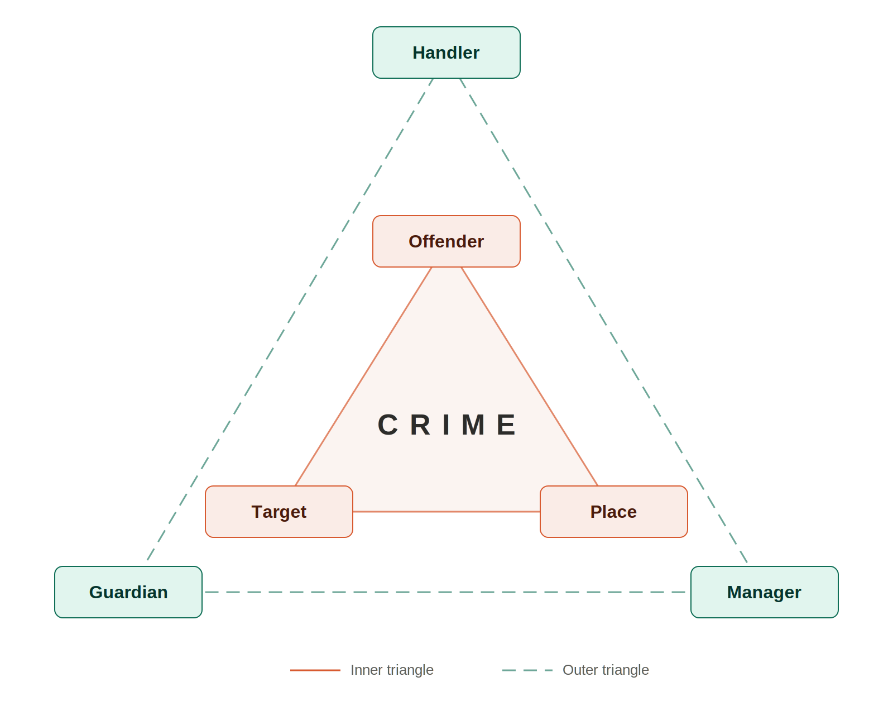
PART 1 — SITUATIONAL
VIVA & Crime Triangle
VIVA criteria — Cohen & Felson, 1979
Crime Triangle — Eck, 2003
How do we evaluate whether a target is suitable?
V
alue — Material or symbolic desirability of target
E.g.) parent, friend
Exert control
I
nertia — Weight, size, and locked features
V
isibility — Physical visibility to offenders
If any one controller functions
= crime can be prevented
A
ccess — How accessible it is
E.g.) Phone on a café table = near-perfect target
Control behavior
Protect
E.g.) Ordinary citizens
E.g.) Owner or designee

Slide 6
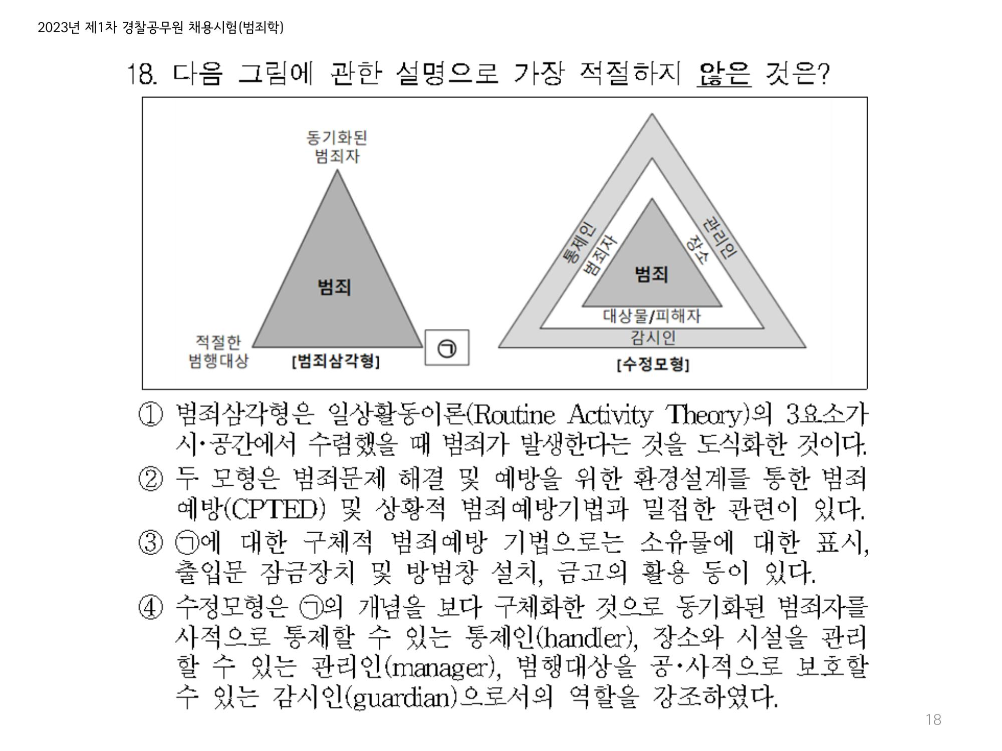
PART 1 — SITUATIONAL
RAT & Crime Triangle
Left: RAT framework — Cohen & Felson, 1979
Right: Crime Triangle — Eck, 2003
The symbol ㉠ refers to the guardian, but option ③ describes target hardening techniques
This is the type of confusion that arises when students do not have a clear understanding of each element and how they differ

Slide 7
PART 1 — SITUATIONAL
Prevention Strategies
Situational Crime Prevention(SCP)
• Clarke(1992) → Clarke & Homel (1997) → Cornish & Clarke (2003)
1
2
3
4
5
Increase
Effort
Increase
Risk
Reduce
Rewards
Reduce
Provocation
Remove
Excuse
Crime Prevention Through Environmental Design (CPTED)
• Jeffery(1971) & Newman(1972) → Saville & Cleveland (1997)/2G → Mihinjac & Saville(2019)/3G
Natural
Surveillance
Access
Control
Territorial
Reinforcement

Slide 8
PART 2 — IPV APPLICATION
Application : IPV
IPV : abuse or aggression by a current or former partner (CDC,2026)
→ Illustrates both strengths & limitations of the situational approach
Mannon (1997) — RAT applied to IPV
Motivated offender : by power, control, jealousy
Victim(Target) : repeatedly exposed in shared living space
Guardian : structurally difficult (private nature of intimate relationship)
Hayes (2018) — Strength
Friends / family were present during initial an assault
→ Re-victimization rate ↓ 60% - within 1 year

Slide 9
PART 2 — IPV APPLICATION
Limitations of the Situational Approach to IPV
Fundamental limitation
As long as the relationship continues, the opportunity structure is continuously recreated
→ Situational approach alone cannot fully address violence in this context.
Practical challenge – Woodlock(2017)
Technology creates perpetrator omnipresence(ability to monitor and control without being physically present)
Because the situational approach was designed for physical environments
→ Application to abuse in digital spaces remains limited.

Slide 10
Conclusion
Target : Opportunity structure
Theoretical foundation : RAT & VIVA & Crime Triangle
Practice strategies : SCP & CPTED
Application : IPV
Limitations
1. Crime displacement —Relocate crime, rather than eliminate it
2. Takes offender motivation as given
3. Application to private / digital spaces remains limited(e.g. IPV)
No single approach is sufficient
→ comprehensive understanding based on diverse frameworks is essential.

