Slide 1
Introducing Lesion Profile Mapping
Jax Skye, PhD
October 21, 2025
INC Working Group Meeting

Slide 2
Outline
Background
Approach development
Lesion profile mapping pipeline
Future directions
Notes:
I’ll be following up on a presentation I gave several months ago. if you weren’t there / don’t remember that’s fine and shouldn’t impact your understanding of this presentation

Slide 3
Background
Notes:
30,000 ft view: I’m interested in using rich data to elucidate brain-behavior relationships in patients with brain lesions.
A lot of my research entails using large datasets containing behavioral and MRI data to 1. answer basic science questions about functional neuroanatomy and 2. use neuroanatomical findings to predict the behavioral effects of a brain lesion based on where the lesion is.
As a post doc, I have been developing longitudinal predictive models that take in data collected within a week or two following a stroke and predict stroke outcomes months to years after lesion onset
In my quest to do this with my PI, we developed a novel approach that I will be sharing we have dubbed ‘lesion profile mapping’
Before I tell you what that is, I’ll first describe how we already perform these groupwise analyses

Slide 4
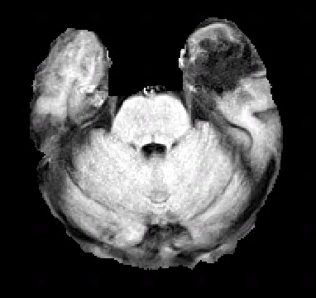
Lesion-Symptom Mapping
Notes:
Lesion-symptom mapping is a statistical approach that identifies association between lesion cavity and behavior,
For example purposes, lets say we are trying to identify regions of brain damage associated with impaired time orientation
To do this, we first get research quality structural MRI (3T or 7T) and manually trace the lesion cavity

Slide 5
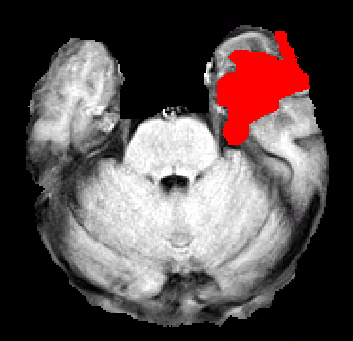
Lesion-Symptom Mapping
Notes:
- Which looks like this

Slide 6
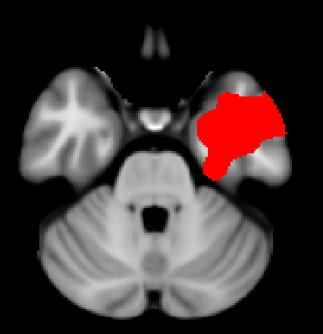
Lesion-Symptom Mapping
Notes:
Each voxel for the final lesion mask is a binary value indicating the presence or absence of a lesion
This is called a lesion mask and we have one for every patient in a cohort
Then the statistical analysis is performed to identify regions associated with performance on a behavioral measure

Slide 7

Brain lesion location
(structural MRI)
Behavioral test score
38
37
25
22
34
Notes:
- X represents some statistical analysis relating region of damage to behavioral test score

Slide 8
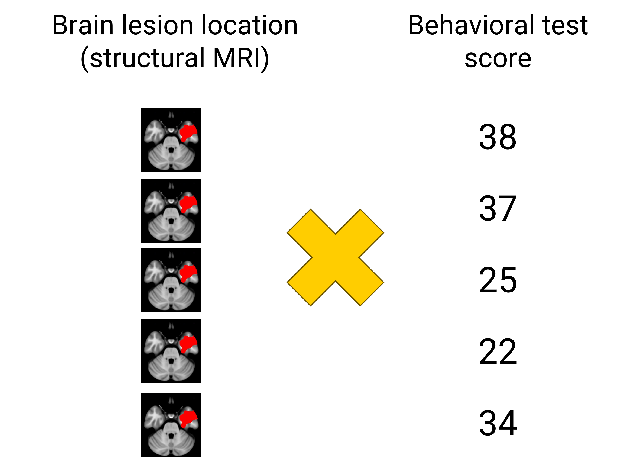
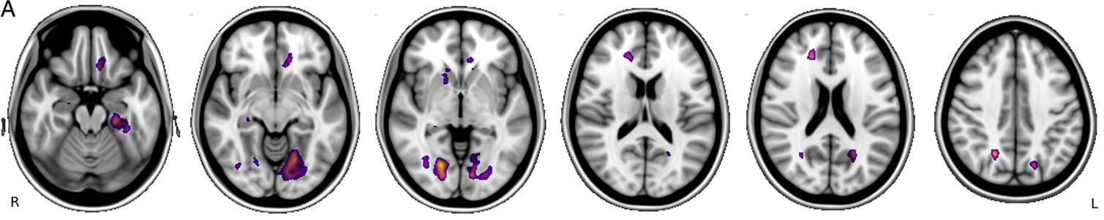
(Skye et al, 2023)
Notes:
The result is a set of voxel value intensities showing the localization of time orientation
But this approach has limitations
Has limitations: construct underrepresentation, test-specific noise, doesn’t fully make use of the rich data we have for these patients.
Most patients have scores for a couple dozen cognitive tests so we richly sample behavior but map single tests
To be clear, I’m not saying we shouldn’t be doing this. Lots of excellent, high impact studies use this approach and it offers valuable insights.
Especially for seeing how a patient might do on a specific test like time orientation
Single tests also are valuable because they’re designed to probe specific aspects of cognitive processes

Slide 9
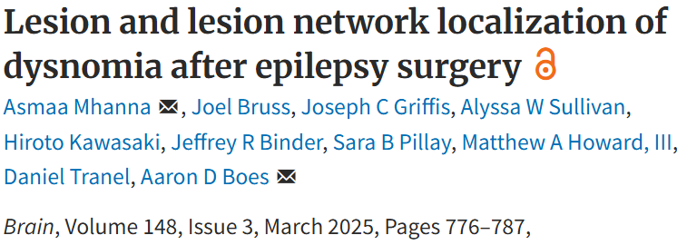
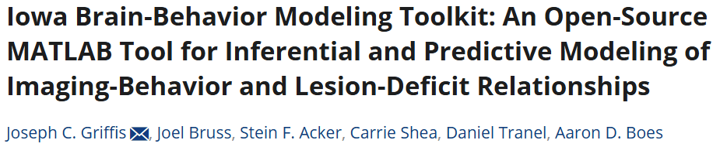
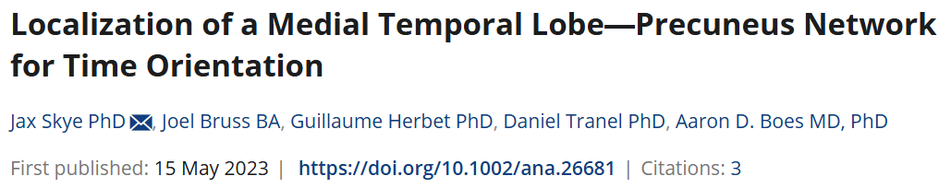
Current Approach 1: Mapping Test Performance
Notes:
Many studies using LSM/LNM as a method seek to identify associations in performance on one behavioral test to regions of brain damage
Nonexhaustive list of examples of this style of lesion mapping done here at Iowa
Asmaa’s study looking at dysnomia in epilepsy resection patients mapped BNT
Joseph’s toolkit publication looked at COWA and Token test
My study looking at time orientation mapped BTOT
Has limitations: construct underrepresentation, test-specific noise, doesn’t fully make use of the rich data we have for these patients.
To be clear, I’m not saying we shouldn’t be doing this. Lots of excellent, high impact studies use this approach and it offers valuable insights.
Especially for single test prediction
Single tests also are valuable because they’re designed to probe specific aspects of cognitive processes

Slide 10
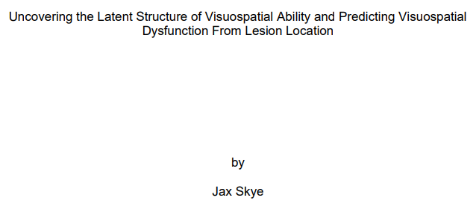
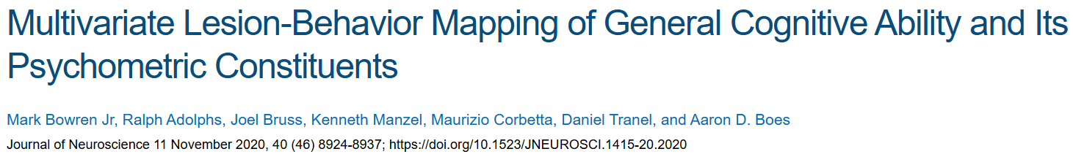
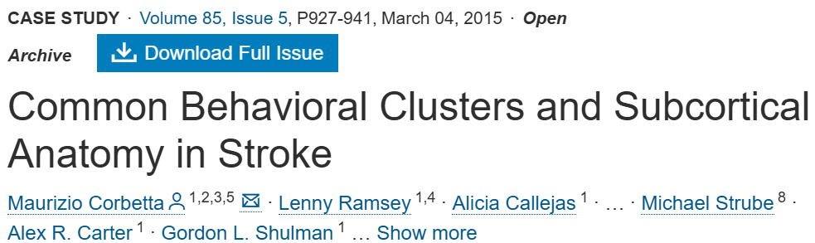
Current Approach 2: Mapping Cognitive Domains
Notes:
Involves using patient performance across multiple behavioral measures to identify latent variables probed by a given set of tests
E.g., my vsp study: EXPLAIN
-

Slide 11
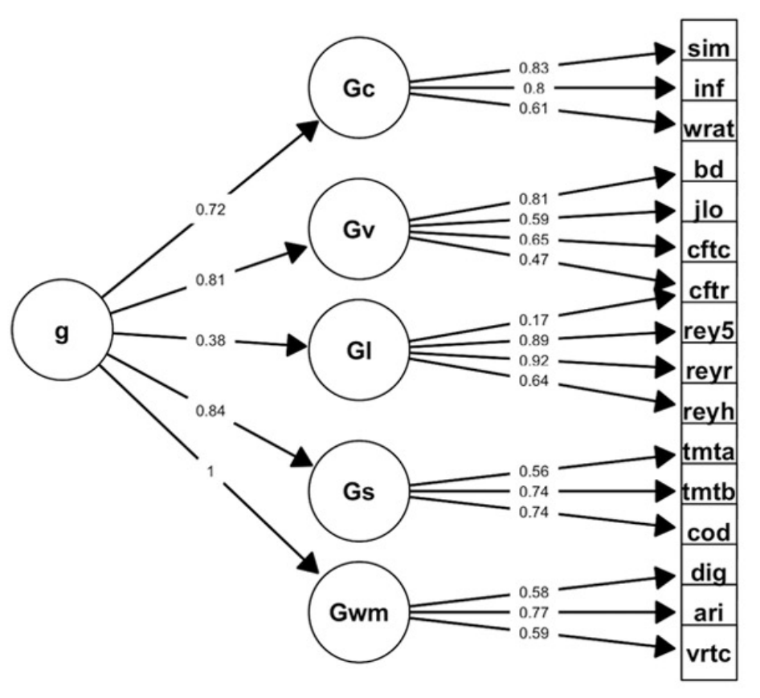
(Bowren et al, 2020)
Notes:
To map multiple related tests, we could do something like a factor analysis which takes a whole set of tests, groups similar ones together in a data-driven manner
Gv here is visuospatial ability, 4 tests in this battery sensitive to that, instead of LSM on 4 separate tests and looking for commonalities manually, could just use the Gv factor score as the behavior

Slide 12
Brain lesion location
(structural MRI)
Behavioral test score
38
37
25
22
34
Notes:
- Lesion symptom mapping example here, but the lesion masks can also be a patient’s lesion-associated networks

Slide 13
Brain lesion location
(structural MRI)
Factor Score
1.1
-2.4
1.4
-0.2
2.1
Notes:
Lesion symptom mapping example here, but the lesion masks can also be a patient’s lesion-associated networks
Identifying lesion locations associated with this shared variance or factor

Slide 14
Methodological Gap
Mapping behavioral profiles
Notes:
Mapping test scores and latent variables doesn’t give us a full picture:
Clinician friends who talk about how they will quickly and correctly guess lesion location based on a brief interaction with a patient
E.g., frontal lobe patients that exhibit a characteristic pattern of behavior
That’s bc clinicians have seen tons of types of patients and see trends: some patients are quite similar to each other behaviorally
If we could identify lesion locations associated with “types” of patients (groups of patients with common deficits)
In other words, can we map a behavioral profile to the brain?

Slide 15
Approach Development
Notes:
I’ll switch gears to how we developed this approach in a longitudinal modeling study we are going to submit soon.

Slide 16
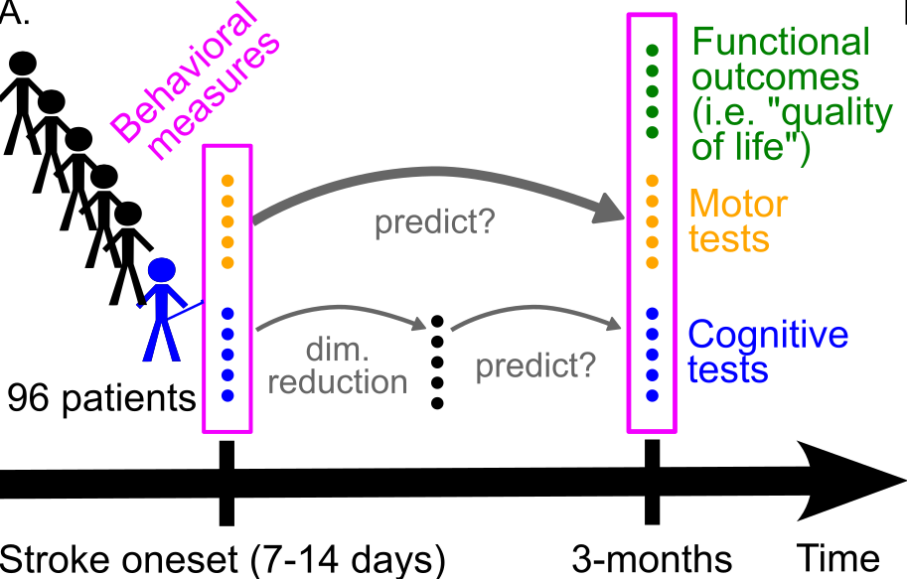

(Skye et al, in prep)
Notes:
In this project, developed a framework for rigorously benchmarking accuracies of stroke outcome prediction.
In a longitudinal unilateral stroke patient dataset collected at WashU: we used subacute behavioral data to predict 3-month behavioral data in 96 stroke patients.
acute
78 total predictors at acute for 96 patients
Don’t have time to list but here are key examples:
Vsp attn: posner cueing task, various cancellation tasks, clock drawing
Language: BDAE word comprehension, commands, complex ideational material, BNT, animal naming; experimental s like stem completion
Memory: HVLT for verbal, BVMT for visual, spatial span total forward and back
chronic
Pass out FO
Same motor and cognitive tests
Original paper cited fairly high test-retest reliability for tests chosen

Slide 17
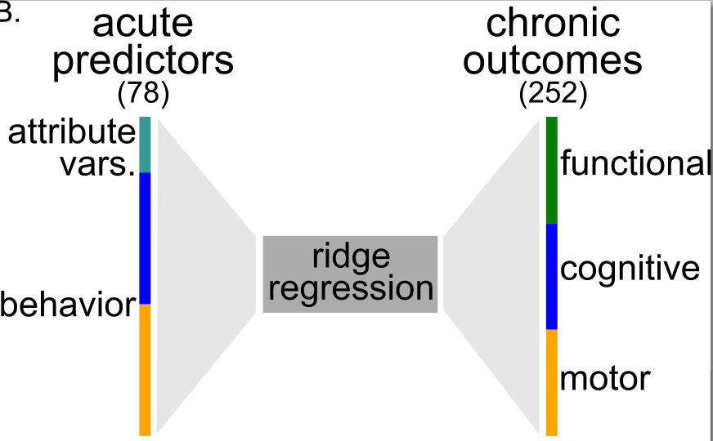
(Skye et al, in prep)
Notes:
Used ridge regression to do our predictions
Will show momentarily that we were able to predict some outcomes using this
We hypothesized that predictive information driving explained variance could be captured by fewer metrics

Slide 18
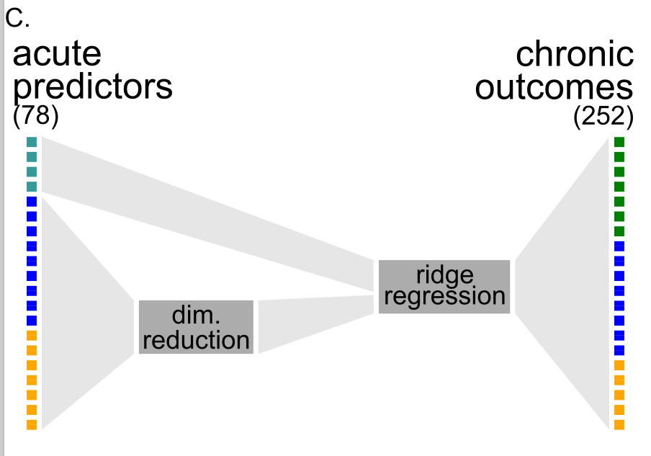
(Skye et al, in prep)
Notes:
We used different types of dimensionality reduction to identify latent variables in acute data
We were going in with this hypothesis that linear dimensionality reduction may not sufficiently capture the trends we see in lesion patient data because this type of data violates assumptions like normality and linear relationships between variables (lesions cause massiv behavioral changes)

Slide 19
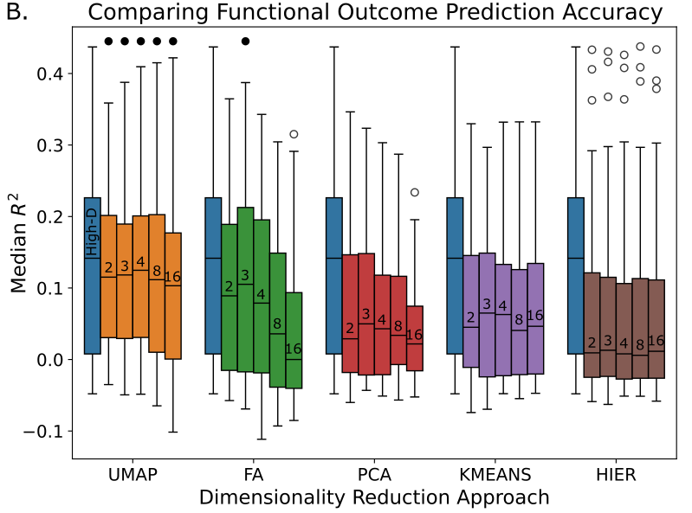
Notes:
Once again DR was applied to the subacute predictors, reducing 78 predictors to only a few
EXPLAIN EACH
UMAP is different because it’s a nonlinear dimensionality reduction approach. We thought perhaps it could do a better job of capturing nonlinear relationships

Slide 20
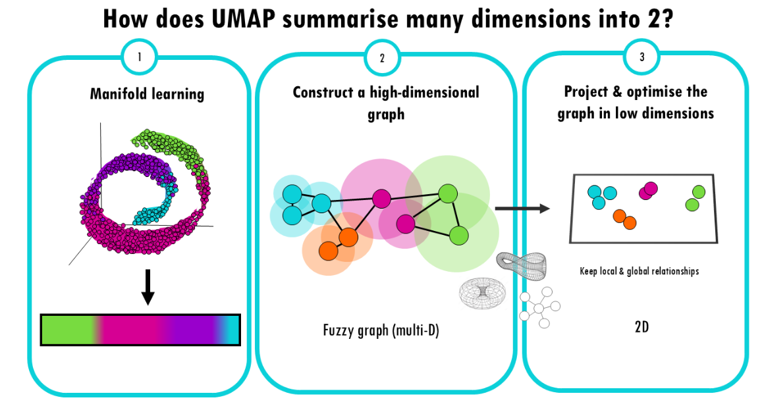

Slide 24
Notes:
Each point is a single functional outcome we tried to model (e.g., stair climbing, psychosocial reintegration, independence in specific daily tasks)
Again, this is just using behavior so far

Slide 25
Notes:
What is it about UMAP that is so special?
Led to some exploratory analyses where we explored the umap space
To reiterate, we took 78 acute behavioral variables and used the UMAP algorithm to reduce those 78 down to 2 numbers for each patient (one for each of the 2 dimensions)
Then using those 2 predictors (somewhat akin to factor scores), we run our predictions.

Slide 26
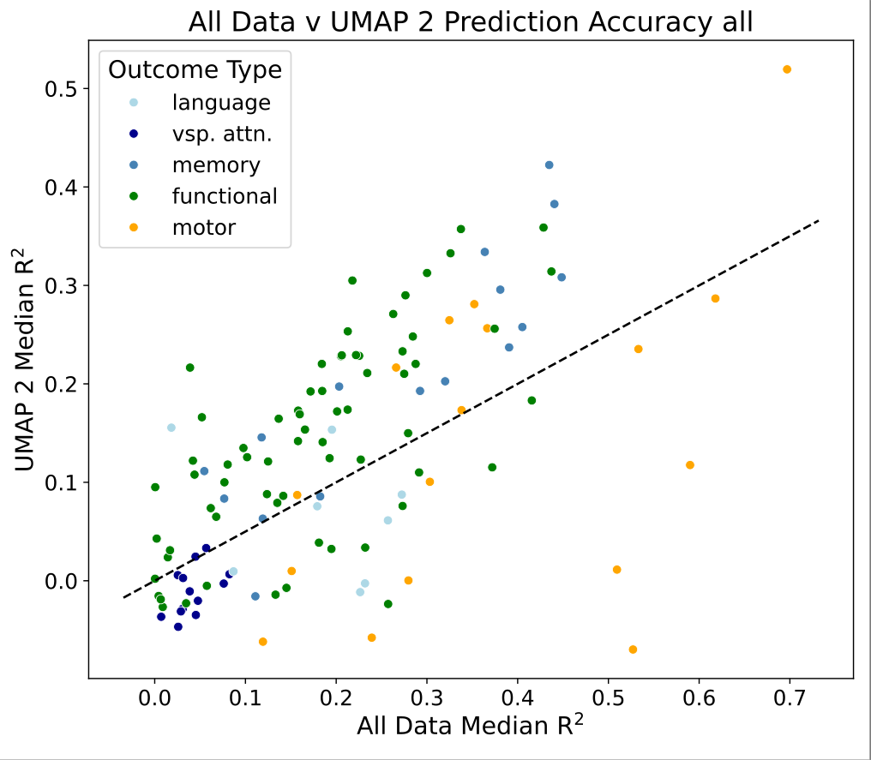
Notes:
Different way of visualizing this
Each point is an outcome
Dots that are above the line mean predictions were better (not necessarily statistically) compared to
Take away point is that UMAP 2D is useful for prediction.
James and I thought we could use this UMAP embedding to identify behavioral profiles of patients in this cohort
Behavioral profile – a data-driven representation of an individual’s behavioral characteristics as measured by standardized assessment
i.e., performance across all behavioral tests
Wanted to characterize this embedding in a set of exploratory analyses: why is it so good at prediction?
Exploration of this behavior space led to development of this approach

Slide 27
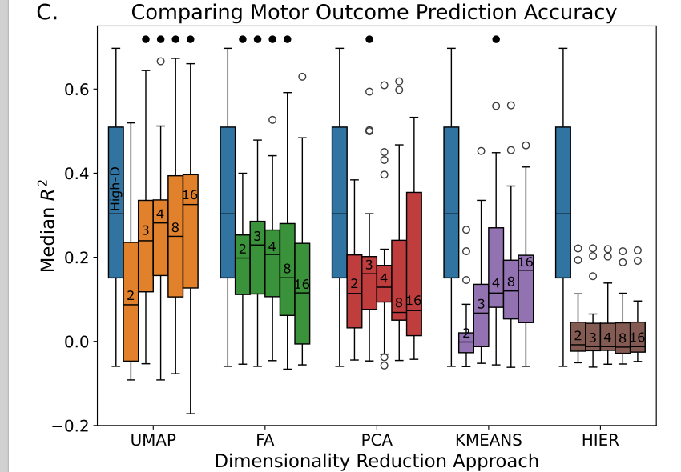
Notes:
In motor outcome predictions, we saw the same trend, robustness to dimension number past 2 dimensions, not seeing the same fall off as seen in factor analysis
Ranges for umap high

Slide 28
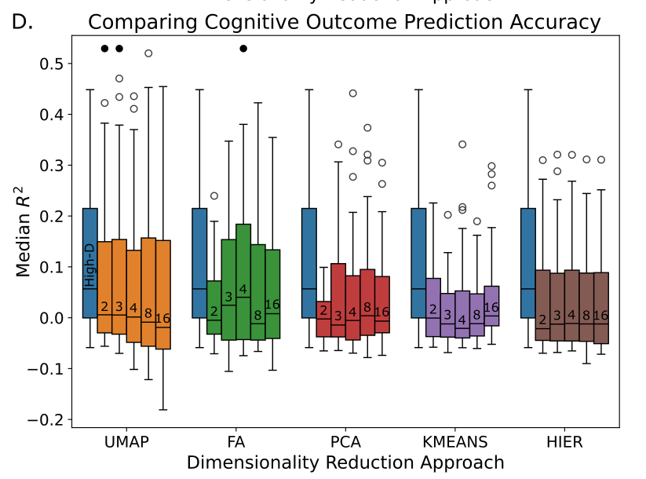
Notes:
- Cog outcomes generally tough, especially driven by inability to predict neglect vsp attn stuff

Slide 29
Lesion Profile Mapping Pipeline
Notes:
Lesion profile mapping uses rich behavioral data to group patients with similar post-lesion deficits.
Instead of mapping task performance, we are mapping a certain profile across all tested cognitive domians
A concrete examples is a subset of patients who have language deficits and right-side-of-the-body weakness
Symptoms of stroke don’t exist in a vacuum

Slide 30
Example: WashU Dataset, subacute timepoint
Patient ID | BNT (T₁) | HVLT (T₂) | BVMT (T₃) | … | T_{N}
001
002
003
…
P_{N}
UMAP dimensionality reduction on behavior
Notes:
This is how we propose you can map behavioral profile
Have some set of test scores for a set of patients like in this table
Run umap on these z-scored data and reduce to 2 dimensions

Slide 31
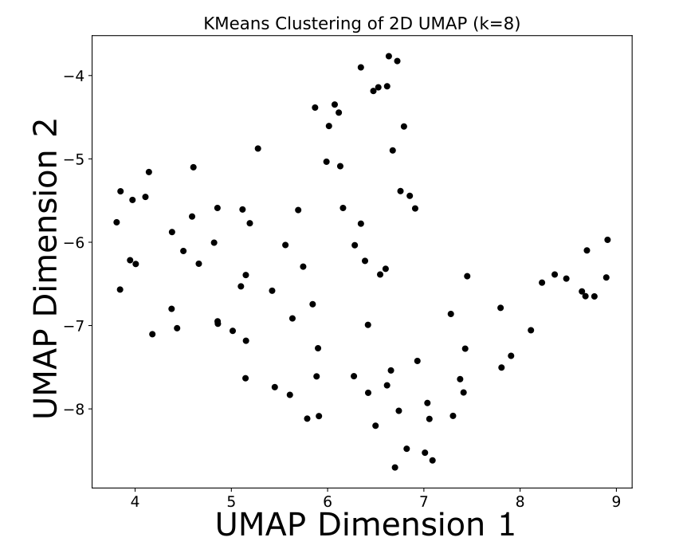
Patients plotted in 2D UMAP behavior space
K-Means clustering on UMAP embedding

Slide 32
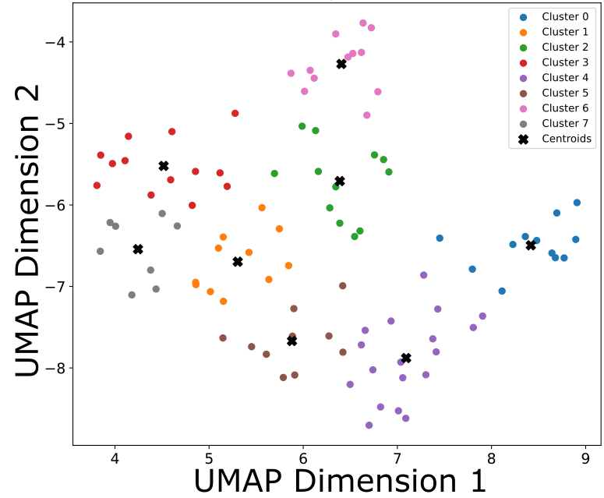
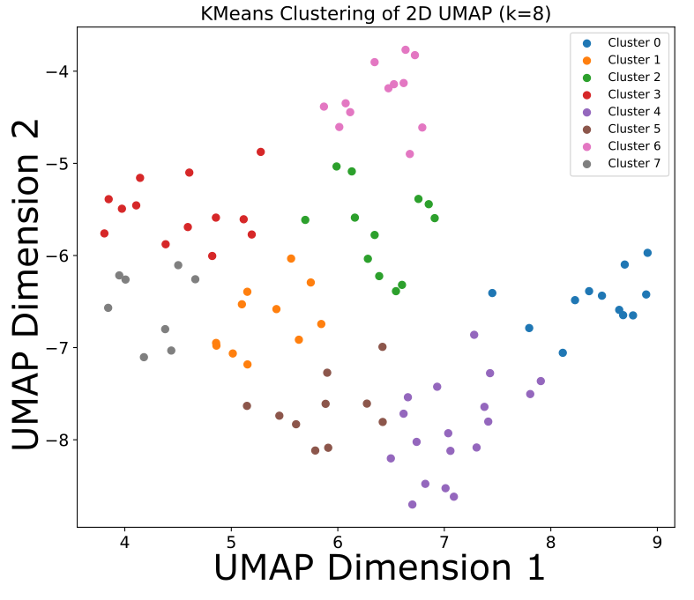
Clusters determined quantitatively or qualitatively
Calculate cluster centroids
Notes:
Calculate one of several different metrics to determine optimal number of K
Davies-Bouldin score
Ratio of within-cluster distances (compactness) to between-cluster distances (separation)
Do this over a range of k values, select the value of k with the lowest DB score

Slide 33
Centroids represent location of a behavioral profile in behavior space
Calculate Euclidean distance from each patient to cluster centroid
Notes:
In other words, we are mapping a location in this UMAP space.
This is important because again, this is showing patient relationship to other patients in a cohort.

Slide 34
2.
1.
Notes:
If we are trying to map blue cluster
Here, short distance means a patient is very close to this behavioral profile because, again, patients close together here are close in 78-D space and if they are close, they have similar behavioral data

Slide 35
Output is New Lesion-Symptom Mapping Input
Patient ID | Distance to Cluster 0 | Distance to Cluster 1 | Distance to Cluster 2 | … | Distance to Cluster N
001
002
003
…
P_{N}
Can use Iowa Brain-Behavior Toolkit to perform lesion mapping analyses
Notes:
When you do this, the resultant lesion profile map will show what lesion locations are associated with a given cluster’s behavioral profile
Then, can proceed forward with lesion-symptom mapping algorithm of choice
Compatible with available toolboxes because this processing is done on the behavioral data then

Slide 36
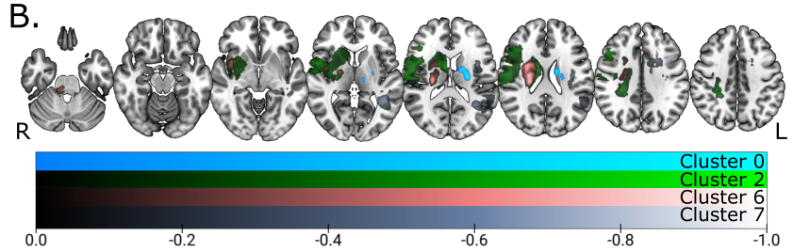
Notes:
- LSM where 4 of 8 clusters localized but we need to calculate the behavioral profile to contextualize this

Slide 37
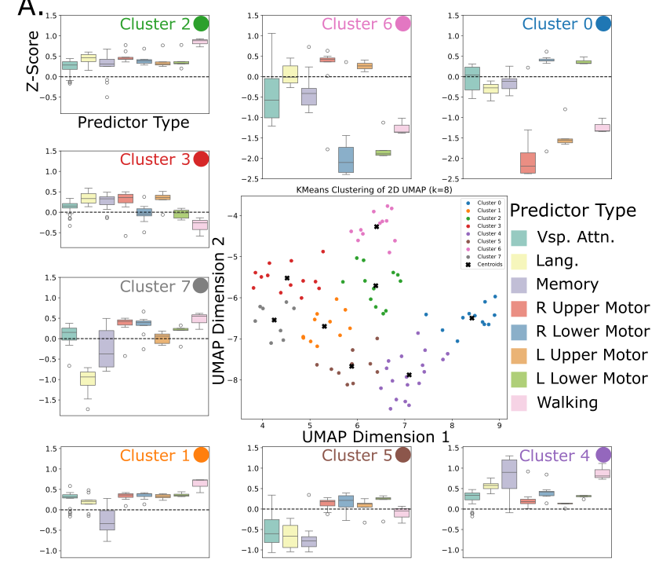
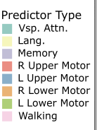
Notes:
Specifics here don’t matter,
in this example, each boxplot would represent the distribution of patient performance on a single neuropsych test
This is an example, this figure in the context of our paper is showing something slightly different but let’s consider each as representing distribution of tests scores.
Dotted line represents sample mean, but you can change is to a population mean to put your data in context of norms

Slide 39
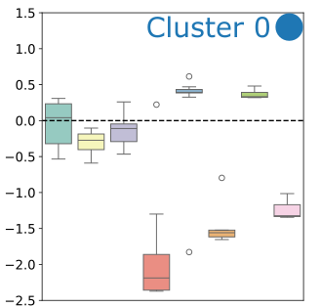
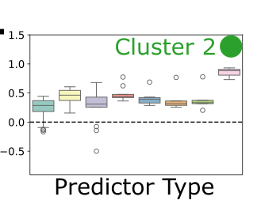
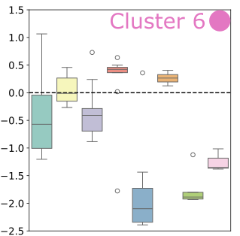
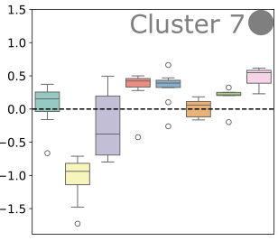

Slide 40
Notes:
Now that we can map behavioral profiles to lesion location with LSM, we can just as easily do this for LNM
These results give valuable basic science insights into functional neuroanatomy
What about when we have a new patient given the same test battery
Let’s say we do this process for the registry core battery, from which we derive some set of behavioral profiles.
New patient that is administered the core battery and want to know, based on lesion location

Slide 41
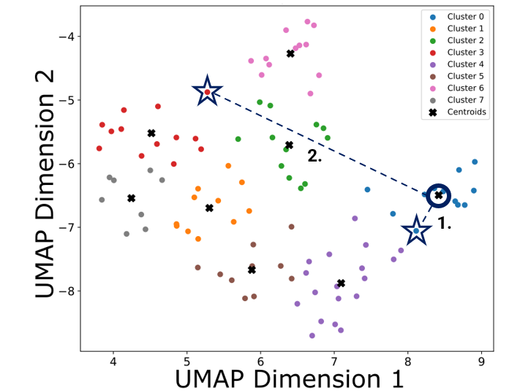
Processing Steps
Patient ID | BNT (T₁) | … | T_{N}
001
…
P_{N}
Reduce test dimensionality with UMAP
Clustering on UMAP embedding
Calculate cluster centroids
Calculate patient distance to centroids
Perform lesion mapping with user’s choice of toolkit
Patient ID | Dist. To Clu. k
001
…
P_{N}

Slide 42
What we have done:
Outlined pipeline that could identify associations between a behavioral profile and lesion location

Slide 43
Using Behavioral Profiles for Prediction
Future directions
Notes:
What about when we have a new patient?
Lets use new example:
Let’s say we did this process for the core lesion battery and identified behavioral subgroups based on this
What about when we get a new patient? (still working on this; see two different options)
1. predict behavioral profile from lesion location in a new patient
Calculate lesion load between new patient’s lesion mask and profile LSM or LNM
Most similar LSM (highest spatial correlation), look at behavioral profile, that’s prediction
2. predict lesion location from behavioral profile
Administer the core battery to new patient
Have all the features umap used for dim reduction,
Take transform values from the training data (aka, the lesion profile map), feed in the new patient, and it will place them within known behavior space.

Slide 44


Thank you!
FUNDED BY:
Iowa Neuroscience Specialty Program in Research Education

Slide 45
Processing Steps
Patient ID | BNT (T₁) | … | T_{N}
001
…
P_{N}
Reduce test dimensionality with UMAP
Clustering on UMAP embedding
Calculate cluster centroids
Calculate patient distance to centroids
Perform lesion mapping with user’s choice of toolkit
Patient ID | Dist. To Clu. k
001
…
P_{N}

Slide 46
Clusters determined quantitatively or qualitatively
Average within-cluster performance on each test

Slide 47
Notes:
Specifics here don’t matter,
in this example, each boxplot would represent the distribution of patient performance on a single neuropsych test
This is an example, this figure in the context of our paper is showing something slightly different but let’s consider each as representing distribution of tests scores.
Dotted line represents sample mean, but you can change is to a population mean to put your data in context of norms

