Slide 1

Accessing JRuby Parse Trees in Clojure
Justin Leitgeb
@justinleitgeb
Stack Builders
January 8, 2013
NYC.rb

Slide 2
Compiling Process
Tokenizing, parsing, building an AST
Can also build a CFG – control flow graph

Slide 3
Inspecting the AST
JRuby - parseInline returns root Node of AST
But then you have to use Java…

Slide 4
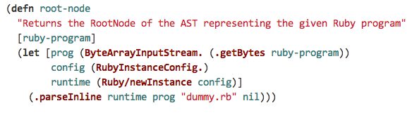
Accessing Ruby’s AST from Clojure

Slide 5
Ruby AST in the REPL
Demo

Slide 6
Static Analysis
CFGs (Control Flow Graphs) can be more useful than ASTs
Some work in progress in JRuby’s “IR”
More possibilities for writing safe code
Why not do some of it in Clojure?

Slide 7
Further reading
http://github.com/jsl/jruby-ast-clj
Google Closure Compiler check for unreachable code: http://closure-compiler.googlecode.com/svn/trunk/src/com/google/javascript/jscomp/CheckUnreachableCode.java
“STATIC ANALYSIS FOR RUBY IN THE PRESENCE OF GRADUAL TYPING,” MICHAEL JOSEPH EDGAR http://www.cs.dartmouth.edu/reports/TR2011-686.pdf
Exploring Ruby AST from Scala: http://langexplr.blogspot.com/2007/11/exploring-jruby-syntax-trees-with-scala.html
Justin Leitgeb
justinleitgeb.com
@justinleitgeb
github.com/jsl

