Slide 1
FAFNIR: Accelerating Sparse Gathering by Using Efficient Near-Memory Intelligent Reduction
Junseo Lee
Electrical and Computer Engineering
Seoul National University

Slide 2
Contents
What is Recommendation System?
Example of Recommendation System: DLRM
Bottleneck of Recommendation System: Embedding layer
Brief Description of State-of-the-Art Solutions of Embedding
Compositional embedding
Tensor Casting
FAFNIR
Challenges of embedding lookup
Comparison with prior solutions
Contributions
Evaluation
Questions

Slide 3
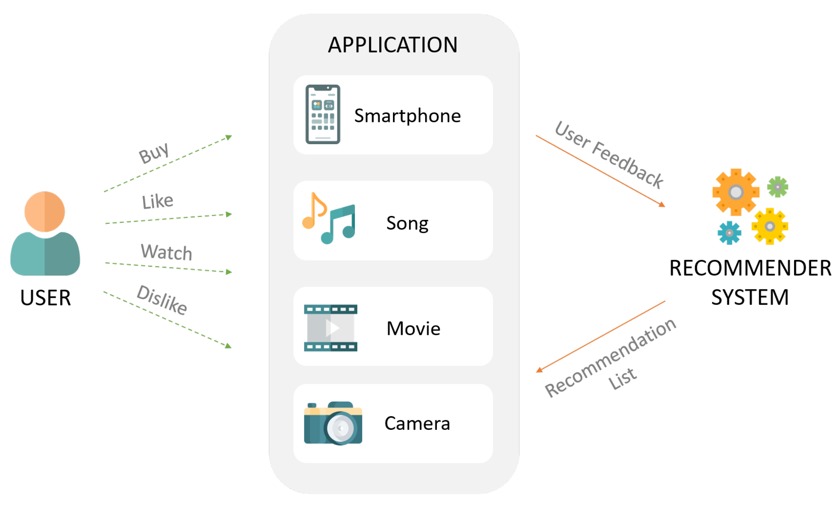
What is Recommendation System?
Goal: Predict the "rating" or "preference" a user would give to an item
Example: Youtube, Netflix recommendation system, Facebook DLRM

Slide 4
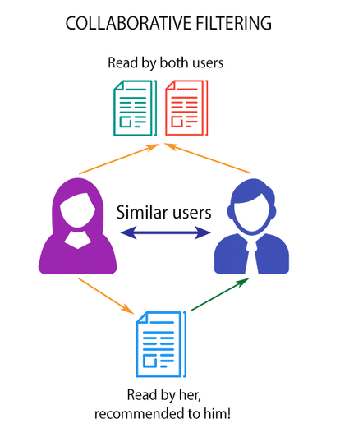
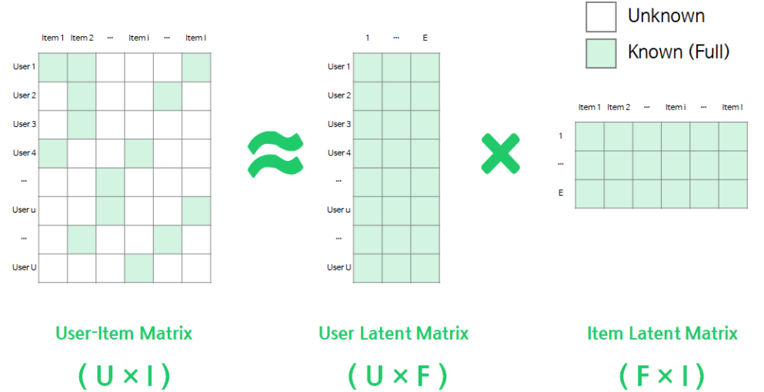
What is Recommendation System?
Collaborative filtering
If someone similar to you likes this item, you are likely to prefer the item either.
Matrix factorization
“Factorize” a user-item matrix into user & item embedding vectors(=latent factors)
Good for “sparse” data (lack of data)
One of the methods of matrix factorization is SVD (singular value decomposition, but not good for sparse user-item matrix

Slide 5
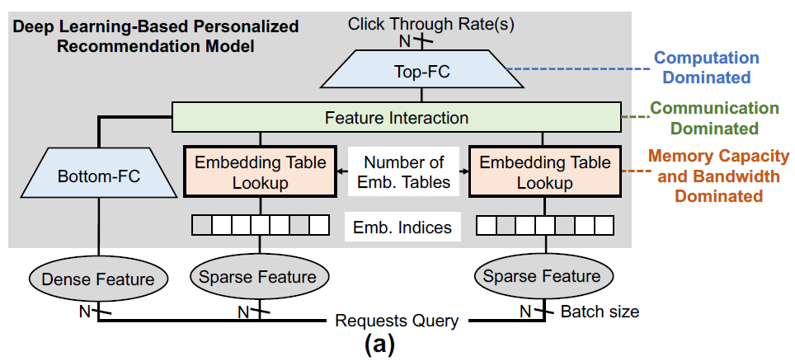
Example of Recommendation System: DLRM
DLRM = Deep Learning Recommendation System (Facebook)
Sparse feature (categorical data) -> Embedding layer
e.g., watch history, location (country)
Dense feature (continuous data) -> MLP (Multilayer Perceptron)
e.g., watch time, time since last watch

Slide 6
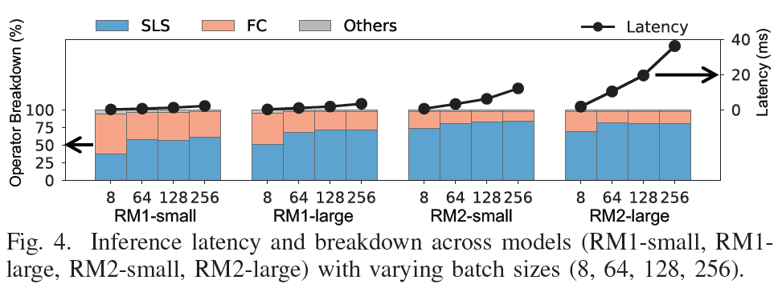
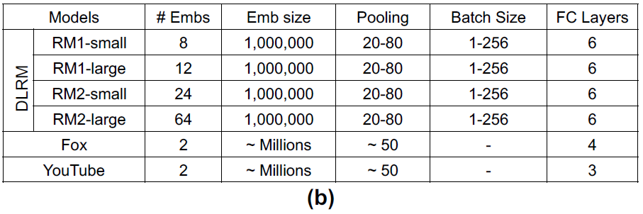
Bottleneck of Recommendation System: Embedding layer
SparseLengthsSum(SLS) is embedding operator in Caffe2
RM1, 2 are two representative recommendation models in Facebook’s production datacenter
RM1 is a comparatively smaller model with few embedding tables; RM2 has tens of embedding tables
Operator latency: SLS(embedding layer) > FC > Others

Slide 7
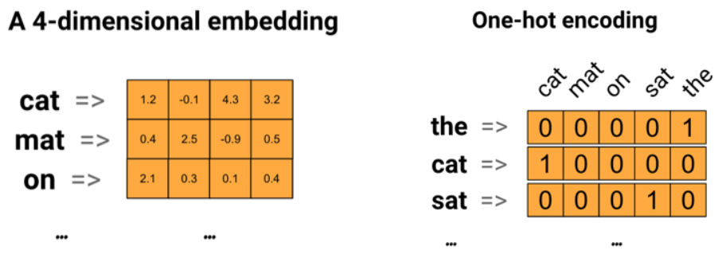
Embedding Table
One-hot encoding
One categorical data can be represented as one-hot vector
This is not a semantic feature
To use meaningful data for ML, one-hot vector should be converted to the feature which has its own characteristics
Embedding vector (latent factor)
Semantic feature representing categorical data
Mapping to latent factor space
The distance in the latent factor space means the similarity of two feature

Slide 8
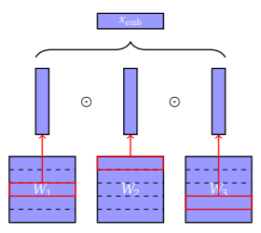
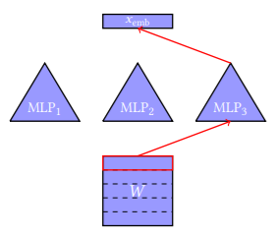
Solutions of Memory-Intensive Embedding
Compositional embedding
Reduce the size of embedding table
Operation-based: concatenation, addition, element-wise multiplication
Path-based: linear function, MLP
Partition
Quotient-Remainder complementary partitions
Generalized Quotient-Remainder complementary partitions
Chinese remainder partitions
Naïve partition

Slide 9




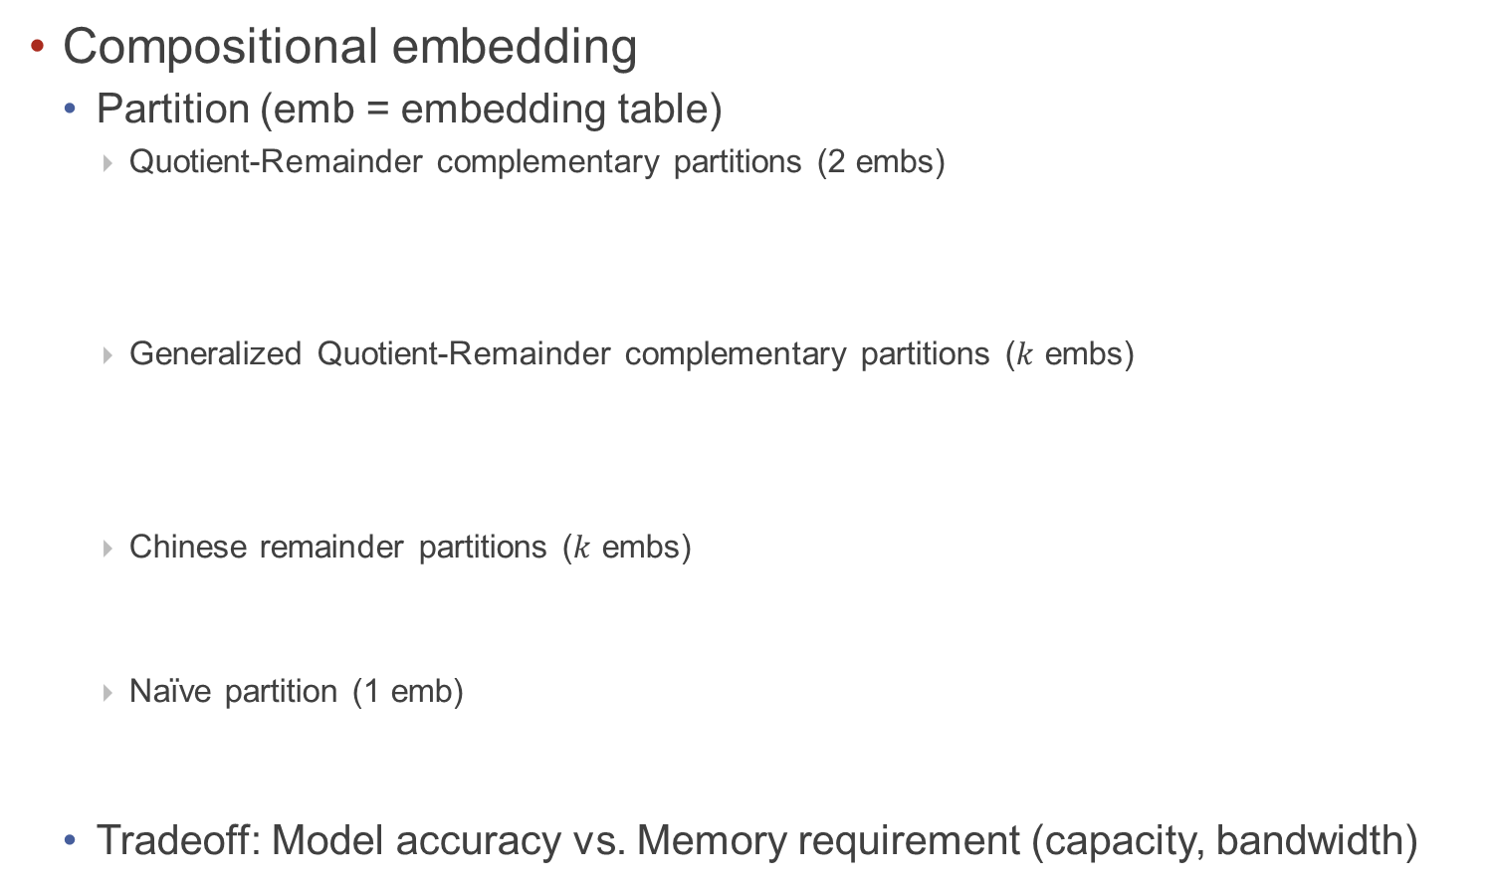
Solutions of Memory-Intensive Embedding (cont’d)
Compositional embedding
Partition (emb = embedding table)
Quotient-Remainder complementary partitions (2 embs)
Generalized Quotient-Remainder complementary partitions ($k$ embs)
Chinese remainder partitions ($k$ embs)
Naïve partition (1 emb)
Tradeoff: Model accuracy vs. Memory requirement (capacity, bandwidth)

Slide 10
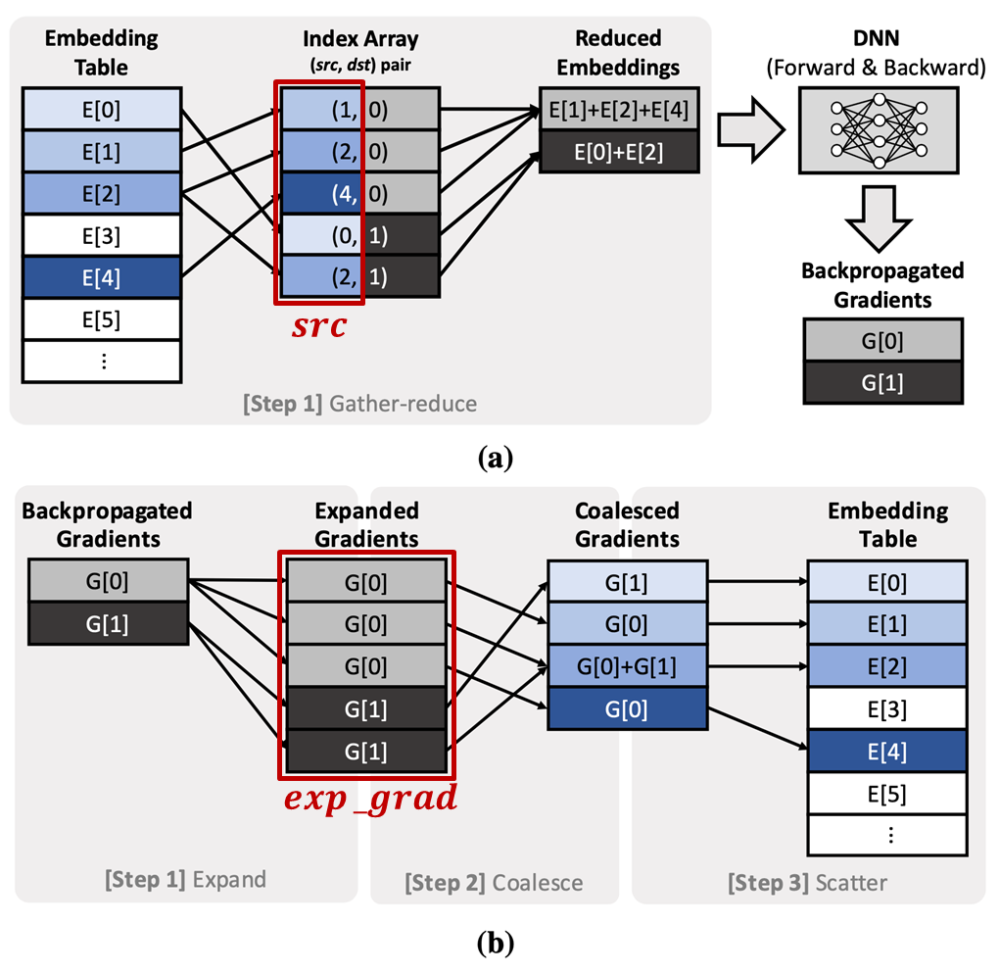
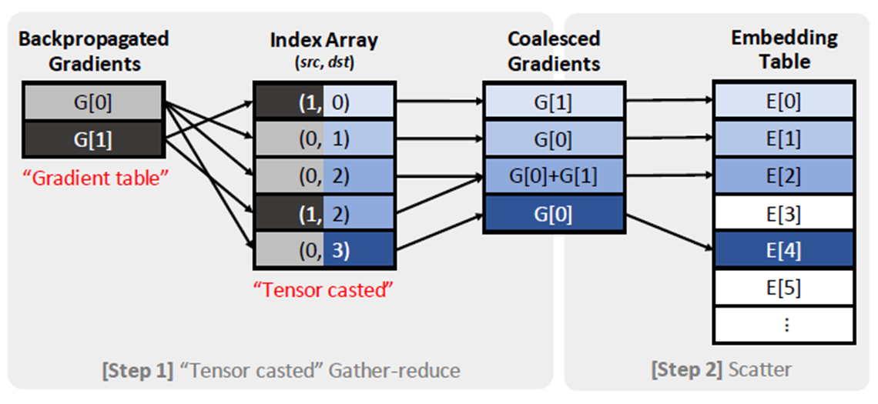
Solutions of Memory-Intensive Embedding (cont’d)
Tensor Casting (HPCA ’21)
Target: Backpropagation stage of embedding layer
Contribution
Gradient expand-coalesce operation is a bottleneck of backpropagation stage
Cast gradient expand-coalesce to tensor gather-reduce because it is just inverse process of gather-reduce operation

Slide 11
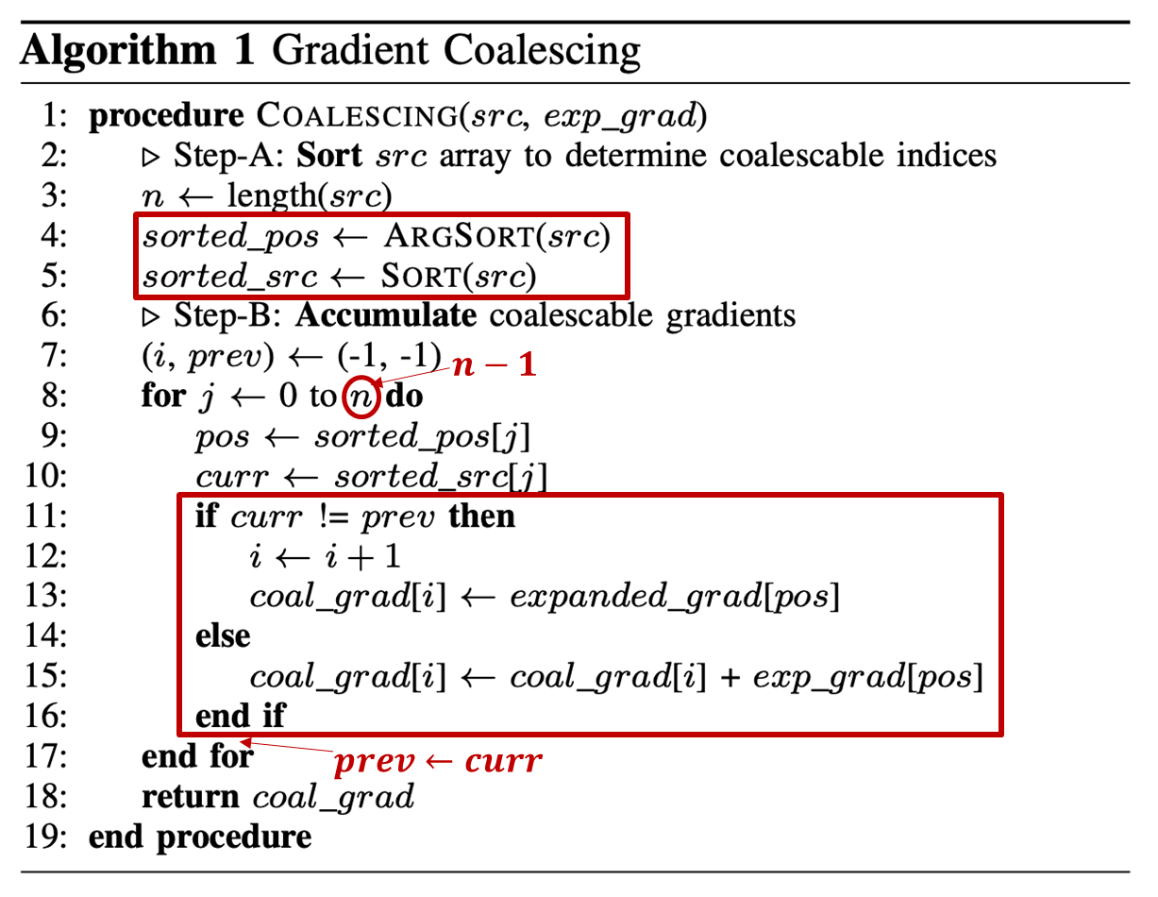
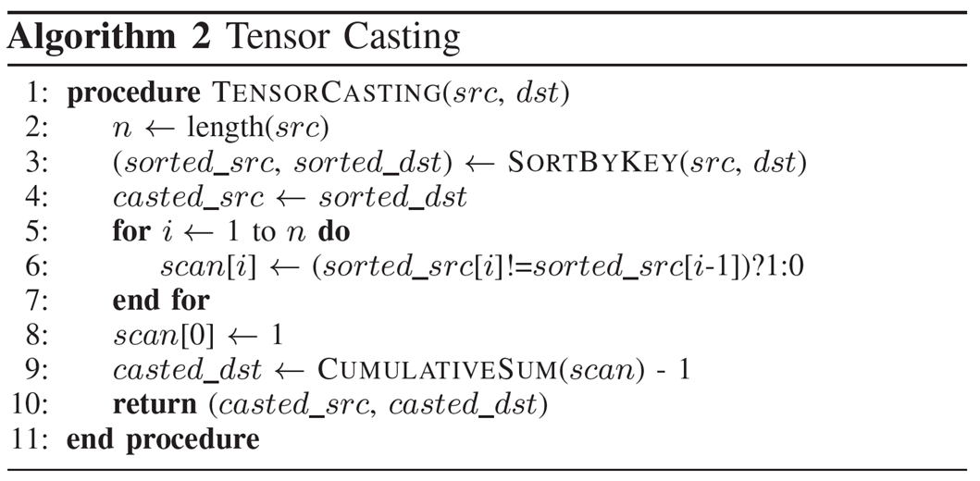
Solutions of Memory-Intensive Embedding (cont’d)
Tensor Casting (HPCA ’21)

Slide 12
Solutions of Memory-Intensive Embedding (cont’d)
Tensor Casting (HPCA ’21)

Slide 13
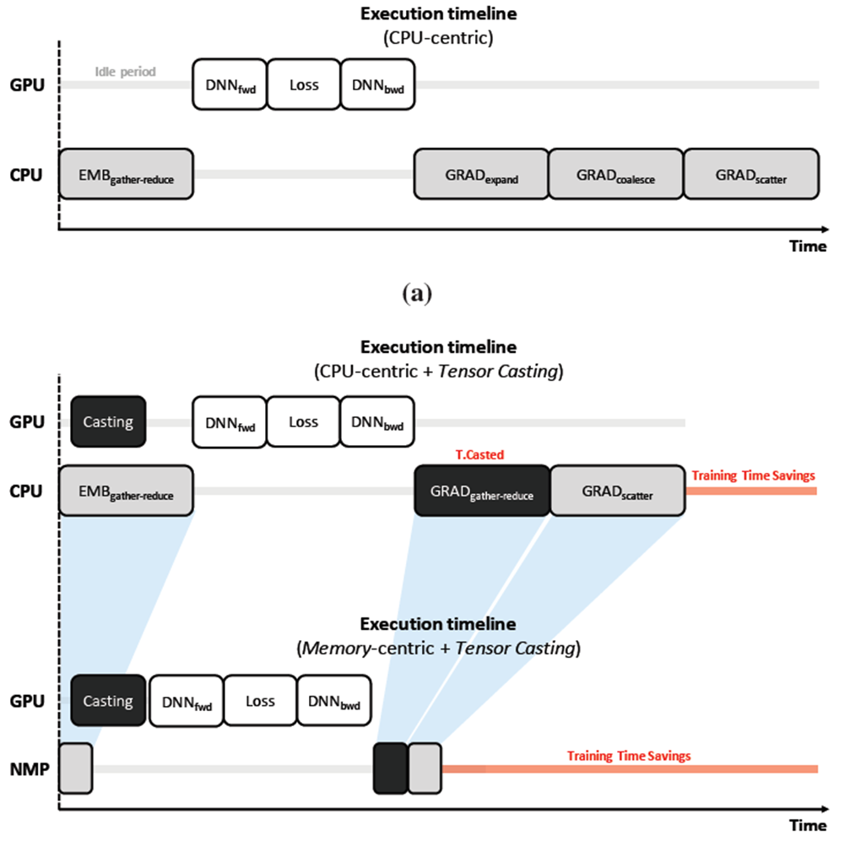
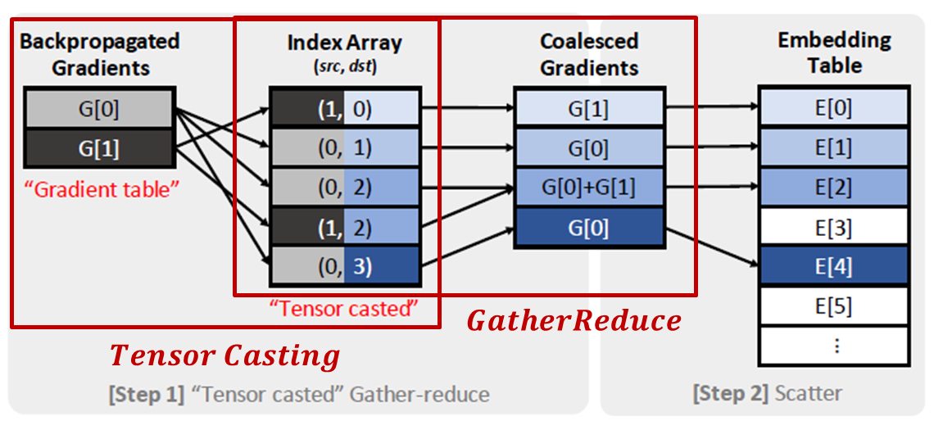
Solutions of Memory-Intensive Embedding (cont’d)
Tensor Casting (HPCA ’21)

Slide 14
FAFNIR
Challenges of embedding lookup
Data movement
(# queries) x (# vectors in a query) x (vector size) elements must be transferred from memory systems to cores: not scalable
Goal: reduce the amount of data movement
Lack of utilization of row buffer locality
TensorDIMM
column-major order, which breaks the row-buffer locality in the DRAM system
splitting embedding vectors across more ranks causes poor utilization of row-buffers
Relying on spatial locality
RecNMP
If low spatial locality, parallel compute at NDP is low compared to that of in theory, DIMM-level parallelsim X
Connection overhead
# of connections (𝑐 x 𝑚) is not scalable for adding more ranks
Using cache to reduce memory access is not a good solution ☹
RecNMP: 128KB rank-level cache adds extra HW overhead but hit rate is ~50%

Slide 15
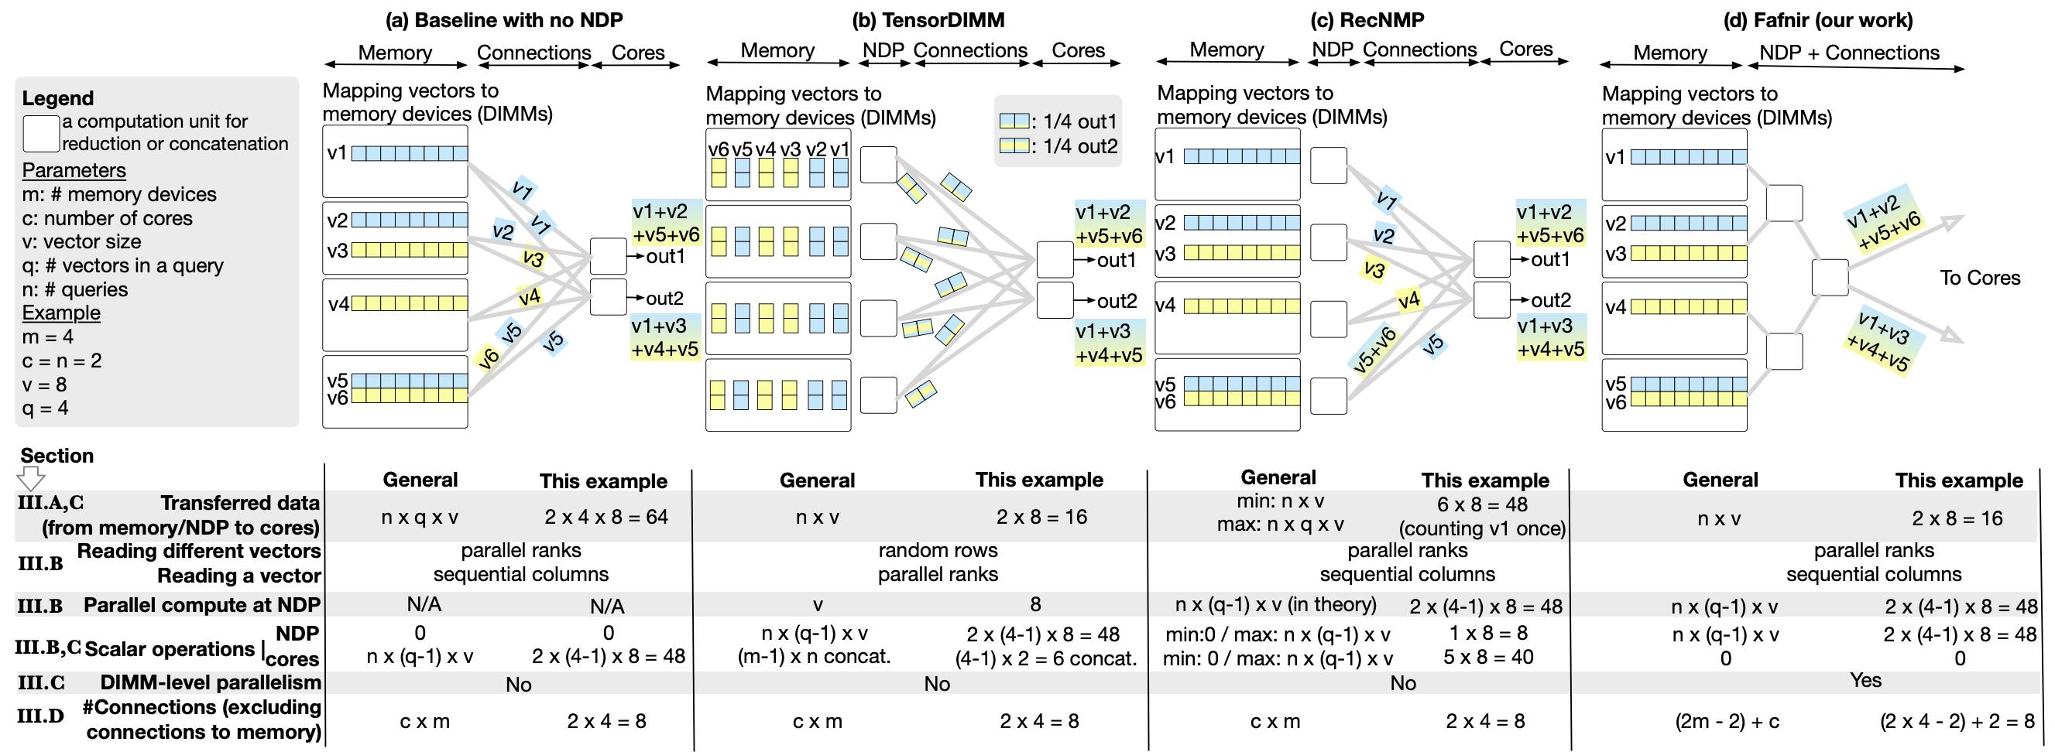



FAFNIR
Comparison with prior solutions
$$c x m$$
$$c x m$$
$$c x m$$

Slide 16
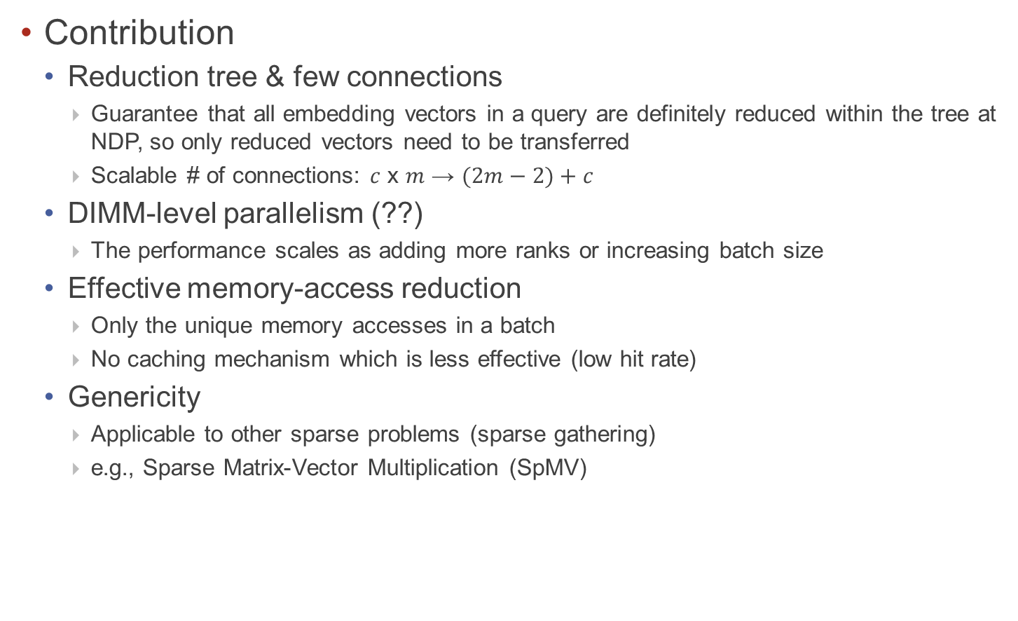
FAFNIR
Contribution
Reduction tree & few connections
Guarantee that all embedding vectors in a query are definitely reduced within the tree at NDP, so only reduced vectors need to be transferred
Scalable # of connections: 𝑐 x 𝑚 → $(2m−2)+c$
DIMM-level parallelism (??)
The performance scales as adding more ranks or increasing batch size
Effective memory-access reduction
Only the unique memory accesses in a batch
No caching mechanism which is less effective (low hit rate)
Genericity
Applicable to other sparse problems (sparse gathering)
e.g., Sparse Matrix-Vector Multiplication (SpMV)

