Slide 1
SNU-Samsung AI (NPEX) Lab 2 : Implementing FC by Verilog Jaewoong Sim Seoul National University

Slide 2
Background

Slide 3
Reference
CS231n: Convolutional Neural Networks for Visual Recognition
Standford CS231n lecture note (translated)
Neural network: http://aikorea.org/cs231n/neural-networks-1/
Convolutional network: http://aikorea.org/cs231n/convolutional-networks/
CNN, Convolution Neural Network summary
Personal Blog: http://bitly.kr/cb6DwW

Slide 4
Background: CNN Network
FC (Fully-Connected) layer
Neural Network for Image Classification
source: https://adeshpande3.github.io/A-Beginner%27s-Guide-To-Understanding-Convolutional-Neural-Networks/

Slide 5
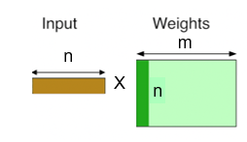
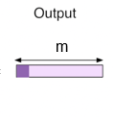

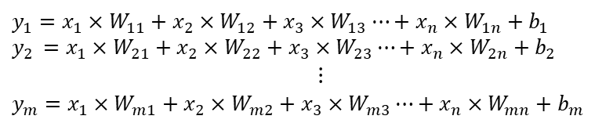
Background: FC Layer
FC layer’s operation
[
Input
Weight
]
Bias
Output
m
$$+$$
=
Structure of FC layer ¹⁾
Operation of FC layer²⁾
$y_{1}=x_{1}×W_{11}+x_{2}×W_{12}+x_{3}×W_{13}⋯+x_{n}×W_{1n}+b_{1}$
$$y_{2 }=x_{1}×W_{21}+x_{2}×W_{22}+x_{3}×W_{23}⋯+x_{n}×W_{2n}+b_{2}$$
$⋮$
$$y_{m}=x_{1}×W_{m1}+x_{2}×W_{m2}+x_{3}×W_{m3}⋯+x_{n}×W_{mn}+b_{m}$$
1) http://needjarvis.tistory.com/182
2) https://petewarden.com/2015/04/20/why-gemm-is-at-the-heart-of-deep-learning/

Slide 6
FC: Example
8x4 FC layer
Input Size: 8
Output Size: 4
Weight Size: Input Size x Output Size = 32
Bias Size: Output Size = 4
I₀
I₁
I₂
I₃
I₄
I₅
I₆
I₇
x W₀
x W₁
x W₂
x W₃
x W₄
x W₅
x W₆
x W₇
∑
+ B₀
O₀
O₁
O₂
O₃

Slide 7
FC: Example
8x4 FC layer
Input Size: 8
Output Size: 4
Weight Size: Input Size x Output Size = 32
Bias Size: Output Size = 4
I₀
I₁
I₂
I₃
I₄
I₅
I₆
I₇
x W₈
x W₉
x W₁₀
x W₁₁
x W₁₂
x W₁₃
x W₁₄
x W₁₅
∑
+ B₁
O₀
O₁
O₂
O₃

Slide 8
FC: Example
8x4 FC layer
Input Size: 8
Output Size: 4
Weight Size: Input Size x Output Size = 32
Bias Size: Output Size = 4
I₀
I₁
I₂
I₃
I₄
I₅
I₆
I₇
x W₁₆
x W₁₇
x W₁₈
x W₁₉
x W₂₀
x W₂₁
x W₂₂
x W₂₃
∑
+ B₂
O₀
O₁
O₂
O₃

Slide 9
FC: Example
8x4 FC layer
Input Size: 8
Output Size: 4
Weight Size: Input Size x Output Size = 32
Bias Size: Output Size = 4
I₀
I₁
I₂
I₃
I₄
I₅
I₆
I₇
x W₂₄
x W₂₅
x W₂₆
x W₂₇
x W₂₈
x W₂₉
x W₃₀
x W₃₁
∑
+ B₃
O₀
O₁
O₂
O₃

Slide 10
FC: Example
8x4 FC layer
I ∙ W + B = O
X
Inner product
+
=

Slide 11
LAB Overview

Slide 12
Background: Overall Structure of FC layer
FC_TOP
FC_Controller
MAC
module
MAC
module
MAC
module
BRAM
(Xilinx IP)

Slide 13
Background: Overall Structure of FC layer
FC_TOP
FC_Controller
MAC
module
BRAM(Block RAM)
SRAM which FPGA can provide (different from LUT, FF) Usually used when we need to store lots of data
Can use BRAM by exploiting IP(Intellectual property)
MAC
module
MAC
module
BRAM
(Xilinx IP)

Slide 14
Background: Overall Structure of FC layer
FC_TOP
FC_Controller
MAC
module
MAC
module
MAC(Multiplier Accumulator)
Module which performs addition & multiplication,
Takes A,B,C as an input and outputs A*B+C
MAC
module
BRAM
(Xilinx IP)

Slide 15
Background: Structure of FC layer
Host (PC)
FC_Top
Control Path
FC_control_path
FC_Layer
MAC
DRAM
Data Path
MAC
BRAM
(Xilinx IP)
MAC

Slide 16
Background: Structure of FC layer
Host
FC_Top
Test
Bench
FC_Controller
Input, Weight, Bias
FC_control_path
MAC
module
MAC
module
Output
FC_Layer
BRAM
(Xilinx IP)
MAC
module
MAC
module
DRAM
MAC
module
BRAM
(Xilinx IP)
MAC
module

Slide 17
Overview of the FC controller

Slide 18
High Level Diagram of FC Controller (fc_controller.v)
FC Controller
BRAM
input_data
out_data
clk
MAC
t_valid
rstn
clka
clk
partial_sum
result_acc
result_q
r_valid
addra
weight_buff
weight
rstn
mout
ena
douta
en
in_data
done
data_a
out_data
dina
data_b
t_valid
wea
data_c
bias

Slide 19
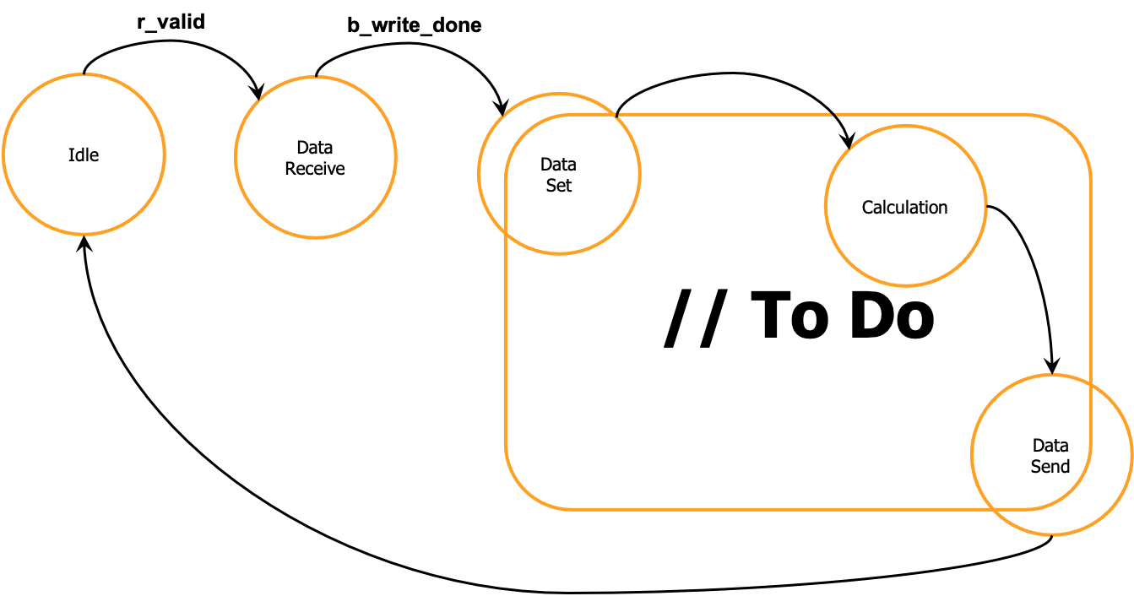
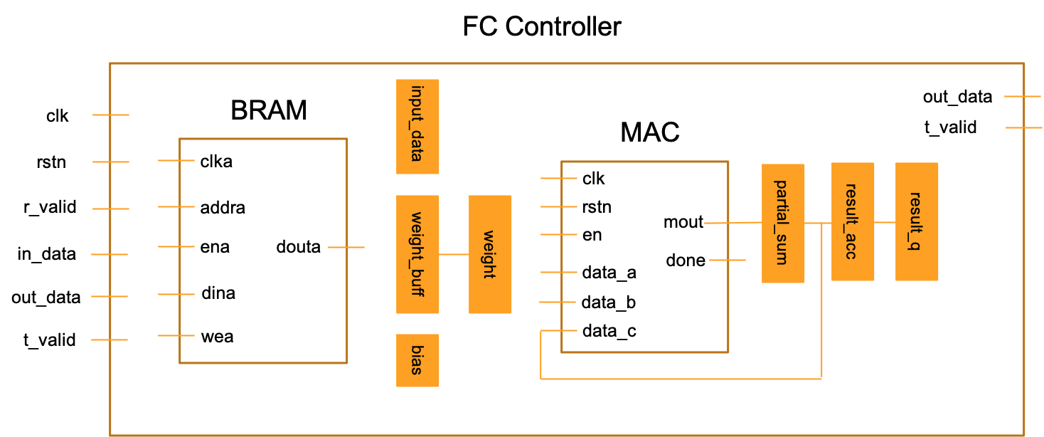
FSM of FC Controller (fc_controller.v)

Slide 20
Flow of FC Controller (fc_controller.v)
r_valid
data_ready
Idle
Data
Receive
Idle
Accumulate
b_write_done
Input
Set
t_valid
element_counter >= INPUT_SIZE-1
weight_counter > OUTPUT_SIZE
out_counter < OUTPUT_SIZE
input_set_done
Data
Send
Bias
Add
Weight
Set
Bias
Set
out_counter >= OUTPUT_SIZE
data_set_done
bias_set_done
BRAM FSM
FC Calculation FSM

Slide 21
Flow of FC Controller (fc_controller.v)
r_valid
Idle
Data
Receive
b_write_done
input_data
clk
BRAM
Input
Set
rstn
clka
r_valid
addra
weight_buff
weight
weight_counter > OUTPUT_SIZE
in_data
ena
douta
input_set_done
out_data
dina
Weight
Set
Bias
Set
wea
t_valid
bias
data_set_done
bias_set_done

Slide 22
Flow of FC Controller (fc_controller.v)
r_valid
Idle
Data
Receive
b_write_done
input_data
clk
BRAM
Input
Set
rstn
clka
r_valid
addra
weight_buff
weight
weight_counter > OUTPUT_SIZE
in_data
ena
douta
input_set_done
out_data
dina
Weight
Set
Bias
Set
wea
t_valid
bias
data_set_done
bias_set_done

Slide 23
Flow of FC Controller (fc_controller.v)
r_valid
input_set_done
Idle
Data
Receive
b_write_done
input_data
clk
BRAM
Input
Set
rstn
clka
r_valid
addra
weight_buff
weight
weight_counter > OUTPUT_SIZE
in_data
ena
douta
input_set_done
out_data
dina
Weight
Set
Bias
Set
wea
t_valid
bias
data_set_done
bias_set_done

Slide 24
Flow of FC Controller (fc_controller.v)
r_valid
bias_set_done
Idle
Data
Receive
b_write_done
input_data
clk
BRAM
Input
Set
rstn
clka
r_valid
addra
weight_buff
weight
weight_counter > OUTPUT_SIZE
in_data
ena
douta
input_set_done
out_data
dina
Weight
Set
Bias
Set
wea
t_valid
bias
bram_oreg_set_done
bias_set_done

Slide 25
Flow of FC Controller (fc_controller.v)
r_valid
weight_set_done
Idle
Data
Receive
b_write_done
input_data
clk
BRAM
Input
Set
rstn
clka
r_valid
addra
weight_buff
weight
weight_counter > OUTPUT_SIZE
in_data
ena
douta
input_set_done
out_data
dina
Weight
Set
Bias
Set
wea
t_valid
bias
bram_oreg_set_done
bias_set_done
bram_oreg_set_done

Slide 26
Flow of FC Controller (fc_controller.v)
bram_oreg_set_done
Idle
Accumulate
input_data
out_data
MAC
t_valid
t_valid
clk
partial_sum
element_counter >= INPUT_SIZE-1
weight_buff
weight
rstn
mout
en
out_counter < OUTPUT_SIZE
data_a
done
Data
Send
Bias
Add
data_b
data_c
bias
out_counter >= OUTPUT_SIZE

Slide 27
Flow of FC Controller (fc_controller.v)
bram_oreg_set_done
Idle
Accumulate
input_data
out_data
copy
MAC
t_valid
t_valid
clk
partial_sum
element_counter >= INPUT_SIZE-1
weight_buff
weight
rstn
mout
en
out_counter < OUTPUT_SIZE
data_a
done
Data
Send
Bias
Add
data_b
data_c
bias
out_counter >= OUTPUT_SIZE
bram_oreg_set_done

Slide 28
Flow of FC Controller (fc_controller.v)
bram_oreg_set_done
Idle
Accumulate
input_data
out_data
MAC
t_valid
t_valid
clk
partial_sum
element_counter >= INPUT_SIZE-1
weight_buff
weight
rstn
mout
en
out_counter < OUTPUT_SIZE
data_a
done
Data
Send
Bias
Add
data_b
data_c
bias
out_counter >= OUTPUT_SIZE
mac_ireg_set_done

Slide 29
Flow of FC Controller (fc_controller.v)
bram_oreg_set_done
Idle
Accumulate
input_data
out_data
MAC
t_valid
t_valid
clk
partial_sum
element_counter >= INPUT_SIZE-1
weight_buff
weight
rstn
mout
en
out_counter < OUTPUT_SIZE
2s’1
data_a
done
Data
Send
Bias
Add
data_b
data_c
bias
out_counter >= OUTPUT_SIZE

Slide 30
Flow of FC Controller (fc_controller.v)
bram_oreg_set_done
Idle
Accumulate
input_data
out_data
MAC
t_valid
t_valid
clk
partial_sum
element_counter >= INPUT_SIZE-1
weight_buff
weight
rstn
mout
en
out_counter < OUTPUT_SIZE
data_a
done
Data
Send
Bias
Add
data_b
data_c
bias
out_counter >= OUTPUT_SIZE

Slide 31
Flow of FC Controller (fc_controller.v)
BRAM Operation
(1) If 'r_valid' == 1, change 'state’ to STATE_DATA_RECEIVE because the tb is ready to send data (STATE_IDLE)
(2) Write 'input’, ‘weight’, 'bias’ into the BRAM (STATE_DATA_RECEIVE)
(3) Read input data from the BRAM, then store it in the 'input_data’ (STATE_INPUT_SET)
(4) Read bias data from BRAM, then store it in ‘bias’ (STATE_BIAS_SET)
(5) Read weight data from the BRAM then store it in register ‘weight_buff’. Since the weight is too large to be stored in a register at once, store only 8-bytes of the weight (which corresponds to a single output). After storing 8-bytes of the weight, set ‘bram_oreg_set_done’ to 1. If ‘mac_ireg_set_done’ == 1, then prepare for the next weight since it means 'weight_buff’ ‘s value is moved to 'weight’
Repeat (5) for 4 times!

Slide 32
Flow of FC Controller (fc_controller.v)
FC Calculation Operation
(1) If ‘bram_oreg_set_done' == 1, move value of 'weight_buff’ to ‘weight’ and set ‘mac_ireg_set_done’ to 1 (STATE_IDLE)
(2) Use a single MAC. Get two 1-byte data from ‘input_data’, 'weight’ each and put them into data_a, data_b of the MAC unit. After computation, put the result into data_c and put the next input and weights into data_a, data_b (Reuse MAC). Repeat step (2) 8 times to get a single output (STATE_ACCUMULATE)
(3) Add the summation result from step (2)and bias by using the MAC unit (STATE_BIAS_ADD)
(4) Repeat step (2)~(3) 4 times, then convert the final output to 8-bits (quantization). Set ‘t_valid’ to 1 to push ‘out_data’ to testbench

Slide 33
Part 1: BRAM Implementation

Slide 34
Experiment 1: BRAM
Objectives
Generate BRAM module with Block RAM generator IP (which Vivado provides)
Implement BRAM Read handshaking process in fc_controller.v

Slide 35
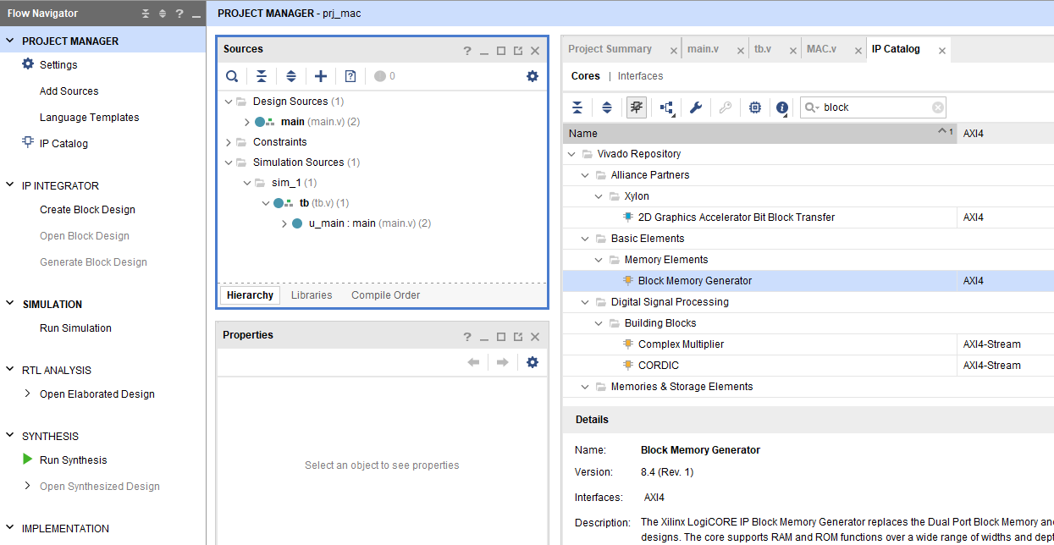
How to add BRAM IP (1)
(1) Click the IP Catalog tab
(2) Search “Block Memory Generator” in the search bar
(3) Double click the Block Memory Generator tab

Slide 36
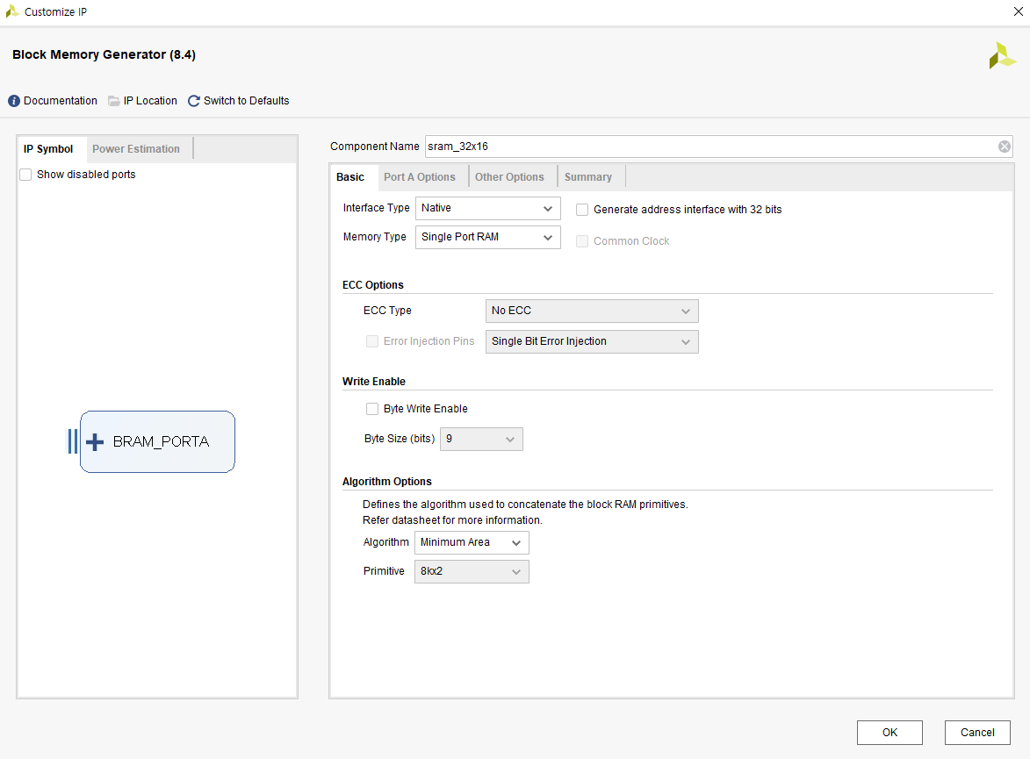
How to add BRAM IP (2)
(4) Enter “sram_32x16” in the Component Name section

Slide 37
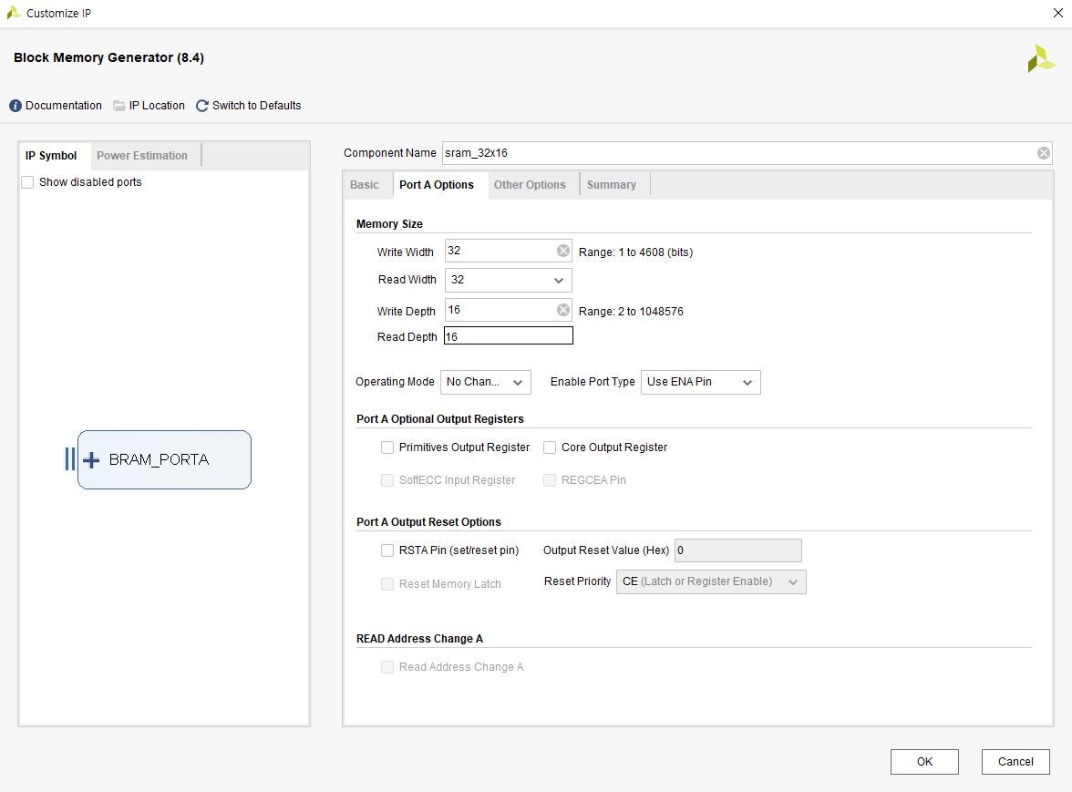
How to add BRAM IP (3)
(5) Configure all options as follows, then click OK button
Memory Size section
Write Width: 32
Read Width: 32
Write Depth: 16
Read Depth: 16
Operating Mode
Select No Change
Primitives Output Register
Deselect

Slide 38
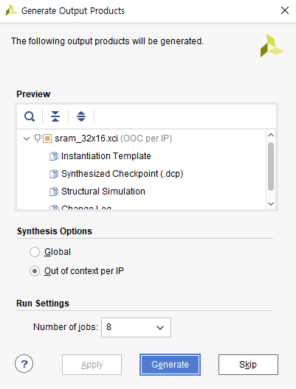
How to add BRAM IP (4)
(6) Click the Generate button
This process may take some time,
So please wait with patience!
# of CPU cores that Vivado will use for generate process

Slide 39
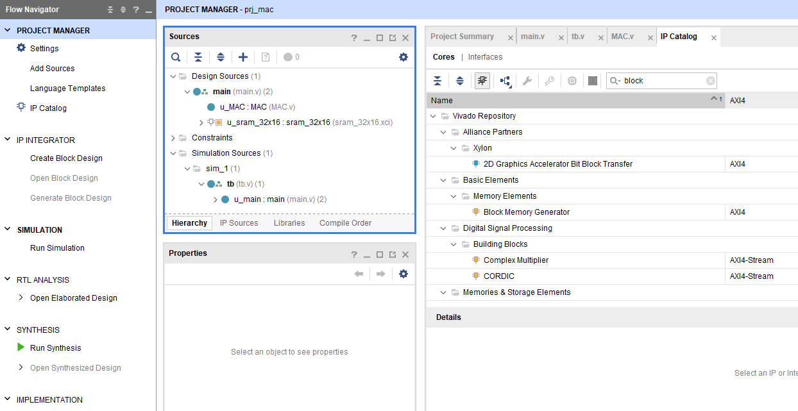
How to add BRAM IP (5)
(7) After generation, you can see that BRAM IP is added in Sources

Slide 40
Lets start coding in Verilog!

Slide 41
Parts
Part2 : Reading data from BRAM and writing it into a register
Part3 : Mac operations
Part4 : Quantization
If you are comfortable with Verilog, you can just skip the instructions and implement the FC controller in the “hard” folder
Otherwise, follow the step by step tutorial in the “easy” folder
Don’t worry if you didn’t finish the previous step!
You can proceed by copying the files completed until the previous step

Slide 42
Part2 : Reading data from BRAM

Slide 43
BRAM Background
BRAM ports description
BRAM의 Input / Output
Input |  |  | Output
Name | Size | Description | Name | Size | Description
clk | 1-bit | Clock
bram_en | 1-bit | Enable
write_en | 1-bit | Write Enable (1: Write, 0: Read) | dout | 32-bit | Data from BRAM
addr | 4-bit | Address
din | 32-bit | Data written into BRAM

Slide 44
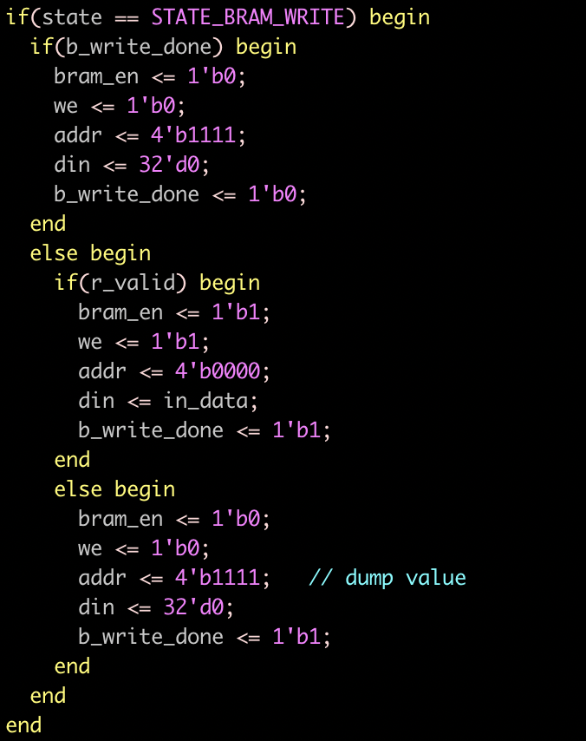
BRAM Background
BRAM write
Enable the BRAM when “r_valid” is 1
r_valid: signal notifying that the testbench is sending data
Change the flags with the data to be written
bram_en : 1
we : 1
addr : address for storing the data
din : data to be written
Set “b_write_done” 1
Writing data into BRAM is done in 1 cycle
Terminate the execution at the next cycle
bram_en <= 0
we <= 0
addr <= 4’b1111
We use the last address for the default value (dump value)
BRAM_WRITE code

Slide 45
BRAM Background
BRAM read
Enable the BRAM when entering the state
bram_en <= 1
we <= 0
addr <= {address for reading data}
BRAM sends the data 1 cycle after receiving the changed flags
The data is available from the “dout” port
Terminate the execution after setting the registers with the data
bram_en <= 0
addr <= 4’b1111

Slide 46
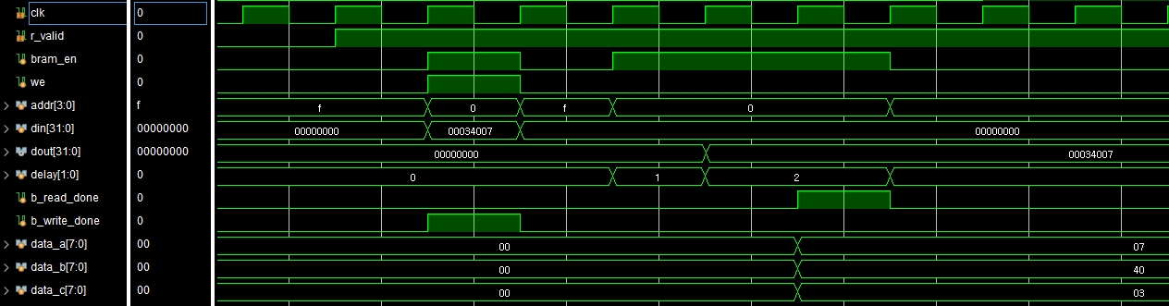
BRAM Background
Point 1
Set both “bram_en” and “we” high
In the next cycle, “din” is written at the “addr”
Point 2
Set “bram_en” high
One cycle later after setting the flag, the target data is received from “addr”
Point 1
Point 2

Slide 47
We will implement the ”Bias Set” state
r_valid
bias_set_done
Idle
Data
Receive
b_write_done
input_data
clk
BRAM
Input
Set
rstn
clka
r_valid
addra
weight_buff
weight
weight_counter > OUTPUT_SIZE
in_data
ena
douta
input_set_done
out_data
dina
Weight
Set
Bias
Set
wea
t_valid
bias
bram_oreg_set_done
bias_set_done

Slide 48
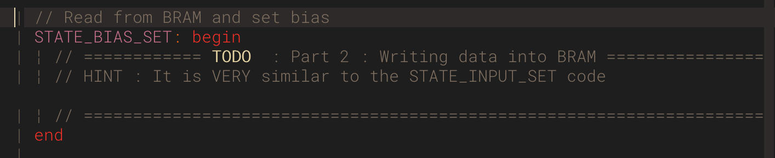
We will implement the ”Bias Set” state
TODO : Line 249 in fc_controller.v
Read the bias values from the BRAM and save them in the “bias” register
Hint : the code is very similar to STATE_INPUT_SET

Slide 49
Part3 : Mac operations

Slide 50
MAC (mac.v)
Reuse the MAC unit to compute the output
I₀
I₁
I₇
B₀
W₀
W₁
W₇
1
0
O₀
9 times

Slide 51
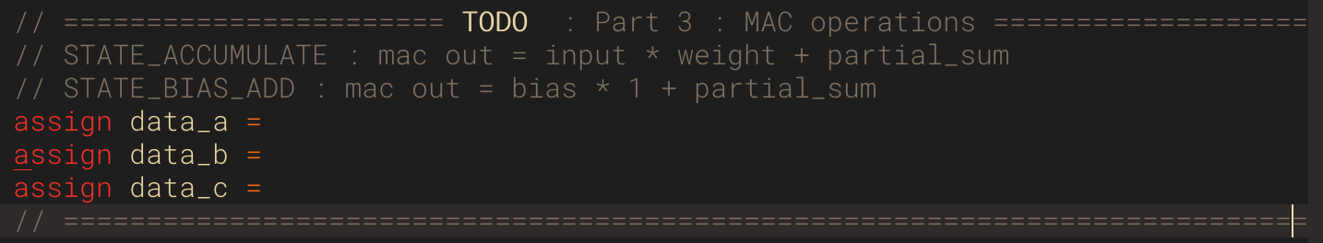
Set the correct MAC input values
TODO : Implement lines 460 ~ 462 so that the input to the MAC unit is set properly
The MAC unit performs operations in the STATE_ACCUMULATE and STATE_BIAS_ADD state

Slide 52
Part4 : Quantization

Slide 53
Quantization Rule (1)
Layer structure
Input : 8-bit 2’s fixed point input, weight, bias
Output: 8-bits 2’s fixed point
Don’t quantize the intermediate result!
To minimize data loss
Quantize the final calculated (MAC) result to 8-bit 2’s fixed point
But you should consider overflow condition when you perform quantization (next slide)
To do so, set OUT_BITWIDTH of MAC large to ensure no loss
ex) For this lab, up to two 8-bits fixed points are multiplied nine times to produce results
result (15bit) + result(15bit) + ... + result(15bit)
Excluding signed bit, then result can have up to 18 bits (7 + 7 + ┌ log₂(9) ┐)
So the result can be expressed with 19 bits, including signed bit
We recommend setting C_BITWIDTH to 18 bits, OUT_BITWIDTH to 19 bits

Slide 54
Quantization Rule (2)
Convert 19-bit 2’s fixed point (result) to 8-bit 2’s fixed point
result[18]: Signed bit
result[17:13]: Bits used for checking overflow
result[12:6]: Real data after conversion
result[5:0]: Dumped data
Example
1_11111_0100101_010010 → 1_0100101
0_00000_1110111_000001 → 0_1110111
Positive overflow (=0111_1111), Negative overflow(=1000_0000)
Pros and Cons of quantization
Pros: Can reduce data size / Fast communication is enabled
Cons: Accuracy is reduced

Slide 55
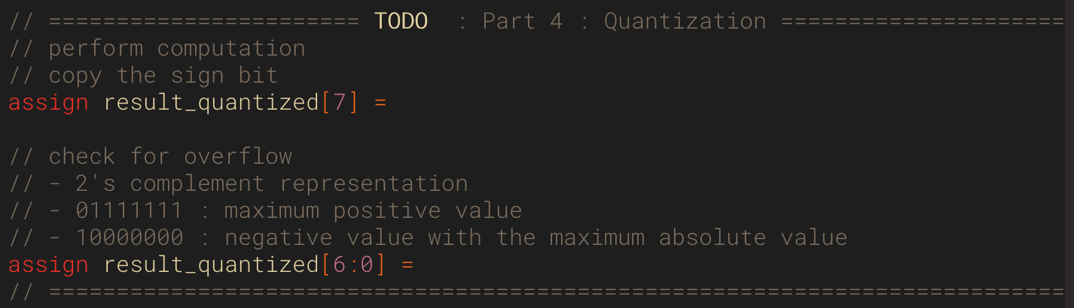
Check for overflow & quantize the output values
TODO : Implement lines 496, 475 so that the output value is quantized properly
Convert “result_accurate” to “result_quantized” by using the provided quantization rules

Slide 56
Final output

Slide 57
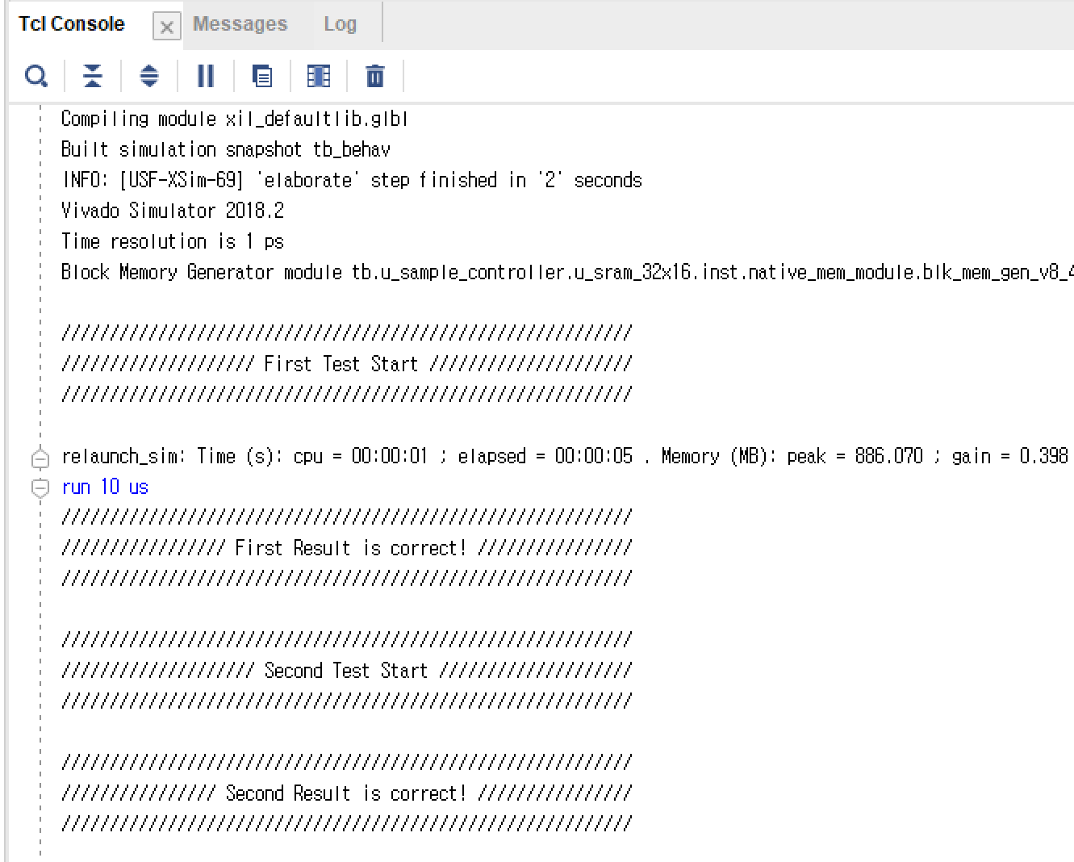
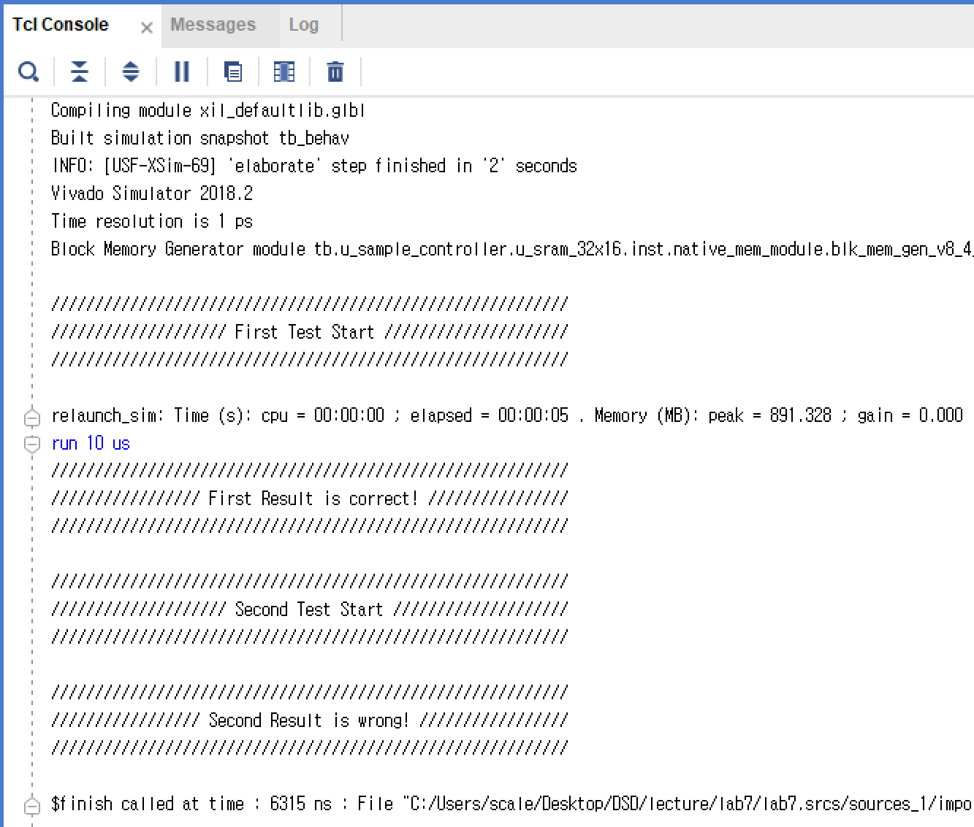
Simulation Outputs
Result
Check out the tcl console result
Incorrect case
(Failed on consecutive test)
→ Please check initialization of values!
Correct case

Slide 58
Wires & Regs

Slide 59
Wires & Regs related to Buffer
Name | Explanation
input_data | A register containing partial input data from BRAM, where the value is fed into the MAC unit
weight | A register containing partial weights from BRAM, where the value is fed into the MAC unit
weight_buff | A register containing partial weights from BRAM, where the value is fed into the weight register
bias | A register containing partial bias data from BRAM, where the value is fed into the MAC unit

Slide 60
Wires & Regs related to BRAM
Name | Explanation
r_valid | A flag indicating that the test bench is sending data to BRAM
b_state | A 3-bit register used for keeping track of the BRAM state
addr | Address to access BRAM
din | Data which will be written to BRAM
dout | Data read from BRAM
bram_en | A flag indicating whether r/w to BRAM is enabled
write_en | A flag indicating the BRAM operation mode (1 : write, 0 : read)
delay | A counter for keeping track of the delay of BRAM reads since it takes 2 cycles
b_write_done | A flag indicating that the data sent from the testbench are all written into the BRAM
input_set_done | A flag indicating that a subset of input values in BRAM are written into the input_data register
weight_set_done | A flag indicating that a subset of weight values in BRAM are written into the write_buffer register
bias_set_done | A flag indicating that a subset of bias values in BRAM are written into the bias register
bram_counter | A counter for keeping track of the number of BRAM reads
bram_oreg_set_done | A flag indicating that the input_data, weight and bias registers are all read from the BRAM and written to registers
weight_counter | A counter for keeping track of how many weight vectors corresponding to an output element were read

Slide 61
Wires & Regs related to FC (fc_controller.v)
Name | Explanation
c_state | A 3 bit register for keeping track of the MAC unit state
mac_en | A flag indicating whether to enable the MAC unit and perform computation
data_a | A register containing a value (a in a * b + c) which will be used by the MAC unit
data_b | A register containing a value (b in a * b + c) which will be used by the MAC unit
data_c | A register containing a value (c in a * b + c) which will be used by the MAC unit
mac_done | A flag indicating that the MAC unit has finished its’ operation
element_counter | A counter keeping track of the number of accumulations that the MAC unit has performed (8 in this expermient)
partial_sum | An intermediate value when calculating the FC layer (It stores the output of the MAC unit and is fed into the MAC unit)
result_accurate | The output of the MAC unit
result_quantized | A register containing the 8-bit quantized value of result_accurate
mac_ireg_set_done | A flag to indicate that the data in the weight_buff has been successfully moved to the weight register, and new values can be loaded into the weight_buff (for parallelization)
out_counter | A counter for keeping track of which output element is currently being calculated
t_valid | A flag indicating that the fc_controller is ready to send the fc computation result back to the testbench

