Slide 1
SNU-Samsung AI (NPEX) Lab 1: Verilog 101 - Register File Design Jaewoong Sim Seoul National University

Slide 2
Goals of Lab 1
The objective of Lab 1 is to design a register file
After this Lab, you need to make sure you
Implemented your register file
Validated your register file with the provided test bench

Slide 3
Outline
Background
RISC processor
Register file
Educational Materials
Verilog 101
Example code: 4:2 encoder
Register file design
Specification
Pseudo code example
Result
Behavior simulation

Slide 4
Background

Slide 5
Background #1 : RISC processor
RISC (Reduced Instruction Set Computer)
Computer design that reduces the number of CPU instructions in order to simplify the internal structure
Execution of the instruction can be classified into 2 stages
Fetch stage: Reads the instruction from instruction memory
Execute stage: Executes the right work based on the read instruction in the fetch stage

Slide 6
Background #1 : RISC processor
Fetch Stage : Reads the instruction from instruction memory
PC (Program counter)
Register that holds the address of the next instruction (which is stored in instruction memory)
Instruction Memory
A part of memory that stores the instruction to be executed
Instruction Register
Register that stores the instruction which is fetched from instruction memory
1) Fetch instruction from instruction memory
2) Store fetched instruction in the instruction register

Slide 7
Background #1 : RISC processor
Execute stage: Executes the instruction fetched in fetch stage
Register file
A group of registers that temporarily hold the data required by the instruction
Decoder
A combinational logic that determines the action to be executed by decoding opcode
Data Memory
A part of memory that stores the data
ALU/Shifter
A combinational logic that executes ALU / shifter operations depending on the decoder’s result
Store the data required by instruction in the register file
3) Execute the operation depending on the
decoder’s result
2) Decode the opcode of the instruction

Slide 8
Background #2 : Register file
Register file temporarily stores data required by the instruction
It stores operands, memory addresses, etc.
It also passes data to the functional unit
Register file reads / writes data to the input address
Register file consists of multiple registers
Each register has unique ID
n
r15
Data 15
…
…
r2
Data 2
r1
Data 1
r0
Data 0
n
Example of register file with 16 registers

Slide 9
Background #2 : Register file
Input / Output of register file
Input
Addr_A , Addr_B : Input address
WR : Signal to notify register file that data write is in progress. Generated by the decoder
CLK : Clock Signal
RSTn : Negative Reset Signal
Data_in : Input data
Output
Src : Data stored in Addr_A
Dest: Data stored in Addr_B
n

Slide 10
Register file operation example
Behavior of register file with actual assembly instruction
Read Operation
Read r3 / r4 from register file, then pass to ALU
Write Operation
Write the result (r3+r4) to r4
Specification
8 registers (each register is 16bit)
Rising CLK edge triggered
ADD r4, r3, r4
r4 = r3 + r4
Data_in
r7
r6
Addr_A
r5
Src
r4
r3
r2
Dest
Addr_B
r1
r0
CLK
WR
RSTn

Slide 11
Register file operation example
Read Operation
Data in Addr_A register → Src
Data in Addr_B register → Dest
Combinational logic (not affected by CLK)
Data_in
r7
r6
r5
Src
a + b
0011
Addr_A
r4
b
r3
a
ALU
r2
Dest
0100
Addr_B
r1
r0
CLK
WR
RSTn

Slide 12
Register file operation example
Write Operation
Destination : Addr_B register
Data: Data_in (from ALU adder in this example)
Condition : Rising edge(posedge) CLK, Positive WR
Sequential logic (affected by CLK)
Data_in
r7
r6
r5
Src
a + b
Addr_A
r4
a + b
r3
a
ALU
r2
Dest
0100
Addr_B
r1
r0
CLK
WR
RSTn

Slide 13
Educational Materials

Slide 14
Verilog 101
Number representation
Format should be : <size>’<base format><number>
Size : The size of the data with bit granularity
Base format: radix
Number : The value of the data
Assign statement
You can assign the value to the data with assign statement
Vector & Array
assign a = 4’b0100; // 4bit binary, value: unsigned 4
assign a = 3’d100 // 3bit decimal, value: unsigned 100
assign a = 8’h0a // 8bit hexadecimal, value: unsigned 11
reg register_1; // 1bit reg
reg [7:0] register_2; // 8bit reg
reg [7:0] reg_array_1[15:0]; // 8bit x 16 array
reg_array_1[2] = register_2;

Slide 15
Verilog 101
Always block
Starts running from simulation time 0
Executes whenever signal changes (indicated in sensitivity list) during simulation
Conditional / Loop statement
You can use conditional / loop statement (e.g., for, if, case) inside the “always block”
always @(A, B) // executes when A or B changes
begin
…
end
always @(*) // execute when any signal changes
begin
…
end
always @(A, B)
begin
if(condition) begin
…
end
end
always @(A, B)
begin
for(condition) begin
…
end
end

Slide 16
Verilog 101
Combinational logic design
Continuous assignment : executes when right-value changes, regardless of the order in code
‘=‘ operator
It indicates continuous assignment outside of the always block
It indicates that code is executed sequentially within the always block
Sequential logic design
‘<=‘ operator
It indicates that code is executed concurrently within the always block
// continuous assignment
wire a;
assign a = 2’b00;
always@*
begin
b = 2’b00;
c = 2’b01; // Assignment to b and c is executed sequentially
end
always@(posedge CLK)
begin
b <= 2’b00;
c <= 2’b01; // Assignment to b and c is executed concurrently
end

Slide 17
Verilog 101 : 4:2 Encoder
We will be synthesizing a simple 4:2 encoder
Y3
4:2 Encoder
A1
Y2
Y1
A0
Y0
Input (Y3, Y2, Y1, Y0) | Output (A1, A0)
(1, 0, 0, 0) | 3 (1, 1)
(0, 1, 0, 0) | 2 (1, 0)
(0, 0, 1, 0) | 1 (0, 1)
(0, 0, 0, 1) | 0 (0,0)
Everything else | 0

Slide 18
Verilog 101 : 4:2 Encoder
This is the Verilog code for the 4:2 encoder
/**
* encoder4to2.v: encoder4to2 module
*
* 4 to 2 encoder: (Y3, Y2, Y1, Y0) => (A1, A0)
*
* (1, 0, 0, 0) => 3
* (0, 1, 0, 0) => 2
* (0, 0, 1, 0) => 1
* (0, 0, 0, 1) => 0
* everything else => 0
*/
// note that the default port type is 'wire'
module encoder4to2(
input Y0,
input Y1,
input Y2,
input Y3,
output reg [1:0] A
);
// use @* for combinational logic always blocks
always @*
begin
if (Y0 == 1 && Y1 == 0 && Y2 == 0 && Y3 == 0) begin
A = 2'b00;
end
else if (Y0 == 0 && Y1 == 1 && Y2 == 0 && Y3 == 0) begin
A = 2'b01;
end
else if (Y0 == 0 && Y1 == 0 && Y2 == 1 && Y3 == 0) begin
A = 2'b10;
end
else if (Y0 == 0 && Y1 == 0 && Y2 == 0 && Y3 == 1) begin
A = 2'b11;
end
else A = 2'b00;
end
endmodule

Slide 19
Lab 1: Design your register file

Slide 20
Specification of register file
You need to design a register file with 8 registers
Each register should be 16 bit
Below operations should be supported
Read: Reads Addr_A / Addr_B register then outputs to Src/Dest
Write : Writes Data_in to Addr_B register
Reset : Resets all registers to 0x00 when RSTn is negative
Input / Output specification
CLK, RSTn, WR (1 bit)
Addr_A, Addr_B (4bit)
However, you may use lower 3-bit since there are only 8 registers
Data_in (16 bit)
Src, Dest (16bit)
Data_in
r7
r6
Addr_A
r5
Src
r4
r3
r2
Dest
Addr_B
r1
r0
CLK
WR
RSTn

Slide 21
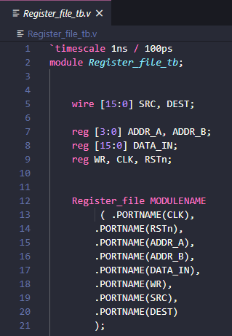
Pseudo-code example
What you need to modify
Type of module
Name of module instance
Name of ports

Slide 22
Pseudo-code example
Register file operation pseudo-code
Reset/Write operation → Sequential Logic
if (RSTn.negedge or CLK.posedge)
{
if (!RSTn)
reset all regs
else if (WR)
reg[ADDR_B] = DATA_IN
}
SRC = reg[ADDR_A]
DEST = reg[ADDR_B]
Read operation → Combinational Logic

Slide 23
Result

Slide 24
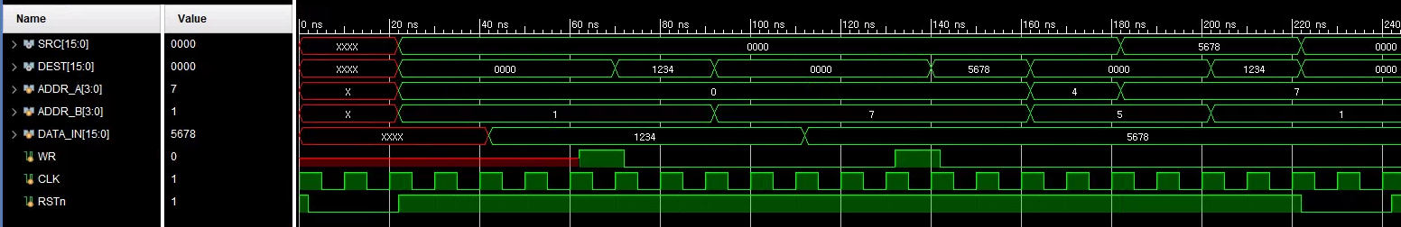
Result
You can test your register file with provided testbench (register_file_tb.v)
In the server, you can use iverilog for verilog simulation
iverilog is already usable in the server, so just write command: make; ./register_file;
If you download Vivado at local, you can also check the waveform from behavior simulation
Sample waveform

Slide 25
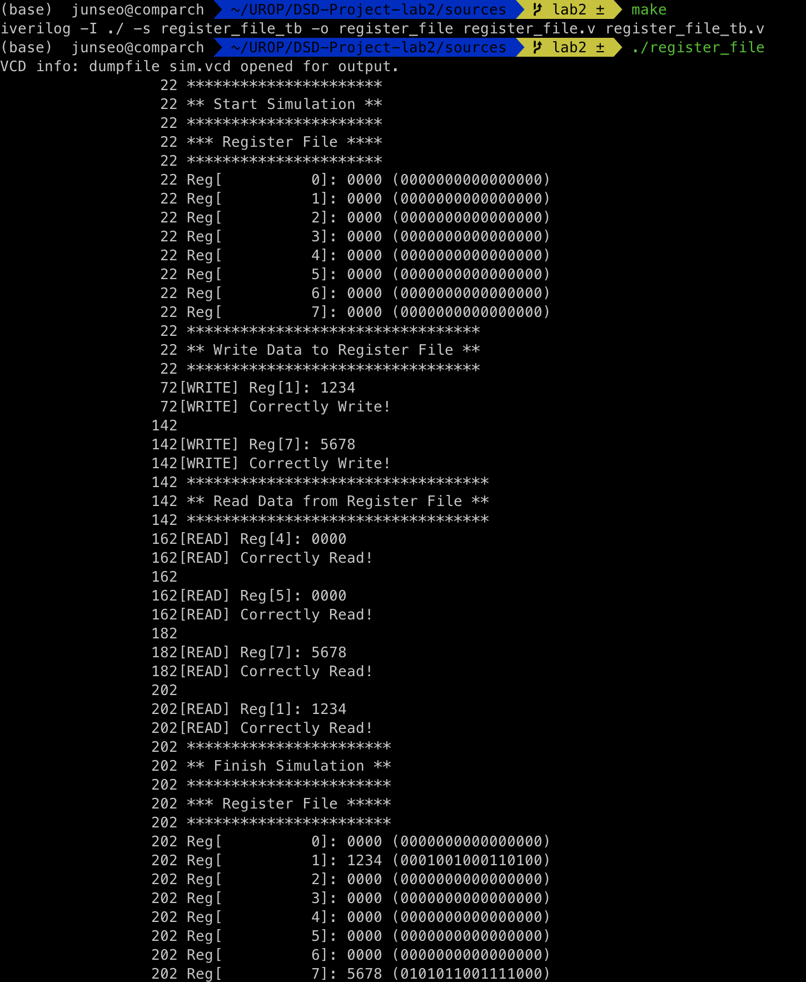
Result
Verilog Simulation in Terminal

