Slide 1
01100101

Slide 2
what is it?
Evented I/O for V8 JavaScript.

Slide 3
ok…
node.js is V8, libev, and libeio mixed together.
Notes:
V8

Slide 4
V8 JavaScript Engine
chrome’s famously fast JavaScript engine
implementation of ECMAScript ECMA-262 5th edition
allows manipulation of JavaScript objects in C++

Slide 5
through the looking glass
chrome’s famously fast JavaScript engine
implementation of ECMAScript ECMA-262 5th edition
allows manipulation of JavaScript objects in C++
JavaScript var result = ‘Hello World’;
V8 Local<String> result = String::New("Hello World");

Slide 6
V8 is the JavaScript engine
libev is the event loop
libeio provides the async I/O
Notes:
libuv will provide abstraction over libev, libeio, iocp in 0.6.0 for windows compat. IOCP

Slide 7
what is an event loop?
browsers have them
event queue
handle it
Notes:
Node is good for I/O intensive tasks. Less good for CPU bound tasks.
Pi example
Walk through a typical request
Compare to Apache multi-threadedness

Slide 8
nutshelling it out
node.js gives you an executable JavaScript engine with api calls for host level I/O

Slide 9
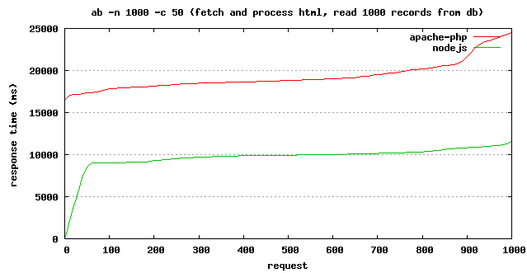
why?
blog.raducojocaru.com/2010/07/02/nodejs-vs-php-apache
It is fast

Slide 10

It is fun!
hyperboleandahalf.blogspot.com

Slide 11
node is not (only) a server
choose our own adventure
ls clone
directory watcher

Slide 12
resources
node.js - nodejs.org/
npm - npmjs.org/
community - github.com/joyent/node/wiki/Community
crockford on JavaScript: javascript.crockford.com
twitter: @jdslatts, @beausorensen
github: @jslatts, @sorensen
irc: #node.js

Slide 13
hardcore resources
Google’s V8 JavaScript Engine - code.google.com/p/v8/
libev - software.schmorp.de/pkg/libev.html
libeio - software.schmorp.de/pkg/libeio.html

