Slide 1

Minishift Virtual OpenShift ® Container Platform Environment
Minishift is a tool that allows you to run OpenShift locally in a single-node OpenShift cluster inside a VM.
It provides an environment for learning about and using the Red Hat® OpenShift Container Platform.
Presented by Jeff Laurenza jeffrey.laurenza@verizon.com
January 31, 2019

Slide 2
Objectives
The objective of this presentation is NOT to make you an expert with OpenShift, Minishift, Docker or Kubernetes.
This is a high level introduction of a container orchestration technology.
It is only meant to introduce some basic concepts relating to several complex tools which are used extensively in Cloud based environments.
It provides an introduction to a virtual environment that can be used for some hands-on learning with these tools.
You should expect to leave with:
A basic foundation of knowledge that you can build upon.
Enough knowledge to be dangerous.
More questions than answers.
Resources for where you can get answers.
A Hunger for more

Slide 3
Minishift
Overview and Installation

Slide 4
Preparing to Install Minishift
Prerequisites
Minishift requires a hypervisor to start the virtual machine on which the OpenShift cluster is provisioned.
Verify that the hypervisor of your choice is installed and enabled on your system before you set up Minishift.
Once the hypervisor is up and running, additional setup may be required for Minishift to work with that hypervisor.
Depending on your host operating system, you have the choice of the following recommended native hypervisors:
macOS - xhyve
Linux - KVM
Windows - Hyper-V
All Platforms - VirtualBox

Slide 5
Minishift Overview
The following section describes how to install Minishift and the required dependencies. These are the basic steps for setting up Minishift on your personal system:
Set up your virtualization environment
Download Minishift software for your operating system.
Install Minishift
Start Minishift
Configure Minishift so you can use it efficiently
The setup procedure should be run as a regular user with permission to launch virtual machines. In the procedure, you will see how to assign that permission, along with ways to configure your hypervisor and command shell to start and effectively interact with Minishift.

Slide 6
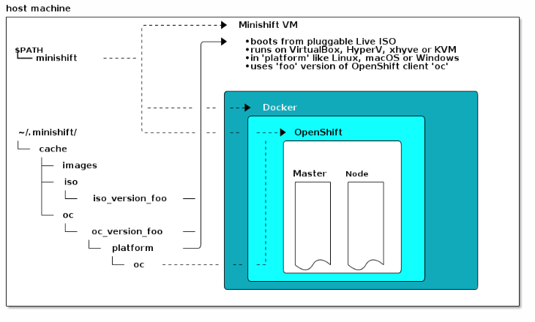
Minishift Architecture

Slide 7
Minishift Documentation
The Minishift documentation can be found here at the OKD website which is run by Red Hat:
https://docs.okd.io/latest/minishift/index.html
Follow the instructions for your OS and Virtual environment.
Windows with VirtualBox seems to work best. (Your mileage my vary)

Slide 8
Core Concepts
Containers, Images and pods
Overview

Slide 9
Container Basics
The basic units of OKD applications are called containers.
Linux container technologies are lightweight mechanisms for isolating running processes so that they are limited to interacting with only their designated resources.
Many application instances can be running in containers on a single host without visibility into each others' processes, files, network, and so on.
Typically, each container provides a single service (often called a "micro-service"), such as a web server or a database, though containers can be used for arbitrary workloads.
The Docker project has developed a convenient management interface for Linux containers on a host.
OKD and Kubernetes add the ability to orchestrate Docker-formatted containers across multi-host installations.
Though you do not directly interact with the Docker CLI or service when using OKD, understanding their capabilities and terminology is important for understanding their role in OKD and how your applications function inside of containers.

Slide 10
Images
Containers in OKD are based on Docker-formatted container images.
An image is a binary that includes all of the requirements for running a single container, as well as metadata describing its needs and capabilities.
Think of it as a “packaging” technology.
Containers only have access to resources defined in the image unless you give the container additional access when creating it.
By deploying the same image in multiple containers across multiple hosts and load balancing between them, OKD can provide redundancy and horizontal scaling for a service packaged into an image.
You can use the Docker CLI directly to build images, but OKD also supplies builder images that assist with creating new images by adding your code or configuration to existing images.
Because applications develop over time, a single image name can actually refer to many different versions of the "same" image.

Slide 11
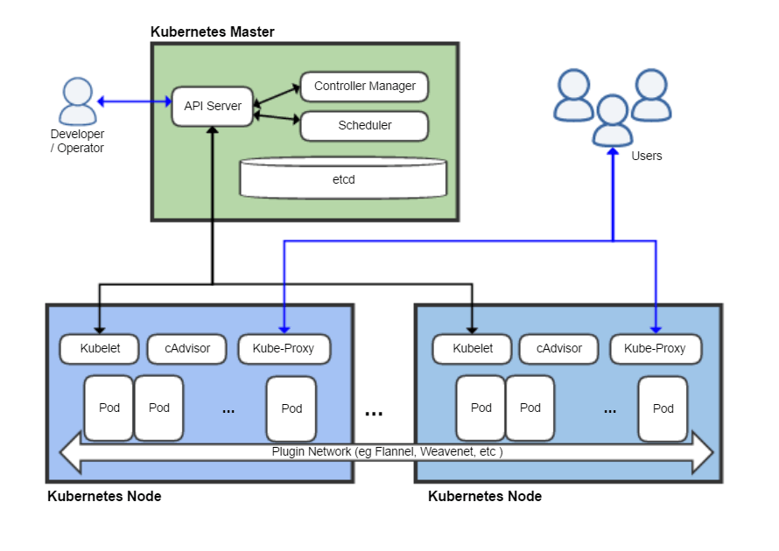
Kubernetes Architecture
By Khtan66 - Own work, CC BY-SA 4.0, https://commons.wikimedia.org/w/index.php?curid=53571935

Slide 12
Container Image Registries or Repositories
A container image registry is a service for storing and retrieving Docker-formatted container images.
A registry contains a collection of one or more image repositories.
Each image repository contains one or more tagged images.
Docker provides its own registry, the Docker Hub.
You can also use private or third-party registries.
Red Hat provides a registry at registry.redhat.io for subscribers.
OKD can also supply its own internal registry for managing custom container images.

Slide 13
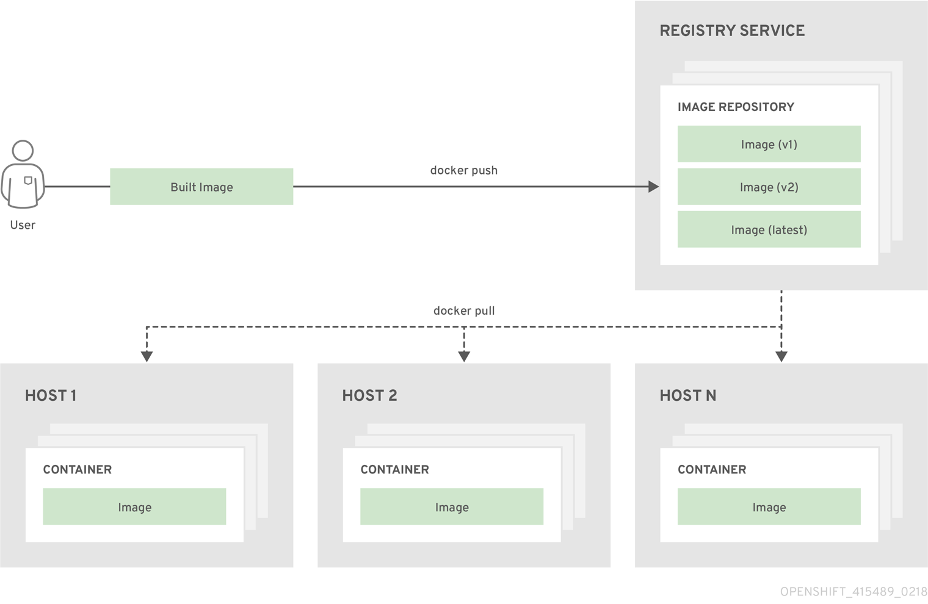
Containers and Image Registries

Slide 14
PODS
OKD leverages the Kubernetes concept of a pod, which is one or more containers deployed together on one host.
A Pod is the smallest compute unit that can be defined, deployed, and managed.
Pods are the rough equivalent of a machine instance (physical or virtual) to a container.
Each pod is allocated its own internal IP address, therefore owning its entire port space.
Containers within pods can share their local storage and networking.
Pods have a lifecycle.
Pods are defined, then they are assigned to run on a node.
They run until their container(s) exit or they are removed for some other reason.
Pods, depending on policy and exit code, may be removed after exiting, or may be retained in order to enable access to the logs of their containers.
OKD treats pods as largely immutable; changes cannot be made to a pod definition while it is running.
OKD implements changes by terminating an existing pod and recreating it with modified configuration, base image(s), or both. Pods are also treated as expendable, and do not maintain state when recreated.

Slide 15
OpenShift
Overview

Slide 16
OpenShift OKD? OpenShift Features
OpenShift v3 brings many architectural changes and introduces new concepts and components as well as some different terminology.
It is built around the applications running in Docker containers.
Provides enhancements to scheduling and container management support provided by the Kubernetes project, adding augmented deployment, orchestration, and routing functionality on top.
The most significant changes surround the container model and how they are monitored and interconnected
Kubernetes pods are a group of containers that act like a single VM: they have a single IP address, they can share a file system, and they typically have similar security settings.
Grouping containers together vastly increases the number of applications that can be brought to OpenShift.
Rather than focusing on a microservice model, pods enable developers to port existing applications that need to share local resources while still benefiting from a container-based model.

Slide 17
OpenShift Features (Cont’d)
Another important change is in the core system design:
OpenShift and Kubernetes are built as sets of microservices working together through common REST APIs to change the system.
Those same APIs are available to system integrators, and those same core components can be disabled to allow alternative implementations.
OpenShift exposes fine-grained access control on the REST APIs to enable this integration, which means there are no actions in the system that cannot also be done by an integrator.

Slide 18
OpenShift Features(Cont’d)
OpenShift uses the concept of “Projects” as opposed to referring to everything as an “Application”.
The keyword “Application” can mean something different to everyone, by using “Projects” the following can be gained:
You can have as many components as you desire, contained by a project.
Projects are flexibly linked together, and optionally labeled to provide any groupings or structure.
For more information on OpenShift terminology, refer to the following link:
https://docs.okd.io/latest/whats_new/terminology.html

Slide 19
OpenShift Architecture Layers Overview
What are the Layers?
The Docker service provides the abstraction for packaging and creating Linux-based, lightweight container images.
Kubernetes provides the cluster management and orchestrates containers on multiple hosts.
OKD adds:
Source code management, builds, and deployments for developers
Managing and promoting images at scale as they flow through your system
Application management at scale
Team and user tracking for organizing a large developer organization
Networking infrastructure that supports the cluster

Slide 20
OpenShift Architecture Layers Overview (Cont’d)
OKD has a microservices-based architecture of smaller, decoupled units that work together.
It runs on top of a Kubernetes cluster, with data about the objects stored in etcd.
“etcd” is a Kubernetes component. It’s a reliable clustered key-value store.
The Microservices are broken down by function:
REST APIs, which expose each of the core objects.
Controllers, which read those APIs, apply changes to other objects, and report status or write back to the object.
Users make calls to the REST API to change the state of the system.
Controllers use the REST API to read the user’s desired state, and then try to bring the other parts of the system into sync.
For example, when a user requests a build they create a "build" object. The build controller sees that a new build has been created, and runs a process on the cluster to perform that build. When the build completes, the controller updates the build object via the REST API and the user sees that their build is complete.

Slide 21
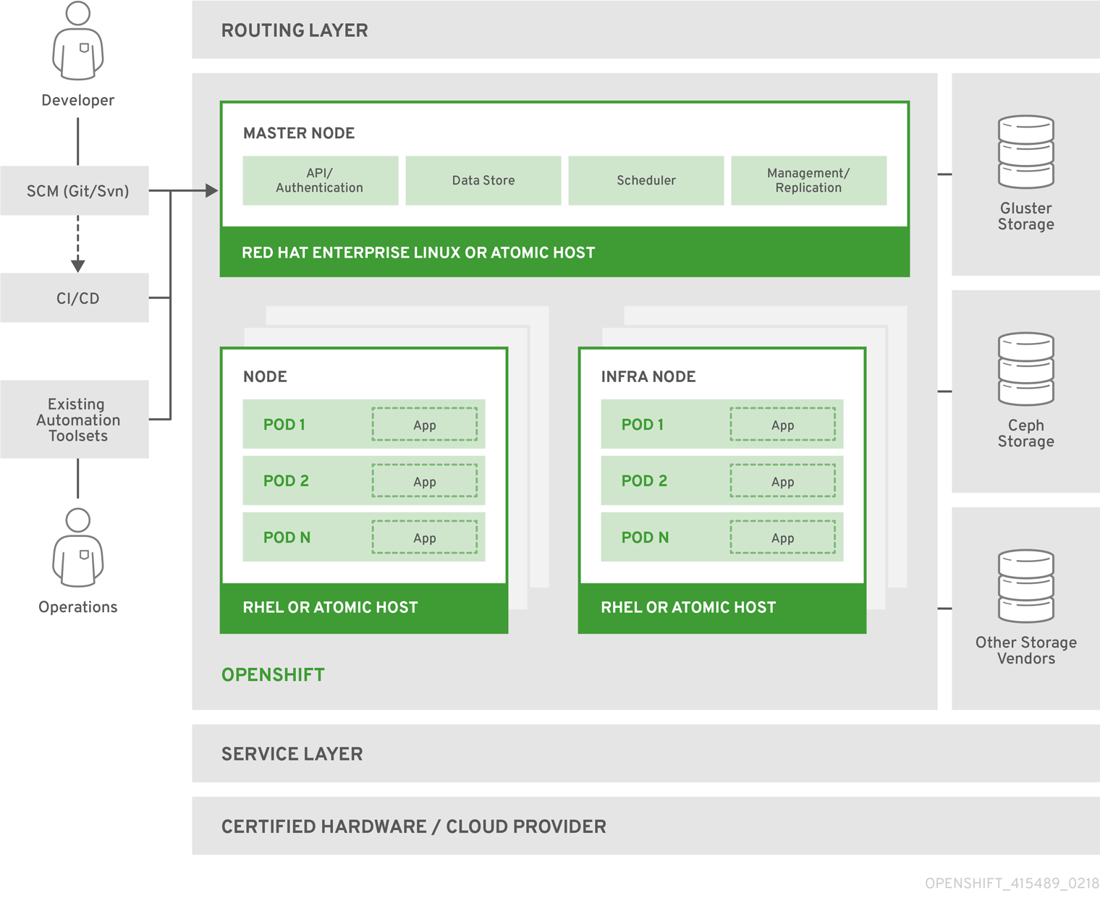
OpenShift Architectural Model Diagram

Slide 22
Minishift and OpenShift In Action
Live Demo

Slide 23
Comments, Questions?

