Slide 1
1. 목적 : Raman Spectrum으로 부터 Nano plastic 성분 정량화
Spectrum Data
Measurement → Raw data
Data Separation
Raw data → Data Separation
Data Classification
Peak “o” or “x”
1D-CNN Training (deep leaning)
Deep leaning (param. Layer, Neuron, Epoch, Validation split…)
Prediction (with model)
Train Loss & Accuracy, Test Loss & Accuracy
Comparison with AI and Worker
Compare the two resulting values, and use the corrected
Interpolation and integration
Quantify based on classified results

Slide 2
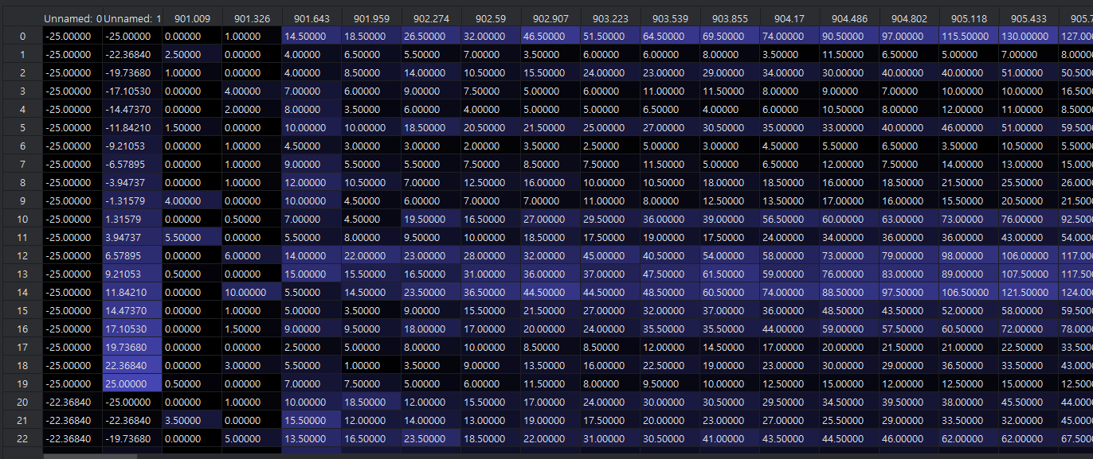
2. Spectrum Data
Raw data file의 data frame.
Header // 1열 : X, 2열 : Y, 3열 : Wavelength,
1열 : x axis. , 2열 y axis (Mapping), 3열 이후 Intensity

Slide 3
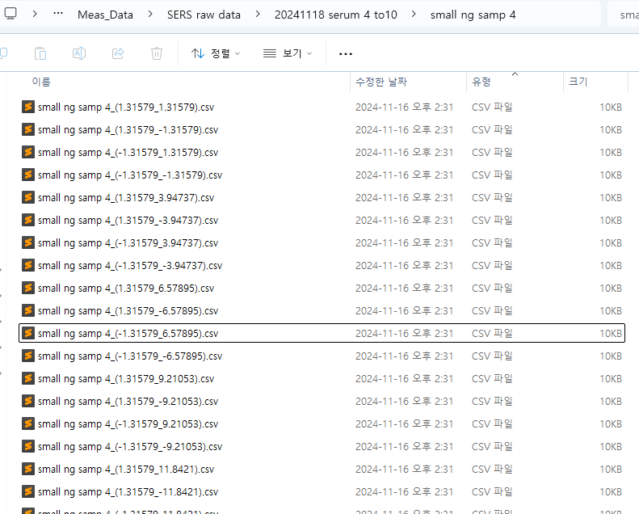
3. Data Separation
Raw data file의 data frame.
Header // 1열 : X, 2열 : Y, 3열 : Wavelength,
1열 : x axis. , 2열 y axis (Mapping), 3열 이후 Intensity

Slide 4
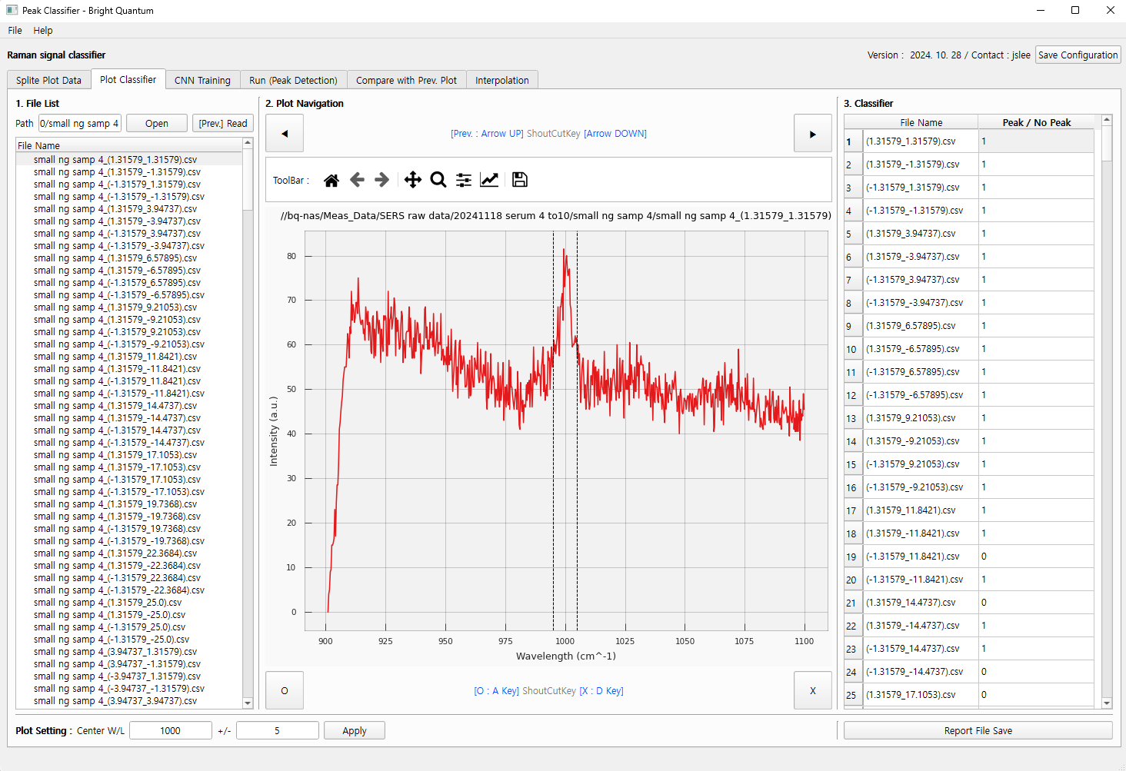
4. Data Classification
분류 과정에 대한 프로그램 작성

Slide 5
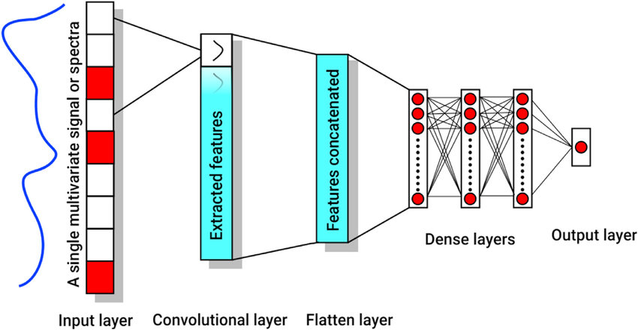
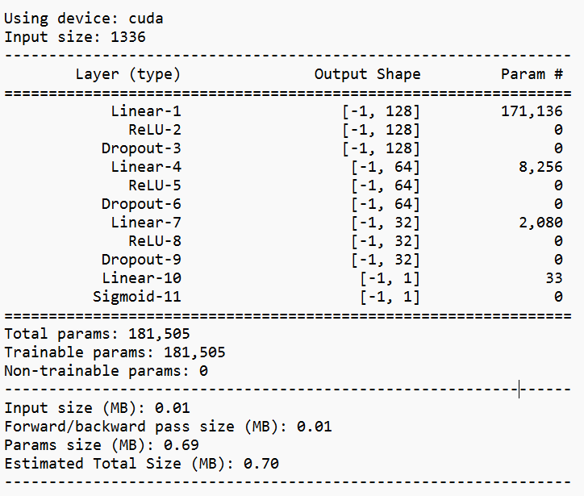
Input size : 1336
Layer1
2
3
4
5. 1D-CNN Training (deep leaning)
1336 → 128 → 64 → 32 → 1
Data ex) [0, 0.1, -0.1 …. ]
[0, 1]
Model Summary
Using device : cuda → GPU 사용
레이어 구성
Input size : 1336
레이어별 분석
Linear-1 : Fully connected layer
1336 에서 128로 변환
Param. 1336 x 128 +128 = 171136
ReLu-2 : 출력값에 비선형성 추가
Dropout : overfitting 방지
…
Sigmoiud-11 : Normalize 함수 (이진 분류 목적 설계)
Model 최적화 중…

Slide 6
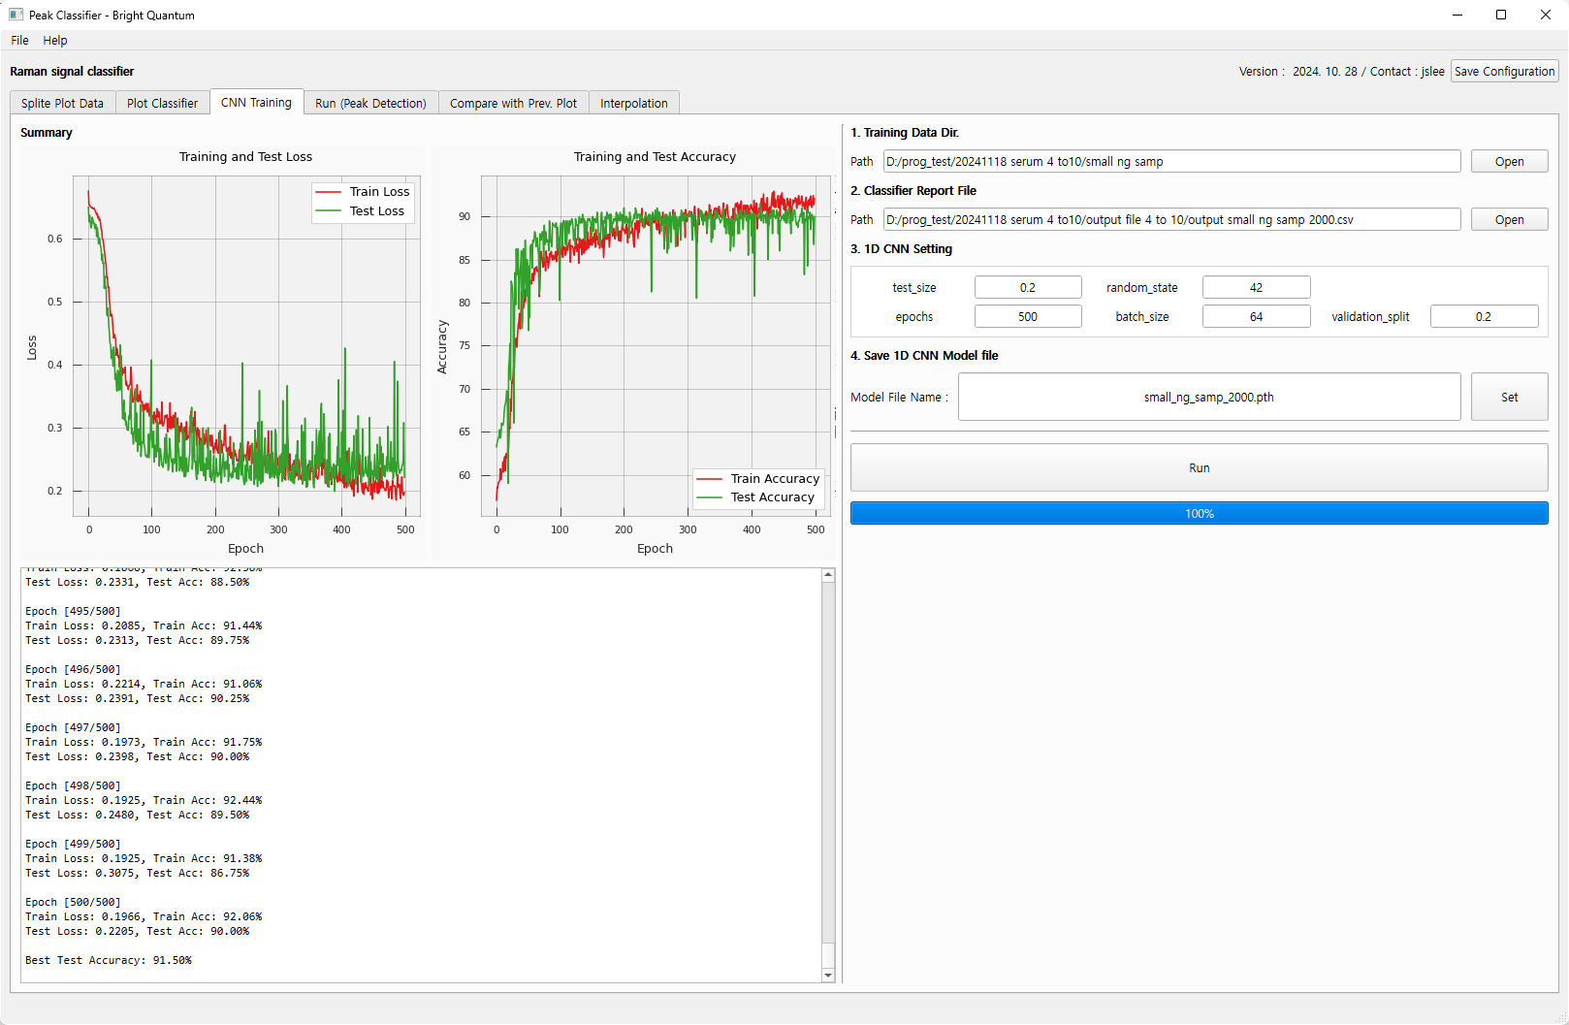
5. 1D-CNN Training (deep leaning)
Training GUI
Param. 설정에 따라 다르지만, 사용하는 컴퓨터에서 대략 30분 정도 소요됨.
Pytorch 사용

Slide 7
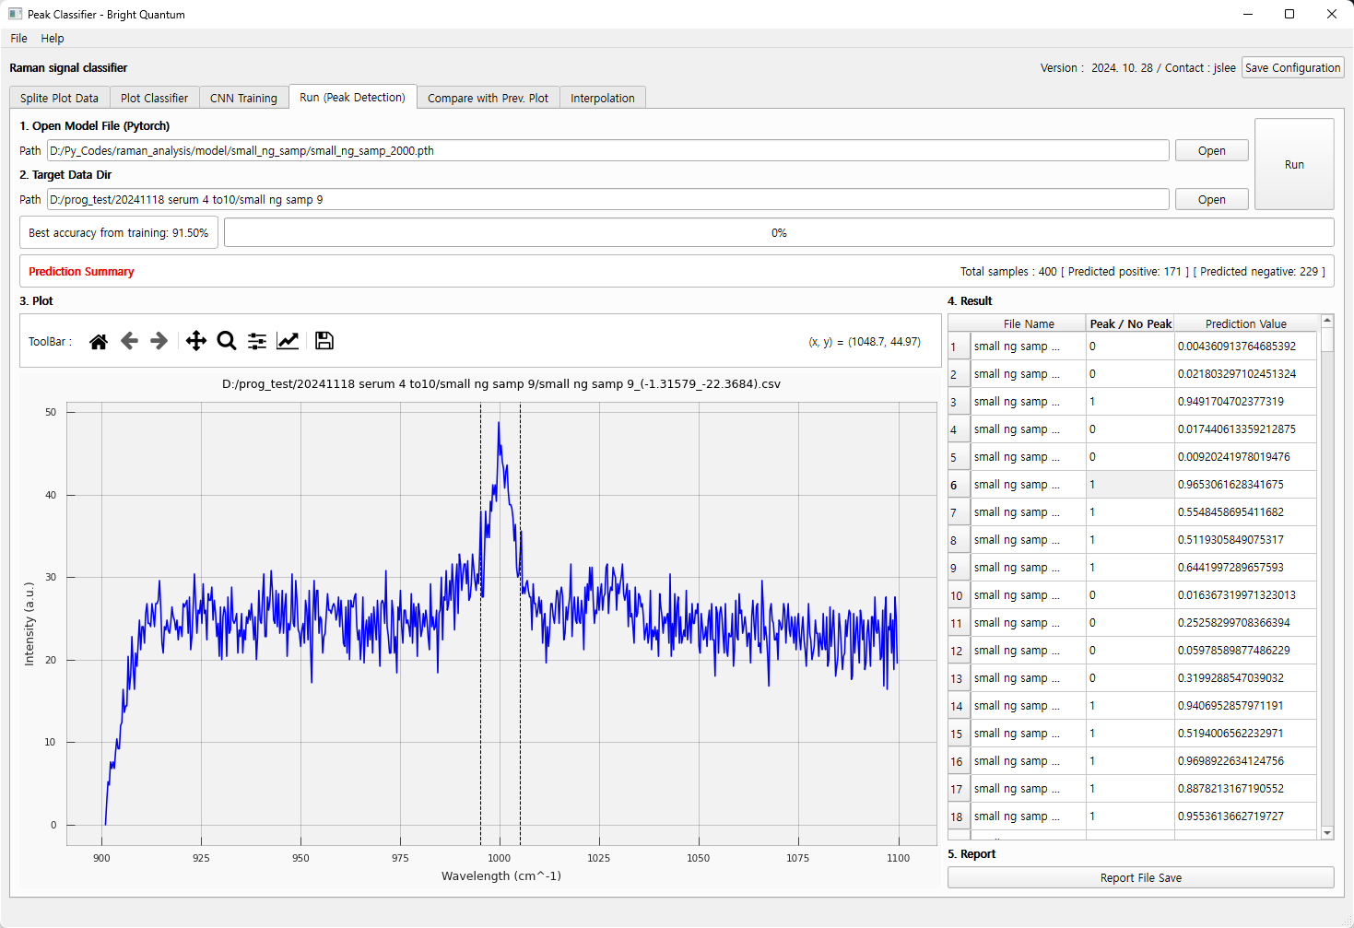
6. Prediction (with model)
Training 된 모델을 결과로 Peak 유무 예측
Best accuracy, Total count, positive negative count …

Slide 8
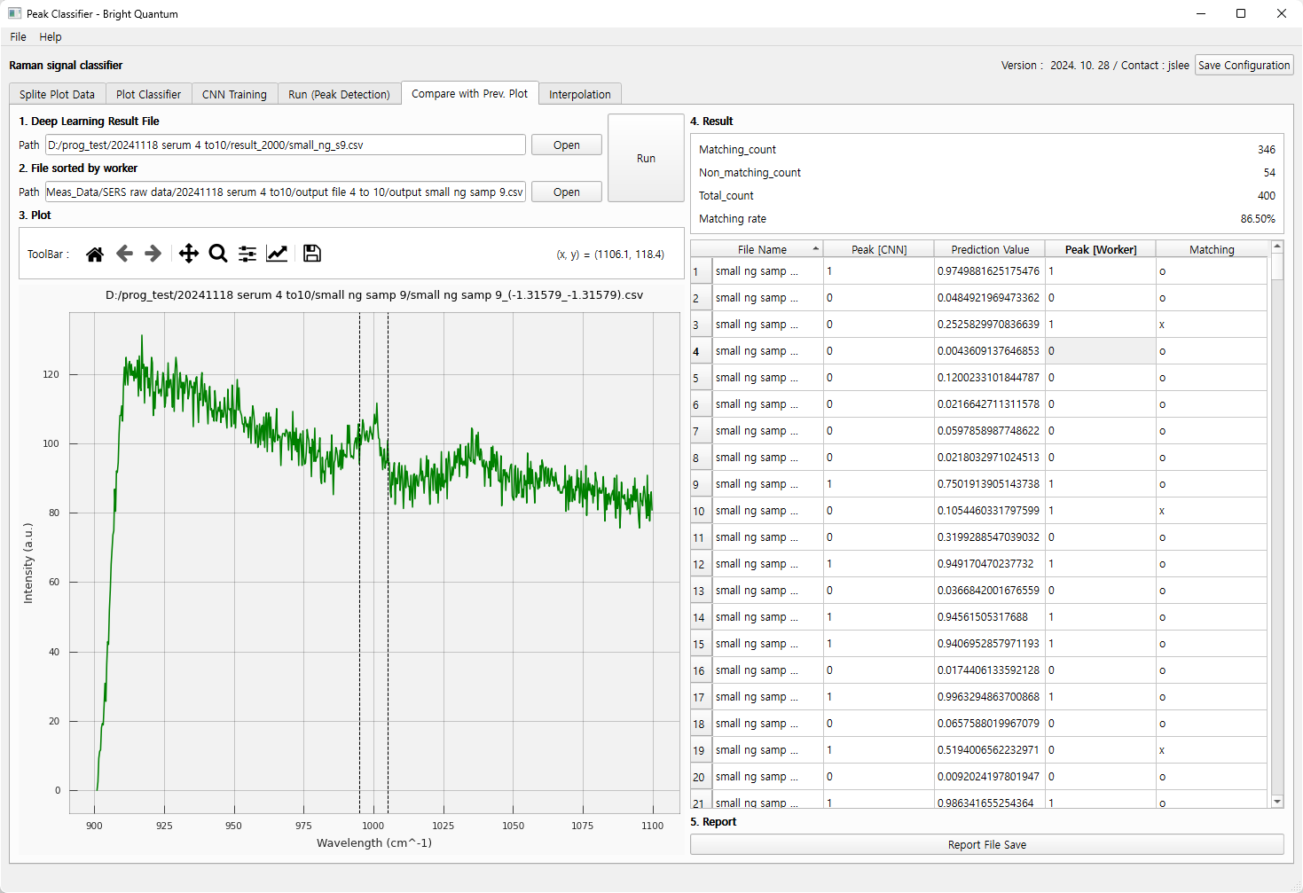
7. Comparison with AI and Worker
사람이 분류한 작업 결과
1D CNN 예측 결과
두 결과 값 비교하여 Report 작성

Slide 9
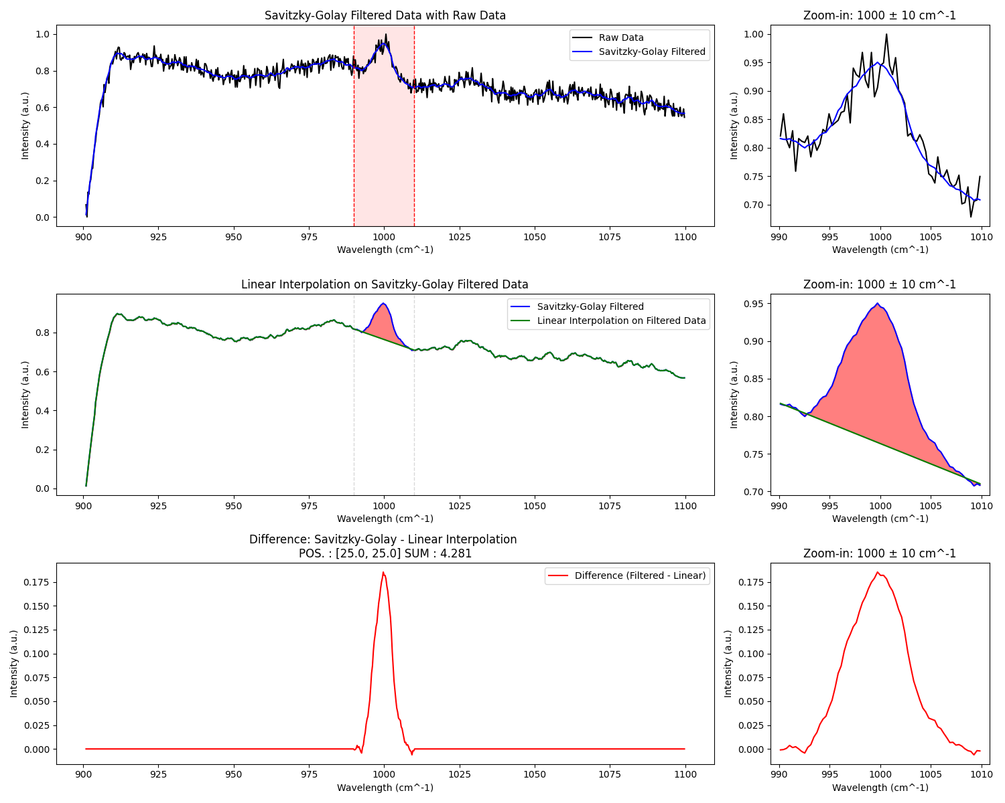
8. Interpolation and integration
plt.title('Linear Interpolation') plt.title('Polynomial Interpolation') plt.title('Gaussian Fitting') plt.title('Savitzky-Golay Filter') plt.title('Fourier Transform') plt.title('Moving Average')
아직 프로그램 상 구현은 안됨.
여러 옵션을 적용해 볼 예정
Param. : Length, polynomial order

Slide 10
Raman spectrum Model update & Interpolation
2025. 02. 03
Lee Jeong-su

Slide 11
1. Model update
M4
 | small ng samp 4 | small ng samp 5 | small ng samp 6 | small ng samp 7 | small ng samp 8 | small ng samp 9 | small ng samp 10 | Sum
Matching_count | 390 | 379 | 385 | 396 | 379 | 373 | 388 | 2690
Non_matching_conut | 10 | 21 | 15 | 4 | 21 | 27 | 12 | 110
Non_matching_peak_1_count | 10 | 21 | 15 | 3 | 20 | 24 | 12 | 105
Non_matching_peak_0_count | 0 | 0 | 0 | 1 | 1 | 3 | 0 | 5
Total_count | 400 | 400 | 400 | 400 | 400 | 400 | 400 | 2800
Matching rate | 97.50% | 94.75% | 96.25% | 99.00% | 94.75% | 93.25% | 97.00% | 96.07%
M5
 | small ng samp 4 | small ng samp 5 | small ng samp 6 | small ng samp 7 | small ng samp 8 | small ng samp 9 | small ng samp 10 | Sum
Matching_count | 394 | 380 | 393 | 398 | 381 | 381 | 389 | 2716
Non_matching_conut | 6 | 20 | 7 | 2 | 19 | 19 | 11 | 84
Non_matching_peak_1_count | 6 | 20 | 7 | 2 | 19 | 14 | 11 | 79
Non_matching_peak_0_count | 0 | 0 | 0 | 0 | 0 | 5 | 0 | 5
Total_count | 400 | 400 | 400 | 400 | 400 | 400 | 400 | 2800
Matching rate | 98.50% | 95.00% | 98.25% | 99.50% | 95.25% | 95.25% | 97.25% | 97.00%
M0 : CNN 초기 모델
M5 : CNN 최신 모델
Matching rate : 97% (M5)
Samp4
Samp5
Samp6
Samp7
Samp8
Samp9
Samp10
SUM

Slide 12
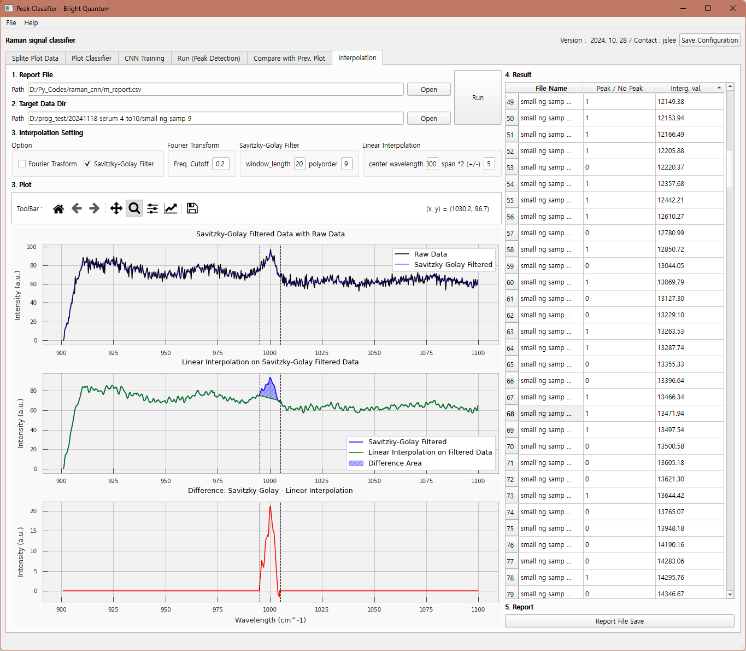
2. Interpolation and integration
Setting
Fourier Transform
Savitzky-Golay
Fourier Transform
Freq. Cutoff
Savitzky-Golay Fliter
Window_length
Polyorder
Linear interpolation
Center wavelength
Span
Interg. Val. → Quantification with Cal.

