Slide 1
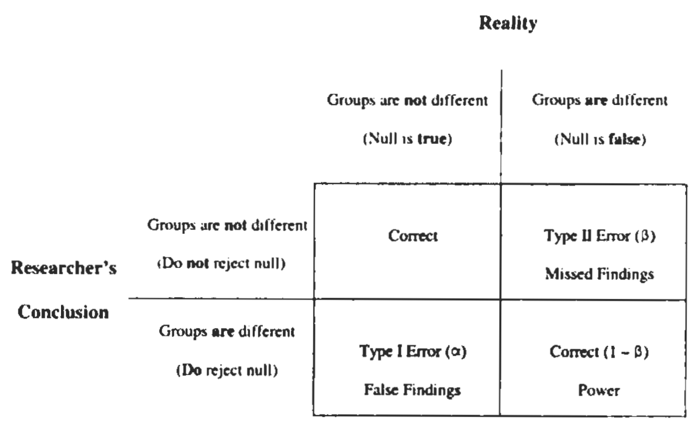
Power Analysis
Jasper Slingsby
Power Analysis
No one ever does them…
…but they could save so much pain and suffering if they did!!!
Power Analysis
Statistical power is the probability of a hypothesis test finding an effect if there is an effect to be found.
Power analysis is a calculation typically used to estimate the smallest sample size needed for an experiment, given a required significance level, statistical power, and effect size.
It is normally conducted before the data collection!
Why do power analysis?
Firstly, it helps you plan your analyses before you’ve done your data collection, which is always useful.
Secondly, not knowing the statistical power of your analysis can result in
missed findings (through Type II Error), or
false findings (through Type I Error).
Why do power analysis?
Type II Error:
occurs when the researcher erroneously concludes that there is not a difference between treatments, when in reality there is…
this is a common outcome of low statistical power
Why do power analysis?
Type I Error:
occurs when the researcher erroneously concludes that there is a difference between treatments, when in reality there is not…
less likely when there is poor statistical power, but can happen with low sample sizes of highly variable subjects, or if there is bias in sampling…
Why do power analysis?
Type I and Type II Errors and how they result in false or missing findings, respectively. Image from Norton and Strube 2001, JOSPT.

Slide 2
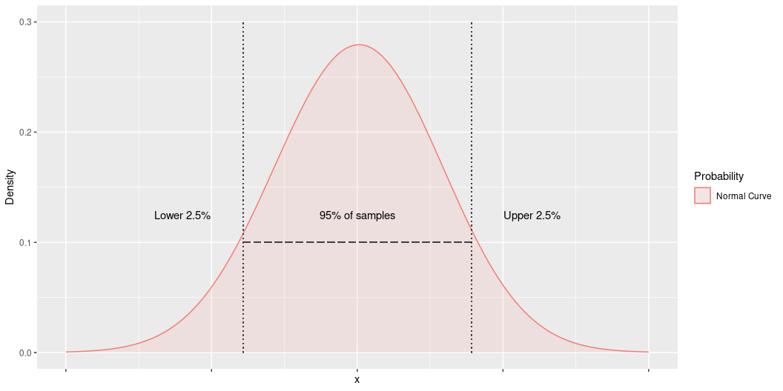
Statistical Power
Is determined by the combination of the:
$α$ (“significance”) level required (e.g. P < 0.05)
difference between group means (effect size)
variability among subjects
sample size (the factor we usually have most control over)
$α$ (“significance”) level

Slide 3
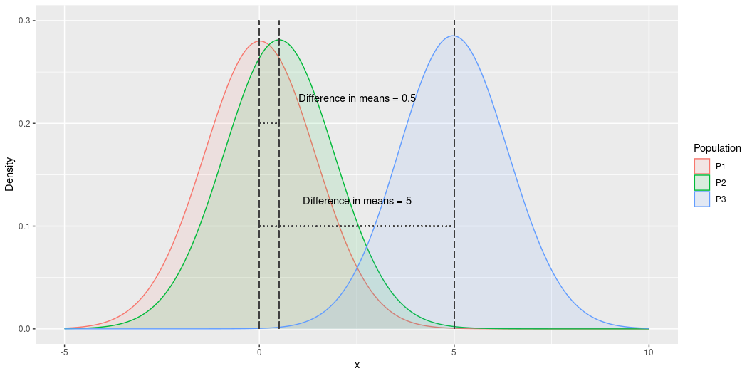
We usually use an $α$ of 0.05 to indicate significant difference.
i.e. the probability of the observation not being different to the null is less than 5% (i.e. p < 0.05), or the result should only be observed once or less for every 20 samples.
This is a subjective cut-off, but is generally accepted in the literature…
Difference between group means

Slide 4
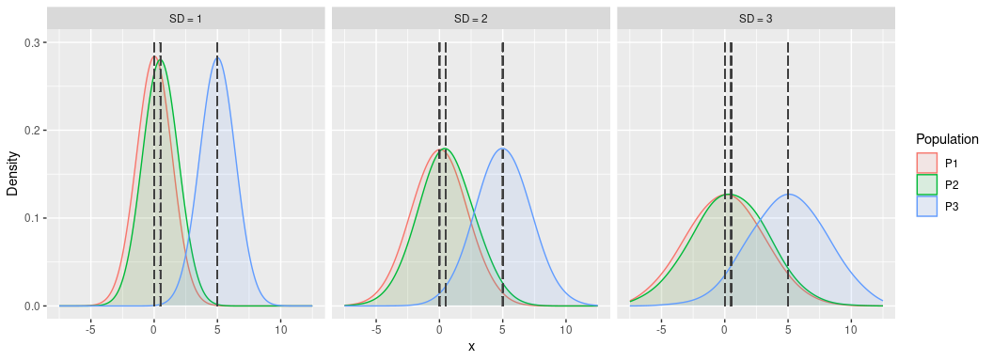
You have greater statistical power when you have greater differences in means (effect size). P1 vs P3 has greater power than either P1 vs P2 or P2 vs P3.
Variability among subjects

Slide 5
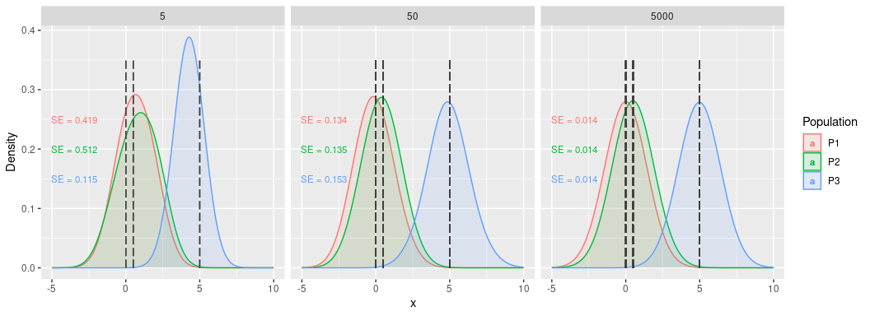
Greater variability among subjects results in larger standard deviations, reducing our ability to distinguish among groups (i.e. statistical power).
Sample size

Slide 6
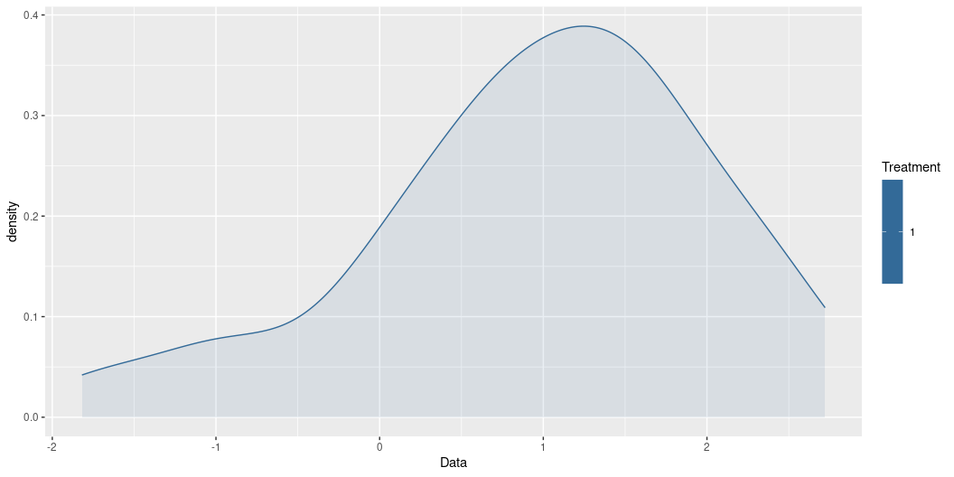
Increasing sample size increases statistical power by improving the estimate of the mean and constricting the distribution of the test statistic (i.e. reducing the standard error (SE)).
How do we do power analysis?
Simulate the data you would expect to collect, varying the:
$α$ (“significance”) level (e.g. P < 0.05)
difference between group means (effect size)
variability among subjects
sample size (the factor we usually have most control over)
…and test for significant difference using the appropriate statistical test.
Simulating data
First, we need to simulate some data.
If we believe our data are normally distributed, we can use the handy rnorm() function, like so:
dat <- rnorm(n = 50, # set the sample size mean = 1, # set the mean to = 1 sd = 1) # set the standard deviation to = 1
Type ?Distributions into your R console for alternative distributions.
Simulating data
Now let’s look at our new data
This is easier if we make it a data frame
df <- data.frame(Data = dat, Treatment = 1) head(df)
Data Treatment 1 0.7057159 1 2 0.4368053 1 3 1.3776016 1 4 0.8569171 1 5 1.2235321 1 6 1.4042901 1
Simulating data
We can plot it like so:
ggplot(df, aes(Data, fill = Treatment, colour = Treatment)) + geom_density(alpha = 0.1)

Slide 7
One sample t-test
Tests the hypothesis that the mean of our population is a specific value (e.g. 0).
t.test(x = df$Data, # set our vector of data values alternative = "two.sided", # specify the alternative hypothesis (which in this case is "not zero" so it is two-sided (verses "greater" or "less")) mu = 0) # set the "true value" of the mean
One Sample t-test data: df$Data t = 6.4457, df = 49, p-value = 4.793e-08 alternative hypothesis: true mean is not equal to 0 95 percent confidence interval: 0.6609861 1.2598437 sample estimates: mean of x 0.9604149
In this case, the difference is highly significant! P < 0.00000005!!!
One sample t-test
What if we fiddle with the $α$ (“significance” level)?
You usually wouldn’t do this!!!
but
With one-sample t-tests one effectively does when choosing your alternative hypothesis.
We set it to be “two-sided” because our alternative was that the mean is “not zero”. This means the result is only significantly different if the observed mean is in the upper or lower 2.5% of the distribution.
If our alternative hypothesis was that the observed mean was “greater” or “less” then we could set that and the result would only be significantly different if the observed mean is in either the upper or lower 5% of the distribution respectively.
i.e. setting the alternative to “greater” or “less” effectively makes the test more sensitive, similar to increasing the $α$
One sample t-test
Now let’s fiddle with the difference between group means (effect size).
In this case this is easiest done by shifting the mu to closer to the mean of our randomly generated data, like so
t.test(x = df$Data, # set our vector of data values alternative = "two.sided", # specify the alternative hypothesis mu = 0.5) # set the "true value" of the mean
One Sample t-test data: df$Data t = 3.09, df = 49, p-value = 0.003295 alternative hypothesis: true mean is not equal to 0.5 95 percent confidence interval: 0.6609861 1.2598437 sample estimates: mean of x 0.9604149
Here we’ve reduced the effect size to from 1 to 0.5, but the result is still significantly different.
One sample t-test
Now let’s fiddle with variability among subjects.
# Make new data with greater variability (standard deviation = 2) df <- data.frame(Data = rnorm(n = 50, # set the sample size mean = 1, # set the mean sd = 2), # set bigger standard deviation Treatment = 1) # Run t-test t.test(x = df$Data, alternative = "two.sided", mu = 0.5)
One Sample t-test data: df$Data t = 0.92312, df = 49, p-value = 0.3605 alternative hypothesis: true mean is not equal to 0.5 95 percent confidence interval: 0.1965978 1.3189782 sample estimates: mean of x 0.757788
With double the variability (standard deviation), and an effect size of 0.5, the result is no longer significantly different…
One sample t-test
Now let’s increase the sample size.
# Make new data with greater sample size (n = 100) df <- data.frame(Data = rnorm(n = 100, # set the sample size mean = 1, # set the mean sd = 2), # set bigger standard deviation Treatment = 1) # Run t-test t.test(x = df$Data, alternative = "two.sided", mu = 0.5)
One Sample t-test data: df$Data t = 3.8761, df = 99, p-value = 0.000191 alternative hypothesis: true mean is not equal to 0.5 95 percent confidence interval: 0.8571468 1.6063205 sample estimates: mean of x 1.231734
Aha! By doubling our sample size, our result is significantly different once again…
Estimating the number of samples
Repeatedly rerunning our simulation with different sample size (n) would rapidly become tedious…
Fortunately, there’s a better way!
library(pwr) allows us to input the effect size and power required and returns the required n.
Estimating the number of samples
One sample t-test

Slide 8
library(pwr) pwr.t.test(d = 0.8, n = NULL, sig.level = 0.05, power = 0.8, type = "one.sample", alternative = "two.sided")
One-sample t test power calculation n = 14.30276 d = 0.8 sig.level = 0.05 power = 0.8 alternative = two.sided
Which suggests we need 15 samples to achieve our desired statistical power.
Here we have set n = NULL because that’s the property we want to estimate.
power = the power of the test (1 minus the Type II error probability), which in this case we have set to 80%
d = Cohen’s d = a measure of effect size = the difference between the means divided by the pooled standard deviation
i.e. you input the effect size and variability in one go

Slide 9
Estimating the number of samples
Cohen’s d
= the difference between the means divided by the pooled standard deviation (i.e. the standard deviation of the difference)
So, for our simulated data, assuming we’re comparing our data to 0:
mean(df$Data)
[1] 1.231734
sd(df$Data)
[1] 1.887832
mean(df$Data)/sd(df$Data)
[1] 0.6524593
Estimating the number of samples

Slide 10
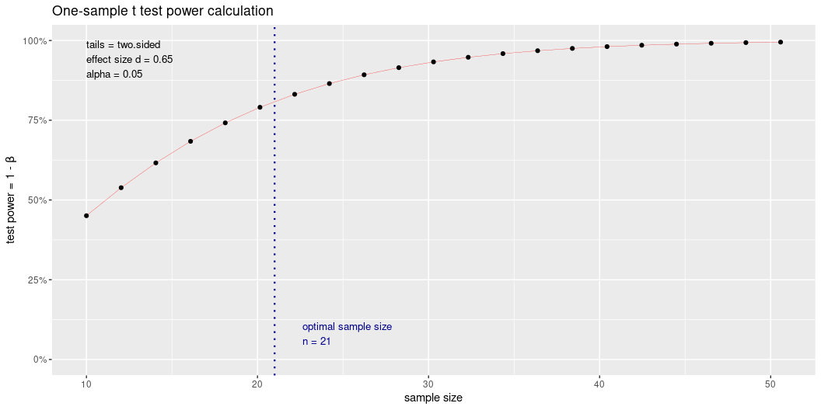
Rerun for our observed d:
pwr.t.test(d = 0.65, n = NULL, sig.level = 0.05, power = 0.8, type = "one.sample", alternative = "two.sided")
One-sample t test power calculation n = 20.58039 d = 0.65 sig.level = 0.05 power = 0.8 alternative = two.sided
And plotted:
pwr.t.test(d = 0.65, n = NULL, sig.level = 0.05, power = 0.8, type = "one.sample", alternative = "two.sided") %>% plot()

Slide 11
library(pwr) functions:
pwr.p.test: one-sample proportion test
pwr.2p.test: two-sample proportion test
pwr.2p2n.test: two-sample proportion test (unequal sample sizes)
pwr.t.test: two-sample, one-sample and paired t-tests
pwr.t2n.test: two-sample t-tests (unequal sample sizes)
pwr.anova.test: one-way balanced ANOVA
pwr.r.test: correlation test
pwr.chisq.test: chi-squared test (goodness of fit and association)
pwr.f2.test: test for the general linear model
library(pwr) functions:
A note on effect sizes…
Each test has a different metric of effect size, each calculated in a different way…
Fortunately, library(pwr) has a convenient function (cohen.ES) that can provide these for you for small, medium and large effect sizes.
cohen.ES(test = "t", size = "medium")
Conventional effect size from Cohen (1982) test = t size = medium effect.size = 0.5
If you’re not sure of the effect size you’d expect, the conservative approach is to use “small”
library(pwr) functions:
A note on effect sizes…
You can pass the results of cohen.ES1 directly to the pwr function by calling the effect.size slot in the returned object:
str(cohen.ES(test = "t", size = "medium"))
List of 4 $ test : chr "t" $ size : chr "medium" $ effect.size: num 0.5 $ method : chr "Conventional effect size from Cohen (1982)" - attr(*, "class")= chr "power.htest"
cohen.ES(test = "t", size = "medium")$effect.size
[1] 0.5
library(pwr) functions: ANOVA

Slide 12
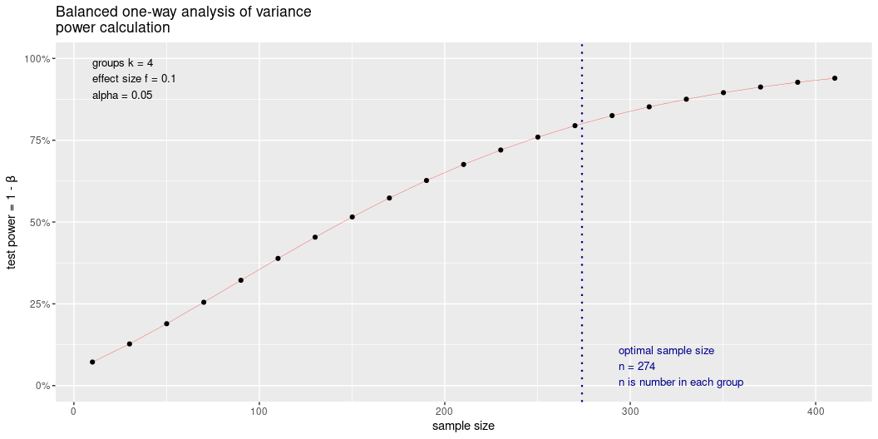
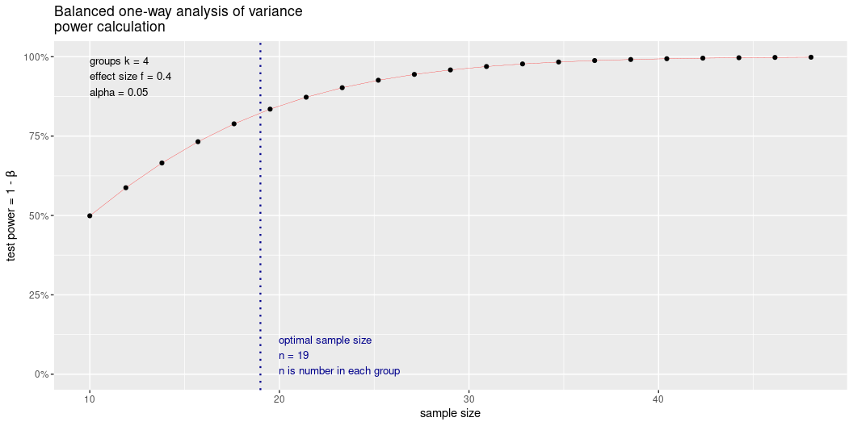
For comparisons among 3 or more groups
pwr.anova.test(f = cohen.ES(test = "anov", size = "small")$effect.size, k = 4, power = 0.80, sig.level = 0.05) %>% plot
f = Effect size
k = Number of groups

Slide 13
library(pwr) functions: Chi-squared

Slide 14
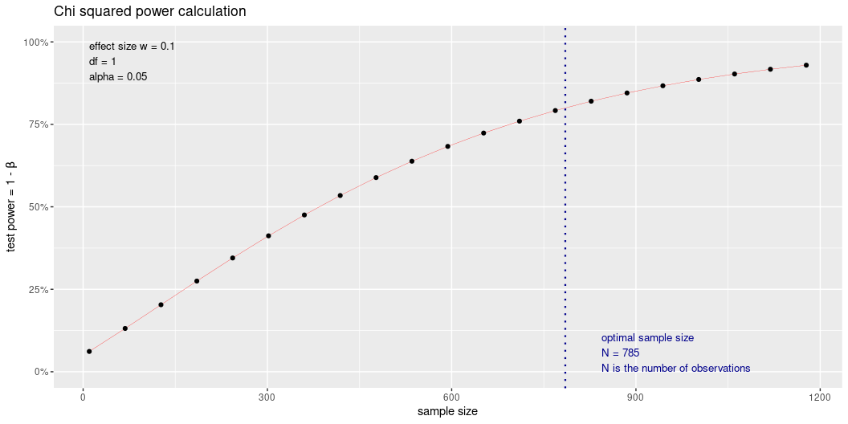
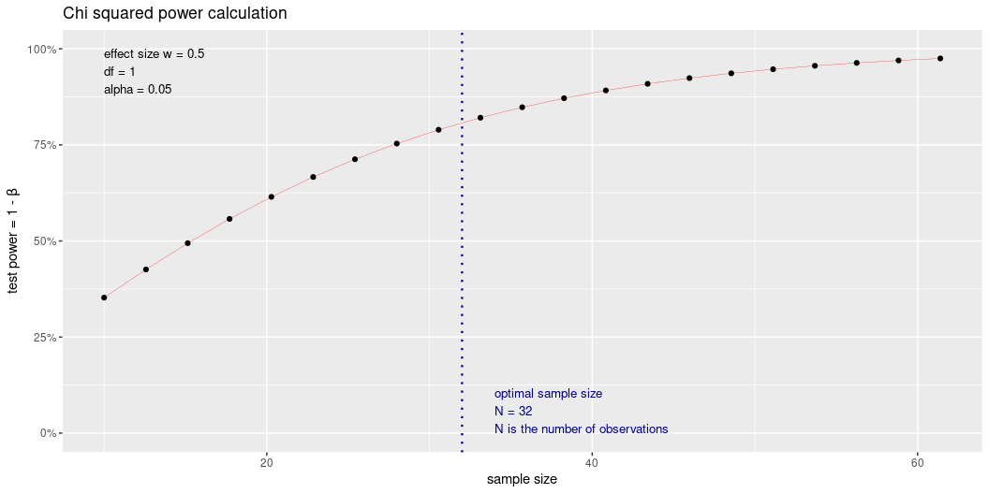
To test whether two categorical variables (two dimensions of a contingency table) are independent
pwr.chisq.test(w = cohen.ES(test = "chisq", size = "small")$effect.size, df = 1, power = 0.80, sig.level = 0.05) %>% plot()
w = Effect size
df = Degrees of freedom

Slide 15
library(pwr) functions: Correlation

Slide 16
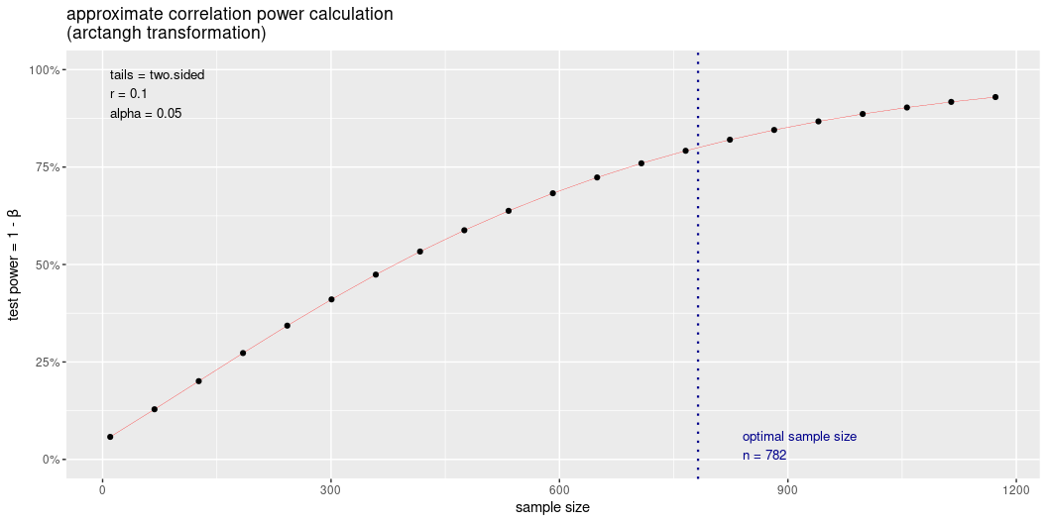
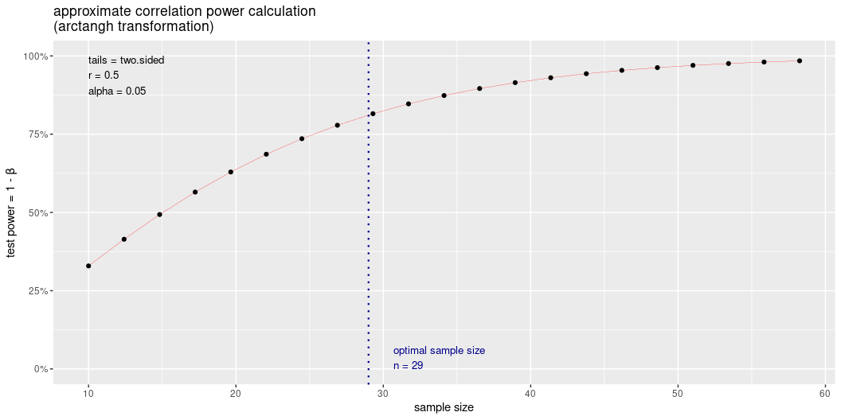
For correlation analysis
pwr.r.test(r = cohen.ES(test = "r", size = "small")$effect.size, power = 0.80, sig.level = 0.05, alternative = "two.sided") %>% plot()
r = correlation coefficient (i.e. it is not $R^{2}$)
Note that for regression analysis you’d need to set the “alternative” to “greater” or “less”, because it assumes that one variable is dependent on the other

Slide 17
library(pwr) functions: GLM

Slide 18
To test whether two categorical variables (two dimensions of a contingency table) are independent
pwr.f2.test(u = 1, v = NULL, f2 = cohen.ES(test = "f2", size = "small")$effect.size, power = 0.8, sig.level = 0.05)
Multiple regression power calculation u = 1 v = 392.373 f2 = 0.02 sig.level = 0.05 power = 0.8
f2 = Effect size
u = degrees of freedom for numerator (= number of groups - 1)
v = degrees of freedom for denominator (= total number of individuals across groups - the number of groups)
Multiple regression power calculation u = 1 v = 22.50313 f2 = 0.35 sig.level = 0.05 power = 0.8

Slide 19
The plan from here…
Think carefully about the data you plan to collect and how to analyze them
Decide on your statistical analyses/tests
Design your data spreadsheet
Design your field data sheet
Do power analyses for each of your analyses/tests to determine necessary sample sizes
If that all goes quickly, we could head into the field to collect some preliminary data

