Slide 1
A DIVERSITY OF ALIEN SPECIES IMPACTS ON NATIVE COMMUNITIES IN A FIRE PRONE BIODIVERSITY HOTSPOT
Invasive species
What impacts on:
Native richness (spc number + rarefied spc number)
Native abundances & Cover!
Native traits
Changes in: Invasive richness, abundance & traits over time

Slide 2
What impacts on Native richness : OBSERVED RICHNESS
All sites | Not-Invaded | Cleared (contrast) | Invaded (contrast) | Time since fire | Cleared*time | Invaded*time | R2
All_Nat | 2.24 | -0.52 | -1.01 | -0.016 | 0.024 | 0.044 | 0.15
Nat_h | 1.11 | -0.74 | -0.95 | -0.10 | - | 0.062 | 0.11
Nat_g | 0.91 | -0.33 | -0.77 | 0.015 | - | - | 0.14
Nat_e | 0.41 | -0.42 | -1.03 | 0.031 | 0.030 | 0.055 | 0.12
Nat_b | -0.36 | - | -0.77 | -0.050 | - | - | 0.03
Nat_t | -0.59 | -0.61 | -1.14 | 0.033 | - | - | 0.09
non-invaded sites : mean richness = 2.24, decrease over time
Cleared sites : less rich than non-invaded sites, increase over time
Invaded sites : less rich than cleared sites, greater increase over time
Sites burnt in 2000 only | Not-Invaded | Cleared (contrast) | Invaded (contrast) | Time since fire | Cleared*time | Invaded*time | R2
All_Nat | 1.83 | -2.78 | -0.73 | - | 0.17 | 0.03 | 0.18
Nat_h | 0.90 | -3.21 | -0.62 | -0.028 | 0.291 | - | 0.10
Nat_g | 0.37 | -3.31 | -0.37 | 0.016 | - | - | 0.13
Nat_e | -0.60 | -3.83 | -0.52 | 0.513 | 0.264 | 0.063 | 0.14
Nat_b | -1.00 | -13.23 | - | - | 1.206 | - | 0.03
Nat_t | -0.56 | - | -1.89 | 0.039 | - | 0.061 | 0.16

Slide 3
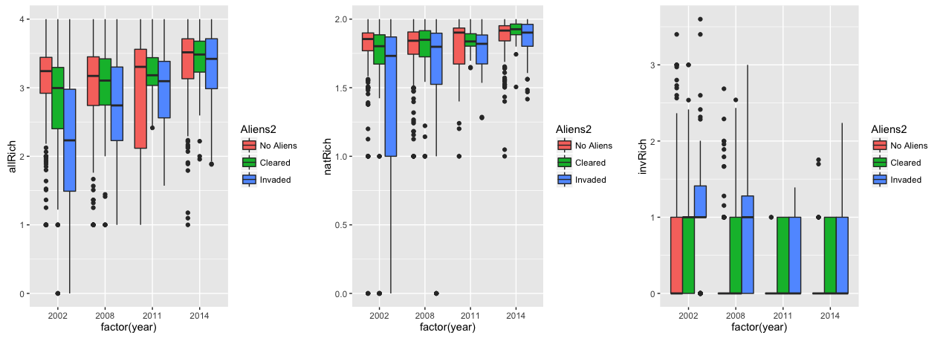
What impacts on Native richness : RAREFIED RICHNESS
All sites | Not-Invaded | Cleared (contrast) | Invaded (contrast) | Time since fire | Cleared*time | Invaded*time | R2
All_Nat | 1.74 | -0.11 | -0.34 | 0.010 | - | 0.017 | 0.09
Nat_h | 1.95 | -0.59 | -0.85 | -0.077 | - | 0.055 | 0.08
Nat_g | 1.73 | -0.27 | -0.80 | 0.044 | -0.037 | - | 0.13
Nat_e | 1.33 | -0.47 | -0.87 | 0.052 | 0.061 | 0.048 | 0.12
Nat_b | 0.84 | -0.22 | -0.43 | -0.03 | 0.025 | 0.019 | 0.03
Nat_t | 0.67 | -0.33 | -0.47 | 0.021 | - | - | 0.09
non-invaded sites : mean richness = 1.74, increase over time
Cleared sites : less rich than non-invaded sites, same increase over time than non-invaded sites
Invaded sites : less rich than cleared sites, greater increase over time
Sites burnt in 2000 only | Not-Invaded | Cleared (contrast) | Invaded (contrast) | Time since fire | Cleared*time | Invaded*time | R2
All_Nat | 1.56 | -1.17 | -0.36 | 0.022 | 0.115 | 0.019 | 0.26
Nat_h | 1.65 | -1.65 | -0.48 | - | - | - | 0.09
Nat_g | 1.15 | -1.18 | - | 0.033 | - | - | 0.16
Nat_e | 0.62 | -0.71 | -0.35 | 0.062 | - | 0.052 | 0.20
Nat_b | 0.53 | -0.47 | -0.18 | -0.013 | - | - | 0.04
Nat_t | 0.64 | -0.34 | -0.57 | 0.033 | - | - | 0.16

Slide 4
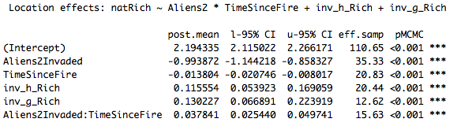
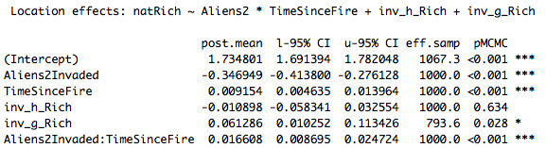
OBSERVED VS RAREFIED RICHNESS
Rich
Time
R2=0.13
Observed Rich
R2=0.10
Rarefied Rich

Slide 5
What impacts on Native abundances
All sites | Not-Invaded | Cleared (contrast) | Invaded (contrast) | Time since fire | Cleared*time | Invaded*time | R2
All_Nat | 1.02 | -0.57 | -0.64 | -0.05 | 0.030 | 0.039 | 0.01
Nat_h | 0.97 | -0.59 | -0.62 | -0.066 | 0.049 | 0.056 | 0.01
Nat_g | 1.32 | -0.58 | -0.58 | -0.062 | - | 0.043 | 0.01
Nat_e | 1.04 | -0.59 | -0.83 | -0.036 | - | 0.045 | 0.01
Nat_t | 1.23 | -1.04 | -0.96 | -0.016 | 0.016 | 0.017 | 0.01
Sites burnt in 2000 only | Not-Invaded | Cleared (contrast) | Invaded (contrast) | Time since fire | Cleared*time | Invaded*time | R2
All_Nat | 0.86 | - | -0.33 | -0.037 | - | 0.022 | 0.01
Nat_h | 0.97 | -0.60 | -0.62 | -0.066 | 0.049 | 0.056 | 0.01
Nat_g | 1.31 | -0.56 | -0.58 | -0.061 | - | 0.043 | 0.01
Nat_e | 1.04 | -0.59 | -0.84 | -0.037 | 0.027 | 0.045 | 0.01
Nat_t | 1.23 | -1.03 | -0.97 | -0.016 | 0.016 | 0.018 | 0.01
All_Nat | Not-Invaded+Cleared /ericoid+tree | Invaded (contrast) | Time since fire | Invaded * time | Graminoid (contrast) | Herbs (contrast) | R2
All sites | 0.96 | -0.56 | -0.048 | 0.039 | 0.19 | -0.10 | 0.01
Sites burnt in 2000 only | 0.96 | -0.56 | -0.048 | 0.039 | 0.19 | -0.10 | 0.01

Slide 6
Changes in Invasive/native vegetation cover over time?
All sites | Not-Invaded | Cleared (contrast) | Invaded (contrast) | Time since fire | Cleared*time | Invaded*time | R2
All_Nat | 48.61 | -21.56 | -33.56 | 5.62 | 1.67 | - | 0.26
Nat_h | 11.28 | - | -3.81 | -0.42 | 0.90 | - | 0.01
Nat_g | 19.66 | -9.78 | -13.72 | 1.61 | -1.03 | - | 0.11
Nat_e | 6.87 | - | -9.24 | 2.43 | 1.55 | 0.79 | 0.15
Nat_t | - | - | - | 2.08 | - | -1.20 | 0.10
Sites burnt in 2000 only | Not-Invaded | Cleared (contrast) | Invaded (contrast) | Time since fire | Cleared*time | Invaded*time | R2
All_Nat | 34.39 | -52.84 | -29.69 | 5.32 | 7.05 | - | 0.39
Nat_h | 16.26 | -27.59 | -6.96 | - | 7.57 | - | 0.10
Nat_g | 10.36 | - | - | 0.99 | - | - | 0.12
Nat_e | - | - | - | 1.91 | - | 2.17 | 0.30
Nat_t | - | - | - | 2.39 | - | -1.36 | 0.12

Slide 7
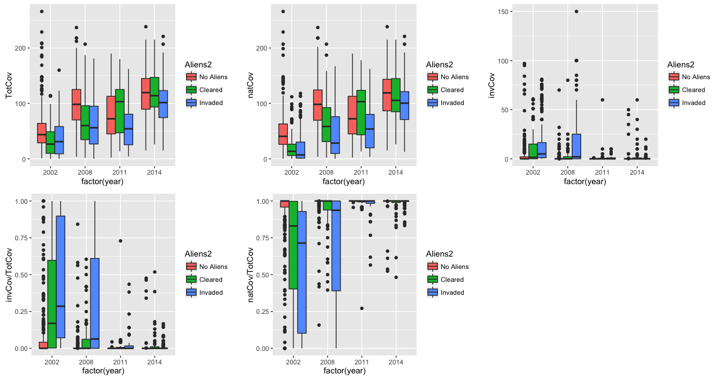
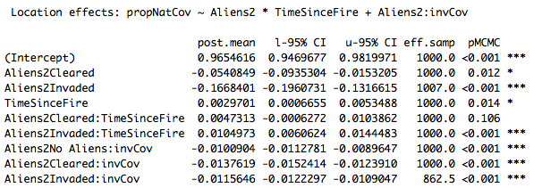
Changes in Invasive/native vegetation cover over time?
R2=0.62

Slide 8
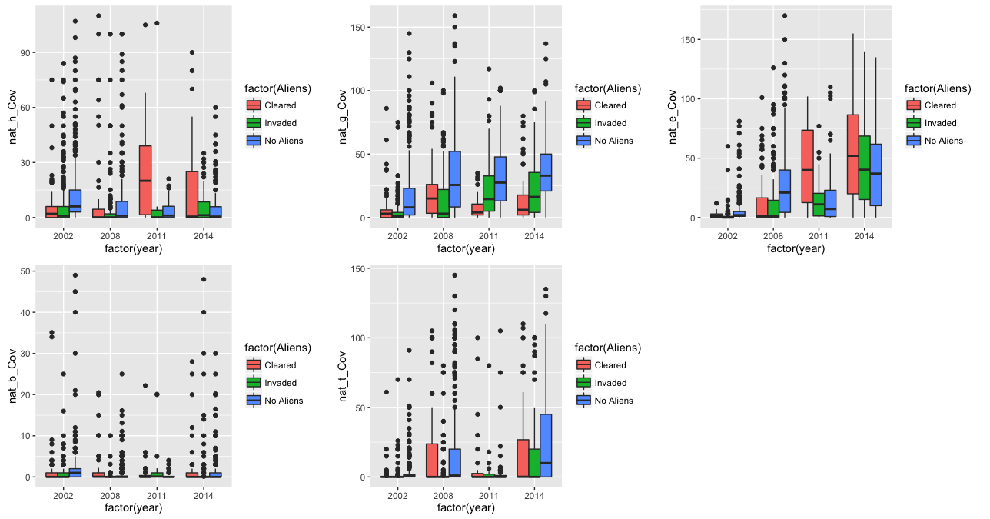
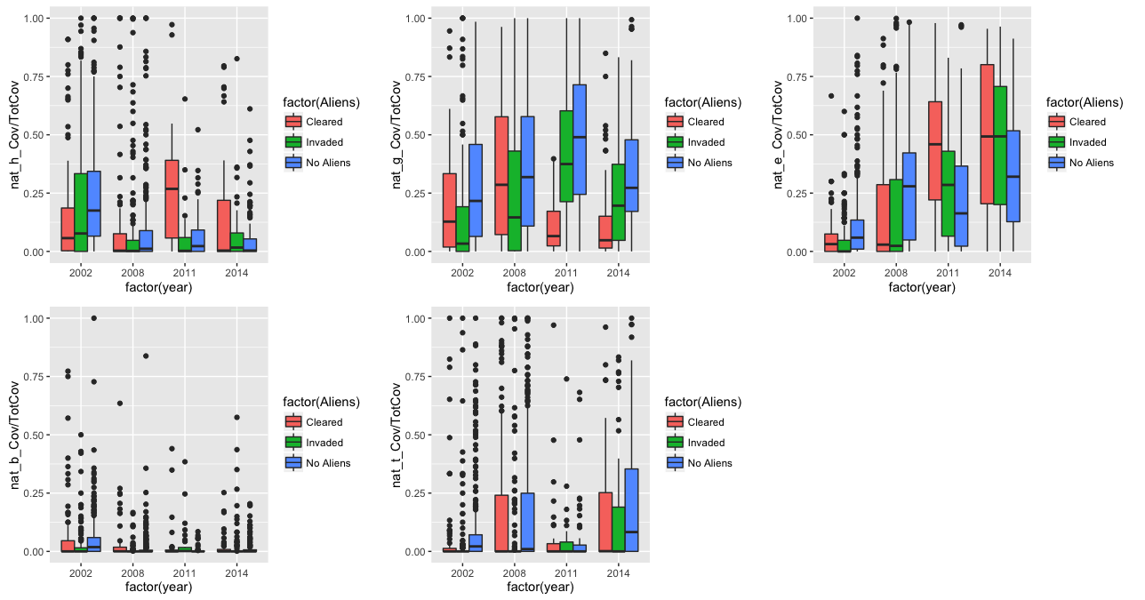
All sites

Slide 9
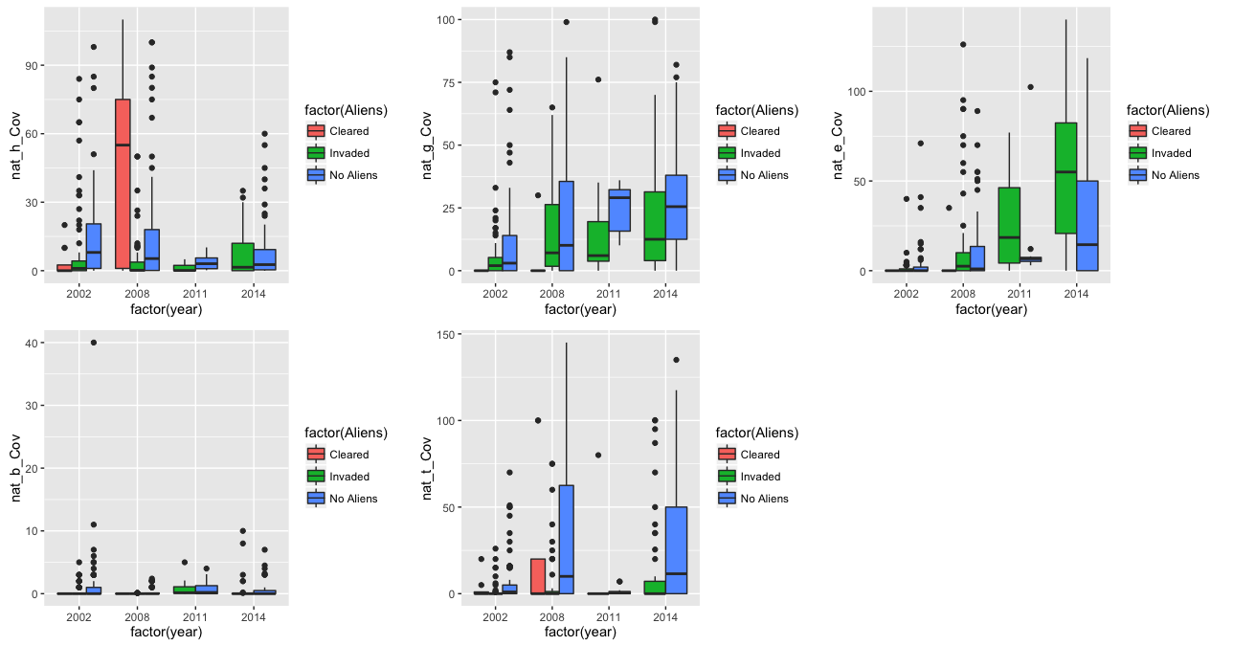
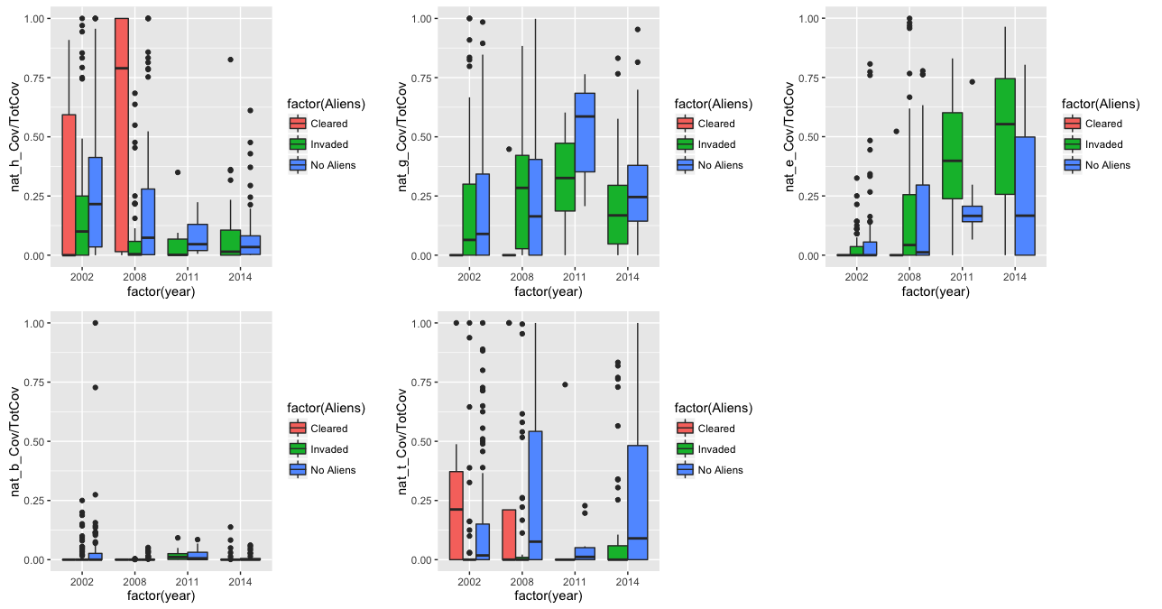
Sites burnt in 2000 only

Slide 10
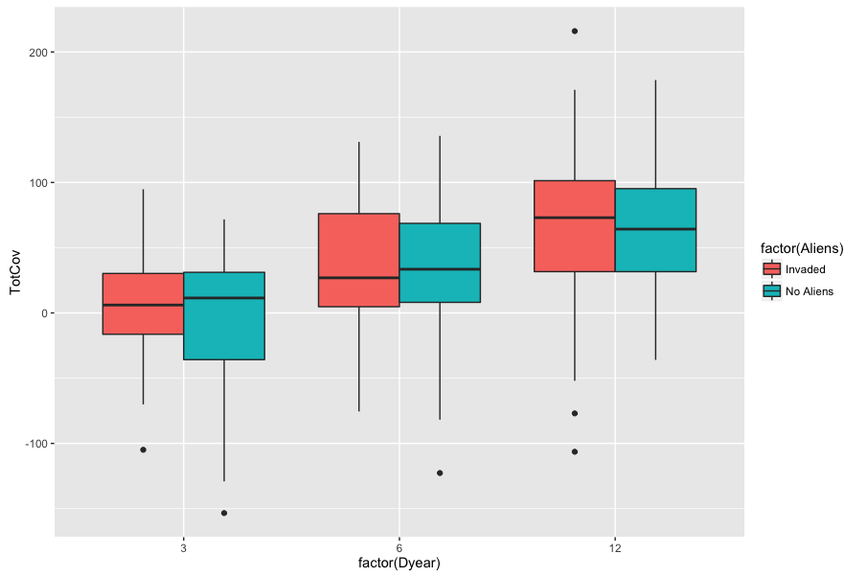
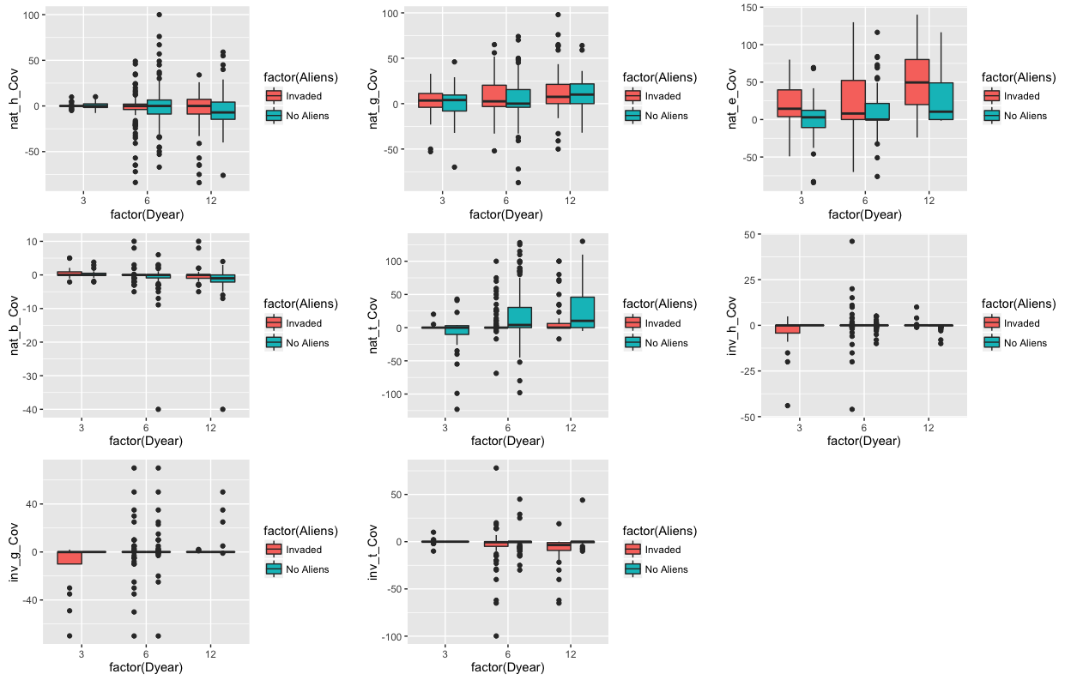
What impacts on Native species traits
Total species cover changes over time (p-val<0.001; R2=0.13)

Slide 11
What impacts on Native species traits
Total species cover changes over time (p-val<0.001; R2=0.13)
 | dTime | N_h | N_g | N_e | N_b | N-t | I_h | I_g | I_t | R²
N_h |  |  |  |  |  |  |  | 0.38 | -0.30 | 0.01
N_g |  |  |  |  | 5.98 | -0.43 |  |  |  | 0.20
N_e | 4.70 |  |  |  |  |  |  |  |  | 0.14
N_b |  |  | 0.02 |  |  |  |  | 0.03 |  | 0.03
N-t | 1.03 |  |  |  |  |  |  |  |  | 0.02
I_h |  |  | -0.07 |  |  |  |  |  | 0.11 | 0.10
I_g | -7.6 |  |  |  |  |  |  |  | 0.29 | 0.12
I_t
Add the spc richness and diversity?
Test only the periods starting in 2002?

Slide 12
Changes in ALIEN richness over time: OBSERVED RICHNESS
All sites | Intercept (invaded treatment only) | Time since fire | R2
All_Inv | 0.18 | -0.044 | 0.03
Inv_h | -2.41 | 0.043 | 0.01
Inv_g | -2.68 | 0.073 | 0.01
Inv_t | 0.07 | -0.142 | 0.14
Sites burnt in 2000 only | Intercept (invaded treatment only) | Time since fire | R2
All_Inv | 0.42 | -0.102 | 0.18
Inv_h | - | - | -
Inv_g | - | - | -
Inv_t | 0.39 | -0.166 | 0.39
Changes in ALIEN richness over time: RAREFIED RICHNESS
All sites | Intercept (invaded treatment only) | Time since fire | R2
All_Inv | 1.00 | -0.035 | 0.04
Inv_h | - | - | -
Inv_g | 0.10 | 0.011 | 0.01
Inv_t | 0.90 | -0.063 | 0.13
Sites burnt in 2000 only | Intercept (invaded treatment only) | Time since fire | R2
All_Inv | 1.26 | -0.069 | 0.24
Inv_h | - | - | -
Inv_g | - | - | -
Inv_t | 1.08 | -0.075 | 0.36

Slide 13
Changes in ALIEN abundances over time
All sites | Intercept (invaded treatment only) | Time since fire | R2
All_Inv | 2.62 | -0.129 | 0.01
Inv_h | 0.13 (ns) | 0.12 | 0.02
Inv_g | 0.48 (ns) | 0.22 | 0.03
Inv_t | 4.86 | -0.41 | 0.07
Sites burnt in 2000 only | Intercept (invaded treatment only) | Time since fire | R2
All_Inv | 4.32 | -0.253 | 0.03
Inv_h | - | - | -
Inv_g | - | - | -
Inv_t | 7.96 | -0.648 | 0.20
All_Inv | Intercept (invaded only)/herb+graminoid | Time since fire | Tree | Time * tree | R2
All sites | 0.61 | 0.122 | 4.34 | -0.54 | 0.07
Sites burnt in 2000 only | 1.05 (ns) | - | 6.89 | -0.73 | 0.11

Slide 14
Changes in Invasive/native vegetation cover over time?
All sites | Intercept (invaded treatment only) | Time since fire | R2
All_Inv | 16.61 | -0.65 | 0.01
Inv_h | - | 0.19 | 0.01
Inv_g | - | - | -
Inv_t | 15.80 | -1.01 | 0.03
Sites burnt in 2000 only | Intercept (invaded treatment only) | Time since fire | R2
All_Inv | 19.94 | -1.07 | 0.10
Inv_h | - | - | -
Inv_g | - | - | -
Inv_t | 18.15 | -0.96 | 0.12

