Slide 1
Post-Hurricane Building Damage Detection
Comparing CNN Architectures on Satellite Imagery
5800 ML Final Project

Slide 2
Problem & Dataset
Binary classification: damage vs no_damage on Hurricane Harvey satellite tiles
Motivation: rapid post-disaster damage assessment from satellite imagery
Manual inspection too slow at city-scale automate with CNNs
Source: Kaggle kmader/satellite-images-of-hurricane-damage
128x128 RGB tiles binary labels (damage / no_damage)
10k train / 2k val / 2k balanced test / 9k imbalanced test (8:1)
Imbalanced split tests robustness under realistic class skew
Class counts (damage / no_damage)
Train_another: 5000 / 5000
Validation_another: 1000 / 1000
Test (balanced): 1000 / 1000
Test_another (imbal): 8000 / 1000

Slide 3
Method
Baseline + transfer learning + interpretability
Models compared:
SimpleCNN 4-block CNN trained from scratch (~0.4M params)
ResNet18 ImageNet pretrained, head replaced (~11M)
EfficientNet-B0 ImageNet pretrained (~4M)
MobileNetV3-Small ImageNet pretrained (~1.5M)
Training: AdamW + Cosine LR, light augmentation (flips, rotation, color jitter)
Selection: best validation accuracy checkpoint
Evaluation on both balanced and imbalanced test sets
Interpretability: Grad-CAM on the best model

Slide 4
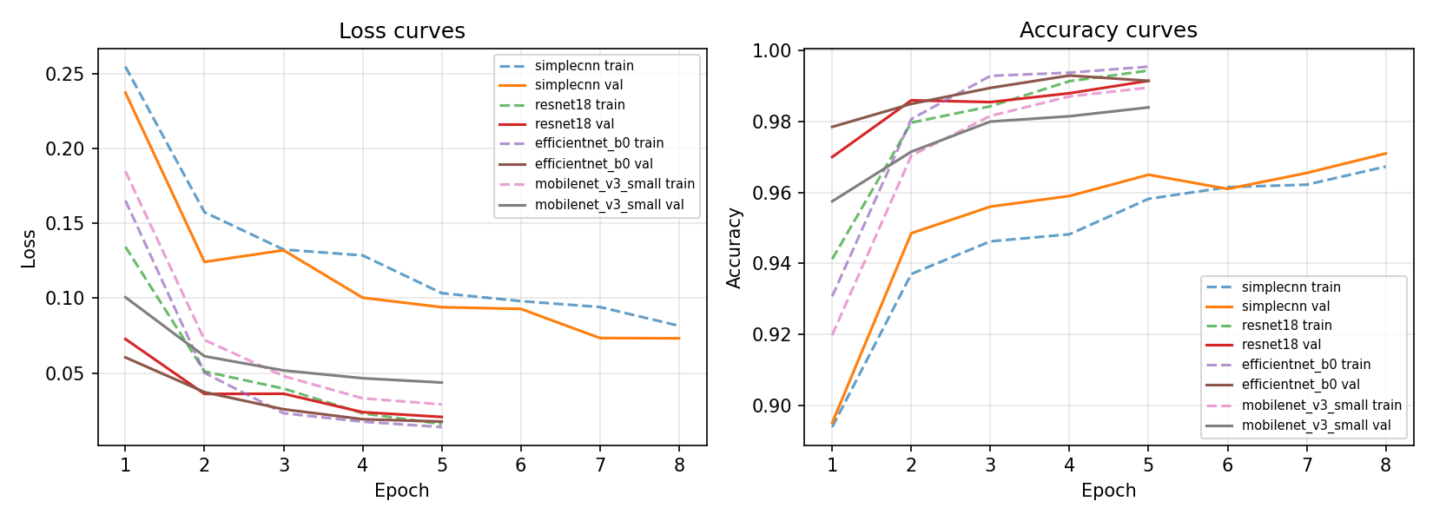
Training Dynamics
Pretrained backbones converge in 2-3 epochs; SimpleCNN needs more
Note: pretrained models trained for 5 epochs (already plateaued); SimpleCNN trained for 8 epochs to give the from-scratch baseline a fair shot.

Slide 5
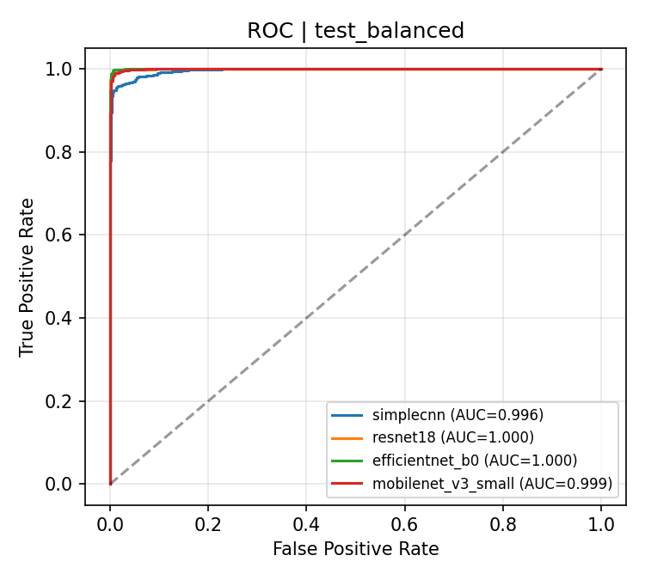
Results Balanced Test (n=2000)
Model | Acc | Prec | Rec | F1 | AUC | Params
simplecnn | 0.9705 | 0.9826 | 0.9580 | 0.9701 | 0.9963 | 436,258
resnet18 | 0.9920 | 0.9950 | 0.9890 | 0.9920 | 0.9997 | 11,177,538
efficientnet_b0 | 0.9955 | 0.9940 | 0.9970 | 0.9955 | 0.9999 | 4,010,110
mobilenet_v3_small | 0.9880 | 0.9929 | 0.9830 | 0.9879 | 0.9994 | 1,519,906
EfficientNet-B0 wins: 99.55% acc, F1 = 0.9955, AUC = 0.99986. All pretrained models > 98.8%; SimpleCNN baseline is solid at 97.05%.

Slide 6
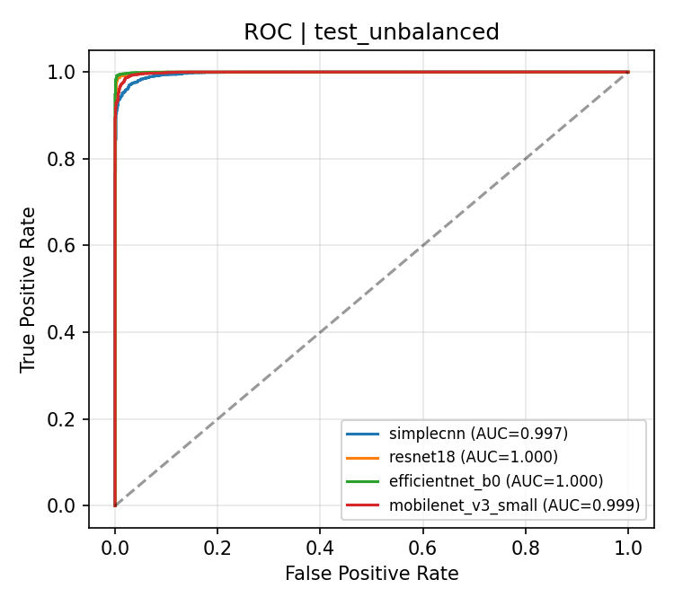
Class Imbalance Stress Test test_another (8:1, n=9000)
Model | Acc | Prec | Rec | F1 | AUC
simplecnn | 0.9648 | 0.9966 | 0.9636 | 0.9799 | 0.9968
resnet18 | 0.9896 | 0.9990 | 0.9892 | 0.9941 | 0.9996
efficientnet_b0 | 0.9923 | 0.9995 | 0.9919 | 0.9957 | 0.9997
mobilenet_v3_small | 0.9834 | 0.9975 | 0.9839 | 0.9906 | 0.9987
Pretrained models stay above 98% accuracy under 8:1 skew.
Precision rises (rare false alarms) while recall stays high.
ROC-AUC > 0.998 for all transfer-learning models.
Conclusion: models are robust to realistic class imbalance.

Slide 7
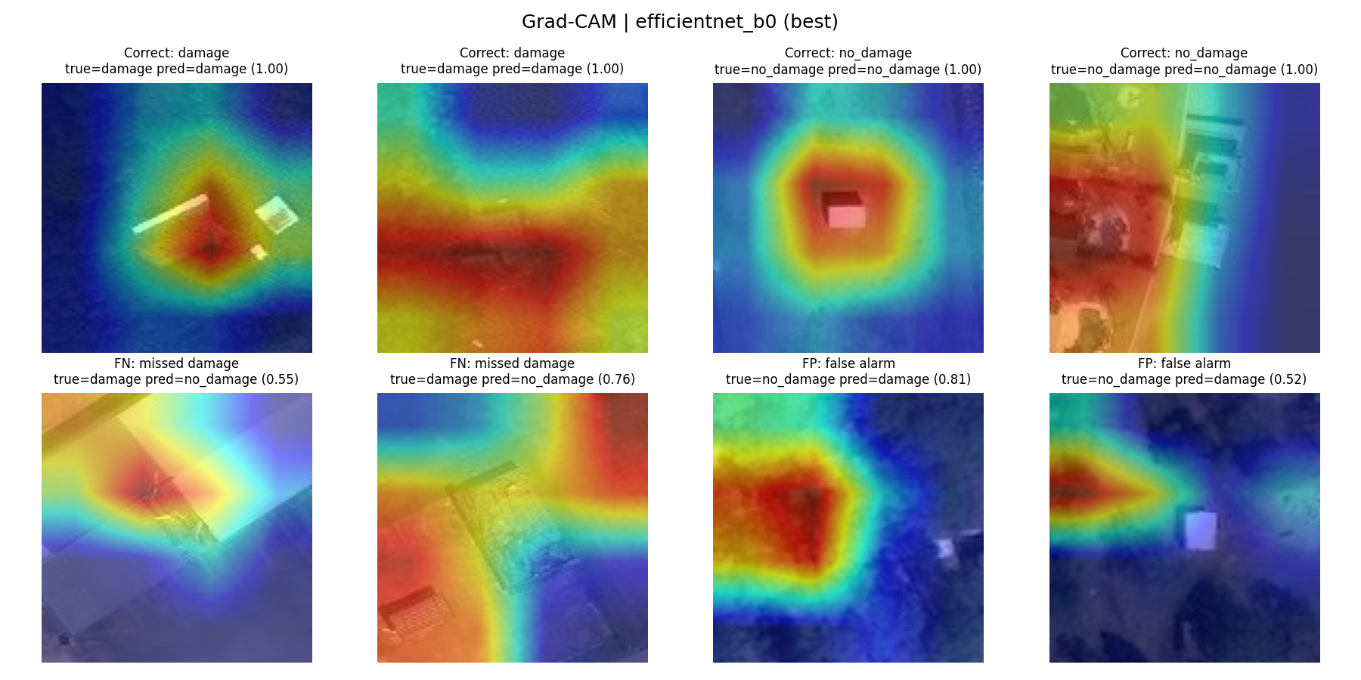
Grad-CAM What does the best model look at?
EfficientNet-B0 attention overlays on test_balanced examples
Top row: correct predictions (damage / no_damage). Bottom row: FN missed damage (model still attends to the right area but with low confidence) and FP false alarms.

Slide 8
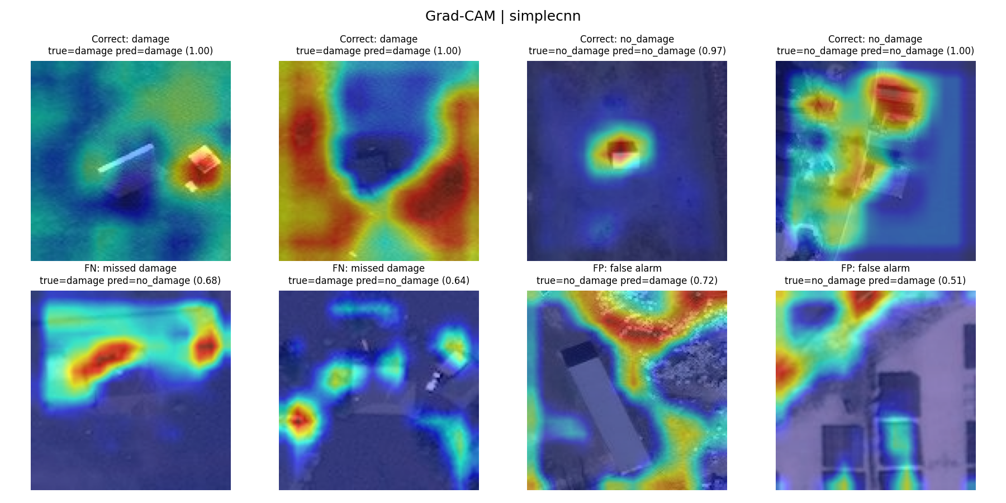
Grad-CAM CNN from scratch (SimpleCNN)
From-scratch baseline on the same test_balanced examples (correct / FN / FP)
Top row: correct predictions. Bottom row: FN missed damage and FP false alarms. Compared with EfficientNet-B0, heatmaps are noisier and more diffuse, attention leaks to background/edges, and FN/FP confidences hover near the decision boundary consistent with SimpleCNN's ~2.5-pt accuracy gap on the balanced test set.

Slide 9
Conclusion & Future Work
Transfer learning beats from-scratch CNN even on a fairly large (10k) dataset.
EfficientNet-B0 gives the best F1 (0.9955) with only 4M parameters.
All pretrained models generalize cleanly to an 8:1 imbalanced test set.
Grad-CAM confirms attention concentrates on damaged structures, not background.
Future work:
Multi-class severity prediction (minor / moderate / severe)
Building-level segmentation with U-Net
Cross-disaster generalization (Hurricane Maria, Irma)

