Slide 1
Beyond the Bean
Global coffee production, quality, and the specialty market
Jinsheng Luo · Data Visualization Final Project

Slide 2
The question
• Where coffee is grown is not where it is graded.
• Where it is graded is not where it is sold at a premium.
• Three datasets, four hypotheses, one dashboard — does the data tell one story or two?

Slide 3
Three datasets
• FAO production (1961–2024) — 7,375 country-years (Our World in Data)
• CQI cupping database — 1,338 professionally graded lots, 10 sensory dimensions
• coffeereview.com — 2,095 specialty consumer reviews (2017–2022)
• Linked at the country level via keyword-matching on origin fields.

Slide 4
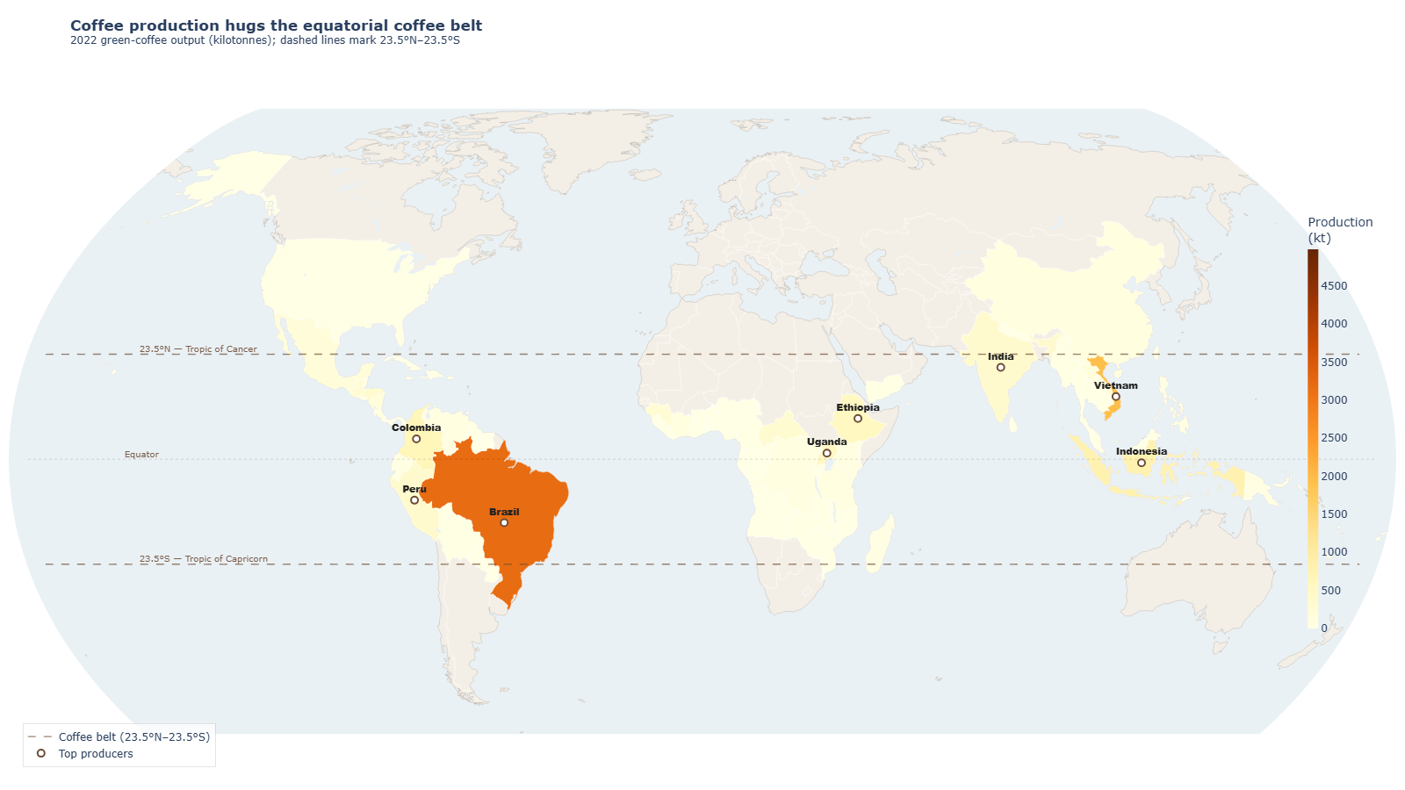
H1 · Where coffee comes from: production hugs the equatorial belt
Production = total tonnes grown. Brazil, Vietnam, Colombia, Indonesia, Ethiopia dominate volume — every major producer sits inside ±23.5° latitude.

Slide 5
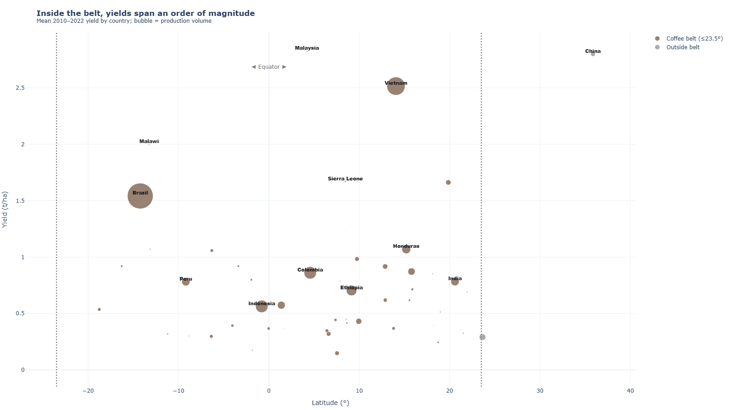
H1 · But the belt is NOT more productive per hectare — hypothesis rejected
Yield = tonnes per hectare. Belt mean = 0.72 t/ha (n=948) · Margin mean = 1.05 t/ha (n=60) · Welch t = -2.48, p = 0.016

Slide 6
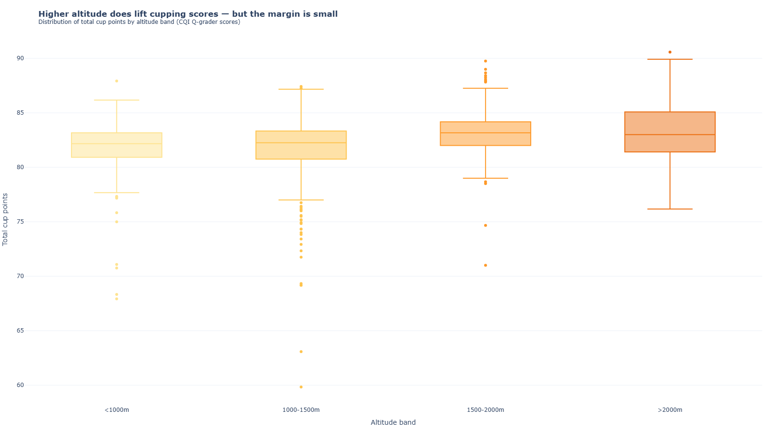
H2 · Altitude lifts cupping score — modestly but reliably
<1000m = 81.8 · >2000m = 83.5 · OLS β(altitude std) = +0.44, p = 7.1e-09

Slide 7
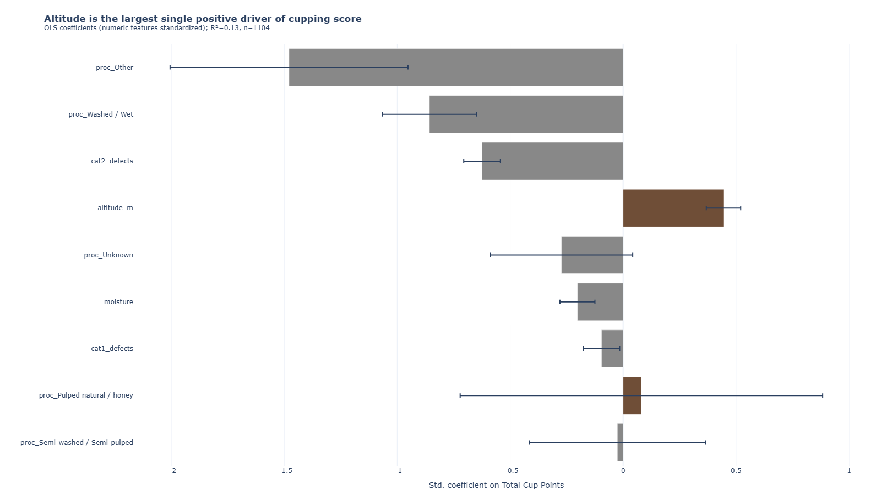
H2 · Standardized OLS coefficients on Total Cup Points
R² = 0.13, n = 1104. Altitude is the largest single positive driver; defects, the largest negative.

Slide 8
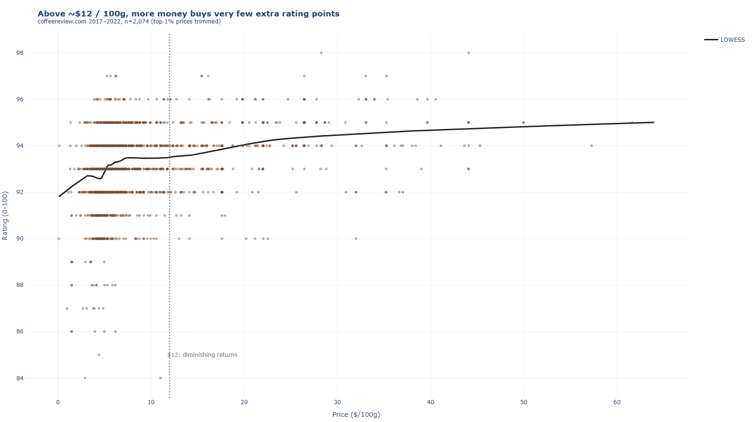
H3 · Above ~$12/100g, more money buys very few extra rating points
Mean rating: <$5 = 92.4, $8–12 = 93.3, >$20 = 94.3 · Spearman ρ = 0.35

Slide 9
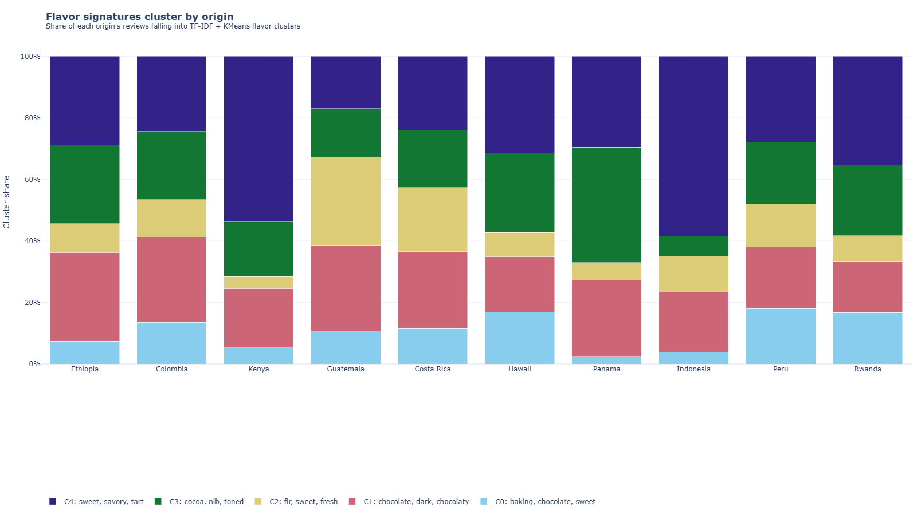
H4 · Flavor language differs systematically by origin
TF-IDF + KMeans clusters of review descriptions, share by top-10 origins. Nuanced support — origin shifts the mix, not the category.

Slide 10
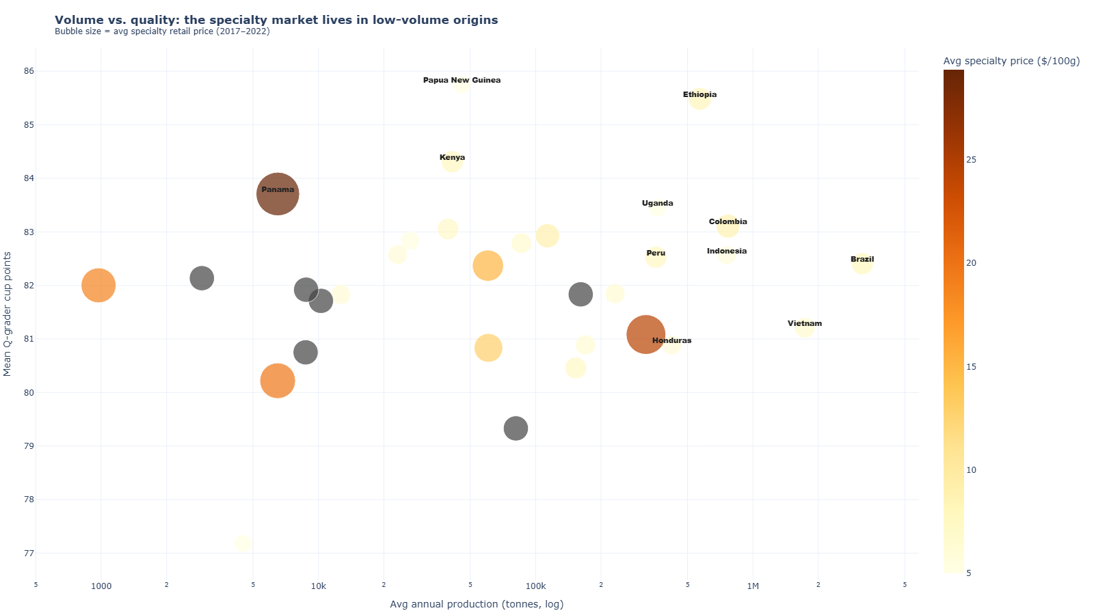
Synthesis · Volume and quality are independent
Volume × quality (Spearman) = +0.09 · Volume × price = -0.08 · Quality × price = -0.03

Slide 11
Putting the four hypotheses together
• H1 — Belt → higher yield: REJECTED. Latitude sets WHERE coffee grows; agronomy sets HOW MUCH per hectare.
• H2 — Altitude → higher cup score: SUPPORTED (β = +0.44 std, p < 1e-8)
• H3 — Diminishing returns above $12/100g: STRONGLY SUPPORTED
• H4 — Flavor clusters track origin: SUPPORTED with nuance
• Big idea: coffee is two industries — commodity (volume) and specialty (story).

Slide 12
What the data cannot tell us
• CQI is a submitted-sample database, not a random sample of world coffee.
• coffeereview.com is curated specialty — ratings cluster between 88 and 96.
• Origin-of-coffee ≠ country-of-roaster; blends resolved to the first listed origin.
• All findings are correlational; no causal claims.

Slide 13
Thank you — questions?
Live dashboard: streamlit run streamlit_app.py · Repo: github.com/jsluo413/coffee-bean

