Slide 2
Command and Query Responsibility Segregation (CQRS)

Slide 3
About Jason Smale
Consultant @ AgileThought
Over 11 years of software development experience
Blog: http://blog.jason.smale.org/
Twitter: @jasonsmale

Slide 4


Slide 5
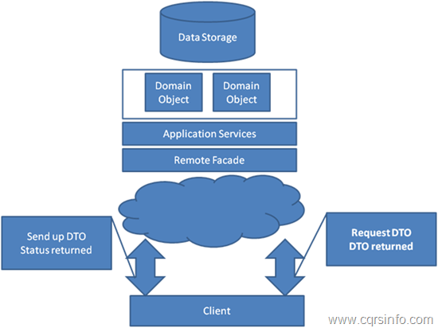
Stereotypical Architecture

Slide 6
N-Tier Architecture
UI
Services
Cache
BL
DAL
Database

Slide 7
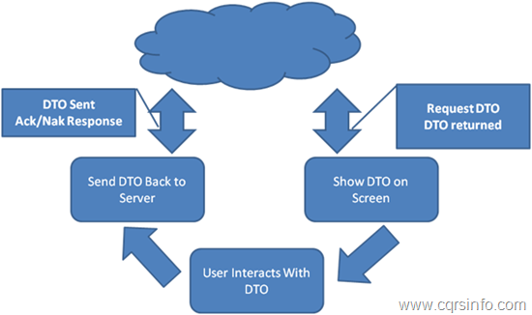
Typical Client Interaction

Slide 8
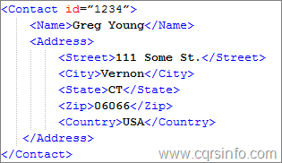
Example in XML of a DTO

Slide 9

Task Based Interface

Slide 10
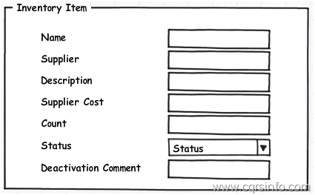
Typical CRUD Screen

Slide 11
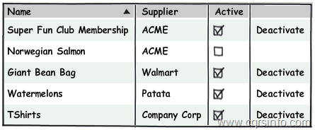
Listing Screen with Link

Slide 12
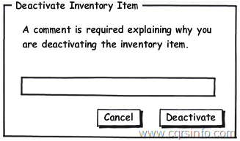
Deactivate Item Task Screen

Slide 13
CQRS

Slide 14
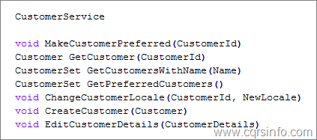
Service Interface

Slide 15
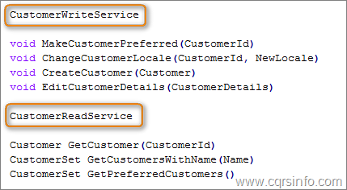
Service Interface after CQRS

Slide 16
Commands and Queries have different needs
Consistency
Command: It is far easier to process transactions with consistent data than to handle all of the edge cases that eventual consistency can bring into play.
Query: Most systems can be eventually consistent on the Query side.
Data Storage
Command: The Command side being a transaction processor in a relational structure would want to store data in a normalized way, probably near 3rd Normal Form.
Query: The Query side would want data in a de-normalized way to minimize the number of joins needed to get a given set of data. In a relational structure likely in 1st Normal Form.
Scalability
Command: In most systems, especially web systems, the Command side generally processes a very small number of transactions as a percentage of the whole. Scalability therefore is not always important.
Query: In most systems, especially web systems, the Query side generally processes a very large number of transactions as a percentage of the whole (often times 2 or more orders of magnitude). Scalability is most often needed for the query side.

Slide 17
Queries

Slide 18
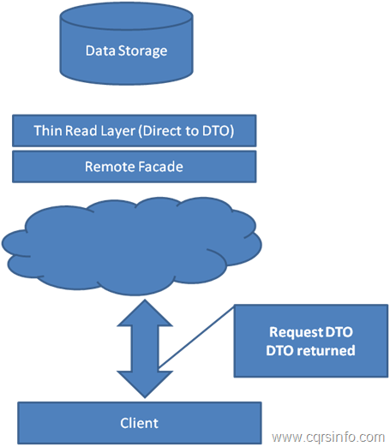
The Query Side

Slide 19
2 Tier Query Model
Persistent View Model
Client
SELECT * FROM MyTable WHERE ID = @ID

Slide 20
Commands

Slide 21
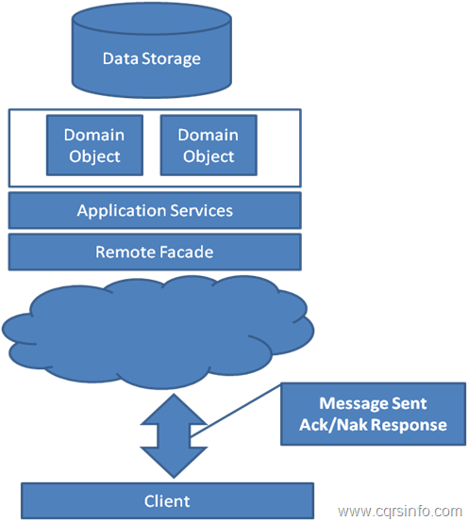
The Command Side

Slide 22
Domain Model

Slide 23
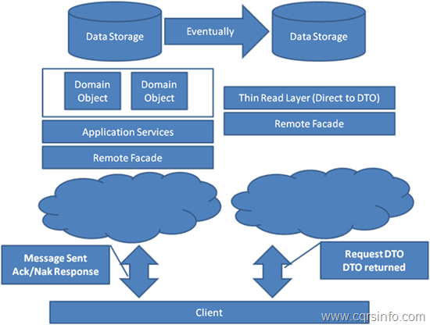
Separated Data Models with CQRS

Slide 24
Events

Slide 25
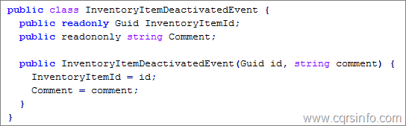
A Simple Event

Slide 26
Events vs. Commands
Command and Events are both messages with data and no behavior (DTO).
Commands are something you are telling the system to do (can be rejected).
Events are something that has already happened (cannot be changed).
Commands are written in the present tense (i.e. AddItemToCart).
Events are written in the past tense (i.e. ItemAddedToCart).
Commands are sent.
Events are published to subscribers.
Commands are processed by a single handler.
Events can be processed by multiple handlers.

Slide 27
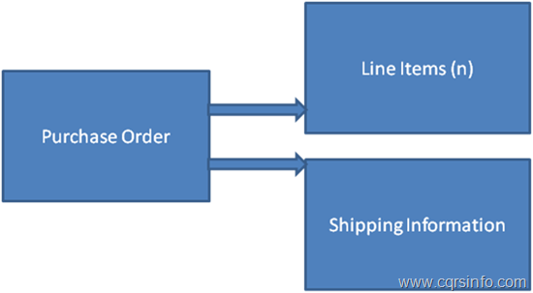
Structural View of an Order

Slide 28
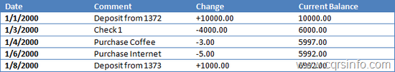
A Simplified Ledger

Slide 29


Slide 30
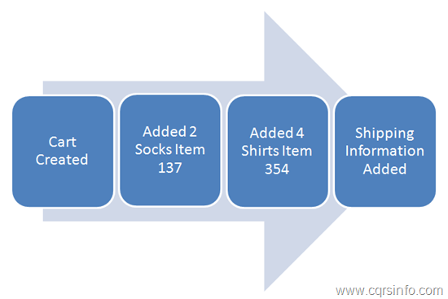
Transactional View of Order

Slide 31
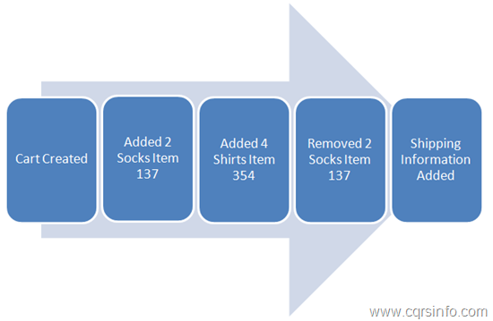
There is no delete

Slide 32
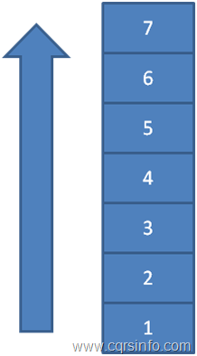
An Event Stream

Slide 33
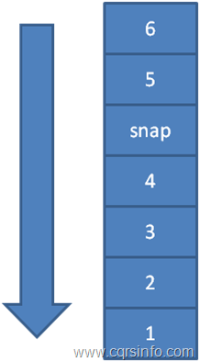
Event Stream with Snapshot

Slide 34
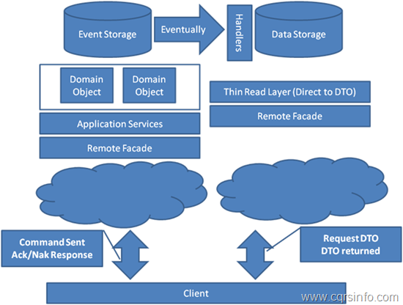
CQRS with Event Sourcing

Slide 35
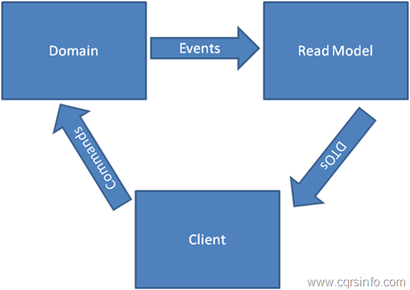
High Level of CQRS with Event Sourcing

Slide 36
References and Resources
CQRS: http://cqrsinfo.com/
Greg Young: http://codebetter.com/gregyoung/
Udi Dahan: http://www.udidahan.com/
Jonathan Oliver: http://blog.jonathanoliver.com/

