Slide 1
SPOMS Progresso – Sprint D
1200871 José Monteiro
1200587 Paulo Couto
1200972 José Rocha
1201008 Luis Ferreira
1192221 João Marques
Data 19/06/2022
Equipa 2DI-2

Slide 2
Resumo
Fases do projeto
Planeamento
Implementação
Revisão

Slide 3
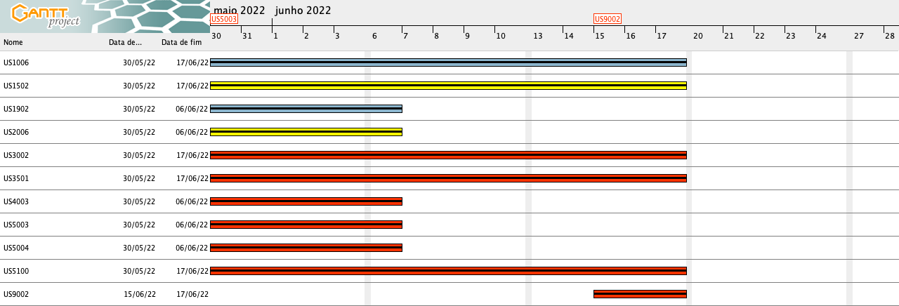
Planeamento

Slide 4
Atividades Concluídas
ID | Atividade | Responsável | Baseline | Real | Estado
US1006 | As Sales Clerk, I want to access a list of orders that had been dispatched for customer delivery and be able to update some of those orders to as being delivered. | João Marques | Início: 30-05-2022 Fim: 19-06-2022 | Início: 30-05-2022 Fim: 19-06-2022 | ✓
US1502 | As Customer, I want to view/check the status of my open orders. | Luís Ferreira | Início: 30-05-2022 Fim: 19-06-2022 | Início: 30-05-2022 Fim: 19-06-2022 | ✓
US1902 | As Project Manager, I want the communications made through the SPOMS2022 protocol to be secured/protected. | Luís Ferreira | Início: 30-05-2022 Fim: 19-06-2022 | Início: 30-05-2022 Fim: 06-06-2022 | ✓
US2006 | As Project Manager, I want the communications made through the SPOMS2022 protocol to be secured/protected. | José Monteiro | Início: 30-05-2022 Fim: 19-06-2022 | Início: 30-05-2022 Fim: 06-06-2022 | ✓
US3002 | As Sales Manager, I want to get a statistical report regarding a previously set up questionnaire. | José Monteiro | Início: 30-05-2022 Fim: 19-06-2022 | Início: 30-05-2022 Fim: 19-06-2022 | ✓

Slide 5
Atividades Concluídas
ID | Atividade | Responsável | Baseline | Real | Estado
US3501 | As Customer, I want to get the list of questionnaires that the system is asking me to answer and be able to answer any of those questionnaires. | José Rocha | Início: 30-05-2022 Fim: 19-06-2022 | Início: 30-05-2022 Fim: 19-06-2022 | ✓
US4003 | As Project Manager, I want the communications (of the AGVManager) made through the SPOMS2022 protocol to be secured/protected. | Paulo Couto | Início: 30-05-2022 Fim: 19-06-2022 | Início: 30-05-2022 Fim: 06-06-2022 | ✓
US5003 | As Project Manager, I want the input communications (of the AGV Digital Twin) made through the SPOMS2022 protocol to be secured/protected. | João Marques | Início: 30-05-2022 Fim: 19-06-2022 | Início: 30-05-2022 Fim: 06-06-2022 | ✓
US5004 | As Project Manager, I want the output communications (of the AGV Digital Twin) made through the SPOMS2022 protocol to be secured/protected. | José Rocha | Início: 30-05-2022 Fim: 19-06-2022 | Início: 30-05-2022 Fim: 06-06-2022 | ✓
US5100 | As Project Manager, I want that the team to develop and integrate the others components/parts of the AGV digital twin (e.g.: movement, obstacle sensors, control unit). | Paulo Couto | Início: 30-05-2022 Fim: 19-06-2022 | Início: 30-05-2022 Fim: 19-06-2022 | ✓

Slide 6
Atividades Concluidas
ID | Atividade | Responsável | Baseline | Real | Estado
US9002 | As Software Product Client, I want the team (software supplier) to prepare a presentation focusing on the following aspects: ... | José Monteiro | Início: 30-05-2022 Fim: 19-06-2022 | Início: 15-06-2022 Fim: 19-06-2022 | ✓

Slide 7
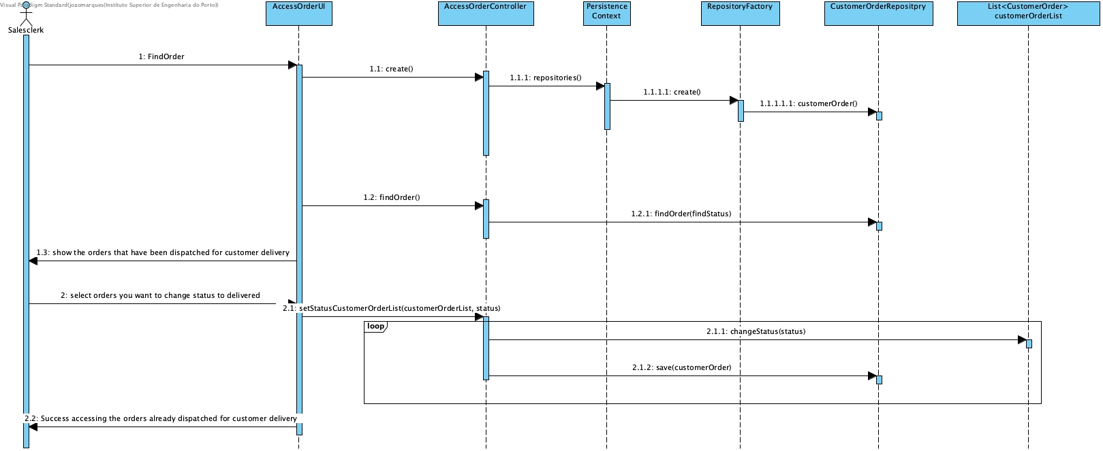
SPOMS

Slide 8
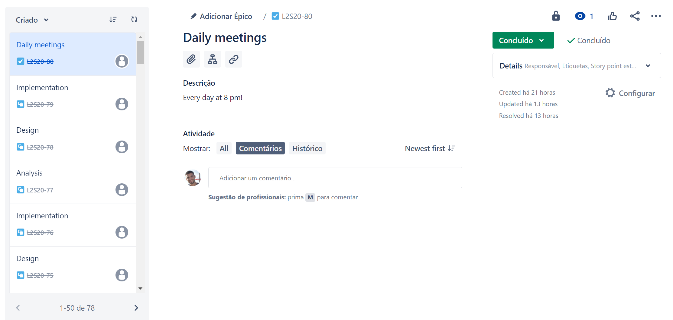
Daily Meetings

Slide 9
SPOMS Progresso – Sprint D
Data 19/06/2022

