Slide 1
SPOMS Progresso – Sprint D
1192221 João Marques
1200587 Paulo Couto
1200871 José Monteiro
1200972 José Rocha
1201008 Luis Ferreira
Data 19/06/2022
Equipa 2DI-2

Slide 2
Resumo
Fases do projeto
Planeamento
Implementação
Revisão
Outros assuntos

Slide 3
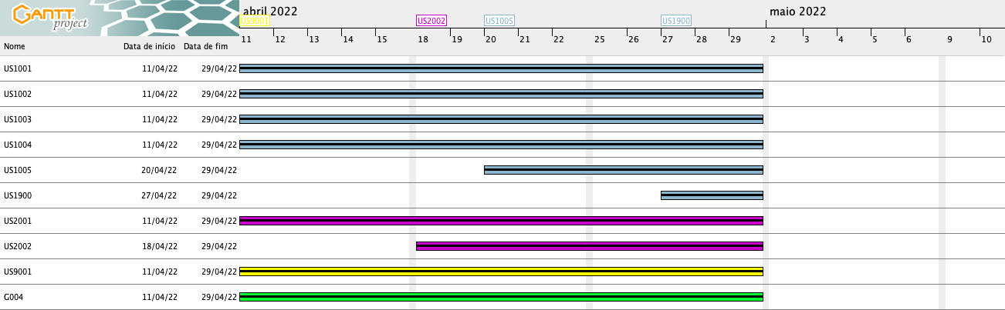
Planeamento
http://www.ganttproject.biz/ ​

Slide 4
Atividades Concluídas
ID | Atividade | Responsável | Baseline | Real | Estado
US1006 | As Customer, I want to view/check the status of my open orders. | João Marques | Início: 30-05-2022 Fim: 19-06-2022 | Início: 01-06-2022 Fim: 06-06-2022 | ✓
US1502 | As Customer, I want to view/check the status of my open orders. | Luís Ferreira | Início: 30-05-2022 Fim: 19-06-2022 | Início: 01-06-2022 Fim: 07/06/2022 | ✓
US1902 | As Project Manager, I want the communications made through the SPOMS2022 protocol to be secured/protected. | Luís Ferreira | Início: 30-05-2022 Fim: 19-06-2022 | Início: 01-06-2022 Fim: 07/06/2022 | ✓
US2006 | As Project Manager, I want the communications made through the SPOMS2022 protocol to be secured/protected. | José Monteiro | Início: 30-05-2022 Fim: 19-06-2022 | Início: 18-04-2022 Fim: 30/05/2022 | ✓
US3002 | As Sales Manager, I want to get a statistical report regarding a previously set up questionnaire. | João Marques/José Monteiro | Início: 30-05-2022 Fim: 19-06-2022 | Início: 13-04-2022 Fim: 30/05/2022 | ✓

Slide 5
Atividades Concluídas
ID | Atividade | Responsável | Baseline | Real | Estado
US3501 | As Customer, I want to get the list of questionnaires that the system is asking me to answer and be able to answer any of those questionnaires. | Luís Ferreira/José Rocha | Início: 30-05-2022 Fim: 19-06-2022 | Início: 01-06-2022 Fim: 19-06-2022 | ✓
US4003 | As Project Manager, I want the communications (of the AGVManager) made through the SPOMS2022 protocol to be secured/protected. | Paulo Couto | Início: 30-05-2022 Fim: 19-06-2022 | Início: 01-06-2022 Fim: 07-06-2022 | ✓
US5003 | As Project Manager, I want that the "AGVManager" component supports properly, at request, the needs of the "BackOfficeApp" application as well as the needs the AGV digital twin. | João Marques | Início: 30-05-2022 Fim: 19-06-2022 | Início: 01-06-2022 Fim: 07-06-2022 | ✓
US5004 | As Project Manager, I want the output communications (of the AGV Digital Twin) made through the SPOMS2022 protocol to be secured/protected. | José Rocha | Início: 30-05-2022 Fim: 19-06-2022 | Início: 01-06-2022 Fim: 07-06-2022 | ✓
US5100 | As Project Manager, I want that the team to develop and integrate the others components/parts of the AGV digital twin (e.g.: movement, obstacle sensors, control unit). | José Rocha/Luís Ferreira/Paulo Couto/José Monteiro | Início: 30-05-2022 Fim: 19-06-2022 | Início: 30-05-2022 Fim: 19-06-2022 | ✓

Slide 6
Atividades Em Curso/A Iniciar
ID | Atividade | Responsável | Baseline | Real | Estado
US9002 | As Software Product Client, I want the team (software supplier) to prepare a presentation focusing on the following aspects: (i) results achieved; (ii) critical analysis of results and teamwork, adopting the SWOT format; (iii) evidence of applying the software engineering/development process; (iv) the deployment scenario of the solution; (v) the quality of the final product; (vi) suggestions of improvement; among others relevant aspects. It is also intended that each student present a self-assessment regarding their technical and behavioral skills before and after carrying out the integrative project. The result must be included in a table/graph containing all the elements of the group. We suggest the adoption of a simple rating scale (e.g. very weak, weak, fair, good, very good, excellent). | Team | Início: 30-05-2022 Fim: 19-06-2022 | Início: 30-05-2022 Fim: 19-06-2022 | ✓
G004 | As Project Manager, I want the team to configure the project structure to facilitate / accelerate the development of upcoming user stories. | Team | Início: 30-05-2022 Fim: 19-06-2022 | Início: 30-05-2022 Fim: 19-06-2022 | ●

Slide 7
SPOMS
principais objetivos do sistema;
processo de desenvolvimento adotado e planeamento;
metodologia de trabalho em equipa e estratégia para resolução de conflitos;
qualidade do produto;
resultados esperados;

Slide 8
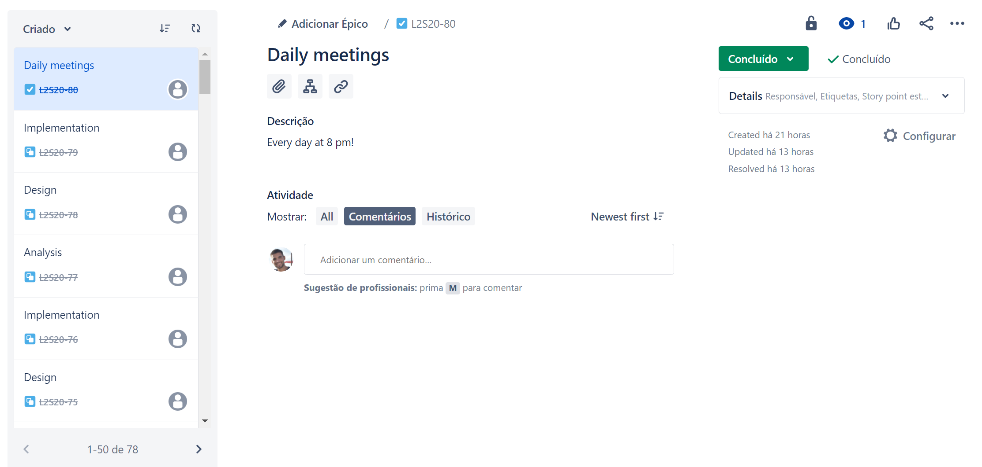
Daily Meetings

Slide 9
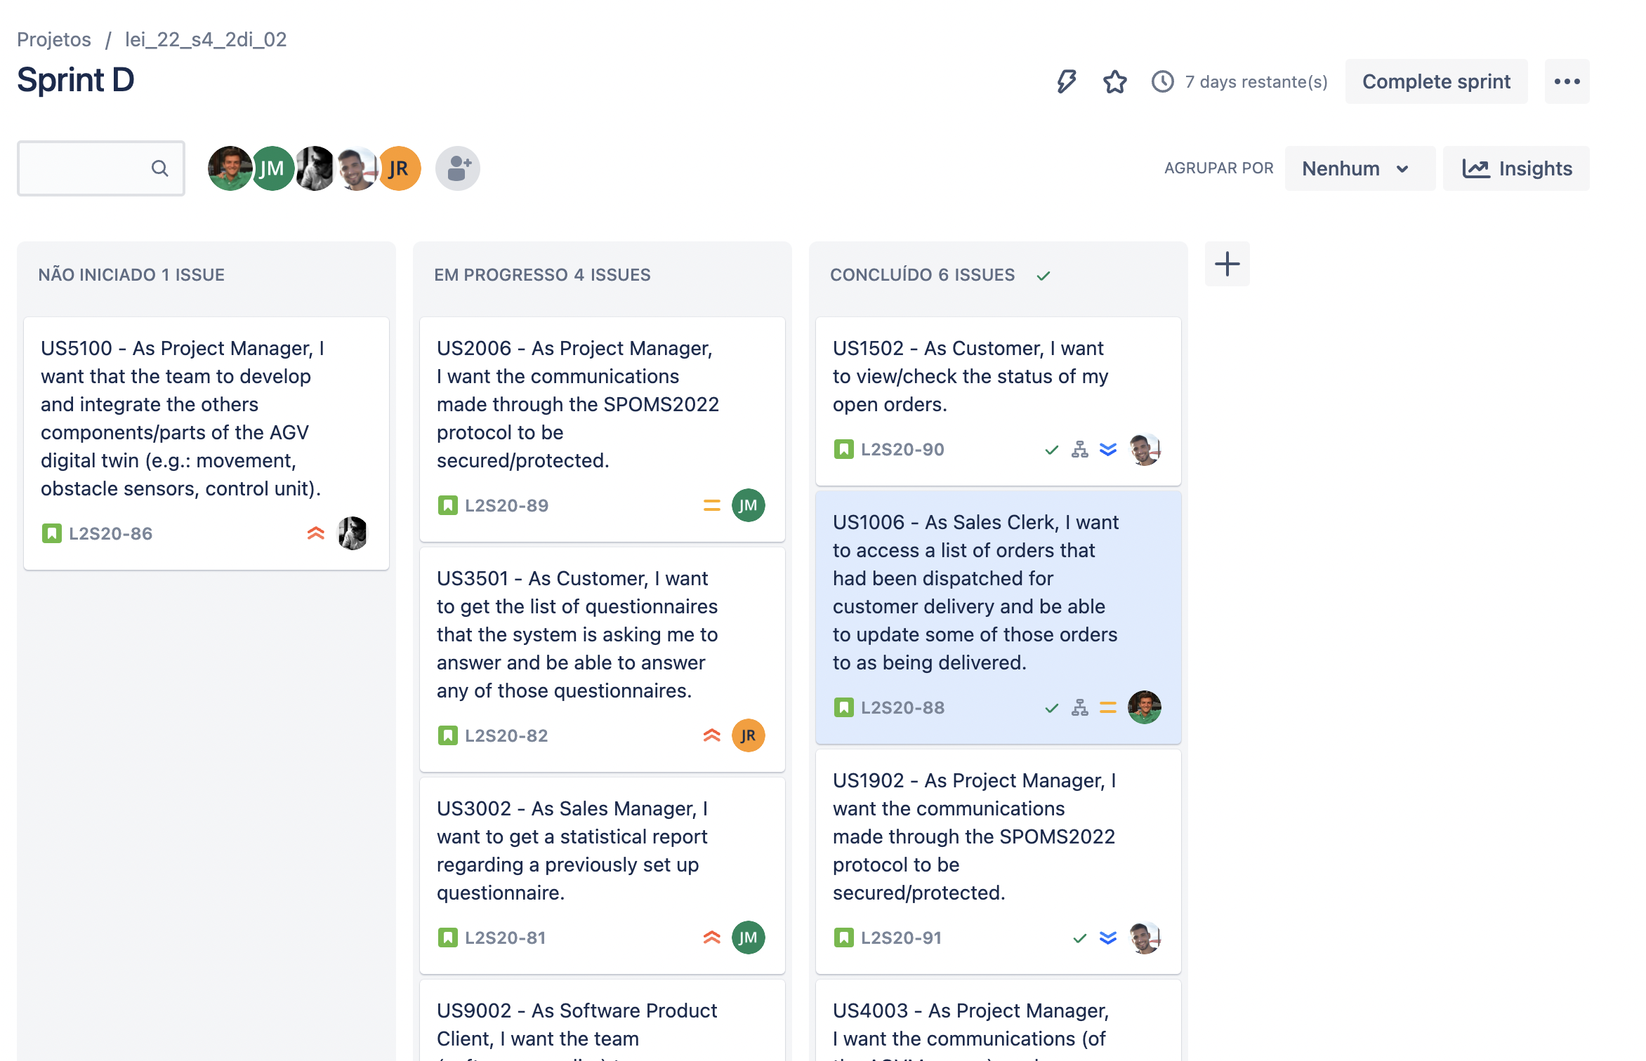
Jira Daily Updates

Slide 10
SPOMS Progresso – Sprint D
Data 19/06/2022

